Slide 2
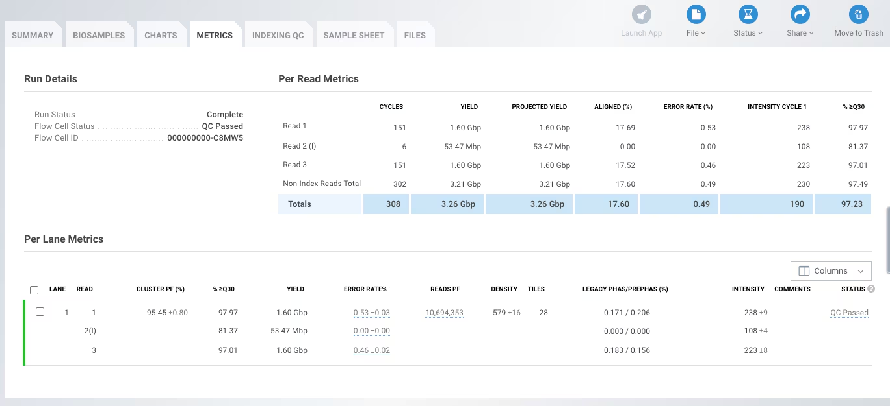
Notes:
Based on the image provided in Picture1.png, here is a breakdown of each column in the Per Read Metrics and Per Lane Metrics tables and how they impact the assessment of your run quality:
1. Cycles
Data in Picture1.png: Read 1 and Read 3 are 151 cycles; Read 2 (I) is 6 cycles.
Importance: This represents the number of bases sequenced for each read. It confirms that the machine completed the number of cycles defined in your sample sheet.
2. Yield
Data in Picture1.png: The total yield is 3.26 Gbp.
Importance: This is the total number of bases generated that passed filter (PF). It determines if you have enough raw data to meet the coverage requirements for your specific experiment.
3. Aligned (%)
Data in Picture1.png: Read 1 is 17.69%; Read 3 is 17.52%; Read 2 (I) is 0.00%.
Importance: This shows the percentage of reads that aligned to a PhiX control spike-in. Since Index reads are not aligned to a reference, they show 0%. A stable alignment percentage across Read 1 and 3 suggests consistent sequencing quality.
4. Error Rate (%)
Data in Picture1.png: Read 1 is 0.53% and Read 3 is 0.46%.
Importance: This is calculated based on the PhiX alignment. In high-quality runs, this should generally be under 1%. Your values (~0.5%) indicate a very successful, low-error run.
5. Intensity Cycle 1
Data in Picture1.png: Values range from 108 (Index) to 238 (Read 1).
Importance: This measures the brightness of the fluorescent signal at the first cycle. If this number is too low, the software may struggle to identify clusters; if too high, it may indicate over-clustering or signal saturation.
6. % ≥ Q30
Data in Picture1.png: The run total is 97.23%.
Importance: This is the gold standard for quality. It represents the percentage of bases with a quality score of 30 or higher (meaning a 1 in 1000 chance of an incorrect base call). Your score of >97% is excellent for a MiSeq run.
7. Cluster PF (%)
Data in Picture1.png: 95.45%.
Importance: "PF" stands for Passed Filter. This tells you what percentage of the DNA clusters on the flow cell were "clean" enough to be sequenced. A high percentage (usually >80%) indicates good library preparation and proper loading concentration.
8. Reads PF
Data in Picture1.png: 10,694,353.
Importance: This is the actual number of individual DNA strings (clusters) that were successfully sequenced. This number is critical for knowing if you have enough "reads" to find rare variants or achieve deep coverage.
9. Density
Data in Picture1.png: 579 K/mm².
Importance: This measures how crowded the clusters are on the flow cell. For a MiSeq, you typically want to see this between 800–1200 K/mm² depending on the chemistry version. Your density is slightly low, which explains why your yields are in the 3.2 Gbp range rather than the maximum possible for the kit.

Slide 3
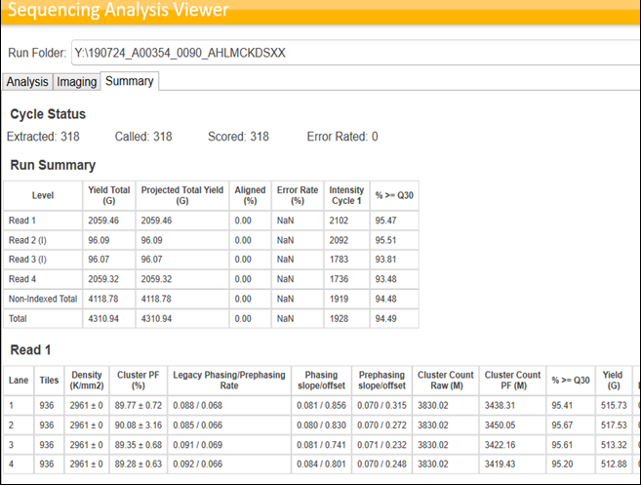

Slide 4
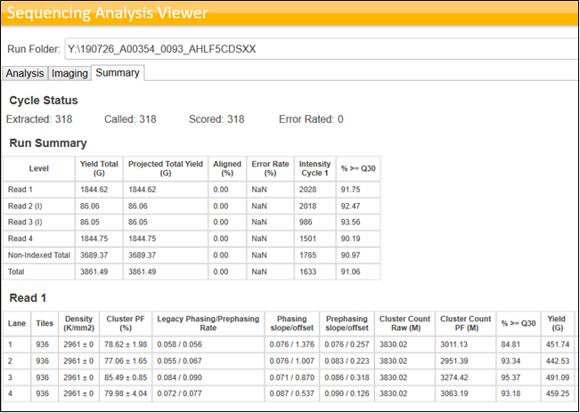

Slide 5
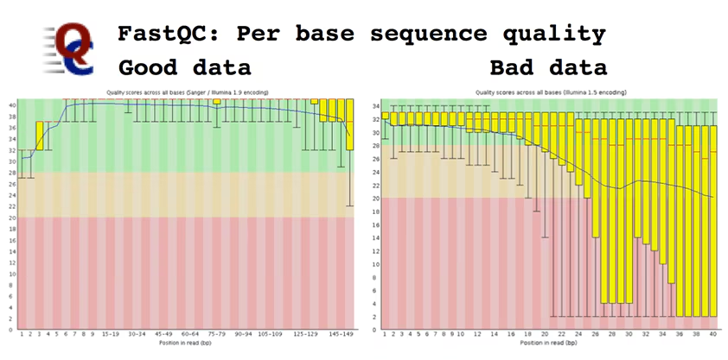

Slide 6
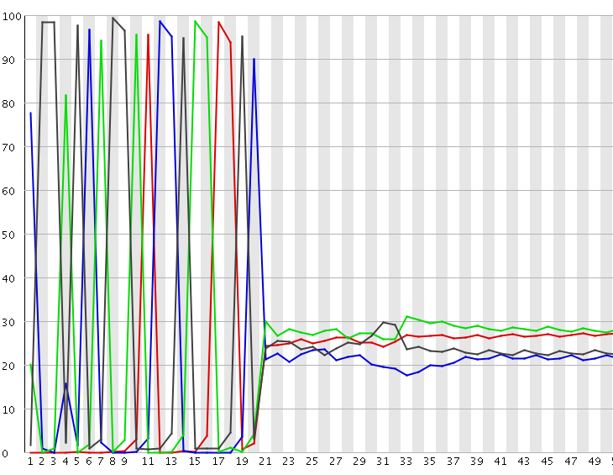
FastQC Per base sequence content
Presence of primers

Slide 7
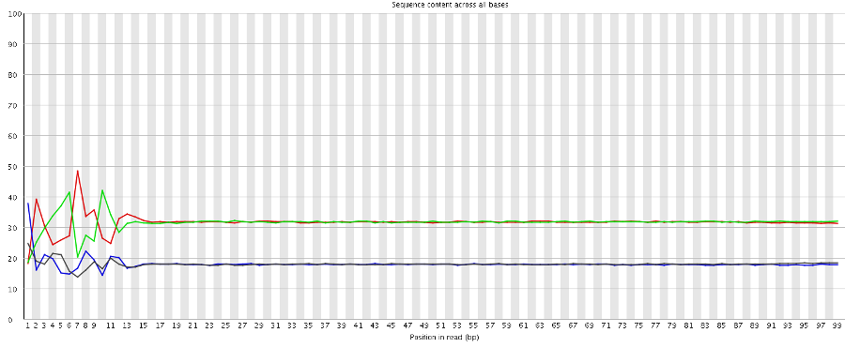
FastQC Per base sequence content
Presence of index

Slide 9
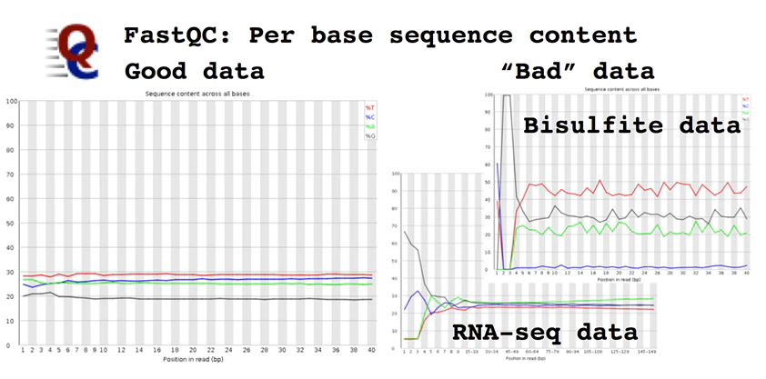

Slide 10
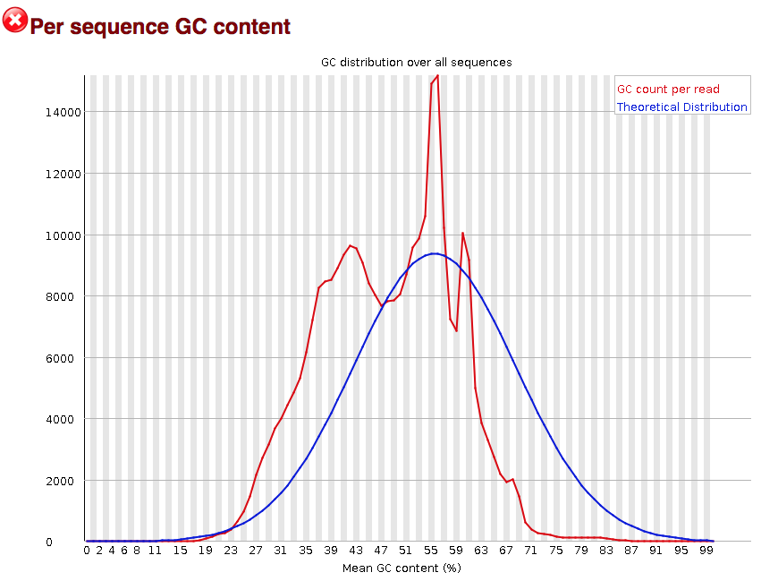

Slide 11
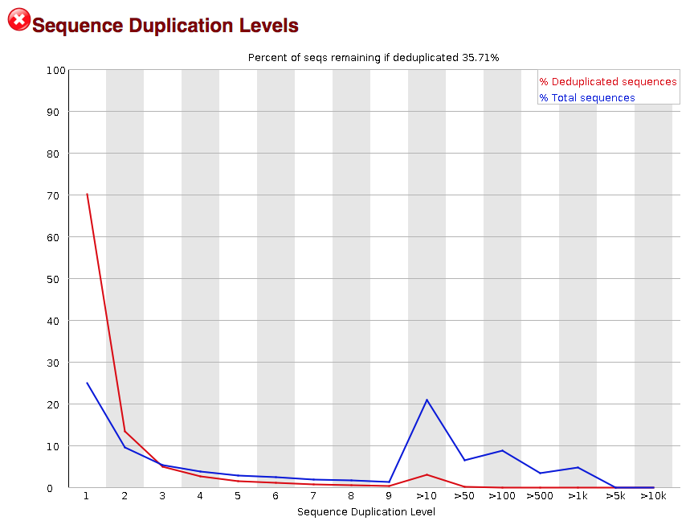

Slide 12
https://training.galaxyproject.org/training-material/topics/variant-analysis/tutorials/somatic-variants/tutorial.html

