Slide 1


The place of artificial intelligence in understanding the epigenetic effects in living beings – Human & Bacterial genome methylation as example.

Slide 2


FDP on Artificial Intelligence in Health Science (03rd – 07th May 2021)
The place of artificial intelligence in understanding
the epigenetic effects in living beings – Human & Bacterial genome methylation as example.
Yassine Kasmi,
Research in Computational Biology
“We are express of gene and maturation
of the environment”
Y. Kasmi
Thünen Institute, Germany

Slide 3
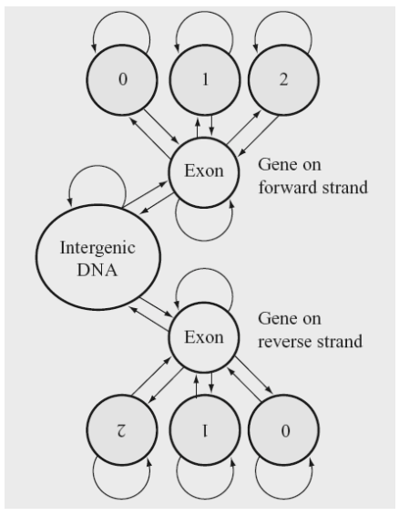
Introduction to Markov and Hidden Markov
Plan
Prediction of Methylation in Human Genes
HMM and methylation in Bacterial Genome
“I think of the world as my laboratory and I look for innovation wherever it exists. I believe there are no limits to what science can do.”

Slide 4
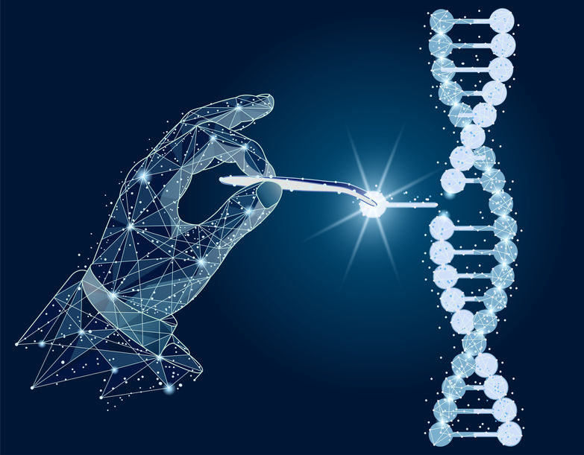
Hassan II University, Casablanca, Morocco
MAScIR - Moroccan Foundation for Advanced Science, Innovation and Research

Slide 5
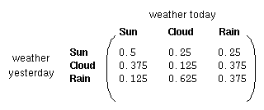
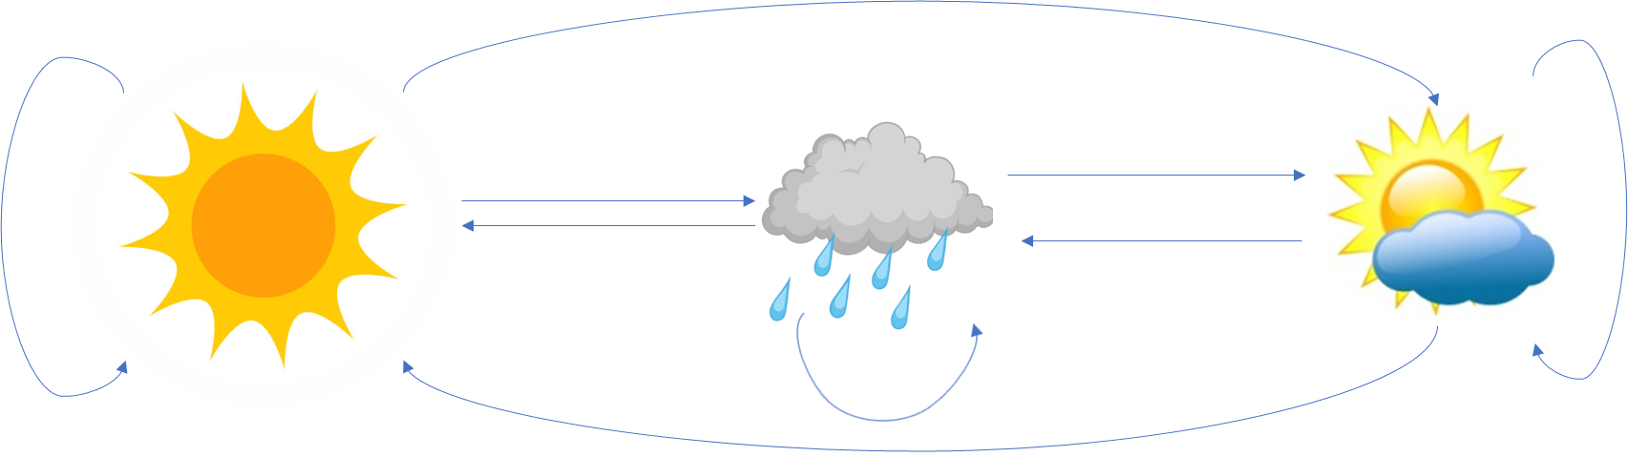

Hidden Markov Introduction
States : Three states - sunny, cloudy, rainy.
State transition matrix : The probability of the weather given the previous day's weather.
Initial Distribution : Defining the probability of the system being in each of the states at time 0.
FDP on Artificial Intelligence in Health Science (03rd – 07th May 2021)
Y. Kasmi

Slide 6
Hidden Markov Introduction
0.3
0.7
Rain
Dry
0.2
0.8
Two states : ‘Rain’ and ‘Dry’.
Transition probabilities: P(‘Rain’|‘Rain’)=0.3 , P(‘Dry’|‘Rain’)=0.7 , P(‘Rain’|‘Dry’)=0.2, P(‘Dry’|‘Dry’)=0.8
Initial probabilities: say P(‘Rain’)=0.4 , P(‘Dry’)=0.6 .
FDP on Artificial Intelligence in Health Science (03rd – 07th May 2021)
Y. Kasmi

Slide 7
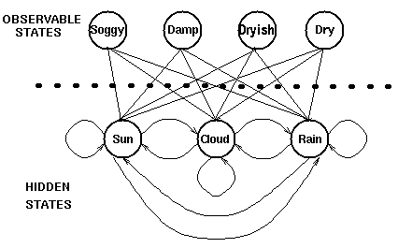
Hidden Markov Introduction
Hidden states : the (TRUE) states of a system that may be described by a Markov process (e.g., the weather).
Observable states : the states of the process that are `visible' (e.g., seaweed dampness).
FDP on Artificial Intelligence in Health Science (03rd – 07th May 2021)
Y. Kasmi

Slide 8
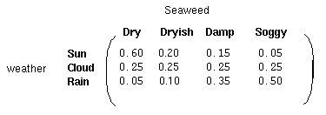
Hidden Markov Introduction
Output matrix : containing the probability of observing a particular observable state given that the hidden model is in a particular hidden state.
Initial Distribution : contains the probability of the (hidden) model being in a particular hidden state at time t = 1.
State transition matrix : holding the probability of a hidden state given the previous hidden state.
FDP on Artificial Intelligence in Health Science (03rd – 07th May 2021)
Y. Kasmi

Slide 9
Hidden Markov Introduction
FDP on Artificial Intelligence in Health Science (03rd – 07th May 2021)
Y. Kasmi

Slide 10
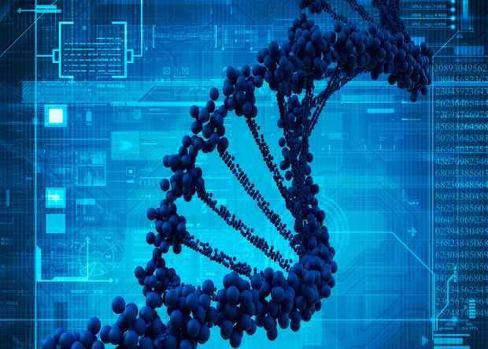
HMM and Human Genome methylation

Slide 11
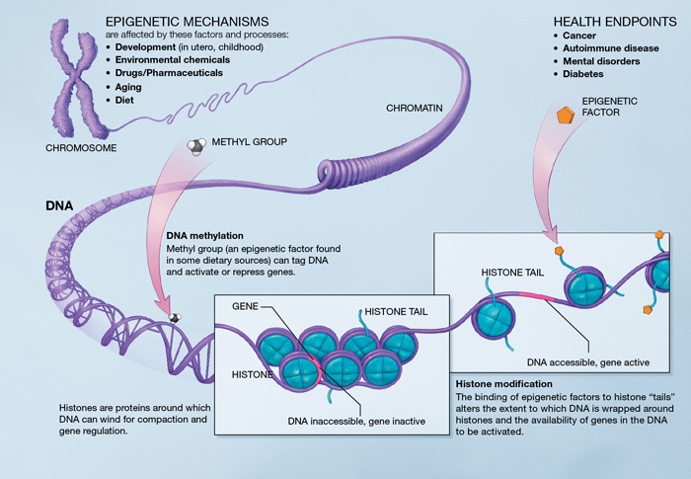
Biological Background

Slide 12
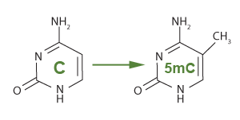
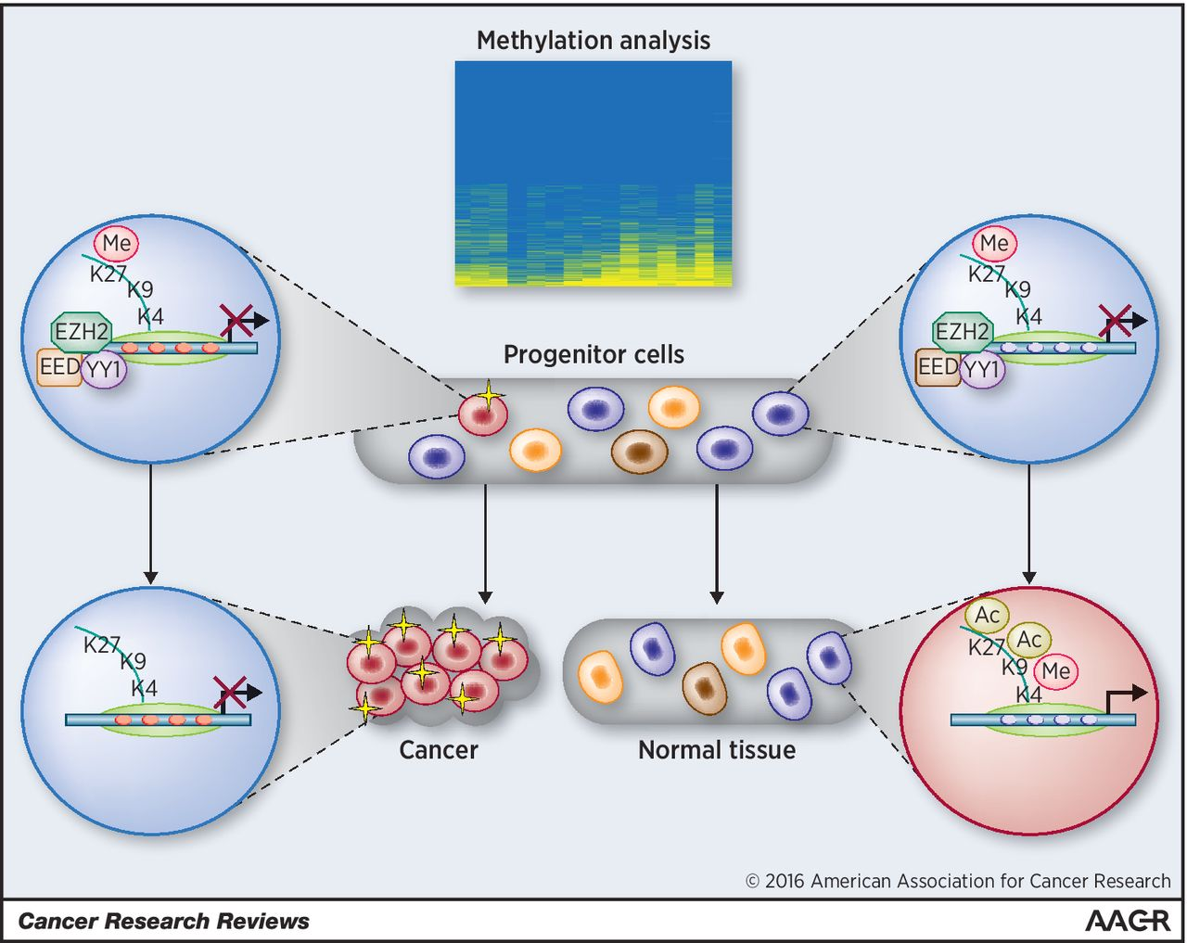
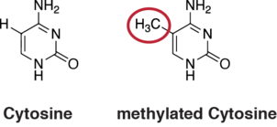
Biological Background

Slide 13
Computational Analysis of Methylation
Methylation Analysis
Whole genome
Profiling
Predictive Mode
NGS
BS PCR

Slide 14
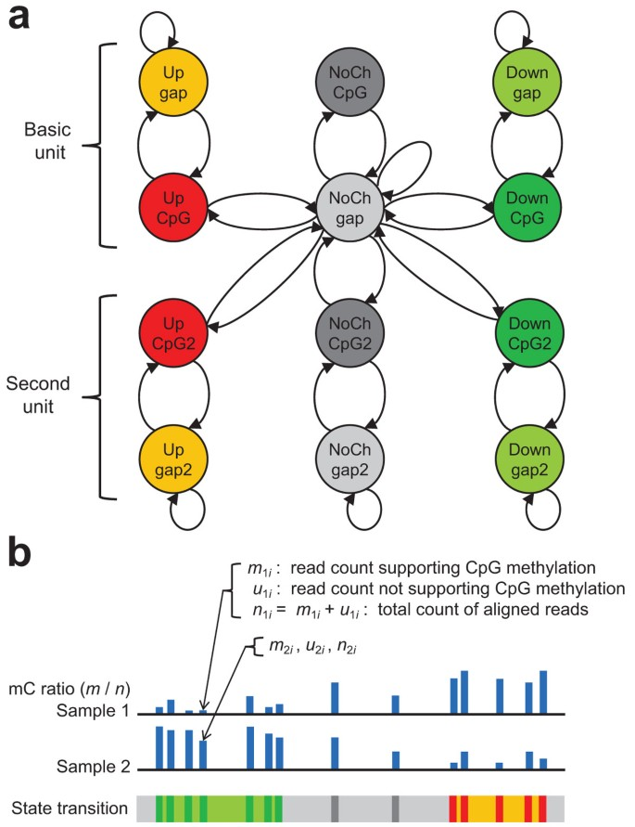
Computational Analysis of Methylation
Methylation Analysis
Whole genome
Profiling
Predictive Mode
NGS
BS PCR

Slide 15
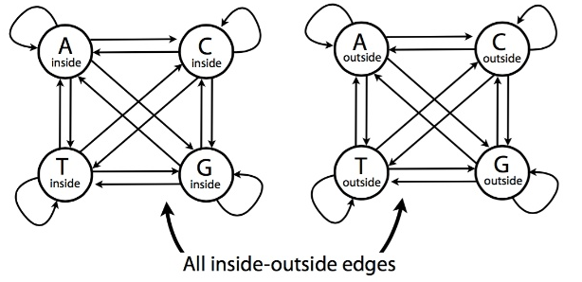
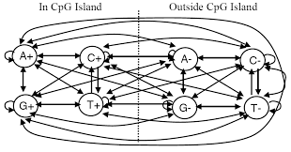
Computational Model

Slide 16
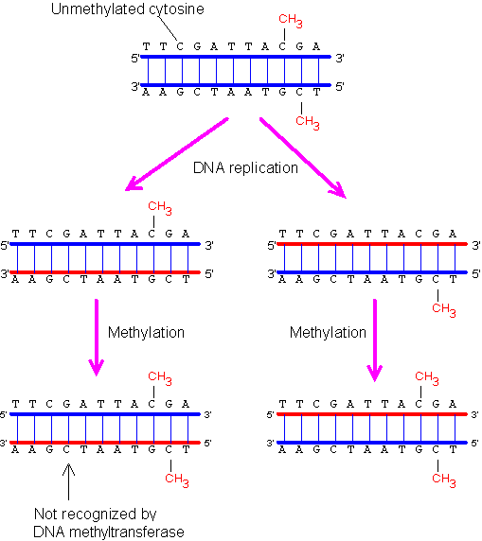
Computational Model
where aij is the probability of transition between the states
el(i) the probability to observe element i(strands for C or G) in state l ; pk(j; x􀀀1) is the probability of the most probable path ending at position x-1 in state k with element j; pkl is the probability of the transition from state l to state k.

Slide 17
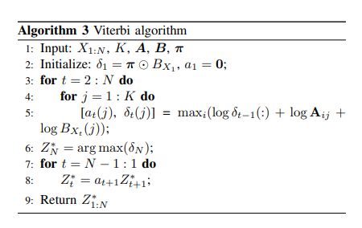
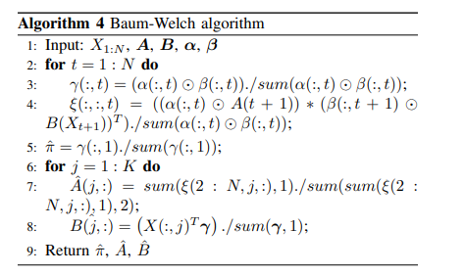
Computational Model

Slide 18
Computational Model
Viterbi
Viterbi
HMM
Baum Walch
Baum Walch
MCMC
MCMC
Specificity
Sensitivity

Slide 19
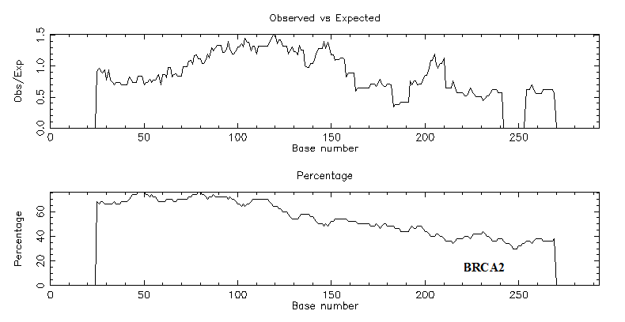
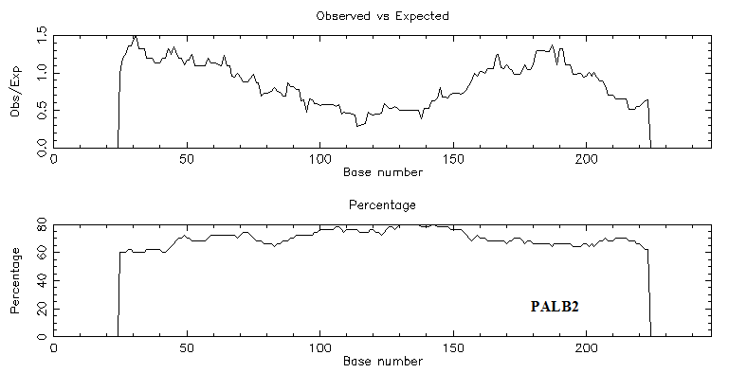
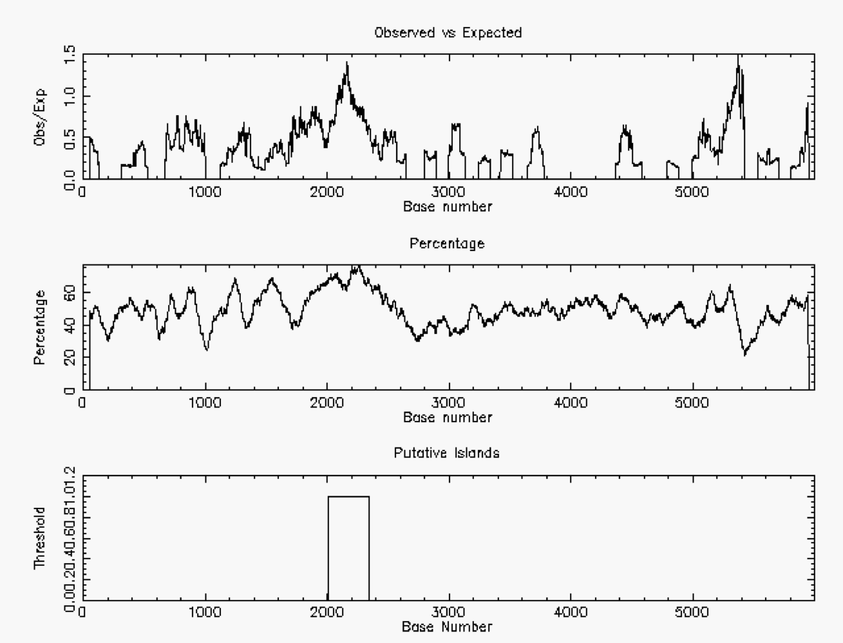
Results

Slide 20
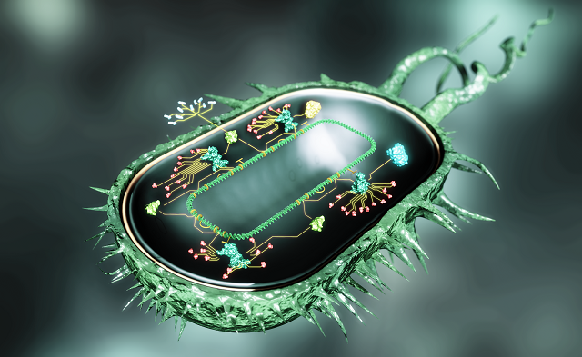
Bacterial Genome methylation Prediction

Slide 21
Computational Analysis of Methylation
Methylation Analysis
Whole genome
Profiling
Predictive Model
SMRT Sequencing
HMM
MCMC

Slide 22
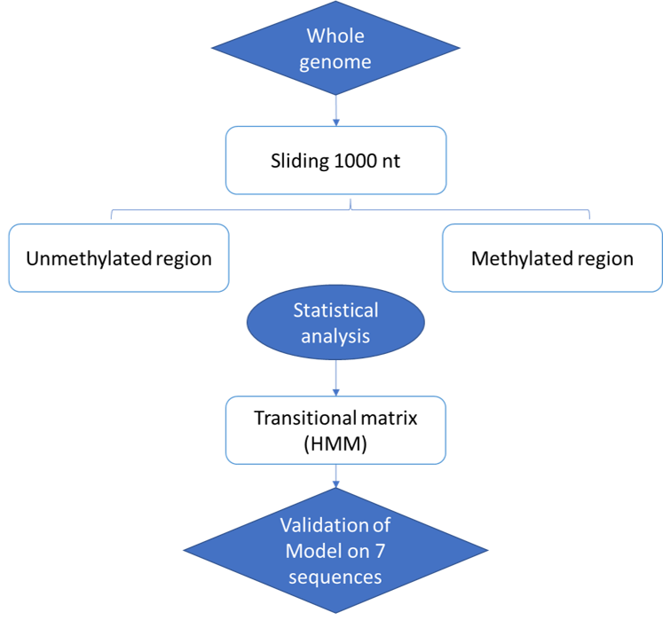
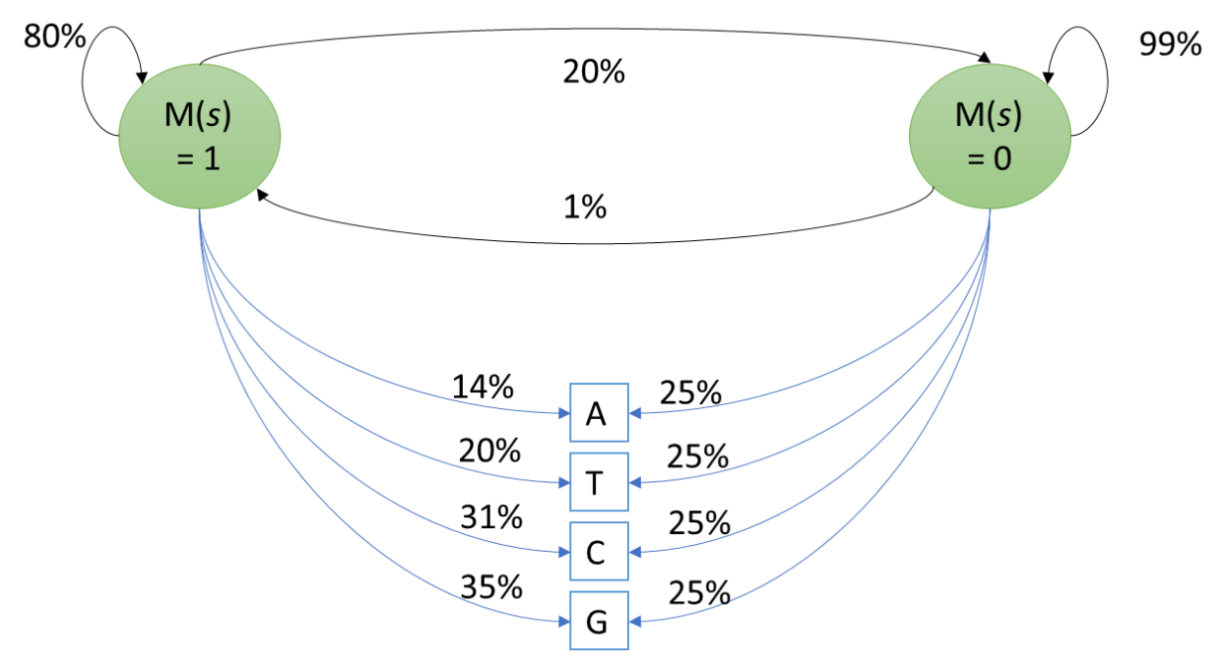
Computational Model

Slide 23
Computational Model
Viterbi
Viterbi
HMM
Baum Walch
Baum Walch
MCMC
MCMC

Slide 24
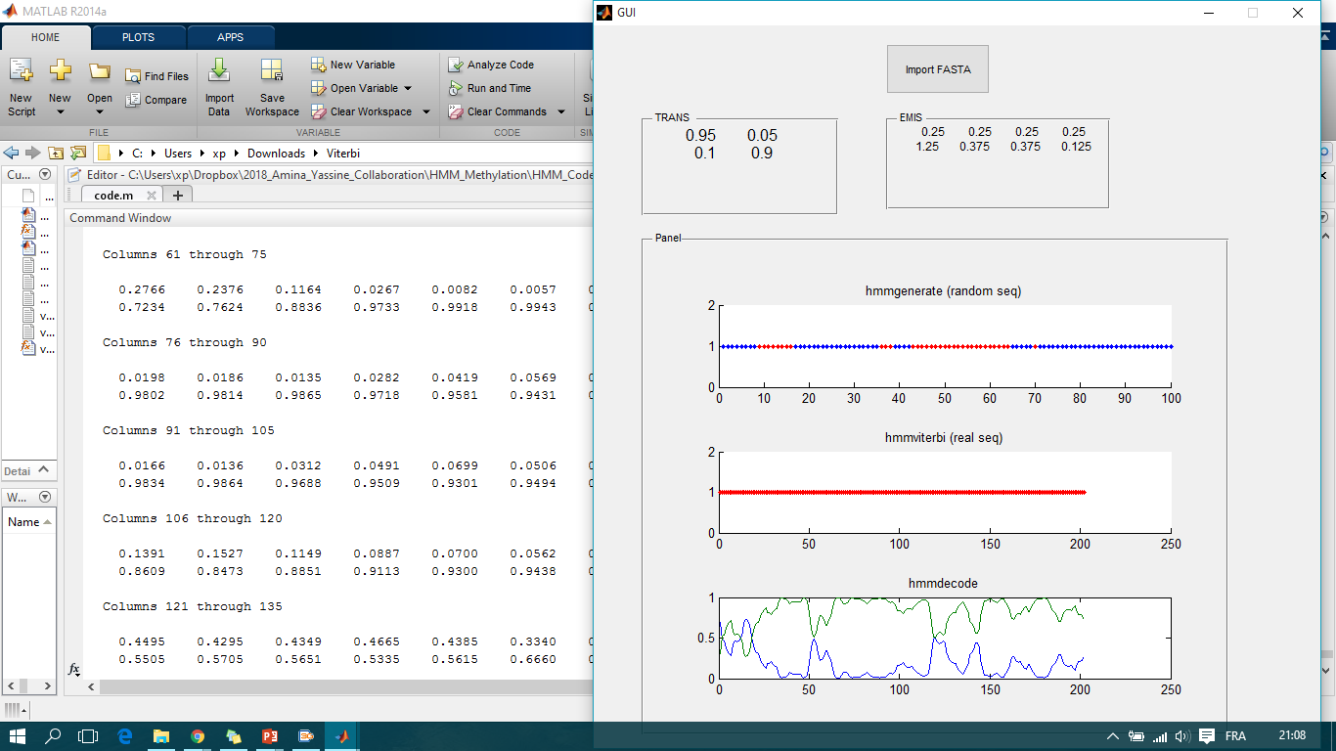
Results

Slide 25
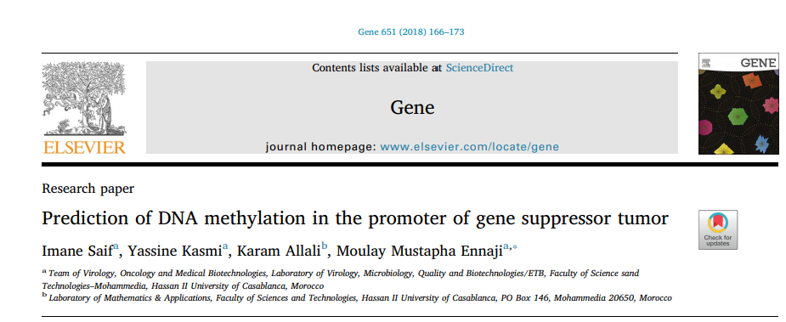
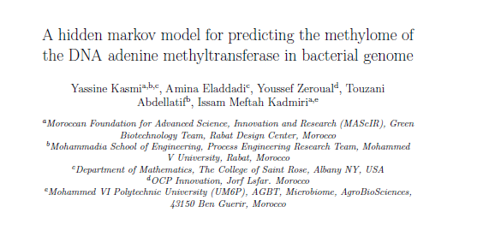
Patent

Slide 26


Patent!!! Hmmm, Is this models applicable?

Slide 27
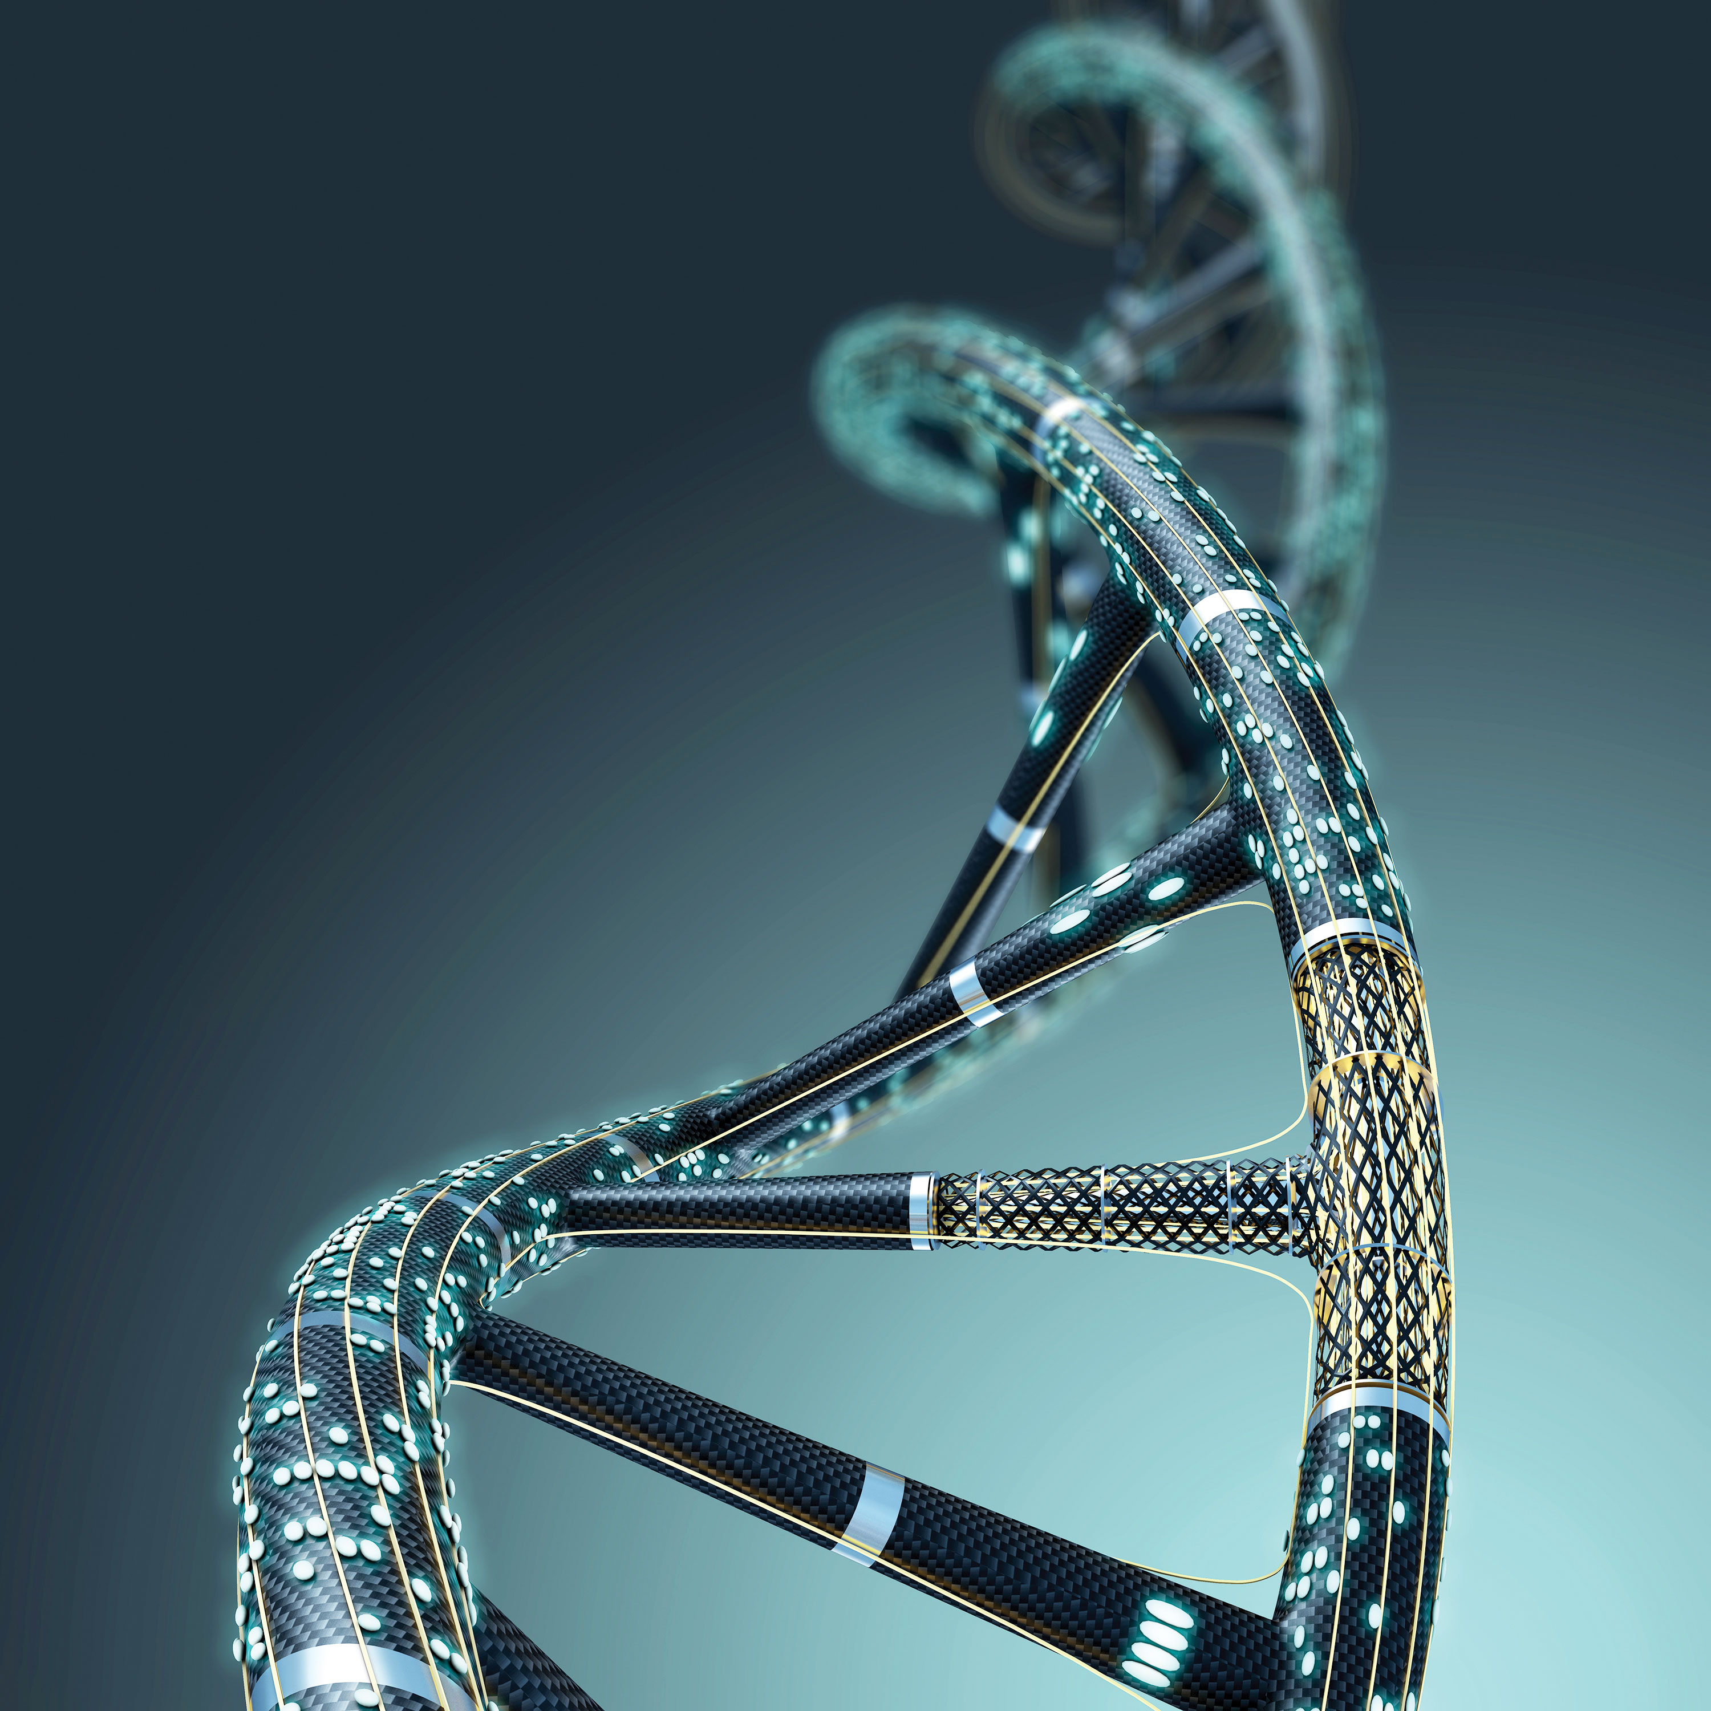
int main()
{
// printf() displays the string inside quotation
printf("Thank you very Much!");
return 0;
}
“We are express of gene and maturation of the environment”YK

Slide 28
The place of artificial intelligence in understanding the epigenetic effects in living beings – Human & Bacterial genome methylation as example.

Slide 29
Bacterial Genome methylation Prediction

Slide 30
