Slide 1
Banking Transaction , Risk & Exposure Analytics
An Integrated Business Intelligence Approach
PRESENTED BY: Group 03
TOOLS: Power BI | Tableau | Qlik Sense

Slide 2
BUSINESS PROBLEM & PROJECT OBJECTIVES
Fragmented banking datasets make it difficult to obtain a consolidated view of transaction activity, risk patterns and branch-level exposure.
Our Approach: Integrate and analyze banking data through interactive BI dashboards.
  Analyze banking transactions across branches and customers.
  Identify high-risk transactions and risk patterns.
  Evaluate regional and branch-level risk.
  Analyze financial exposure.
  Develop interactive dashboards across three BI platforms.
  Ensure consistency in KPIs and business logic.

Slide 3
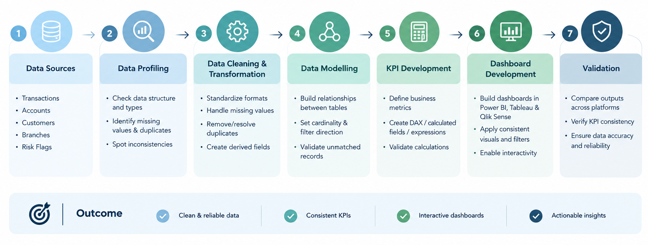
WORKFLOW

Slide 4
DATA PREPARATION & CLEANING
Key Activities
Profiling: Identified missing values, duplicates and inconsistencies.
Standardization: Normalized data types and date formats.
Missing Values: Applied appropriate imputation and replacement logic.
Duplicates: Retained appropriate records using timestamp-based sorting.
Validation: Checked account, customer and branch mappings.
Derived Fields: Created negative balance and fraud suspected flags.

Slide 5
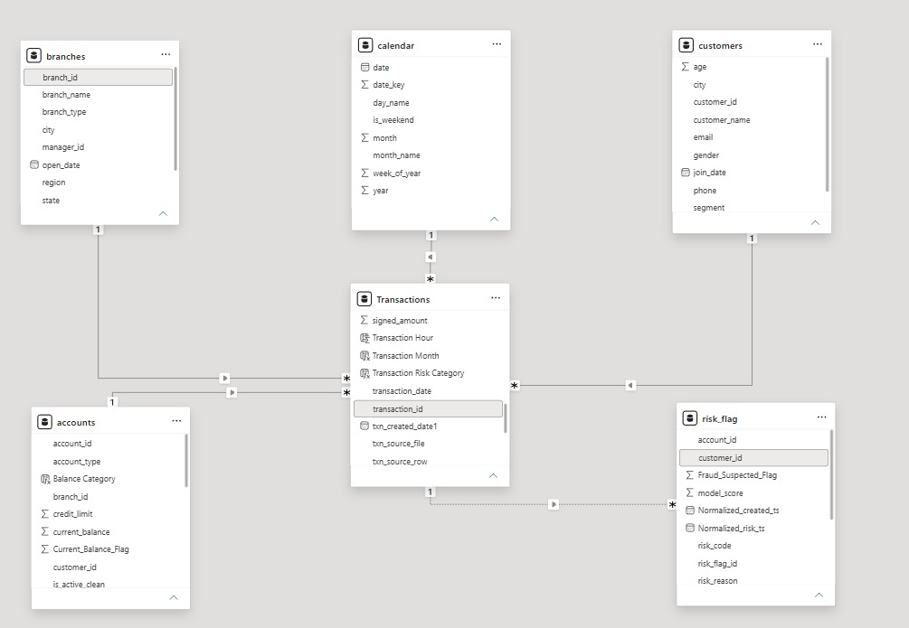
DATA MODELLING
Established relationships between:
Transactions, Accounts, Customers, Branches, Risk Flags, Calendar
Validated cardinality, filter direction and unmatched records.

Slide 6
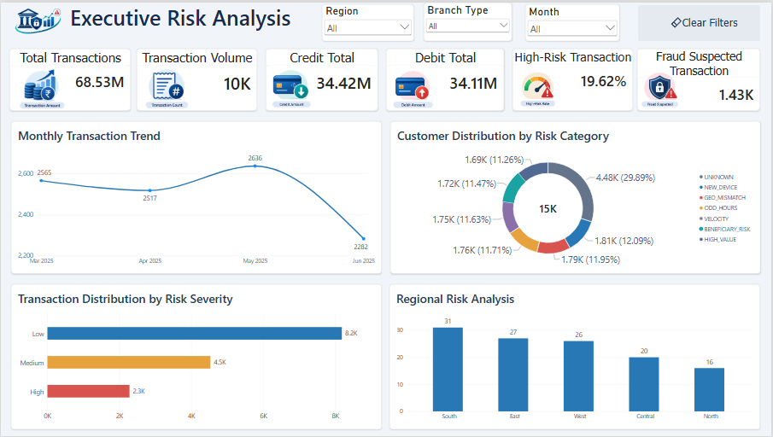
EXECUTIVE RISK OVERVIEW DASHBOARD

Slide 7
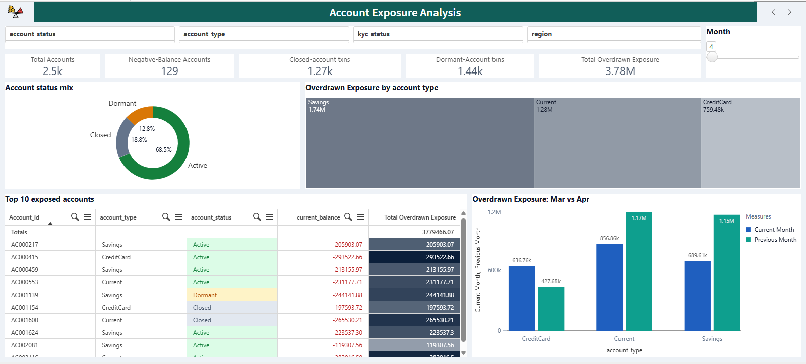
ACCOUNT EXPOSURE ANALYSIS DASHBOARD

Slide 8
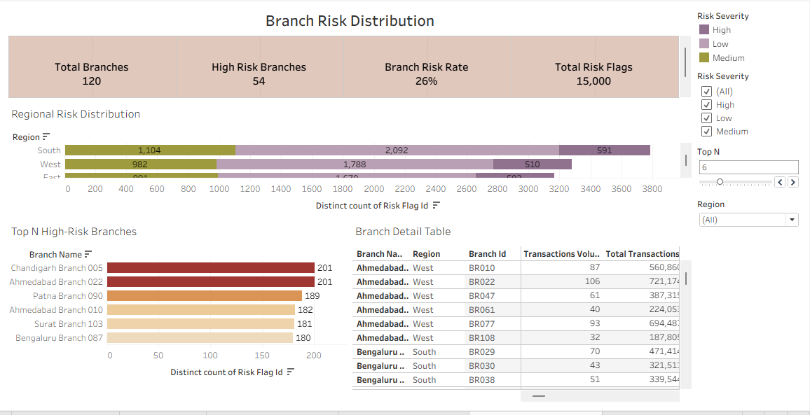
BRANCH RISK DISTRIBUTION DASHBOARD

Slide 9
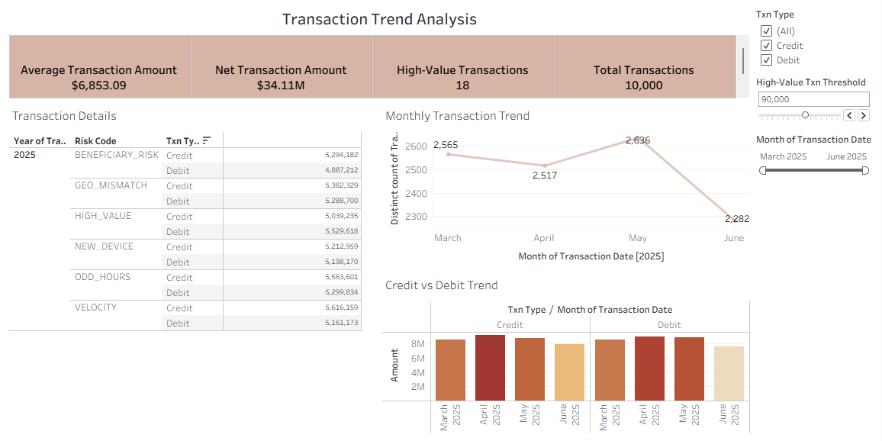
TRANSACTION TREND ANALYSIS DASHBOARD

Slide 10
KEY TAKEAWAYS
The four dashboards provide a consolidated view of banking operations, transaction activity, account exposure, and financial risk.
Executive Risk Analysis – Delivers an overall view of transaction performance and key risk indicators.
Account Exposure Analysis – Highlights account balances, dormant accounts, and potential financial exposure.
Branch Risk Distribution – Identifies high-risk branches and regional variations in risk.
Transaction Trend Analysis – Tracks transaction behavior, value trends, and credit-debit movement.
Overall, the solution transforms raw banking data into actionable insights, enabling better risk monitoring, informed decision-making, and proactive identification of potential fraudulent activities.
Consistent data preparation and metric definitions across Power BI, Tableau, and Qlik Sense also ensure comparable and reliable insights across all three platforms.

Slide 11
Thank you

