Slide 1
LSTM: Next Word Predictor
PD LAB

Slide 2
Introduction
3
We have implemented a next-word predictor model using the LSTM architecture.
Neural networks often encounter the vanishing gradient problem, which may lead to the neglect of important information over time.
To address this issue, LSTMs maintain an additional state known as the cell state, responsible for retaining crucial information and facilitating the generation of output for the current state.
In our implementation, we have utilized the pre-existing TensorFlow architecture. Our training data consists of text extracted from novels, enabling the model to learn and predict words effectively.

Slide 3
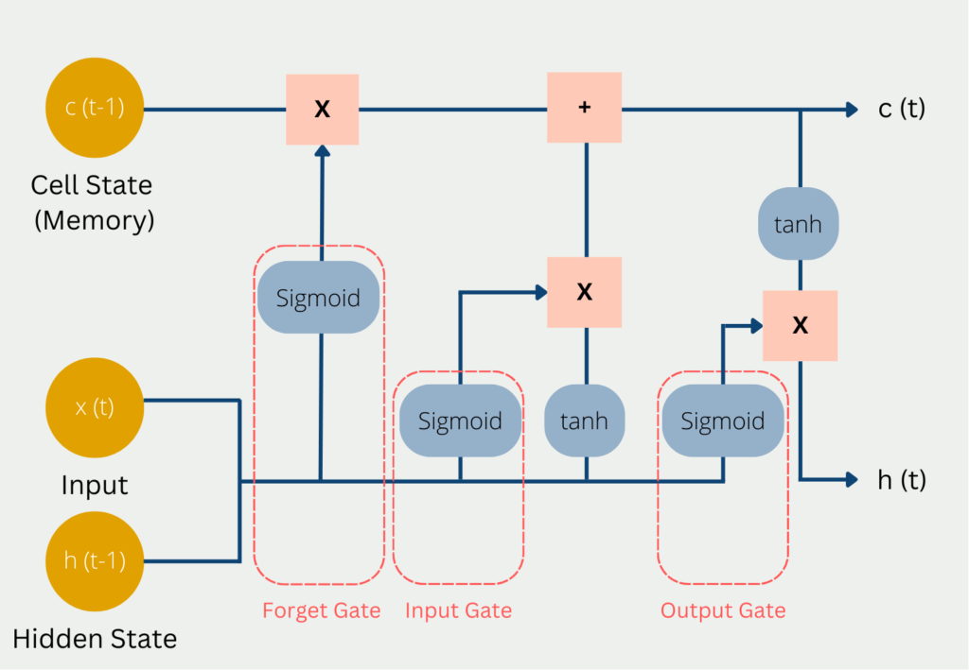
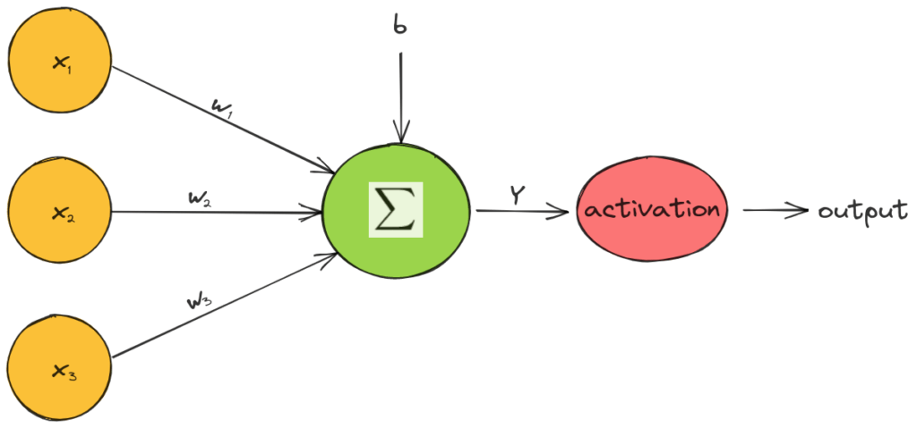
LSTM Architecture!
Important Formula:
{W * [h[t - 1], x[t]] + B}

Slide 4
Explanation.
Long Term Memory is known as Cell State(c[t]).
Short Term Memory is known as Hidden State(h[t]).
Inputs:
1. Prev Cell State.
2. Prev Hidden State.
3. Input for the Current Time Stamp.
Outputs:
1. Current Hidden State.
2. Current Cell State.
Processing:
1. Update Cell State.
a. Remove.
b. Add.
2. Calculate Hidden State.

Slide 5
Explanation
Forget Gate
Input Gate
Output Gate
To remove something from Cell State.
a. Calculate f[t].
b. c[t] = c[t-1]*f[t].
To add something to Cell State. a. Calculate Candidate Cell State from tanh. (Potential Information to be added).
b. Calculate I[t] from sigmoid. (Decides what to add from Candidate to Cell State).
c. c[t] = c[t] + (bar) c[t]*I[t].
To calculate Hidden State. a. Calculate tanh(c[t]).
b. Calculate o[t] from sigmoid.
c. h[t] = tanh(c[t]) * o[t].

Slide 6
Our team
KASODARIYA DEEP
REG.NO: 221080029
ANISH DESHPANDE
REG.NO: 221080013

Slide 7
Thank you
Mirjam Nilsson​
mirjam@contoso.com
www.contoso.com

