Slide 1
Building Portfolio App Backend
with
Node.js, Express and MongoDB
Prepared and presented by
Isaac Kasongoyo

Slide 2
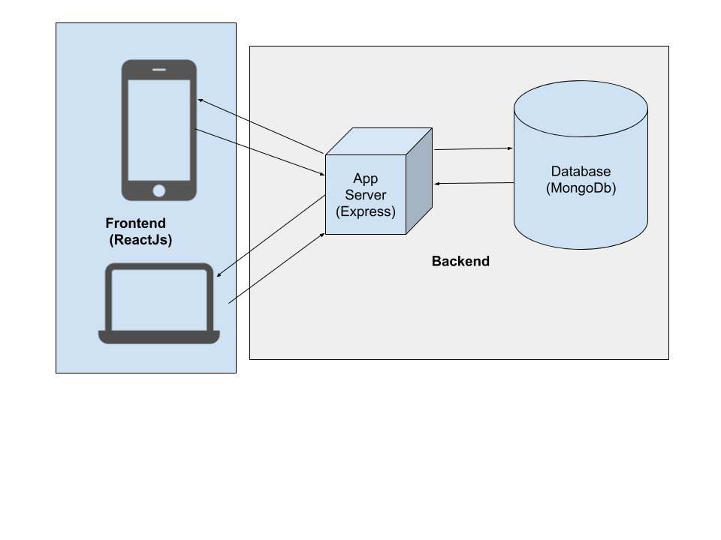

Slide 3
What’s backend
Backend refers to the server-side of the web app typically concerned with storing and manipulating of data.

Slide 4
Backend Features
Data storage
Data manipulation
Push notifications
File storage
User management
Messaging and chat functions

Slide 5
Backend Solutions
Backend as a service (CloudBoost, Firebase, Azure etc..)
Custom solutions

Slide 6
Backend languages
Php (Laravel, Yii etc)
Node.js (Expressjs, Hapijs, Nestjs, Sailsjs etc)
Java (Spring, Vaadin etc)
Python (Django, Flask etc)
Ruby (Ruby on rails etc)
Go (Revel etc)

Slide 7
Backend data storage engine
SQL (MySql, Postgresql, MariaDb, Oracle Db etc)
NoSQL (MongoDb, Redis, Cassandra)

Slide 8
Why Node.js and expressjs
Node.js allow us to use javascript as server-side programming language and expressjs as the nodejs framework simplify the server side app creation by offering most of the common features and security

Slide 9
Why MongoDB
No need for object-relational mapping (ORM) layer that translates objects in code to relational tables.
MongoDB’s flexible data model
MongoDB can also be scaled within and across multiple distributed data centers, providing new levels of availability and scalability previously unachievable with relational databases like MySQL.

Slide 10
What we’re building
We are going to build backend for the portfolio application. We will keep things simple and mainly focus on how to use CRUD, Express and Mongo DB.

Slide 11
Lets Create A Portfolio Backend!

Slide 12
Tools
Node.js & Express (Server)
MongoDb(Database)
Mongoose(ODM)

