Slide 1
CSCI 474/574 Introduction to Cryptography/Theory of Cryptography Chapter 1 Overview
1.2 Security Terminology and Architecture
Notes:
Lecture slides by Lawrie Brown for “Cryptography and Network Security”, by William Stallings, briefly reviewing the text outline from Ch 0, and then presenting the content from Chapter 1 – “Introduction”.
Enhanced and Modified by Chuan Yue at the Colorado School of Mines.

Slide 2
OSI Security Architecture
ITU-T X.800 “Security Architecture for OSI”
defines a systematic way of defining and providing security requirements
for us it provides a useful, if abstract, overview of concepts we will study
Notes:
To assess effectively the security needs of an organization and to evaluate and choose various security products and policies, the manager responsible for security needs some systematic way of defining the requirements for security and characterizing the approaches to satisfying those requirements. This is difficult enough in a centralized data processing environment; with the use of local and wide area networks the problems are compounded. ITU-T Recommendation X.800, Security Architecture for OSI (Open Systems Interconnection), defines such a systematic approach. The OSI security architecture is useful to managers as a way of organizing the task of providing security.

Slide 3
Aspects of Security
consider 3 aspects of information security:
security attack
security mechanism
security service
terms
threat – a potential for violation of security
vulnerability – a weakness
risk - “Where a threat intersects with a vulnerability, risk is present” – NIST Special Publication 800-100: Information Security Handbook: A Guide for Managers
attack – an assault on system security, a deliberate attempt to evade security services
Notes:
Enhanced and Modified by Chuan Yue at the Colorado School of Mines.
The OSI security architecture focuses on security attacks, mechanisms, and services. These can be defined briefly as follows:
• Security attack: Any action that compromises the security of information owned by an organization.
• Security mechanism: A process (or a device incorporating such a process) that is designed to detect, prevent, or recover from a security attack.
• Security service: A processing or communication service that enhances the security of the data processing systems and the information transfers of an organization. The services are intended to counter security attacks, and they make use of one or more security mechanisms to provide the service.
In the literature, the terms threat and attack are commonly used to mean more or less the same thing. Table 1.1 provides definitions taken from RFC 2828, Internet Security Glossary.
Threat - A potential for violation of security, which exists when there is a circumstance, capability, action, or event that could breach security and cause harm. That is, a threat is a possible danger that might exploit a vulnerability.
Attack - An assault on system security that derives from an intelligent threat; that is, an intelligent act that is a deliberate attempt (especially in the sense of a method or technique) to evade security services and violate the security policy of a system.

Slide 4
Countermeasures
means used to deal with security attacks
prevent
detect
recover
may result in new vulnerabilities
will have residual vulnerability
goal is to minimize risk given constraints
Notes:
A countermeasure is any means taken to deal with a security attack. Ideally, a countermeasure can be devised to prevent a particular type of attack from succeeding. When prevention is not possible, or fails in some instance, the goal is to detect the attack, and then recover from the effects of the attack. A countermeasure may itself introduce new vulnerabilities. In and case, residual vulnerabilities may remain after the imposition of countermeasures. Such vulnerabilities may be exploited by threat agents representing a residual level of risk to the assets. Owners will seek to minimize that risk given other constraints.

Slide 5
Security Functional Requirements
technical measures:
access control; identification & authentication; system & communication protection; system & information integrity
management controls and procedures
awareness & training; audit & accountability; certification, accreditation, & security assessments; contingency planning; maintenance; physical & environmental protection; planning; personnel security; risk assessment; systems & services acquisition
overlapping technical and management:
configuration management; incident response; media protection
Notes:
Here we view countermeasures in terms of functional requirements, and we follow the classification defined in FIPS PUB 200 (Minimum Security Requirements for Federal Information and Information Systems). This standard enumerates seventeen security-related areas, and are defined in Table 1.4 in the text. The requirements listed in FIP PUB 200 encompass a wide range of countermeasures to security vulnerabilities and threats. Each of the functional areas may involve both computer security technical measures and management measures. Functional areas that are primarily require computer security technical measures include access control; identification and authentication; system and communication protection; and system and information integrity. Functional areas that primarily involve management controls and procedures include awareness and training; audit and accountability; certification, accreditation, and security assessments; contingency planning; maintenance; physical and environmental protection; planning; personnel security; risk assessment; and systems and services acquisition. Functional areas that overlap computer security technical measures and management controls include configuration management; incident response; and media protection.

Slide 6
Security Attack
Passive Attacks
A passive attack attempts to learn or make use of information from the system but does not affect system resources.
Active Attacks
An active attack attempts to alter system resources or affect their operation.
Notes:
A useful means of classifying security attacks, used both in X.800 and RFC 2828, is in terms of passive attacks and active attacks. A passive attack attempts to learn or make use of information from the system but does not affect system resources.
Passive attacks are in the nature of eavesdropping on, or monitoring of, transmissions. The goal of the opponent is to obtain information that is being transmitted. Two types of passive attacks are:
+ release of message contents - as shown above in Stallings Figure 1.2a here
+ traffic analysis - monitor traffic flow to determine location and identity of communicating hosts and could observe the frequency and length of messages being exchanged
These attacks are difficult to detect because they do not involve any alteration of the data.

Slide 7
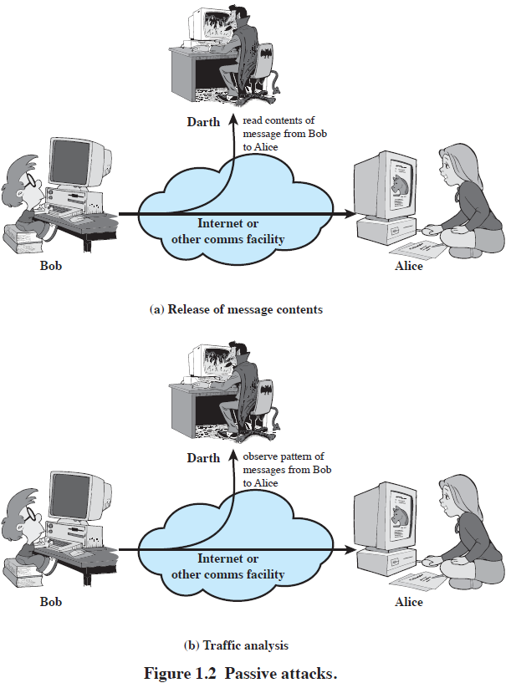
Two types of Passive Attacks
Passive attacks are difficult to detect because they do not involve any alteration of the data.
Our main goal is to prevent their success.
Notes:
Enhanced and Modified by Chuan Yue at the Colorado School of Mines.
A useful means of classifying security attacks, used both in X.800 and RFC 2828, is in terms of passive attacks and active attacks. A passive attack attempts to learn or make use of information from the system but does not affect system resources.
Passive attacks are in the nature of eavesdropping on, or monitoring of, transmissions. The goal of the opponent is to obtain information that is being transmitted. Two types of passive attacks are:
+ release of message contents - as shown above in Stallings Figure 1.2a here
+ traffic analysis - monitor traffic flow to determine location and identity of communicating hosts and could observe the frequency and length of messages being exchanged
These attacks are difficult to detect because they do not involve any alteration of the data.

Slide 8
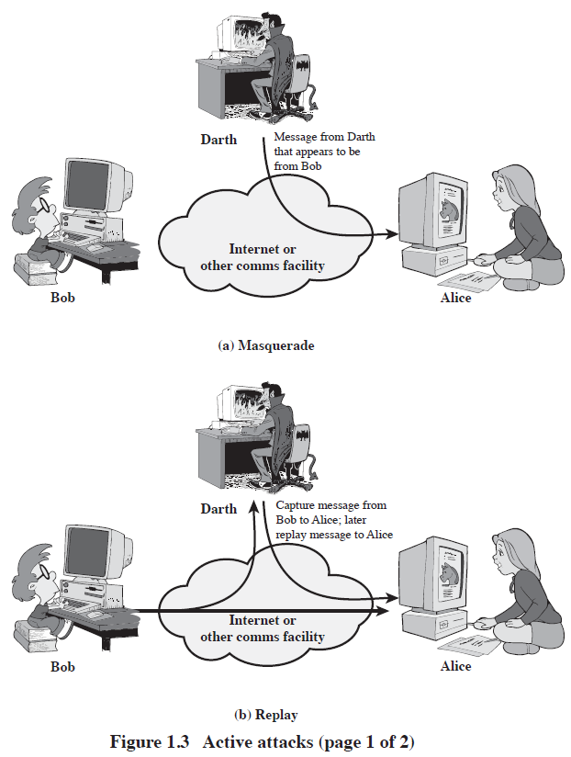
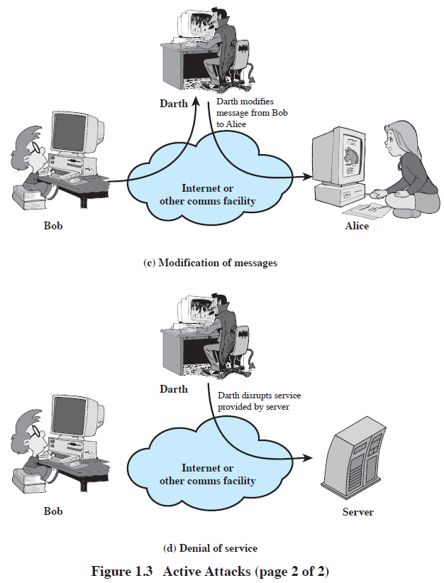
Four types of Active Attacks
Active attacks are difficult to prevent because of the wide variety of potential physical, software, and network vulnerabilities.
Our main goal is to detect them and to recover from any disruption or delays caused by them.
Notes:
Enhanced and Modified by Chuan Yue at the Colorado School of Mines.
Active attacks involve some modification of the data stream or the creation of a false stream and can be subdivided into four categories: masquerade, replay, modification of messages, and denial of service:
masquerade of one entity as some other
replay previous messages (as shown above in Stallings Figure 1.3b)
modify/alter (part of) messages in transit to produce an unauthorized effect
denial of service - prevents or inhibits the normal use or management of communications facilities
Active attacks present the opposite characteristics of passive attacks. Whereas passive attacks are difficult to detect, measures are available to prevent their success. On the other hand, it is quite difficult to prevent active attacks absolutely, because of the wide variety of potential physical, software, and network vulnerabilities. Instead, the goal is to detect active attacks and to recover from any disruption or delays caused by them.

Slide 9
Security Services
X.800: “a service provided by a protocol layer of communicating open systems, which ensures adequate security of the systems or of data transfers”
RFC 2828: “a processing or communication service provided by a system to give a specific kind of protection to system resources”
uses one or more security mechanisms
often replicates functions normally associated with physical documents
for example, have signatures, dates; need protection from disclosure, tampering, or destruction; be notarized or witnessed; be recorded or licensed
Notes:
Enhanced and Modified by Chuan Yue at the Colorado School of Mines.
State here a couple of definitions of “security services” from relevant standards. X.800 defines a security service as a service provided by a protocol layer of communicating open systems, which ensures adequate security of the systems or of data transfers. Perhaps a clearer definition is found in RFC 2828, which provides the following definition: a processing or communication service that is provided by a system to give a specific kind of protection to system resources; security services implement security policies and are implemented by security mechanisms.

Slide 10
Security Services (X.800)
Authentication - assurance that communicating entity is the one claimed
have both peer-entity & data origin authentication
Access Control - prevention of the unauthorized use of a resource
Data Confidentiality –protection of data from unauthorized disclosure
Data Integrity - assurance that data received is as sent by an authorized entity, no modification, replay, etc.
Non-Repudiation - protection against denial by one of the parties in a communication
Availability – resource accessible/usable
Notes:
This list is taken from Stallings Table 1.2 which provides details of the 5 Security Service categories and the 14 specific services given in X.800.
This list includes the various "classic" security services which are traditionally discussed. Note there is a degree of ambiguity as to the meaning of these terms, and overlap in their use. The broad service categories are:
authentication is concerned with assuring that a communication is authentic. Two specific authentication services are defined in X.800: Peer entity authentication: provides corroboration of the identity of a peer entity in an association; and Data origin authentication: provides corroboration of the source of a data unit.
access control is the ability to limit and control the access to host systems and applications via communications links.
confidentiality is the protection of transmitted data from passive attacks, and the protection of traffic flow from analysis.
integrity assures that messages are received as sent, with no duplication, insertion, modification, reordering, replay, or loss.
availability is the property of a system / resource being accessible and usable upon demand by an authorized system entity, according to performance specifications for the system.

Slide 11
Security Mechanisms
features designed to prevent, detect, or recover from a security attack
no single mechanism that will support all services required
however one particular element underlies many of the security mechanisms in use:
cryptographic techniques
hence our focus on this topic
Notes:
Now introduce “Security Mechanism” which are the specific means of implementing one or more security services. Note these mechanisms span a wide range of technical components, but one aspect seen in many is the use of cryptographic techniques.

Slide 12
Security Mechanisms (X.800)
specific security mechanisms:
encipherment, digital signatures, access controls, data integrity, authentication exchange, traffic padding, routing control, notarization
pervasive security mechanisms:
trusted functionality, security labels, event detection, security audit trails, security recovery
not specific to any particular OSI security service or protocol layer
Notes:
Some examples of mechanisms from X.800. Note that the “specific security mechanisms” are protocol layer specific, whilst the “pervasive security mechanisms” are not. We will meet some of these mechanisms in much greater detail later.
See Stallings Table 1.3 for details of these mechanisms in X.800, and Table 1.4 for the relationship between services and mechanisms.

Slide 13
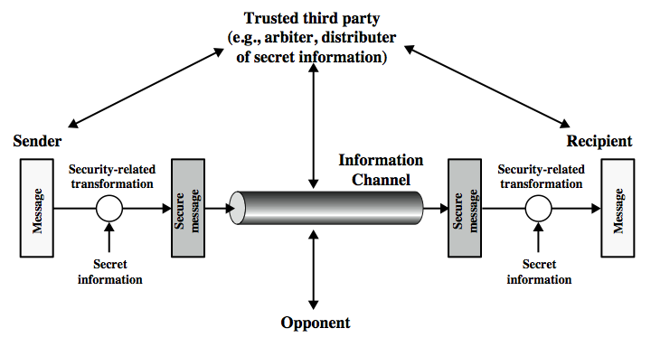
Model for Network Security
Notes:
In considering the place of encryption, its useful to use the following two models from Stallings section 1.6.
The first, illustrated in Figure 1.4, models information being transferred from one party to another over an insecure communications channel, in the presence of possible opponents. The two parties, who are the principals in this transaction, must cooperate for the exchange to take place.
Security aspects come into play when it is necessary or desirable to protect the information transmission from an opponent who may present a threat to confidentiality, integrity, and so on. All the techniques for providing security have two components:
A security-related transformation on the information to be sent.
Some secret information shared by the two principals and, it is hoped, unknown to the opponent.
They can use an appropriate security transform (encryption algorithm), with suitable keys, possibly negotiated using the presence of a trusted third party. Parts One through Four of this book concentrates on the types of security mechanisms and services that fit into the model shown here.

Slide 14
Model for Network Security
Using this model requires us to:
design a suitable algorithm for the security transformation
generate the secret information (keys) used by the algorithm
develop methods to distribute and share the secret information
specify a protocol enabling the principals to use the transformation and secret information for a security service
Notes:
This general model shows that there are four basic tasks in designing a particular security service, as listed.

Slide 15
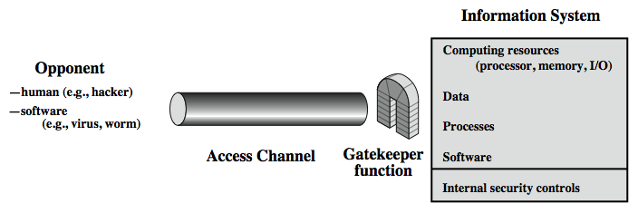
Model for Network Access Security
Notes:
The second, illustrated in Figure 1.5, model is concerned with controlled access to information or resources on a computer system, in the presence of possible opponents. Here appropriate controls are needed on the access to and within the system, to provide suitable security.
The security mechanisms needed to cope with unwanted access fall into two broad categories (as shown in this figure). The first category might be termed a gatekeeper function. (Chuan: talk about the four authentication factors). It includes password-based login procedures that are designed to deny access to all but authorized users and screening logic that is designed to detect and reject worms, viruses, and other similar attacks. Once either an unwanted user or unwanted software gains access, the second line of defense consists of a variety of internal controls that monitor activity and analyze stored information in an attempt to detect the presence of unwanted intruders. These issues are explored in Part Four.

Slide 16
Model for Network Access Security
using this model requires us to:
select appropriate gatekeeper functions to identify users
implement security controls to ensure only authorised users access designated information or resources
Notes:
Detail here the tasks needed to use this model.

Slide 17
Summary
X.800 security architecture
security attacks, services, mechanisms
security functional requirements
models for network (access) security

