Slide 1
CSCI 474/574 Introduction to Cryptography/Theory of Cryptography Chapter 3 Block Ciphers and the Data Encryption Standard
3.1 Ideal Block Cipher and Feistel Cipher Structure
Notes:
Lecture slides by Lawrie Brown for “Cryptography and Network Security”, by William Stallings, Chapter 3 – “Block Ciphers and the Data Encryption Standard”.
Enhanced and Modified by Chuan Yue at the Colorado School of Mines.

Slide 2
Modern Block Ciphers
now look at modern symmetric block ciphers
one of the most widely used types of cryptographic algorithms
provide confidentiality/authentication services
focus on DES (Data Encryption Standard)
more about block cipher design principles
Notes:
The objective of this chapter is to illustrate the principles of modern symmetric ciphers. For this purpose, we focus on the most widely used symmetric cipher: the Data Encryption Standard (DES). Although numerous symmetric ciphers have been developed since the introduction of DES, and although it is destined to be replaced by the Advanced Encryption Standard (AES), DES remains the most important such algorithm. Further, a detailed study of DES provides an understanding of the principles used in other symmetric ciphers. This chapter begins with a discussion of the general principles of symmetric block ciphers. Next, we cover full DES. Following this look at a specific algorithm, we return to a more general discussion of block cipher design.

Slide 3
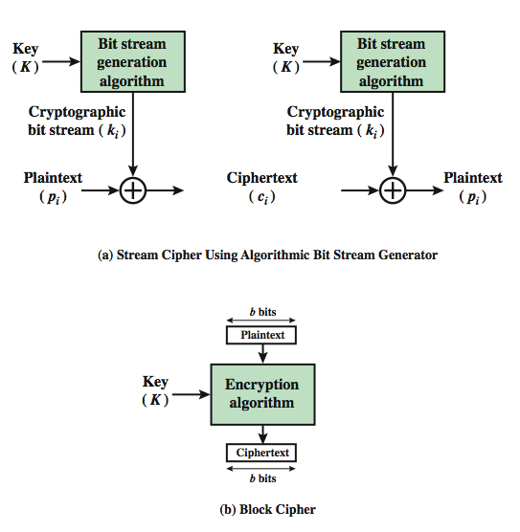
Block vs. Stream Ciphers
One-time pad version of Vernam cipher
keystream
keystream
stream ciphers process messages a bit or byte at a time when en/decrypting
block ciphers process messages in blocks, each of which is then en/decrypted
many current ciphers are block ciphers
better analyzed
broader range of applications
Notes:
Enhanced and Modified by Chuan Yue at the Colorado School of Mines.
Block ciphers work a on block / word at a time, which is some number of bits. All of these bits have to be available before the block can be processed. Stream ciphers work on a bit or byte of the message at a time, hence process it as a “stream”. Block ciphers are currently better analysed, and seem to have a broader range of applications, hence focus on them.
A block cipher is one in which a block of plaintext is treated as a whole and used to produce a ciphertext block of equal length. Typically, a block size of 64 or 128 bits is used. As with a stream cipher, the two users share a symmetric encryption key (Figure 3.1b). A stream cipher is one that encrypts a digital data stream one bit or one byte at a time. In the ideal case, a one-time pad version of the Vernam cipher would be used (Figure 2.7), in which the keystream (k ) is as long as the plaintext bit stream (p).

Slide 4
Block Cipher and the Feistel Cipher Structure
most symmetric block ciphers are based on a Feistel Cipher Structure
Horst Feistel was a cryptographer who worked on the design of ciphers at IBM, initiating research that would culminate in the development of the Data Encryption Standard (DES) in the 1970s.
Notes:
Most symmetric block encryption algorithms in current use are based on a structure referred to as a Feistel block cipher.

Slide 5
Motivation for the Feistel Cipher Structure
block cipher:
n bits plaintext → n bits ciphertext
2^{n} possible plaintext blocks
Reversible (nonsingular) transformation
each unique plaintext block → a unique ciphertext block
2^{n}! reversible transformations
Feistel refers to an n-bit general substitution as an ideal block cipher
it allows for the maximum number of possible encryption mappings from the plaintext to ciphertext block.
Notes:
Added by Chuan Yue at the Colorado School of Mines.

Slide 6
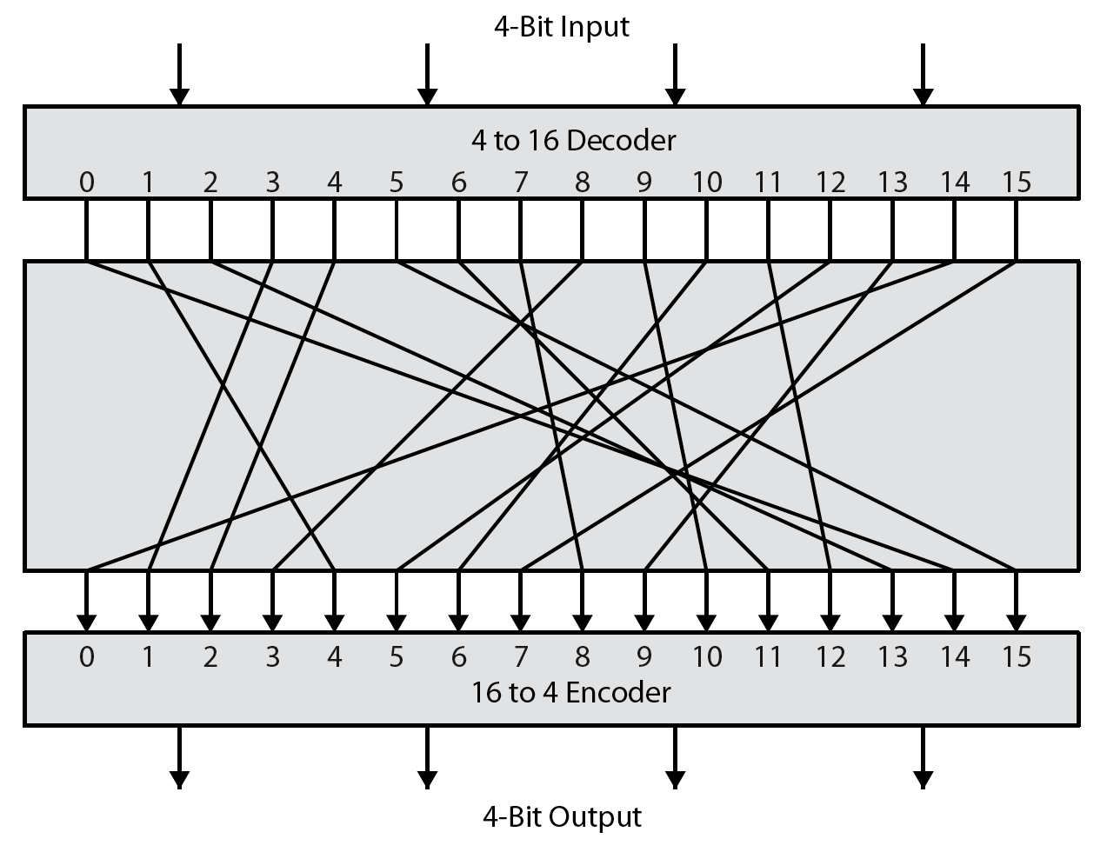
Ideal Block Cipher Example (n=4)
Notes:
Feistel refers to an n-bit general substitution as an ideal block cipher, because it allows for the maximum number of possible encryption mappings from the plaintext to ciphertext block. A 4-bit input produces one of 16 possible input states, which is mapped by the substitution cipher into a unique one of 16 possible output states, each of which is represented by 4 ciphertext bits. The encryption and decryption mappings can be defined by a tabulation, as shown in Stallings Figure 3.2. It illustrates a tiny 4-bit substitution to show that each possible input can be arbitrarily mapped to any output - which is why its complexity grows so rapidly.

Slide 7
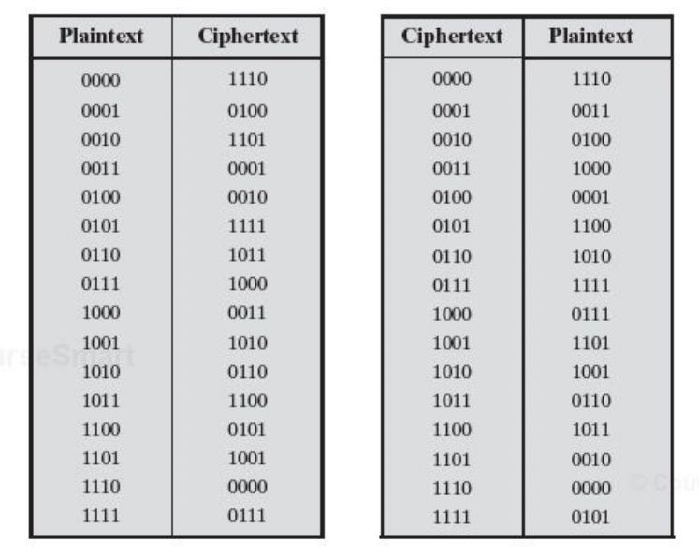
Encryption and Decryption Tables for the Ideal Block Cipher Example (n=4)
The mapping itself constitutes the key.
Key length: 4 x 16 = 64 bits
n*2^{n}
(2⁴)! -> 2⁴⁴ ~2⁴⁵
Notes:
Added by Chuan Yue at the Colorado School of Mines.

Slide 8
The Problems of Ideal Block Cipher
The block size n must be very large to thwart attacks
Statistical analysis of block content, due to small block size
Straightforward mappings are not practical from an implementation and performance point of view
In general, key length = n* 2^{n} bits
For a 64-bit block, key length = 64* 2⁶⁴ = 2⁷⁰ ≈ 10²¹ bits
Poorly confined mappings ( to a subset of 2^{n}! reversible transformations) may be vulnerable to cryptanalysis
Notes:
Added by Chuan Yue at the Colorado School of Mines.

Slide 9
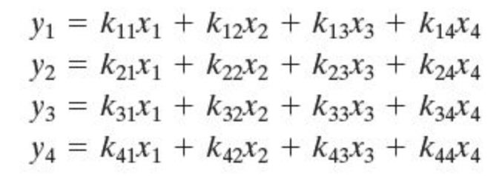
An Example of Confined Mappings
A mapping in terms of a set of linear equations
Key length = n² (in this case, 16)
vulnerable to cryptanalysis (this case is essentially a Hill Cipher)
Notes:
where the x_i are the four binary digits of the plaintext block, the y_iare the four binary digits of the ciphertext block, the k_ij are the binary coefficients, and arithmetic is mod 2. The key size is just , in this case 16 bits.

Slide 10
Feistel’s Observation
What is needed is an approximation to the ideal block cipher system for large n, built up out of components that are easily realizable.

Slide 11
The Feistel Cipher
approximate the ideal block cipher using a product cipher
the execution of two or more simple ciphers in sequence
the final result or product is cryptographically stronger than any of the component ciphers.
The essence of the approach
Key length k bits, block length n bits, 2^{k} instead of 2^{n}! transformations, k is large for thwarting brute force attacks
Alternate substitutions and permutations (transpositions) to defend against cryptanalytic attacks
A practical application of the Claude Shannon’s proposal.

Slide 12
Claude Shannon and Substitution-Permutation Ciphers
Claude Shannon introduced idea of substitution-permutation (S-P) networks in a 1949 paper (Communication Theory of Secrecy Systems)
form basis of modern block ciphers
S-P nets are based on the two primitive cryptographic operations:
substitution (S-box)
permutation (P-box)
provide confusion & diffusion of message & key
Thwart cryptanalysis based on statistical analysis
Notes:
Feistel proposed that we can approximate the ideal block cipher by utilizing the concept of a product cipher, which is the execution of two or more simple ciphers in sequence in such a way that the final result or product is cryptographically stronger than any of the component ciphers. In particular, Feistel proposed the use of a cipher that alternates substitutions and permutations, as a practical application of a proposal by Claude Shannon. Claude Shannon’s 1949 paper has the key ideas that led to the development of modern block ciphers. Critically, it was the technique of layering groups of S-boxes separated by a larger P-box to form the S-P network, a complex form of a product cipher. He also introduced the ideas of confusion and diffusion, notionally provided by S-boxes and P-boxes (in conjunction with S-boxes).

Slide 13
Confusion and Diffusion (cornerstone of modern block cipher design)
cipher aims to completely obscure statistical properties of original message (e.g., one-time pad)
more practically, combining S & P elements to obtain:
diffusion – make the statistical relationship between the plaintext and ciphertext as complex as possible
achieved by repeated permutation followed by a function
having each ciphertext digit be affected by many plaintext digits
confusion – make the statistical relationship between ciphertext and key as complex as possible
achieved by complex substitution
Notes:
The terms diffusion and confusion were introduced by Claude Shannon to capture the two basic building blocks for any cryptographic system. Shannon's concern was to thwart cryptanalysis based on statistical analysis. Every block cipher involves a transformation of a block of plaintext into a block of ciphertext, where the transformation depends on the key. The mechanism of diffusion seeks to make the statistical relationship between the plaintext and ciphertext as complex as possible in order to thwart attempts to deduce the key. Confusion seeks to make the relationship between the statistics of the ciphertext and the value of the encryption key as complex as possible, again to thwart attempts to discover the key.
So successful are diffusion and confusion in capturing the essence of the desired attributes of a block cipher that they have become the cornerstone of modern block cipher design.

Slide 14
Feistel Cipher Structure
Horst Feistel devised the Feistel cipher
based on concept of invertible product cipher
partition input block into two halves
process through multiple rounds which
perform a substitution on left half data based on round function of right half & subkey
then have permutation swapping halves
implement Shannon’s S-P net concept
Notes:
Horst Feistel, working at IBM Thomas J Watson Research Labs devised a suitable invertible cipher structure in early 70's.
One of Feistel's main contributions was the invention of a suitable structure which adapted Shannon's S-P network in an easily inverted structure. It partitions input block into two halves which are processed through multiple rounds which perform a substitution on left data half, based on round function of right half & subkey, and then have permutation swapping halves. Essentially the same h/w or s/w is used for both encryption and decryption, with just a slight change in how the keys are used. One layer of S-boxes and the following P-box are used to form the round function.

Slide 15
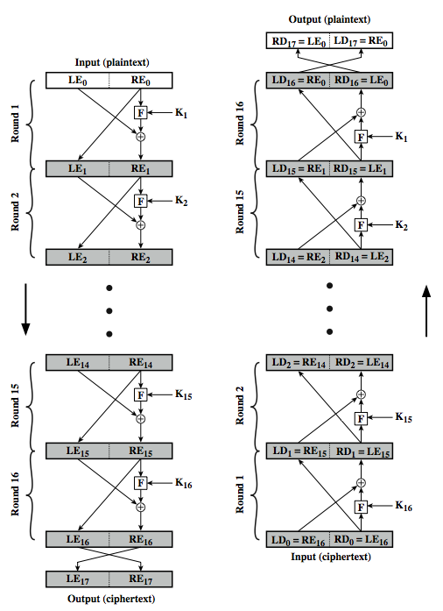
Feistel Cipher Structure
The ith round of encryption:
LE_{i}=RE_{i-1};
RE_{i}=LE_{i-1} ⊕ F(RE_{i-1,} K_{i} );
At every round, the intermediate value of the decryption process is equal to the corresponding value of the encryption process with the two halves of the value swapped. Verify LD₁||RD_{1 ,} i.e.,
LD₁=RE₁₅
RD₁=LE₁₅
The round function F does not need to be reversible.
Notes:
Stallings Figure 3.3 illustrates the classical feistel cipher structure, with data split in 2 halves, processed through a number of rounds which perform a substitution on left half using output of round function on right half & key, and a permutation which swaps halves, as listed previously. The LHS side of this figure shows the flow during encryption, the RHS in decryption.
The inputs to the encryption algorithm are a plaintext block of length 2w bits and a key K. The plaintext block is divided into two halves, L₀ and R₀. The two halves of the data pass through n rounds of processing and then combine to produce the ciphertext block. Each round i has as inputs L_{i–1} and R_{i–1}, derived from the previous round, as well as a subkey K_{i}, derived from the overall K. In general, the subkeys K are different from K and from each other.
The process of decryption with a Feistel cipher is essentially the same as the encryption process. The rule is as follows: Use the ciphertext as input to the algorithm, but use the subkeys K_{i} in reverse order. That is, use K_{n} in the first round, K_{n–1} in the second round, and so on until K₁ is used in the last round. This is a nice feature because it means we need not implement two different algorithms, one for encryption and one for decryption. See discussion in text for why using the same algorithm with a reversed key order produces the correct result, noting that at every round, the intermediate value of the decryption process is equal to the corresponding value of the encryption process with the two halves of the value swapped.

Slide 16
Feistel Cipher Design Elements
block size
key size
number of rounds
subkey generation algorithm
round function
fast software en/decryption
ease of analysis
Notes:
The exact realization of a Feistel network depends on the choice of the following parameters and design features:
block size - increasing size improves security, but slows cipher
key size - increasing size improves security, makes exhaustive key searching harder, but may slow cipher
number of rounds - increasing number improves security, but slows cipher
subkey generation algorithm - greater complexity can make analysis harder, but slows cipher
round function - greater complexity can make analysis harder, but slows cipher
fast software en/decryption - more recent concern for practical use
ease of analysis - for easier validation & testing of strength

Slide 17
Summary
block vs stream ciphers
ideal block cipher
substitution-permutation (S-P) networks
confusion and diffusion
Feistel cipher design & structure

