Slide 1
CSCI 474/574 Introduction to Cryptography/Theory of Cryptography Chapter 3 Block Ciphers and the Data Encryption Standard
3.2 Data Encryption Standard (DES)
Notes:
Lecture slides by Lawrie Brown for “Cryptography and Network Security”, by William Stallings, Chapter 3 – “Block Ciphers and the Data Encryption Standard”.
Enhanced and Modified by Chuan Yue at the Colorado School of Mines.

Slide 2
Data Encryption Standard (DES) History
IBM developed Lucifer cipher in 1971
by team led by Feistel in late 60’s
used 64-bit data blocks with 128-bit key
redeveloped as a commercial 56-bit key cipher (to be used on a chip) with input from NSA and others
in 1973 NBS (now NIST) requested for proposals
IBM submitted their revised Lucifer which was eventually accepted as the DES in 1977
Notes:
In the late 1960s, IBM set up a research project in computer cryptography led by Horst Feistel. The project concluded in 1971 with the development of the LUCIFER algorithm. LUCIFER is a Feistel block cipher that operates on blocks of 64 bits, using a key size of 128 bits.
Because of the promising results produced by the LUCIFER project, IBM embarked on an effort, headed by Walter Tuchman and Carl Meyer, to develop a marketable commercial encryption product that ideally could be implemented on a single chip. It involved not only IBM researchers but also outside consultants and technical advice from NSA. The outcome of this effort was a refined version of LUCIFER that was more resistant to cryptanalysis but that had a reduced key size of 56 bits, to fit on a single chip.
In 1973, the National Bureau of Standards (NBS) issued a request for proposals for a national cipher standard. IBM submitted the modified LUCIFER. It was by far the best algorithm proposed and was adopted in 1977 as the Data Encryption Standard.

Slide 3
DES Design Controversy
although DES standard is public
considerable controversy over design
choice of 56-bit key (vs Lucifer 128-bit)
design criteria (S-boxes) were classified
subsequent events and public analysis show in fact design was appropriate (e.g., differential cryptanalysis in 1990) - “The Data Encryption Standard (DES) and its strength against attacks”, Don Coppersmith
use of DES has flourished
still used in legacy applications
Notes:
Enhanced and Modified by Chuan Yue at the Colorado School of Mines.
Before its adoption as a standard, the proposed DES was subjected to intense & continuing criticism over the size of its key & the classified design criteria.
Recent analysis has shown despite this controversy, that DES is well designed. DES is theoretically broken using Differential or Linear Cryptanalysis but in practise is unlikely to be a problem yet. Also rapid advances in computing speed though have rendered the 56 bit key susceptible to exhaustive key search, as predicted by Diffie & Hellman.
DES has flourished and is widely used, especially in financial applications. It is still standardized for legacy systems, with either AES or triple DES for new applications.

Slide 4
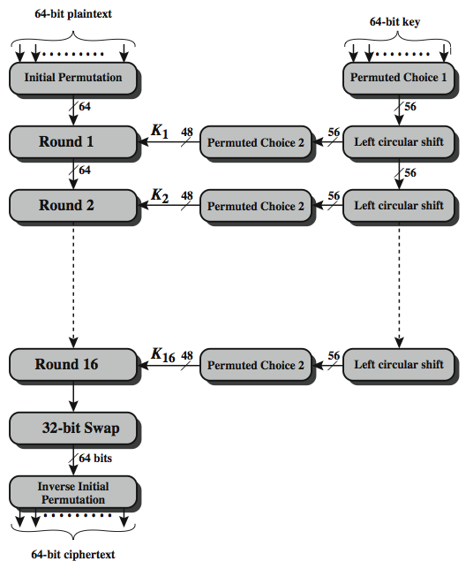
DES Encryption Overview
PC-1: 64 -> 56
PC-2: 56 -> 48
LCS: 1 or 2 bits
Three phases.
Each round: key dependent round function with S and P
Except for IP and IP⁻¹, DES has the exact structure of a Feistel cipher.
Notes:
Enhanced and Modified by Chuan Yue at the Colorado School of Mines.
The overall scheme for DES encryption is illustrated in Stallings Figure 3.4, which takes as input 64-bits of data and of key.
The left side shows the basic process for enciphering a 64-bit data block which consists of:
- an initial permutation (IP) which shuffles the 64-bit input block
- 16 rounds of a complex key dependent round function involving substitutions & permutations
- a final permutation, being the inverse of IP
The right side shows the handling of the 56-bit key and consists of:
- an initial permutation of the key (PC1) which selects 56-bits out of the 64-bits input, in two 28-bit halves
- 16 stages to generate the 48-bit subkeys using a left circular shift and a permutation of the two 28-bit halves

Slide 5
Initial Permutation IP and Inverse Initial Permutation IP⁻¹
IP
IP⁻¹
58 | 50 | 42 | 34 | 26 | 18 | 10 | 2
60 | 52 | 44 | 36 | 28 | 20 | 12 | 4
62 | 54 | 46 | 38 | 30 | 22 | 14 | 6
64 | 56 | 48 | 40 | 32 | 24 | 16 | 8
57 | 49 | 41 | 33 | 25 | 17 | 9 | 1
59 | 51 | 43 | 35 | 27 | 19 | 11 | 3
61 | 53 | 45 | 37 | 29 | 21 | 13 | 5
63 | 55 | 47 | 39 | 31 | 23 | 15 | 7
40 | 8 | 48 | 16 | 56 | 24 | 64 | 32
39 | 7 | 47 | 15 | 55 | 23 | 63 | 31
38 | 6 | 46 | 14 | 54 | 22 | 62 | 30
37 | 5 | 45 | 13 | 53 | 21 | 61 | 29
36 | 4 | 44 | 12 | 52 | 20 | 60 | 28
35 | 3 | 43 | 11 | 51 | 19 | 59 | 27
34 | 2 | 42 | 10 | 50 | 18 | 58 | 26
33 | 1 | 41 | 9 | 49 | 17 | 57 | 25
L₀
R₀
quite regular in structure
Notes:
Enhanced and Modified by Chuan Yue at the Colorado School of Mines.
The initial permutation and its inverse are defined by tables, as shown in Stallings Tables 3.2a and 3.2b, respectively. The tables are to be interpreted as follows. The input to a table consists of 64 bits numbered left to right from 1 to 64. The 64 entries in the permutation table contain a permutation of the numbers from 1 to 64. Each entry in the permutation table indicates the position of a numbered input bit in the output, which also consists of 64 bits.
Note that the bit numbering for DES reflects IBM mainframe practice, and is the opposite of what we now mostly use - so be careful! Numbers from Bit 1 (leftmost, most significant) to bit 32/48/64 etc (rightmost, least significant).
For example, a 64-bit plaintext value of “675a6967 5e5a6b5a” (written in left & right halves) after permuting with IP becomes “ffb2194d 004df6fb”. Note that example values are specified using hexadecimal.

Slide 6
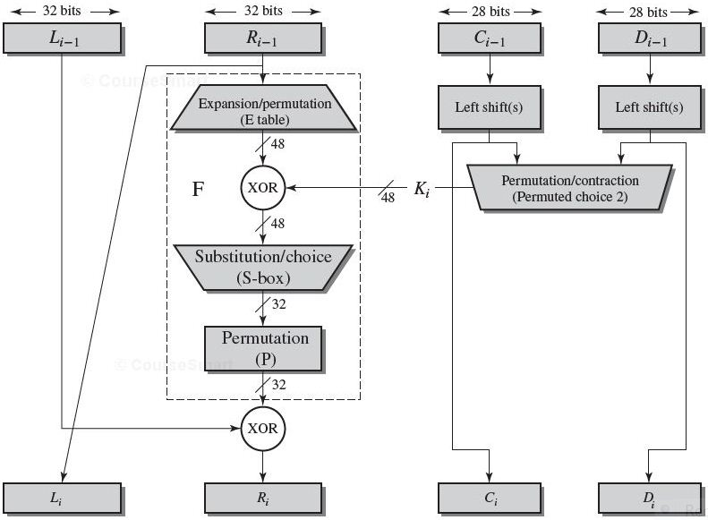
Single Round of DES Algorithm
32 | 1 | 2 | 3 | 4 | 5
4 | 5 | 6 | 7 | 8 | 9
8 | 9 | 10 | 11 | 12 | 13
12 | 13 | 14 | 15 | 16 | 17
16 | 17 | 18 | 19 | 20 | 21
20 | 21 | 22 | 23 | 24 | 25
24 | 25 | 26 | 27 | 28 | 29
28 | 29 | 30 | 31 | 32 | 1
LE_{i}=RE_{i-1};
RE_{i}=LE_{i-1}⊕ F(RE_{i-1,} K_{i} );
Expansion by taking the outer bits from the two adjacent groups (underlined numbers)
16 | 7 | 20 | 21 | 29 | 12 | 28 | 17
1 | 15 | 23 | 26 | 5 | 18 | 31 | 10
2 | 8 | 24 | 14 | 32 | 27 | 3 | 9
19 | 13 | 30 | 6 | 22 | 11 | 4 | 25
Notes:
Enhanced and Modified by Chuan Yue at the Colorado School of Mines.
Stallings Figure 3.6 illustrates the single round of DES algorithm.
F takes 32-bit R half and 48-bit subkey:
expands R to 48-bits using perm E
adds to subkey using XOR
passes through 8 S-boxes to get 32-bit result
finally permutes using 32-bit perm P
We now review the internal structure of the DES round function F, which takes R half & subkey, and processes them. The round key K_{i} is 48 bits. The R input is 32 bits. This R input is first expanded to 48 bits by using a table that defines a permutation plus an expansion that involves duplication of 16 of the R bits (Table 3.2c). The resulting 48 bits are XORed with K_{i} This 48-bit result passes through a substitution function that produces a 32-bit output, which is permuted as defined by Table 3.2d. This follows the classic structure for a feistel cipher.
Note that the s-boxes provide the “confusion” of data and key values, whilst the permutation P then spreads this as widely as possible, so each S-box output affects as many S-box inputs in the next round as possible, giving “diffusion”.

Slide 7
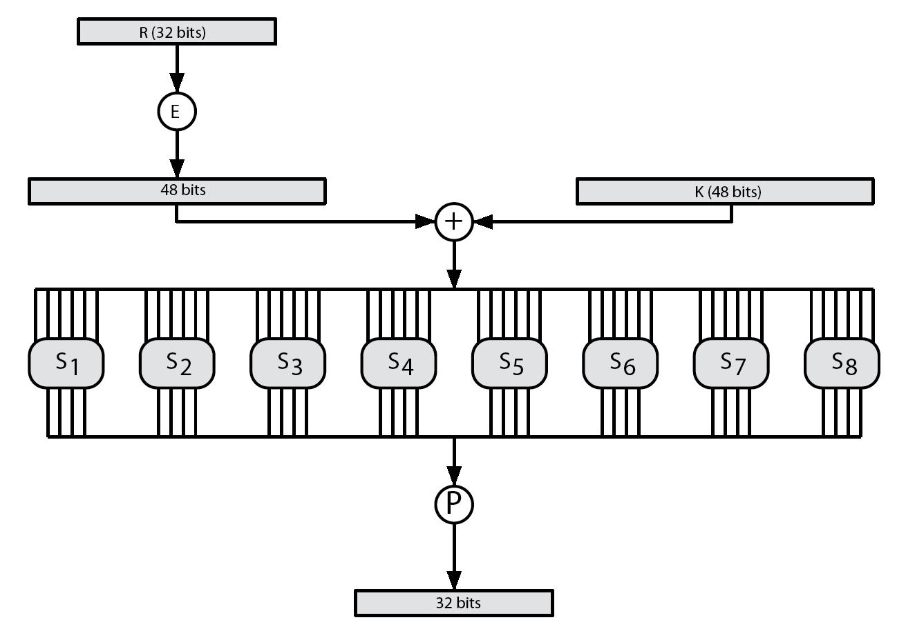
Calculation of F(R, K)
Substution/choice
(eight S-boxes, each accepts 6 bits, outputs 4 bits)
Each S-box: 6 bits input (first and last select row, the middle four select column).
Notes:
Enhanced and Modified by Chuan Yue at the Colorado School of Mines.
Stallings Figure 3.7 illustrates the internal structure of the DES round function F. The R input is first expanded to 48 bits by using expansion table E that defines a permutation plus an expansion that involves duplication of 16 of the R bits (Stallings Table 3.2c). The resulting 48 bits are XORed with key K_{i} . This 48-bit result passes through a substitution function comprising 8 S-boxes which each map 6 input bits to 4 output bits, producing a 32-bit output, which is then permuted by permutation P as defined by Stallings Table 3.2d.

Slide 8
Definition of DES S-Boxes (e.g., S₁)
S₁
 | x0000x | x0001x | x0010x | x0011x | x0100x | x0101x | x0110x | x0111x | x1000x | x1001x | x1010x | x1011x | x1100x | x1101x | x1110x | x1111x
0yyyy0 | 14 | 4 | 13 | 1 | 2 | 15 | 11 | 8 | 3 | 10 | 6 | 12 | 5 | 9 | 0 | 7
0yyyy1 | 0 | 15 | 7 | 4 | 14 | 2 | 13 | 1 | 10 | 6 | 12 | 11 | 9 | 5 | 3 | 8
1yyyy0 | 4 | 1 | 14 | 8 | 13 | 6 | 2 | 11 | 15 | 12 | 9 | 7 | 3 | 10 | 5 | 0
1yyyy1 | 15 | 12 | 8 | 2 | 4 | 9 | 1 | 7 | 5 | 11 | 3 | 14 | 10 | 0 | 6 | 13
E.g., input: 011001
output: 1001
Row selection depends on both data (recall expansion permutation) & subkey
Each row of an S-box defines a general 4-bit reversible substitution (ideal block cipher)
The only nonlinear part of DES
Notes:
Enhanced and Modified by Chuan Yue at the Colorado School of Mines.
The substitution consists of a set of eight S-boxes, each of which accepts 6 bits as input and produces 4 bits as output. These transformations are defined in Stallings Table 3.3, which is interpreted as follows: The first and last bits of the input to box Si form a 2-bit binary number to select one of four substitutions defined by the four rows in the table for Si. The middle four bits select one of the sixteen columns. The decimal value in the cell selected by the row and column is then converted to its 4-bit representation to produce the output. For example, in S1, for input 011001, the row is 01 (row 1) and the column is 1100 (column 12). The value in row 1, column 12 is 9, so the output is 1001.
The example lists 8 6-bit values (ie 18 in hex is 011000 in binary, 09 hex is 001001 binary, 12 hex is 010010 binary, 3d hex is 111101 binary etc), each of which is replaced following the process detailed above using the appropriate S-box. ie
S1(011000) lookup row 00 col 1100 in S1 to get 5
S2(001001) lookup row 01 col 0100 in S2 to get 15 = f in hex
S3(010010) lookup row 00 col 1001 in S3 to get 13 = d in hex
S4(111101) lookup row 11 col 1110 in S4 to get 2 etc

Slide 9
DES Key Schedule
Permuted Choice One (PC-1)
Permuted Choice Two (PC-2)
57 | 49 | 41 | 33 | 25 | 17 | 9
1 | 58 | 50 | 42 | 34 | 26 | 18
10 | 2 | 59 | 51 | 43 | 35 | 27
19 | 11 | 3 | 60 | 52 | 44 | 36
63 | 55 | 47 | 39 | 31 | 23 | 15
7 | 62 | 54 | 46 | 38 | 30 | 22
14 | 6 | 61 | 53 | 45 | 37 | 29
21 | 13 | 5 | 28 | 20 | 12 | 4
14 | 17 | 11 | 24 | 1 | 5
3 | 28 | 15 | 6 | 21 | 10
23 | 19 | 12 | 4 | 26 | 8
16 | 7 | 27 | 20 | 13 | 2
41 | 52 | 31 | 37 | 47 | 55
30 | 40 | 51 | 45 | 33 | 48
44 | 49 | 39 | 56 | 34 | 53
46 | 42 | 50 | 36 | 29 | 32
C
D
64 -> 56: every eighth bit is discarded
56 -> 48: eight more bits are discarded
Schedule of Left Circular Shifts
(C and D will be separately shifted)
Notes:
The DES Key Schedule generates the subkeys needed for each data encryption round. A 64-bit key is used as input to the algorithm, though every eighth bit is ignored, as indicated by the lack of shading in Table 3.4a. It is first processed by Permuted Choice One (Stallings Table 3.4b). The resulting 56-bit key is then treated as two 28-bit quantities C & D. In each round, these are separately processed through a circular left shift (rotation) of 1 or 2 bits as shown in Stallings Table 3.4d. These shifted values serve as input to the next round of the key schedule. They also serve as input to Permuted Choice Two (Stallings Table 3.4c), which produces a 48-bit output that serves as input to the round function F.
The 56 bit key size comes from security considerations as we know now. It was big enough so that an exhaustive key search was about as hard as the best direct attack (a form of differential cryptanalysis called a T-attack, known by the IBM & NSA researchers), but no bigger. The extra 8 bits were then used as parity (error detecting) bits, which makes sense given the original design use for hardware communications links. However we hit an incompatibility with simple s/w implementations since the top bit in each byte is 0 (since ASCII only uses 7 bits), but the DES key schedule throws away the bottom bit! A good implementation needs to be cleverer!

Slide 10
DES Decryption
as with any Feistel cipher, DES decryption uses the same algorithm as encryption
do encryption steps again using subkeys in reverse order (SK16 … SK1)
IP undoes final FP step of encryption
1st round with SK16 undoes 16th encrypt round
….
16th round with SK1 undoes 1st encrypt round
then final FP undoes initial encryption IP
thus recovering original data value
Notes:
As with any Feistel cipher, DES decryption uses the same algorithm as encryption except that the subkeys are used in reverse order SK16 .. SK1.
If you trace through the DES overview diagram can see how each decryption step top to bottom with reversed subkeys, undoes the equivalent encryption step moving from bottom to top.

Slide 11
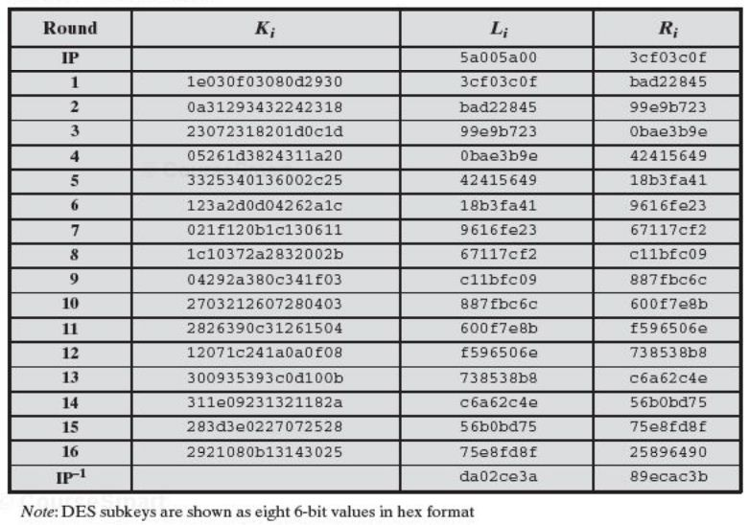
DES Example
Key: 0f1571c947d9e859 Plaintext: 02468aceeca86420 Ciphertext: da02ce3a89ecac3b
Notes:
Can now work through an example, and consider some of its implications. In this example, the plaintext is a hexadecimal palindrome, with:
Plaintext: 02468aceeca86420
Key: 0f1571c947d9e859
Ciphertext: da02ce3a89ecac3b
Table 3.5 shows the progression of the algorithm. The first row shows the 32-bit values of the left and right halves of data after the initial permutation. The next 16 rows show the results after each round. Also shown is the value of the 48-bit subkey generated for each round. The final row shows the left and right-hand values after the inverse initial permutation. These two values combined form the ciphertext.

Slide 12
Avalanche Effect
A key desirable property of encryption algorithm
where a change of one input or key bit results in changing approximately half output bits
DES exhibits strong avalanche
Notes:
A desirable property of any encryption algorithm is that a small change in either the plaintext or the key should produce a significant change in the ciphertext. In particular, a change in one bit of the plaintext or one bit of the key should produce a change in many bits of the ciphertext. If the change were small, this might provide a way to reduce the size of the plaintext or key space to be searched. DES exhibits a strong avalanche effect, as may be seen in Stallings Table 3.5.

Slide 13
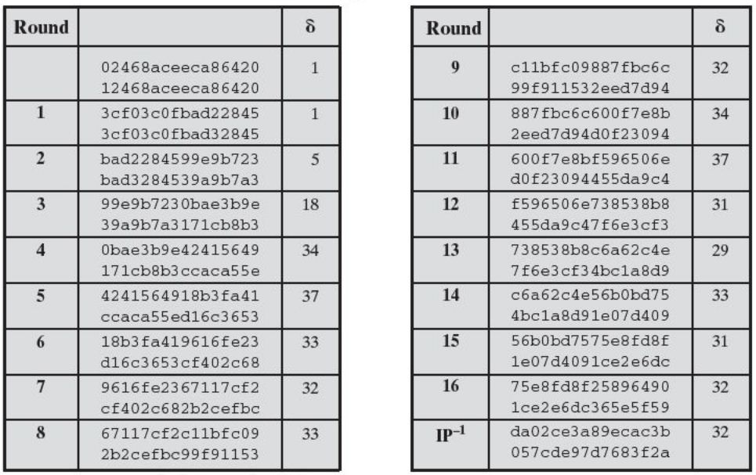
Avalanche in DES (change in plaintext)
Notes:
A desirable property of any encryption algorithm is that a small change in either the plaintext or the key should produce a significant change in the ciphertext. In particular, a change in one bit of the plaintext or one bit of the key should produce a change in many bits of the ciphertext. This is referred to as the avalanche effect. Using the example from Table 3.5, Table 3.6 shows the result when the fourth bit of the plaintext is changed, so that the plaintext is 12468aceeca86420. The second column of the table shows the intermediate 64-bit values at the end of each round for the two plaintexts. The third column shows the number of bits that differ between the two intermediate values. The table shows that after just three rounds, 18 bits differ between the two blocks. On completion, the two ciphertexts differ in 32 bit positions. Table 3.7 in the text shows a similar test using the original plaintext of with two keys that differ in only the fourth bit position. Again, the results show that about half of the bits in the ciphertext differ and that the avalanche effect is pronounced after just a few rounds.

Slide 14
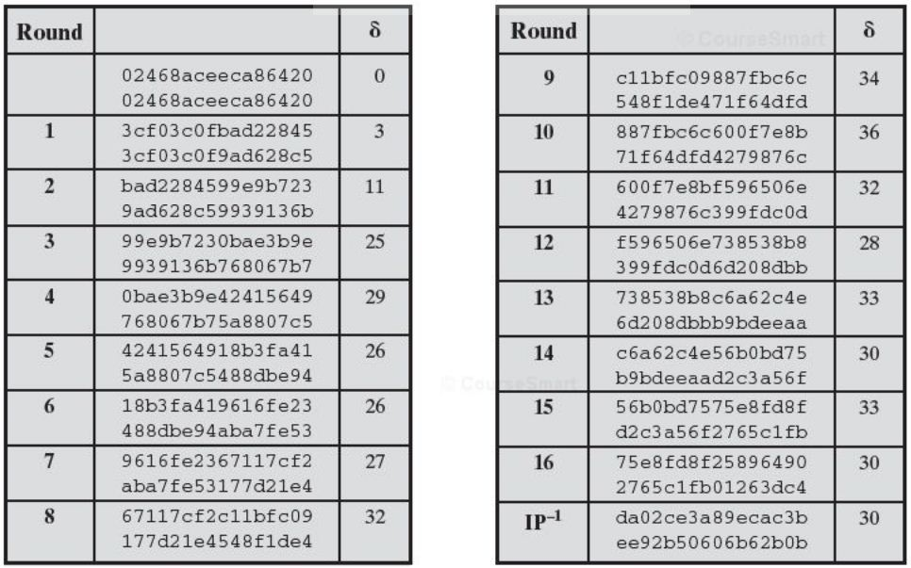
Avalanche in DES (change in key)
Notes:
A desirable property of any encryption algorithm is that a small change in either the plaintext or the key should produce a significant change in the ciphertext. In particular, a change in one bit of the plaintext or one bit of the key should produce a change in many bits of the ciphertext. This is referred to as the avalanche effect. Using the example from Table 3.5, Table 3.6 shows the result when the fourth bit of the plaintext is changed, so that the plaintext is 12468aceeca86420. The second column of the table shows the intermediate 64-bit values at the end of each round for the two plaintexts. The third column shows the number of bits that differ between the two intermediate values. The table shows that after just three rounds, 18 bits differ between the two blocks. On completion, the two ciphertexts differ in 32 bit positions. Table 3.7 in the text shows a similar test using the original plaintext of with two keys that differ in only the fourth bit position. Again, the results show that about half of the bits in the ciphertext differ and that the avalanche effect is pronounced after just a few rounds.

Slide 15
Strength of DES – Key Size
56-bit keys have 2⁵⁶ = 7.2 x 10¹⁶ values
brute force search was no longer hard
in 1997 on Internet in a few months
in 1998 on dedicated h/w in a few days
in 1999 above combined in 22hrs!
considered alternatives to DES
Notes:
Since its adoption as a federal standard, there have been lingering concerns about the level of security provided by DES in two areas: key size and the nature of the algorithm.
With a key length of 56 bits, there are 2⁵⁶ possible keys, which is approximately 7.2*10¹⁶ keys. Thus a brute-force attack appeared impractical.
However DES was finally and definitively proved insecure in July 1998, when the Electronic Frontier Foundation (EFF) announced that it had broken a DES encryption using a special-purpose "DES cracker" machine that was built for less than $250,000. The attack took less than three days. The EFF has published a detailed description of the machine, enabling others to build their own cracker [EFF98].
There have been other demonstrated breaks of the DES using both large networks of computers & dedicated h/w, including:
- 1997 on a large network of computers in a few months
- 1998 on dedicated h/w (EFF) in a few days
- 1999 above combined in 22hrs!
It is important to note that there is more to a key-search attack than simply running through all possible keys. Unless known plaintext is provided, the analyst must be able to recognize plaintext as plaintext.
Clearly must now consider alternatives to DES, the most important of which are AES and triple DES.

Slide 16
Strength of DES – Cryptanalytic Attacks
utilize some deep characteristics of the cipher
by gathering information about encryptions
can eventually recover some/all of the sub-key bits
if necessary then exhaustively search for the rest
generally these are statistical attacks
differential cryptanalysis
observe pairs of text blocks evolving along each round
linear cryptanalysis
find linear approximation to the transformations
related key attacks
observe the operation of a cipher under several related keys
theoretical estimation; brute-force is practical concern
Notes:
Another concern is the possibility that cryptanalysis is possible by exploiting the characteristics of the DES algorithm. The focus of concern has been on the eight substitution tables, or S-boxes, that are used in each iteration. These techniques utilise some deep structure of the cipher by gathering information about encryptions so that eventually you can recover some/all of the sub-key bits, and then exhaustively search for the rest if necessary. Generally these are statistical attacks which depend on the amount of information gathered for their likelihood of success. Attacks of this form include differential cryptanalysis. linear cryptanalysis, and related key attacks.

Slide 17
Strength of DES – Timing Attacks
attack actual implementation of a cipher
information about the key or the plaintext is obtained by observing how long it takes a given implementation to perform decryptions on various ciphertext.
specifically use fact that calculations can take varying times depending on the value of the inputs to it
particularly problematic on smartcards, AES/RSA…
Notes:
We will discuss timing attacks in more detail later, as they relate to public-key algorithms. However, the issue may also be relevant for symmetric ciphers. A timing attack is one in which information about the key or the plaintext is obtained by observing how long it takes a given implementation to perform decryptions on various ciphertexts. A timing attack exploits the fact that an encryption or decryption algorithm often takes slightly different amounts of time on different inputs. The AES analysis process has highlighted this attack approach, and showed that it is a concern particularly with smartcard implementations, though DES appears to be fairly resistant to a successful timing attack.

Slide 18
DES Design Criteria
as reported by Coppersmith in [COPP94]
7 criteria for S-boxes provide for
non-linearity
resistance to differential cryptanalysis
good confusion
3 criteria for permutation P provide for
increased diffusion
Notes:
Although much progress has been made in designing block ciphers that are cryptographically strong, the basic principles have not changed all that much since the work of Feistel and the DES design team in the early 1970s. Some of the criteria used in the design of DES were reported in [COPP94], and focused on the design of the S-boxes and on the P function that distributes the output of the S boxes, as summarized above. See text for further details.

Slide 19
7 criteria for S-boxes (e.g., 1, 2, 3)
1. No output bit of any S- box should be too close a linear function of the input bits. Specifically, if we select any output bit and any subset of the six input bits, the fraction of inputs for which this output bit equals the XOR of these input bits should not be close to 0 or 1, but rather should be near 1/ 2.
2. Each row of an S- box ( determined by a fixed value of the leftmost and right-most input bits) should include all 16 possible output bit combinations.
3. If two inputs to an S- box differ in exactly one bit, the outputs must differ in at least two bits.
Notes:
Added by Chuan Yue at the Colorado School of Mines.

Slide 20
3 criteria for permutation P (e.g, 1, 2)
1. The four output bits from each S- box at round i are distributed so that two of them affect ( provide input for) “ middle bits” of round (i+1) and the other two affect end bits. The two middle bits of input to an S- box are not shared with adjacent S- boxes. The end bits are the two left-hand bits and the two right- hand bits, which are shared with adjacent S- boxes.
2. The four output bits from each S- box affect six different S-boxes on the next round, and no two affect the same S-box.
Notes:
Added by Chuan Yue at the Colorado School of Mines.
Chuan: for 1, need to consider the path from the four output bits of each S- box to the six input bits of adjacent S-boxes

Slide 21
Block Cipher Design
basic principles still like Feistel’s in 1970’s
number of rounds
more is better
round function f:
provides “confusion”, nonlinear, avalanche, bit independence
have issues of how S-boxes are selected
key schedule
complex subkey creation, key avalanche
Notes:
The cryptographic strength of a Feistel cipher derives from three aspects of the design: the number of rounds, the function F, and the key schedule algorithm. Briefly discuss these.
The greater the number of rounds, the more difficult it is to perform cryptanalysis, even for a relatively weak F. In general, the criterion should be that the number of rounds is chosen so that known cryptanalytic efforts require greater effort than a simple brute-force key search attack. This criterion is attractive because it makes it easy to judge the strength of an algorithm and to compare different algorithms.
The function F provides the element of confusion in a Feistel cipher, want it to be difficult to “unscramble” the substitution performed by F. One obvious criterion is that F be nonlinear. The more nonlinear F, the more difficult any type of cryptanalysis will be. We would like it to have good avalanche properties, or even the strict avalanche criterion (SAC). Another criterion is the bit independence criterion (BIC). One of the most intense areas of research in the field of symmetric block ciphers is that of S-box design. Would like any change to the input vector to an S-box to result in random-looking changes to the output. The relationship should be nonlinear and difficult to approximate with linear functions.
A final area of block cipher design, and one that has received less attention than S-box design, is the key schedule algorithm. With any Feistel block cipher, the key schedule is used to generate a subkey for each round. Would like to select subkeys to maximize the difficulty of deducing individual subkeys and the difficulty of working back to the main key. The key schedule should guarantee key/ciphertext Strict Avalanche Criterion and Bit Independence Criterion.

Slide 22
Number of Rounds
DES brute force
on average 2⁵⁵
DES 16 rounds, differential cryptanalysis
2^{55.1} (known plaintext attack)
DES (if 15 rounds), differential cryptanalysis
less than 2⁵⁵ (known plaintext attack)
make known cryptanalytic attacks require greater effort than simple brute-force key search attacks
A general and attractive criterion for judging the strength of an algorithm
Notes:
Added by Chuan Yue at the Colorado School of Mines.

Slide 23
Round Function F
Strict Avalanche Criterion (SAC)
any output bit j of an S- box should change with probability 1/2 when any single input bit i is inverted for all i, j.
a similar criterion could be applied to F as a whole.
Bit Independence Criterion (BIC)
output bits j and k should change independently when any single input bit i is inverted for all i, j, and k.
S-Box (n x m) Design
larger S-boxes are more resistant to cryptanalysis, but need larger lookup table and are more difficult to design properly
n limited to 8~10, e.g, DES 6x4, Blowfish (Bruce Schneier) 8x32,…
random, random with testing, human-made (DES), math-made
Blowfish: random and key dependent, hard to analyze ahead of time
Notes:
Enhanced and Modified by Chuan Yue at the Colorado School of Mines.

Slide 24
Key Schedule Algorithm
Use the main key to generate subkey for each round
Maximize the difficulty of deducing individual subkeys
Maximize the difficulty of working back to the main key
Guarantee key/ciphertext meet Strict Avalanche Criterion and Bit Independence Criterion [ADAM94]

Slide 25
Summary
DES
history and design controversy
details
Strength
design criteria
differential & linear cryptanalysis
block cipher design principles

