Slide 1
CSCI 474/574 Introduction to Cryptography/Theory of Cryptography Chapter 5 Advanced Encryption Standard (AES)
5.1 Advanced Encryption Standard (AES)
Notes:
Lecture slides by Lawrie Brown for “Cryptography and Network Security”, by William Stallings, Chapter Chapter 5 –”Advanced Encryption Standard”.
Enhanced and Modified by Chuan Yue at the Colorado School of Mines.

Slide 2
Origins
clearly a replacement for DES was needed
can use Triple-DES – but slow, has small blocks
NIST issued call for ciphers in 1997
15 candidates accepted in June 1998
5 were shortlisted in August 1999
Rijndael (designed by Rijmen and Daemen in Belgium) was selected as the AES in Oct-2000
issued as FIPS PUB 197 standard in Nov-2001
Notes:
The Advanced Encryption Standard (AES) was published by NIST (National Institute of Standards and Technology) in 2001. AES is a symmetric block cipher that is intended to replace DES as the approved standard for a wide range of applications. The AES cipher (& other candidates) form the latest generation of block ciphers, and now we see a significant increase in the block size - from the old standard of 64-bits up to 128-bits; and keys from 128 to 256-bits. In part this has been driven by the public demonstrations of exhaustive key searches of DES. Whilst triple-DES is regarded as secure and well understood, it is slow, especially in s/w. In a first round of evaluation, 15 proposed algorithms were accepted. A second round narrowed the field to 5 algorithms. NIST completed its evaluation process and published a final standard (FIPS PUB 197) in November of 2001. NIST selected Rijndael as the proposed AES algorithm. The two researchers who developed and submitted Rijndael for the AES are both cryptographers from Belgium: Dr. Joan Daemen and Dr.Vincent Rijmen.

Slide 3
The AES Main Points
has 128/192/256 bit keys, 128 bit block size (16 bytes)
an iterative rather than Feistel cipher
processes data as block of 4 columns of 4 bytes
operates on entire data block (not half-half) in every round
all operations are performed on 8-bit bytes
the arithmetic operations are performed over the finite field GF (2⁸), with the irreducible polynomial m(x) = x⁸ + x⁴ + x³ + x + 1 (first of the 30 degree-8 irreducible polynomials).
designed to be:
resistant against known attacks
speed and code compactness on many CPUs
design simplicity
Notes:
Enhanced and Modified by Chuan Yue at the Colorado School of Mines.
The Rijndael proposal for AES defined a cipher in which the block length and the key length can be independently specified to be 128,192,or 256 bits. The AES specification uses the same three key size alternatives but limits the block length to 128 bits. Rijndael is an academic submission, based on the earlier Square cipher, from Belgium academics Dr Joan Daemen and Dr Vincent Rijmen. It is an iterative cipher (operates on entire data block in every round) rather than feistel (operate on halves at a time), and was designed to have characteristics of: Resistance against all known attacks, Speed and code compactness on a wide range of platforms, & Design simplicity.

Slide 4
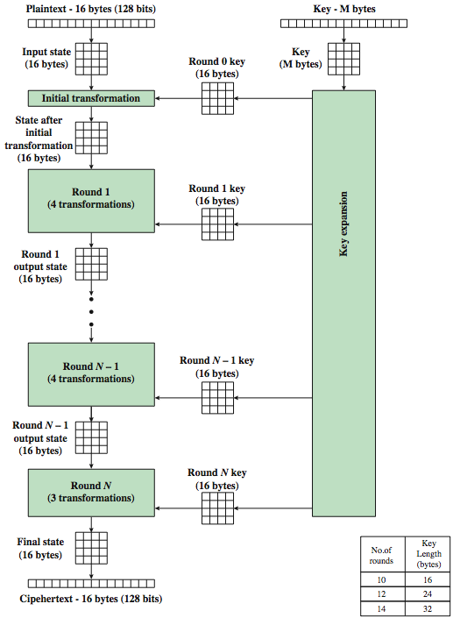
AES Encryption Process
The byte ordering is by column from left to right for both the data and key
State array holds data
Key expansion function generates N+1 round keys
128-bit key length:
expanded into 44 32-bit words
First N-1 round: 4 transformations; Final round: 3 transformations.
Each round:
4x4 state → 4x4 state
Number of rounds relates to key length
Notes:
Enhanced and Modified by Chuan Yue at the Colorado School of Mines.
Stallings Figure 5.1 shows the overall encryption process in AES.

Slide 5
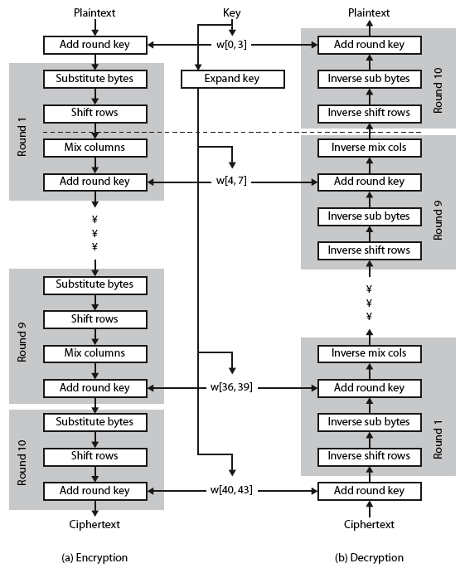
AES Structure in Detail (128-bit key)
Substitute Bytes: one S-box used on every byte-by-byte substitution
ShiftRows: a simple permutation
MixColumns: a substitution makes use of arithmetic over GF(2⁸)
AddRoundKey: a simple substitution (XOR state with key)
XOR encryption (AddRoundKey), followed by scrambling of the block (the other three stages), followed by XOR encryption, and so on. Each stage is reversible. Only AddRoundKey really provides the security.
Key is expanded into array of 32-bit words;
four words (128-bit key) form a round key in each round.
Decryption & encryption procedures are not identical.
Notes:
Enhanced and Modified by Chuan Yue at the Colorado School of Mines.
Stallings Figure 5.3 shows the structure of AES in more detail. The cipher consists of N rounds, where the number of rounds depends on the key length: 10 rounds for a 16-byte key; 12 rounds for a 24-byte key; and 14 rounds for a 32-byte key. The first N – 1 rounds consist of four distinct transformation functions: SubBytes, ShiftRows, MixColumns, and AddRoundKey, which are described subsequently. The final round contains only 3 transformation, and there is a initial single transformation (AddRoundKey) before the first round, which can be considered Round 0. Each transformation takes one or more 4 x 4 matrices as input and produces a 4 x 4 matrix as output. Figure 5.1 shows that the output of each round is a 4 x 4 matrix, with the output of the final round being the ciphertext. Also, the key expansion function generates N + 1 round keys, each of which is a distinct 4 x 4 matrix. Each round key serve as one of the inputs to the AddRoundKey transformation in each round.

Slide 6
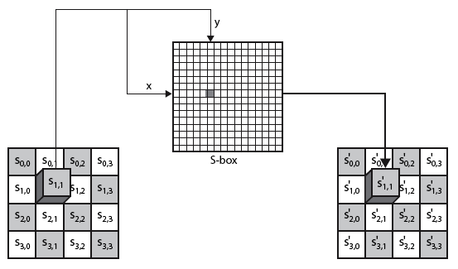

Substitute Bytes
a simple substitution of each byte
uses a of 16 x 16 S-Box which contains a permutation of all the 256 unique 8-bit values
each byte of state is replaced by byte indexed by row (left 4-bits) & column (right 4-bits)
Notes:
Enhanced and Modified by Chuan Yue at the Colorado School of Mines.
We now turn to a discussion of each of the four transformations used in AES. For each stage, we mention the forward (encryption) algorithm, the inverse (decryption) algorithm, and the rationale for the design of that stage.
The Substitute bytes stage uses an S-box to perform a byte-by-byte substitution of the block.
As this diagram from Stallings Fig 5.5a shows, the Byte Substitution operates on each byte of state independently, with the input byte used to index a row/col in the table to retrieve the substituted value.

Slide 7
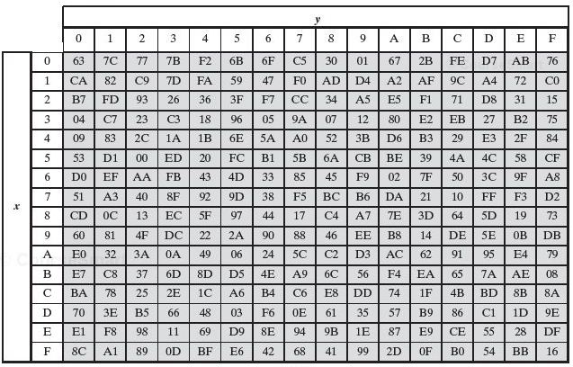
S-Box
E.g., byte {95} is replaced by byte in row 9 column 5
which has value {2A}
S-box constructed using the defined transformation of values in GF(2⁸), uses multiplicative inverse, etc.
S-box is invertible (IS-box[S-box(a)] = a)
designed to be resistant to all known attacks
Notes:
Enhanced and Modified by Chuan Yue at the Colorado School of Mines.
There is a single 8-bit wide S-box used on every byte. This S-box is a permutation of all 256 8-bit values, constructed using a transformation which treats the values as polynomials in GF(2⁸) – however it is fixed, so really only need to know the table when implementing. Decryption requires the inverse of the table. These tables are given in Stallings Table 5.2.
The table was designed to be resistant to known cryptanalytic attacks. Specifically, the Rijndael developers sought a design that has a low correlation between input bits and output bits, with the property that the output cannot be described as a simple mathematical function of the input, with no fixed points and no “opposite fixed points”.

Slide 8
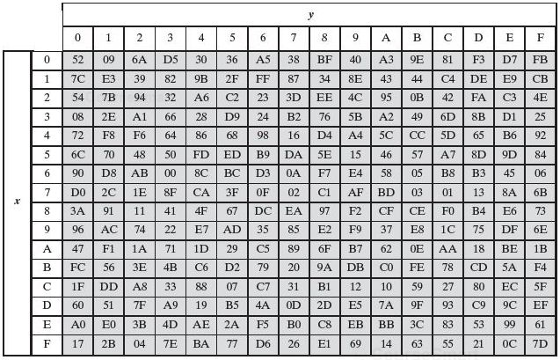
IS-Box
E.g., IS-box(S-box({95})) = IS-box({2A}) = {95}
Notes:
Added by Chuan Yue at the Colorado School of Mines.

Slide 9
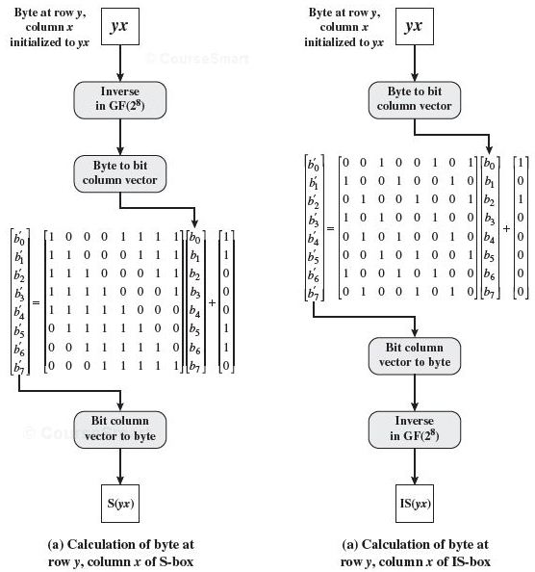
Construction of S-Box and IS-Box
Initialize the S-box
00 01 02 …..0F
10 11 12 …..1F
……
F0 F1 F2 …..FF
Nonlinearity due to multiplicative inverse
No fixed points (S-box(a) =a) and no opposite fixed point (S-box(a) =~a) due to the constant; S-box(a) != IS-box(a)
Notes:
Added by Chuan Yue at the Colorado School of Mines.

Slide 10

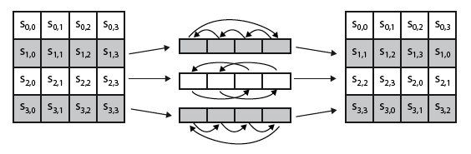
Shift Rows
a circular byte shift in each row
1st row is unchanged
2nd row does 1 byte circular shift to left
3rd row does 2 byte circular shift to left
4th row does 3 byte circular shift to left
decrypt inverts using shifts to right
since state is processed by columns, this step permutes bytes between the columns
Notes:
The ShiftRows stage provides a simple “permutation” of the data, whereas the other steps involve substitutions. Further, since the state is treated as a block of columns, it is this step which provides for diffusion of values between columns. It performs a circular rotate on each row of 0, 1, 2 & 3 places for respective rows. When decrypting it performs the circular shifts in the opposite direction for each row. This row shift moves an individual byte from one column to another, which is a linear distance of a multiple of 4 bytes, and ensures that the 4 bytes of one column are spread out to four different columns.

Slide 11
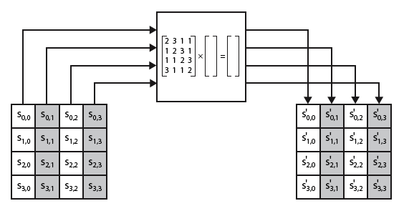

Mix Columns
each column is processed separately
each byte is replaced by a value dependent on all 4 bytes in that column
effectively a matrix multiplication in GF(2⁸) using prime polynomial m(x) =x⁸+x⁴+x³+x+1
Notes:
Enhanced and Modified by Chuan Yue at the Colorado School of Mines.
The forward mix column transformation, called MixColumns, operates on each column individually. Each byte of a column is mapped into a new value that is a function of all four bytes in that column. It is a substitution that makes use of arithmetic over GF(2^8). Each byte of a column is mapped into a new value that is a function of all four bytes in that column. It is designed as a matrix multiplication where each byte is treated as a polynomial in GF(2⁸). The inverse used for decryption involves a different set of constants.
The constants used are based on a linear code with maximal distance between code words – this gives good mixing of the bytes within each column. Combined with the “shift rows” step provides good avalanche, so that within a few rounds, all output bits depend on all input bits.
Stalling Figure 5.5b illustrates the Mix Columns transformation.

Slide 12

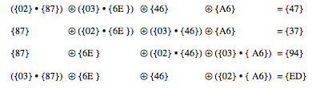
Mix Columns Example
uses arithmetic in the finite field GF(2⁸) with irreducible polynomial m(x)=x⁸+x⁴+x³+x+1,which is (100011011)or{11b}
multiplication of a value by {02} means by x, multiplication of a value by {03} means by x+1
E.g. {02} • {87} mod {11b} = x • {10000111} mod {11b} =(100001110) mod {11b} = (00001110) XOR (00011011) = (00010101)
Notes:
Added by Chuan Yue at the Colorado School of Mines.
Show an example of the MixColumns transformation from the text, along with verification of the first column of this example.
AES uses arithmetic in the finite field GF(2⁸), with the irreducible polynomial m(x) = x⁸ + x⁴ + x³ + x + 1. AES operates on 8-bit bytes. Addition of two bytes is defined as the bitwise XOR operation. Multiplication of two bytes is defined as multiplication in the finite field GF(2⁸). In particular, multiplication of a value by x (i.e., by {02}) can be implemented as a 1-bit left shift followed by a conditional bitwise XOR with (0001 1011) if the leftmost bit of the original value (prior to the shift) is 1.

Slide 13
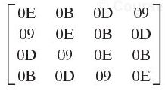
Mix Columns Design Rationale
decryption uses an inverse matrix
with larger coefficients, a little harder & slow to implement
encryption is more important than decryption
Some cipher modes of operation and MAC only uses encryption
coefficients based on linear code with maximal distance between code words
ensures a good mixing among bytes of each column
Shift Rows plus Mix Columns
All output bits depend on all input bits after a few (two rounds indeed) rounds
Notes:
Enhanced and Modified by Chuan Yue at the Colorado School of Mines.
In practise, you implement Mix Columns by expressing the transformation on each column as 4 equations (Stallings equation 5.4) to compute the new bytes for that column. This computation only involves shifts, XORs & conditional XORs (for the modulo reduction).
The decryption computation requires the use of the inverse of the matrix, which has larger coefficients, and is thus potentially a little harder & slower to implement.
The coefficients of the matrix are based on a linear code with maximal distance between code words, which ensures a good mixing among the bytes of each column. The mix column transformation combined with the shift row transformation ensures that after a few rounds, all output bits depend on all input bits. In addition, the choice of coefficients in MixColumns, which are all {01}, {02}, or {03}, was influenced by implementation considerations.

Slide 14
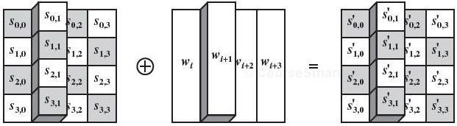
Add Round Key
XOR state with 128-bits of the round key
inverse transformation for decryption is identical
since XOR is its own inverse
design rationale
as simple as possible, affects every bit of State
complexity of the round key expansion and the combination with other stages ensure security
Notes:
Lastly is the Add Round Key stage which is a simple bitwise XOR of the current block with a portion of the expanded key. Note this is the only step which makes use of the key and obscures the result, hence MUST be used at start and end of each round, since otherwise could undo effect of other steps. But the other steps provide confusion/diffusion/non-linearity. That us you can look at the cipher as a series of XOR with key then scramble/permute block repeated. This is efficient and highly secure it is believed.
Stallings Figure 5.5b illustrates the Add Round Key stage, which like Byte Substitution, operates on each byte of state independently.

Slide 15
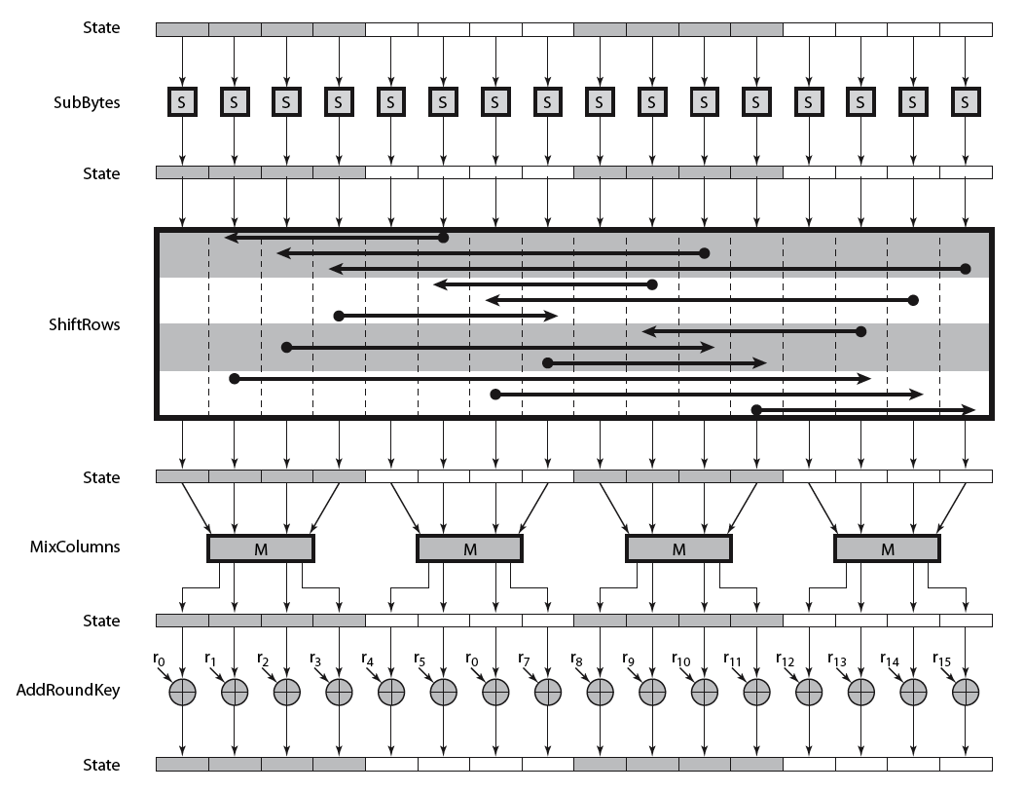
AES Round
column 1
column 2
column 3
column 4
Notes:
Can thus now view all the internal details of the AES round, showing how each byte of the state is manipulated, as shown in Stallings Figure 5.4.

Slide 16
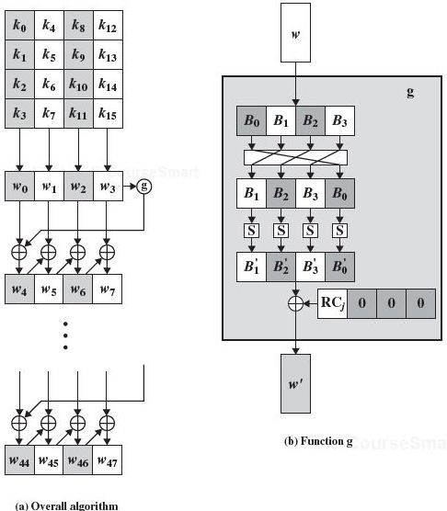

AES Key Expansion
w[i-1]
Expand 128/192/256 bits (16/24/32bytes) key to 44/52/60 32-bit words
start by copying key into first 4 words w₀ to w₃
then loop creating new word w[i] that depends on values in w[i-1] and w[i-4]
4 does not divides i: just XOR w[i-1] and w[i-4]
4 divides i: a more complex function g is applied on w[i-1] before XOR with w[i-4].
The same S-box as used in Substitute Bytes
round constant RC[j] for the 10 rounds
Notes:
The AES key expansion algorithm takes as input a 4-word (16-byte) key and produces a linear array of words, providing a 4-word round key for the initial AddRoundKey stage and each of the 10/12/14 rounds of the cipher. It involves copying the key into the first group of 4 words, and then constructing subsequent groups of 4 based on the values of the previous & 4th back words. The first word in each group of 4 gets “special treatment” with rotate + S-box + XOR constant on the previous word before XOR’ing the one from 4 back. In the 256-bit key/14 round version, there’s also an extra step on the middle word. The text includes in section 5.4 pseudocode that describes the key expansion.
The first block of the AES Key Expansion is shown here in Stallings Figure 5.9a. It shows each group of 4 bytes in the key being assigned to the first 4 words, then the calculation of the next 4 words based on the values of the previous 4 words, which is repeated enough times to create all the necessary subkey information.

Slide 17
Key Expansion Rationale
designed to resist known attacks
design criteria included
knowing part key insufficient to find more key bits
an invertible transformation with Nk consecutive words of expanded key
fast on wide range of CPU’s
use round constants to eliminate symmetries
diffusion of key bits into round keys
enough non-linearity to prohibit determination of round key differences from cipher key differences
simplicity of description
Notes:
The Rijndael developers designed the expansion key algorithm to be resistant to known cryptanalytic attacks. It is designed to be simple to implement, but by using round constants break symmetries, and make it much harder to deduce other key bits if just some are known (but once have as many consecutive bits as are in key, can then easily recreate the full expansion). The design criteria used are listed above.

Slide 18
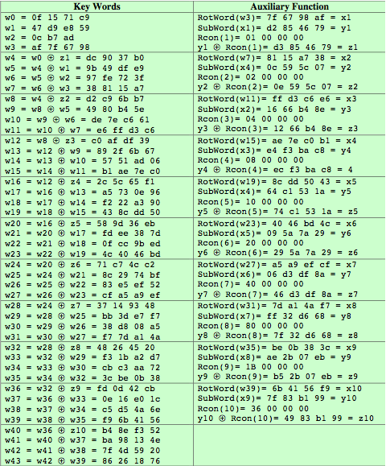
AES Example Key Expansion
Notes:
We now work through an example, and consider some of its implications. The plaintext, key, and resulting ciphertext are as follows:
Plaintext: 0123456789abcdeffedcba9876543210
Key: 0f1571c947d9e8590cb7add6af7f6798
Ciphertext: ff0b844a0853bf7c6934ab4364148fb9
Table 5.3 shows the expansion of the 16-byte key into 10 round keys. As previously explained, this process is performed word by word, with each four-byte word occupying one column of the word round key matrix. The left hand column shows the four round key words generated for each round. The right hand column shows the steps used to generate the auxiliary word used in key expansion. We begin, of course, with the key itself serving as the round key for round 0.

Slide 19
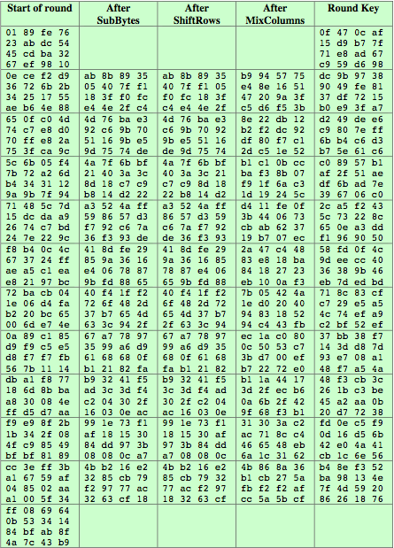
AES Example Encryption
Notes:
Next, Table 5.4 shows the progression of the state matrix through the AES encryption process. The first column shows the value of the state matrix at the start of a round. For the first row, the state matrix is just the matrix arrangement of the plaintext. The second, third, and fourth columns show the value of the state matrix for that round after the SubBytes, ShiftRows, and MixColumns transformations, respectively. The fifth column shows the round key. You can verify that these round keys equate with those shown in Table 5.3. The first column shows the value of the state matrix resulting from the bitwise XOR of the state after the preceding MixColumns with the round key for the preceding round.

Slide 20
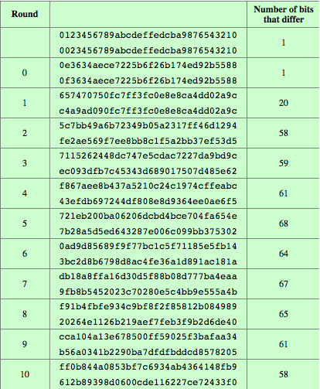
AES Example Avalanche (change 1-bit in plaintext)
Notes:
In any good cipher design, want the avalanche effect, in which a small change in plaintext or key produces a large change in the ciphertext. Using the example from Table 5.4, Table 5.5 shows the result when the eighth bit of the plaintext is changed. The second column of the table shows the value of the state matrix at the end of each round for the two plaintexts. Note that after just one round, 20 bits of the state vector differ. And after two rounds, close to half the bits differ. This magnitude of difference propagates through the remaining rounds. A bit difference in approximately half the positions in the most desirable outcome.

Slide 21
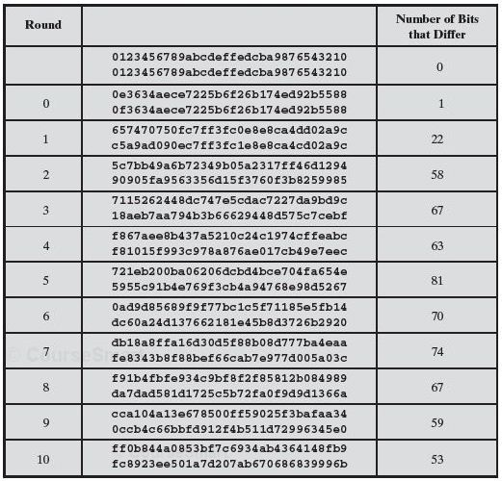
AES Example Avalanche (change 1-bit in key)
Notes:
Added by Chuan Yue at the Colorado School of Mines.

Slide 22
Decryption and Implementation Aspects
AES decryption is not identical to encryption as their sequence of transformations are different
may need two separate implementation modules
some cipher modes of operation and MAC only uses encryption
Can be efficiently implemented on 8-bit CPU
Substitute bytes only requires looking up a table of 256 bytes
Shift rows is simple byte shift
Mix columns is byte XOR’s or table lookups (thwart timing attacks)
Add round key works on byte XOR’s
can be efficiently implemented on 32-bit CPU
with operations defined on 32-bit words
designers believe this was a key factor in selecting AES cipher
Notes:
The AES decryption cipher is not identical to the encryption cipher (Stallings Figure 5.3). The sequence of transformations for decryption differs from that for encryption, although the form of the key schedules for encryption and decryption is the same. This has the disadvantage that two separate software or firmware modules are needed for applications that require both encryption and decryption.
The Rijndael proposal [DAEM99] provides some suggestions for efficient implementation on 8- bit processors, typical for current smart cards, and on 32-bit processors, typical for PCs.
AES can be implemented very efficiently on an 8-bit processor.
AddRoundKey is a bytewise XOR operation.
ShiftRows is a simple byte shifting operation.
SubBytes operates at the byte level and only requires a lookup of a 256 byte table S.
MixColumns (matrix multiply) can be implemented as byte XOR’s & table lookups with a 2nd 256 byte table X2, using the formulae shown in Stallings equation 5.9.
AES can also be very efficiently implemented on an 32-bit processor, by rewriting the stage transformation to use 4 table lookups & 4 XOR’s per column of state. These tables can be computed in advance using the formulae shown in the text, and need 4Kb to store.
The developers of Rijndael believe that this compact, efficient implementation was probably one of the most important factors in the selection of Rijndael for AES.

Slide 23
Summary
the AES selection process
the details of Rijndael – the AES cipher
the stages in each round
the key expansion
implementation aspects

