Slide 1
CSCI 474/574 Introduction to Cryptography/Theory of Cryptography Chapter 2 Classical Encryption Techniques
2.1 Terminology and Attacks to Cryptographic Systems
Notes:
Lecture slides by Lawrie Brown for “Cryptography and Network Security”, by William Stallings, Chapter 2 – “Classical Encryption Techniques”.
Enhanced and Modified by Chuan Yue at the Colorado School of Mines.

Slide 2
Symmetric Encryption
or conventional / secret-key / single-key
sender and recipient share a common key
all classical encryption algorithms are secret-key
was the only type prior to invention of public-key in 1970’s
and by far most widely used
Notes:
Symmetric encryption, also referred to as conventional encryption or single-key encryption, was the only type of encryption in use prior to the development of public-key encryption in the 1970s. It remains by far the most widely used of the two types of encryption. All traditional schemes are symmetric / single key / private-key encryption algorithms, with a single key, used for both encryption and decryption. Since both sender and receiver are equivalent, either can encrypt or decrypt messages using that common key.

Slide 3
Some Basic Terminology
plaintext - original message
ciphertext - coded message
cipher - algorithm for transforming plaintext to ciphertext
key - info used in cipher known only to sender/receiver
encipher (encrypt) - converting plaintext to ciphertext
decipher (decrypt) - recovering ciphertext from plaintext
cryptography - study of encryption principles/methods
cryptanalysis (codebreaking) - study of principles/ methods of deciphering ciphertext without knowing key
cryptology - field of both cryptography and cryptanalysis
Notes:
Briefly review some terminology used throughout the course.

Slide 4
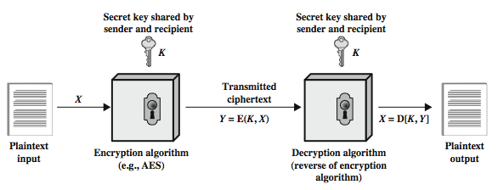
Symmetric Cipher Model
Notes:
Detail the five ingredients of the symmetric cipher model, shown in Stallings Figure 2.1:
plaintext - original message
encryption algorithm – performs substitutions/transformations on plaintext
secret key – control exact substitutions/transformations used in encryption algorithm
ciphertext - scrambled message
decryption algorithm – inverse of encryption algorithm

Slide 5
Requirements
two requirements for secure use of symmetric encryption:
a strong encryption algorithm
a secret key known only to sender / receiver
mathematically have:
Y = E(K, X)
X = D(K, Y)
assume en(de)cryption algorithm is known
implies a secure channel to distribute key
Notes:
There are two requirements for secure use of conventional encryption that mean we assume that it is impractical to decrypt a message on the basis of the cipher- text plus knowledge of the encryption/decryption algorithm, and hence do not need to keep the algorithm secret; rather we only need to keep the key secret. This feature of symmetric encryption is what makes it feasible for widespread use. It allows easy distribution of s/w and h/w implementations.
Can take a closer look at the essential elements of a symmetric encryption scheme: mathematically it can be considered a pair of functions with: plaintext X, ciphertext Y, key K, encryption algorithm E, decryption algorithm D. The intended receiver, in possession of the key, is able to invert the transformation. An opponent, observing Y but not having access to K or X, may attempt to recover X or K.

Slide 6
Cryptography
can characterize cryptographic systems by:
type of encryption operations used
substitution
transposition
Multiple stages of substitutions and transpositions
number of keys used
single-key or secret-key
two-key or public
way in which plaintext is processed
block
stream
Notes:
Cryptographic systems can be characterized along these three independent dimensions.
The type of operations used for transforming plaintext to ciphertext. All encryption algorithms are based on two general principles: substitution, in which each element in the plaintext (bit, letter, group of bits or letters) is mapped into another element, and transposition, in which elements in the plaintext are rearranged. The fundamental requirement is that no information be lost (that is, that all operations are reversible). Most systems, referred to as product systems, involve multiple stages of substitutions and transpositions.
The number of keys used. If both sender and receiver use the same key, the system is referred to as symmetric, single-key, secret-key, or conventional encryption. If the sender and receiver use different keys, the system is referred to as asymmetric, two-key, or public-key encryption.
The way in which the plaintext is processed. A block cipher processes the input one block of elements at a time, producing an output block for each input block. A stream cipher processes the input elements continuously, producing output one element at a time, as it goes along.

Slide 7
Attacks to Cryptographic Systems
objective to recover key not just message
two general approaches:
cryptanalytic attack
Characteristics of the algorithm
brute-force attack
Key space
if either succeed all key use compromised
Notes:
Typically objective is to recover the key in use rather then simply to recover the plaintext of a single ciphertext. There are two general approaches:
Cryptanalysis: relies on the nature of the algorithm plus perhaps some knowledge of the general characteristics of the plaintext or even some sample plaintext- ciphertext pairs. This type of attack exploits the characteristics of the algorithm to attempt to deduce a specific plaintext or to deduce the key being used.
Brute-force attacks try every possible key on a piece of ciphertext until an intelligible translation into plaintext is obtained. On average,half of all possible keys must be tried to achieve success.
If either type of attack succeeds in deducing the key, the effect is catastrophic: All future and past messages encrypted with that key are compromised.

Slide 8
Cryptanalytic Attacks
ciphertext only
only know algorithm & ciphertext
known plaintext (an encryption algorithm should withstand)
Know some plaintext/ciphertext pairs
e.g., Postscript format files, message headers
chosen plaintext
select plaintext and obtain ciphertext
chosen ciphertext
select ciphertext and obtain plaintext
chosen text
select plaintext or ciphertext to en/decrypt
Notes:
Stallings Table 2.1 summarizes the various types of cryptanalytic attacks, based on the amount of information known to the cryptanalyst, from least to most. The most difficult problem is presented when all that is available is the ciphertext only. In some cases, not even the encryption algorithm is known, but in general we can assume that the opponent does know the algorithm used for encryption. Then with increasing information have the other attacks. Generally, an encryption algorithm is designed to withstand a known-plaintext attack.

Slide 9
More Definitions
unconditional security
no matter how much computer power or time is available, the cipher cannot be broken since the ciphertext provides insufficient information to uniquely determine the corresponding plaintext
One-time pad (later)
computational security
given limited computing resources (e.g., time needed for calculations is greater than age of universe), the cipher cannot be broken
Notes:
Two more definitions are worthy of note. An encryption scheme is unconditionally secure if the ciphertext generated by the scheme does not contain enough information to determine uniquely the corresponding plaintext, no matter how much ciphertext is available. An encryption scheme is said to be computationally secure if either the cost of breaking the cipher exceeds the value of the encrypted information, or the time required to break the cipher exceeds the useful lifetime of the information. Unconditional security would be nice, but the only known such cipher is the one-time pad (later).
For all reasonable encryption algorithms, we have to assume computational security where it either takes too long, or is too expensive, to bother breaking the cipher.

Slide 10
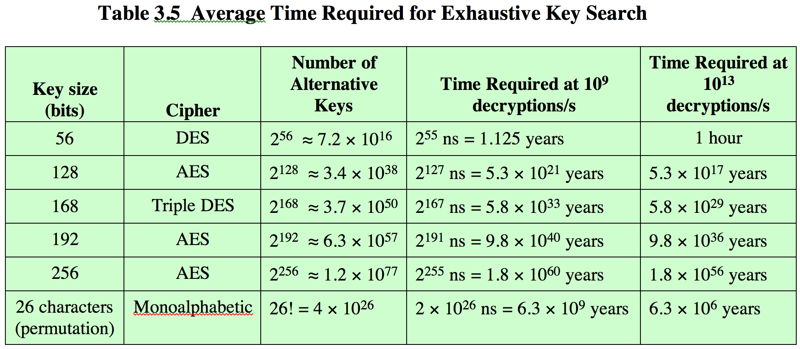
Brute Force Search
always possible to simply try every key
most basic attack, proportional to key size
on average, half of the key space must be tried
assume either know / recognize plaintext
Notes:
A brute-force attack involves trying every possible key until an intelligible translation of the ciphertext into plaintext is obtained. On average, half of all possible keys must be tried to achieve success. Stallings Table 2.2 shows how much time is required to conduct a brute-force attack, for various common key sizes (DES is 56, AES is 128, Triple-DES is 168, plus general mono-alphabetic cipher), where either a single system or a million parallel systems, are used. In terms of the number of decryptions in per microsecond.
Chuan: The Table 3.5 (chapter 3, page 78, and 6th edition) of this textbook shows that a rate of 1 billion (10^9 ) decryptions per second can be achieved by today’s multicore computers.

Slide 11
Summary
basic terminology
symmetric cipher model and requirements
three ways for characterizing cryptographic systems
two general approaches to attacking cryptographic systems
cryptanalytic attacks
the known plaintext capability (i.e., known plaintext attack)
brute-force attacks
key length/size: the length or size of a single key
key space size: the total or maximum number of unique keys or mappings

