Slide 1
CSCI 474/574 Introduction to Cryptography/Theory of Cryptography Chapter 2 Classical Encryption Techniques
2.3 More Substitution Ciphers, Transposition Ciphers, and Product Ciphers
Notes:
Lecture slides by Lawrie Brown for “Cryptography and Network Security”, by William Stallings, Chapter 2 – “Classical Encryption Techniques”.
Enhanced and Modified by Chuan Yue at the Colorado School of Mines.

Slide 2
Polyalphabetic Ciphers
polyalphabetic substitution ciphers
improve security using multiple monoalphabetic ciphers
make cryptanalysis harder with more alphabets to guess and flatter frequency distribution
use a key to select which alphabet is used for each letter of the message
use each alphabet in turn
repeat from start after end of key is reached
Notes:
One approach to reducing the "spikyness" of natural language text is used the Playfair cipher which encrypts more than one letter at once. We now consider the other alternative, using multiple cipher alphabets in turn. This gives the attacker more work, since many alphabets need to be guessed and because the frequency distribution is more complex, since the same plaintext letter could be replaced by several ciphertext letters, depending on which alphabet is used. The general name for this approach is a polyalphabetic substitution cipher. All these techniques have the following features in common:
A set of related monoalphabetic substitution rules is used.
A key determines which particular rule is chosen for a given transformation.

Slide 3
Vigenère Cipher
simplest polyalphabetic substitution cipher
effectively multiple Caesar ciphers
key is multiple letters long K = k₀ k₁ ... K_{m-1}
i^{th} letter specifies i^{th} alphabet to use
use each alphabet in turn, repeat after m letters
Encryption: C_{i} = (P_{i} + k_{i mod m}) mod 26
Decryption: P_{i} = (C_{i} - k_{i mod m}) mod 26
Notes:
The best known, and one of the simplest, such algorithms is referred to as the Vigenère cipher, where the set of related monoalphabetic substitution rules consists of the 26 Caesar ciphers, with shifts of 0 through 25. Each cipher is denoted by a key letter, which is the ciphertext letter that substitutes for the plaintext letter ‘a’, and which are each used in turn, as shown next.

Slide 4
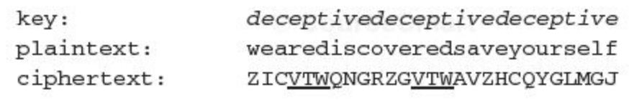
Example of Vigenère Cipher
write the plaintext out
write the keyword repeated above it
use each key letter as a Caesar cipher key
encrypt the corresponding plaintext letter
E.g., using keyword deceptive
Notes:
Discuss this simple example from text Stallings section 2.2.

Slide 5
Security of Vigenère Ciphers
have multiple ciphertext letters for each plaintext letter
letter frequencies are obscured but not totally lost
the Kasiski method for attacking Vigenère Ciphers
start with letter frequencies to see if it is monoalphabetic
if not, determine length of the keyword
key Insight: if two identical sequences of plaintext letters occur at a distance that is an integer multiple of the keyword length, they will generate identical ciphertext sequences.
repetitions in ciphertext give clues to period, e.g., repeated “VTW” in previous example suggests a keyword length of 3 or 9.
then attack each monoalphabetic cipher individually using same techniques as before
key length m →m monoalphabetic substitution ciphers
Notes:
The Vigenère & related polyalphabetic ciphers still do not completely obscure the underlying language characteristics. The strength of this cipher is that there are multiple ciphertext letters for each plaintext letter, one for each unique letter of the keyword. Thus, the letter frequency information is obscured. However, not all knowledge of the plaintext structure is lost. The key to breaking them is to identify the number of translation alphabets, and then attack each separately. If a monoalphabetic substitution is used, then the statistical properties of the ciphertext should be the same as that of the language of the plaintext. If, on the other hand, a Vigenère cipher is suspected, then progress depends on determining the length of the keyword.
For some centuries the Vigenère cipher was le chiffre indéchiffrable (the unbreakable cipher). As a result of a challenge, it was broken by Charles Babbage (the inventor of the computer) in 1854 but kept secret (possibly because of the Crimean War - not the first time governments have kept advances to themselves!). The method was independently reinvented by a Prussian, Friedrich Kasiski, who published the attack now named after him in 1863. However lack of major advances meant that various polyalphabetic substitution ciphers were used into the 20C. One very famous incident was the breaking of the Zimmermann telegram in WW1 which resulted in the USA entering the war. The important is that if two identical sequences of plaintext letters occur at a distance that is an integer multiple of the keyword length, they will generate identical ciphertext sequences.
In general the approach is to find a number of duplicated sequences, collect all their distances apart, look for common factors, remembering that some will be random flukes and need to be discarded. Now have a series of monoalphabetic ciphers, each with original language letter frequency characteristics. Can attack these in turn to break the cipher.

Slide 6
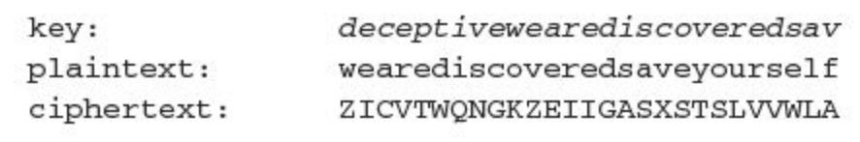
Autokey Cipher
ideally want a key as long as the message
Vigenère proposed the autokey cipher with keyword prefixed to message as a running key. E.g., key deceptive
knowing keyword can recover the first few letters
use these in turn on the rest of the message
but still have frequency characteristics to attack
Key & plaintext share the same frequency distribution of letters
E.g., e encrypted by e with a (0.127) ²
Notes:
Taking the polyalphabetic idea to the extreme, want as many different translation alphabets as letters in the message being sent. One way of doing this with a smallish key, is to use the Autokey cipher.
The example uses the keyword "DECEPTIVE" prefixed to as much of the message "WEAREDISCOVEREDSAV" as is needed. When deciphering, recover the first 9 letters using the keyword "DECEPTIVE". Then instead of repeating the keyword, start using the recovered letters from the message "WEAREDISC". As recover more letters, have more of key to recover later letters.
Problem is that the same language characteristics are used by the key as the message. ie. a key of 'E' will be used more often than a 'T' etc hence an 'E' encrypted with a key of 'E' occurs with probability (0.1275)2 = 0.01663, about twice as often as a 'T' encrypted with a key of 'T' have to use a larger frequency table, but it exists given sufficient ciphertext this can be broken.

Slide 7
Vernam Cipher
ultimate defense is to use a key as long as the plaintext with no statistical relationship to it
invented by AT&T engineer Gilbert Vernam in 1918
originally proposed using a very long but eventually repeating key
Encrypt binary data rather than letters
Exclusive-or(XOR) operation
c_{i}=p_{i} k_{i}; p_{i}=c_{i} k_{i}
Can still be broken: sufficient ciphertext, known plaintext
Notes:
The ultimate defense against such a cryptanalysis is to choose a keyword that is as long as the plaintext and has no statistical relationship to it. Such a system was introduced by an AT&T engineer named Gilbert Vernam in 1918. His system works on binary data (bits0 rather than letters. The system can be expressed succinctly as follows: c_{i} = p_{i} XOR k_{i}
The essence of this technique is the means of construction of the key. Vernam proposed the use of a running loop of tape that eventually repeated the key, so that in fact the system worked with a very long but repeating keyword. Although such a scheme, with a long key, presents formidable cryptanalytic difficulties, it can be broken with sufficient ciphertext, the use of known or probable plaintext sequences, or both.

Slide 8
One-Time Pad
if a truly random key as long as the message is used, the cipher will be secure
called a One-Time pad
is unbreakable since ciphertext bears no statistical relationship to the plaintext
since for any plaintext & any ciphertext there exists a key mapping one to the other
can only use the key once though
Notes:
The One-Time Pad is an evolution of the Vernham cipher. An Army Signal Corp officer, Joseph Mauborgne, proposed an improvement using a random key that was truly as long as the message, with no repetitions, which thus totally obscures the original message. It produces random output that bears no statistical relationship to the plaintext. Because the ciphertext contains no information whatsoever about the plaintext, there is simply no way to break the code, since any plaintext can be mapped to any ciphertext given some key.
The one-time pad offers complete security but, in practice, has two fundamental difficulties:
There is the practical problem of making large quantities of random keys.
And the problem of key distribution and protection, where for every message to be sent, a key of equal length is needed by both sender and receiver.
Because of these difficulties, the one-time pad is of limited utility, and is useful primarily for low-bandwidth channels requiring very high security. The one-time pad is the only cryptosystem that exhibits what is referred to as perfect secrecy.

Slide 9
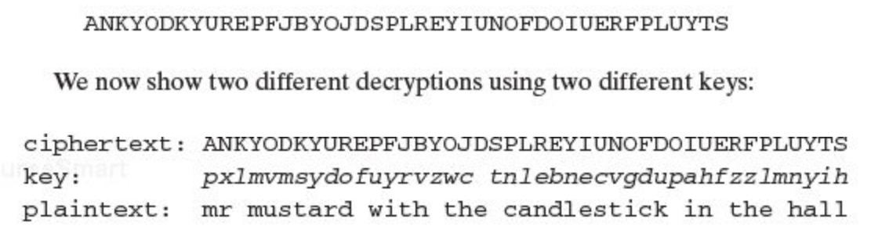
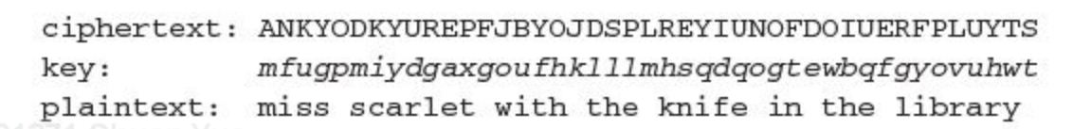
Break One-Time Pad?
E.g., a one-time pad Vigenère cipher with the space character as the 27th character (there is one error in the example)
Exhaustive search will generate multiple legible results. Hard to know which is the intended plaintext.
Notes:
Added by Chuan Yue at the Colorado School of Mines.

Slide 10
One-Time Pad Analysis
In theory, we need look no further for a cipher. The one-time pad offers unconditional security but, in practice, has two fundamental difficulties:
There is the practical problem of making large quantities of random keys.
Even more daunting is the problem of key distribution and protection.
The one-time pad is of limited utility, and is useful primarily for low-bandwidth channels requiring very high security
Notes:
In theory, we need look no further for a cipher. The one-time pad offers complete security but, in practice, has two fundamental difficulties:
There is the practical problem of making large quantities of random keys. Any heavily used system might require millions of random characters on a regular basis. Supplying truly random characters in this volume is a significant task.
Even more daunting is the problem of key distribution and protection. For every message to be sent, a key of equal length is needed by both sender and receiver. Thus, a mammoth key distribution problem exists.
The one-time pad is of limited utility, and is useful primarily for low-bandwidth channels requiring very high security

Slide 11
Transposition Ciphers
now consider classical transposition or permutation ciphers
these hide the message by rearranging the letter order
without altering the actual letters used
can recognise these since have the same frequency distribution as the original text
Notes:
All the techniques examined so far involve the substitution of a ciphertext symbol for a plaintext symbol. A very different kind of mapping is achieved by performing some sort of permutation on the plaintext letters. This technique is referred to as a transposition cipher, and form the second basic building block of ciphers. The core idea is to rearrange the order of basic units (letters/bytes/bits) without altering their actual values.

Slide 12
Rail Fence cipher
write message letters out diagonally over a number of rows
then read off cipher row by row
E.g., write message out as:
m e m a t r h t g p r y
e t e f e t e o a a t
giving ciphertext
MEMATRHTGPRYETEFETEOAAT
Notes:
The simplest such cipher is the rail fence technique, in which the plaintext is written down as a sequence of diagonals and then read off as a sequence of rows.
The example message is: "meet me after the toga party" with a rail fence of depth 2.
This sort of thing would be trivial to cryptanalyze.

Slide 13
Row Transposition Ciphers
is a more complex transposition
write the message in a rectangle, row by row, and read the message off shuffling the order of the columns in each row.
the order of the columns is the key
Key: 4 3 1 2 5 6 7
Plaintext: a t t a c k p
o s t p o n e
d u n t i l t
w o a m x y z
Ciphertext: TTNAAPTMTSUOAODWCOIXKNLYPETZ
Notes:
A more complex transposition cipher is to write the message in a rectangle, row by row, and read the message off shuffling the order of the columns in each row. The order of the columns then becomes the key to the algorithm. In the example shown, the key is 4312567, that is use column 4 first, then column3, then 1 etc (as shown in the Column Out row).
A pure transposition cipher is easily recognized because it has the same letter frequencies as the original plaintext. For the type of columnar transposition just shown, cryptanalysis is fairly straightforward and involves laying out the ciphertext in a matrix and playing around with column positions. Digram and trigram frequency tables can be useful.

Slide 14
Security of Transposition Ciphers
A pure transposition cipher is easily recognized
Letter frequencies do not change
Digram and trigram frequency tables can be useful
Can be made significantly more secure by performing multiple stages of transposition.
Key: 4 3 1 2 5 6 7
Plaintext: t t n a a p t
m t s u o a o
d w c o i x k
n l y p e t z
Ciphertext: NSCYAUOPTTWLTMDNAOIEPAXTTOKZ
Brute force becomes difficult, cryptanalytic attacks are still feasible
Notes:
A more complex transposition cipher is to write the message in a rectangle, row by row, and read the message off shuffling the order of the columns in each row. The order of the columns then becomes the key to the algorithm. In the example shown, the key is 4312567, that is use column 4 first, then column3, then 1 etc (as shown in the Column Out row).
A pure transposition cipher is easily recognized because it has the same letter frequencies as the original plaintext. For the type of columnar transposition just shown, cryptanalysis is fairly straightforward and involves laying out the ciphertext in a matrix and playing around with column positions. Digram and trigram frequency tables can be useful.

Slide 15
Product Ciphers
ciphers using single substitution or transposition are not secure because of language characteristics
hence consider using several ciphers in succession to make harder, but:
two substitutions make a more complex substitution
two transpositions make a more complex transposition
but a substitution followed by a transposition makes a new much harder cipher
this is the bridge from classical to modern ciphers
Notes:
Have seen that ciphers based on just substitutions or transpositions are not secure, and can be attacked because they do not sufficient obscure the underlying language structure
So consider using several ciphers in succession to make harder.
A substitution followed by a transposition is known as a Product Cipher, and makes a new much more secure cipher, and forms the bridge to modern ciphers.

Slide 16
Rotor Machines
before modern ciphers, rotor machines were most common complex ciphers in use
widely used in WW2
German Enigma, Allied Hagelin, Japanese Purple
implemented a very complex, varying substitution cipher
used a series of cylinders, each giving one substitution, which rotated and changed after each letter was encrypted
with 3 cylinders have 26³=17576 alphabets before the system repeats (3 monoalphabetic substitution)
Notes:
The next major advance in ciphers required use of mechanical cipher machines which enabled to use of complex varying substitutions.
A rotor machine consists of a set of independently rotating cylinders through which electrical pulses can flow. Each cylinder has 26 input pins and 26 output pins, with internal wiring that connects each input pin to a unique output pin. If we associate each input and output pin with a letter of the alphabet, then a single cylinder defines a monoalphabetic substitution. After each input key is depressed, the cylinder rotates one position, so that the internal connections are shifted accordingly. The power of the rotor machine is in the use of multiple cylinders, in which the output pins of one cylinder are connected to the input pins of the next, and with the cylinders rotating like an “odometer”, leading to a very large number of substitution alphabets being used, eg with 3 cylinders have 26³=17576 alphabets used.
They were extensively used in world war 2, and the history of their use and analysis is one of the great stories from WW2.

Slide 17
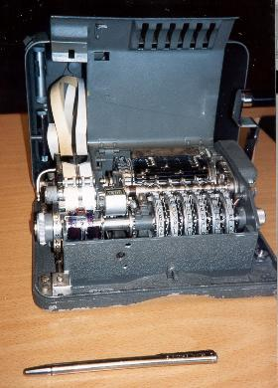
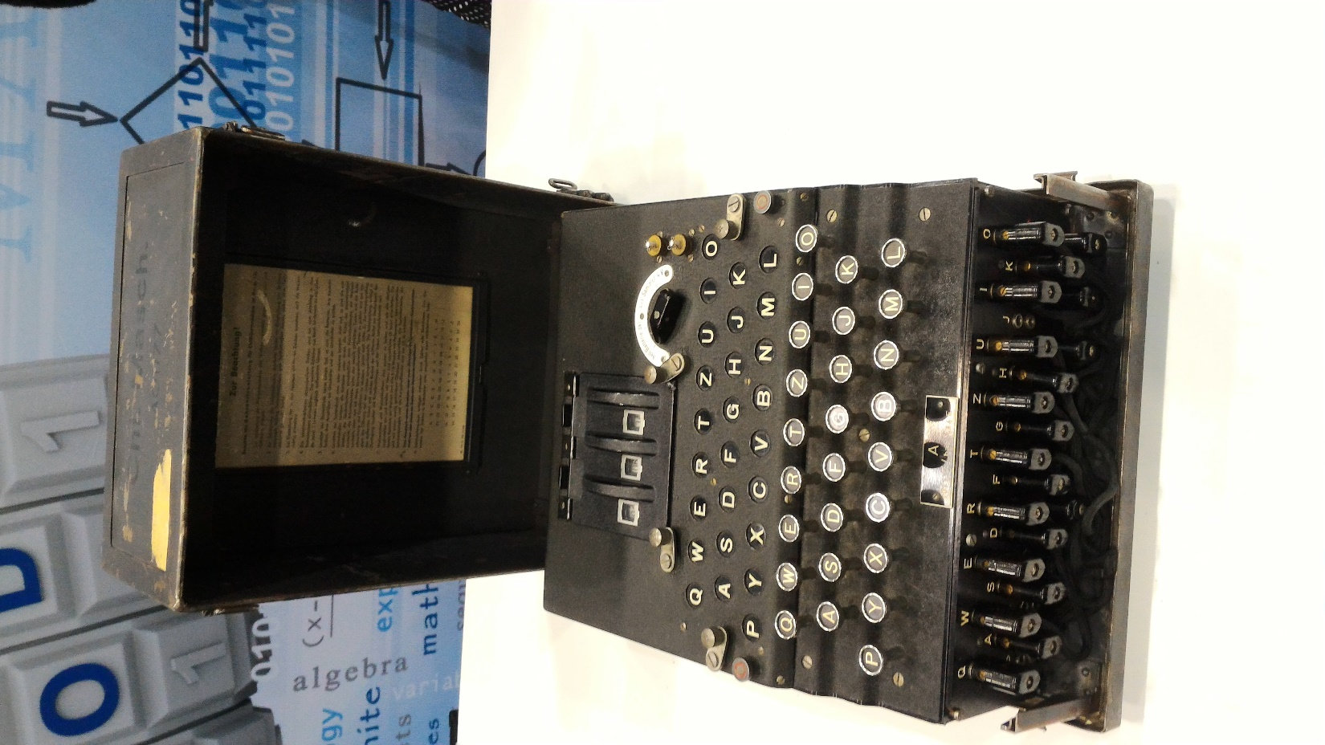
Hagelin Rotor Machine
Enigma Machine
Notes:
This photo of an Allied Hagelin machine was taken by Lawrie Brown at Eurocrypt'93 in Norway. Note pen for scale, and the rotating cipher wheels near the front.
This phone of an Enigma machine was take by Chuan Yue at the National Cyber Security Summit in 2016.

Slide 18
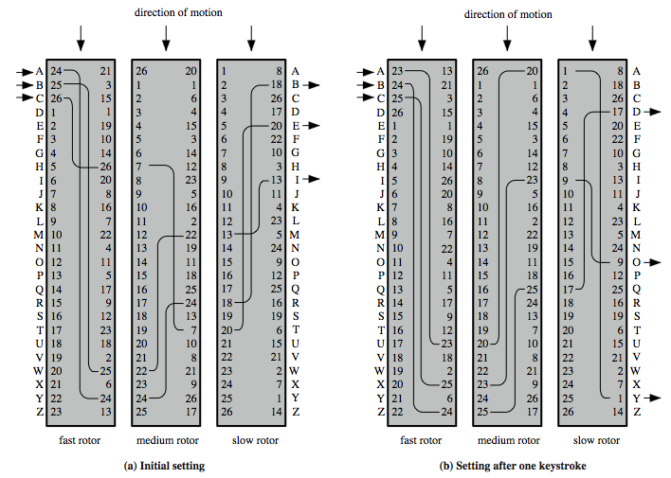
Rotor Machine Principles
Notes:
The basic principle of the rotor machine is illustrated in Figure 2.8. The machine consists of a set of independently rotating cylinders through which electrical pulses can flow. Each cylinder has 26 input pins and 26 output pins, with internal wiring that connects each input pin to a unique output pin. If we associate each input and output pin with a letter of the alphabet, then a single cylinder defines a monoalphabetic substitution. If an operator depresses the key for the letter A, an electric signal is applied to the first pin of the first cylinder and flows through the internal connection to the twenty-fifth output pin. Consider a machine with a single cylinder. After each input key is depressed, the cylinder rotates one position, so that the internal connections are shifted accordingly. Thus, a different monoalphabetic substitution cipher is defined. After 26 letters of plaintext, the cylinder would be back to the initial position. Thus, we have a polyalphabetic substitution algorithm with a period of 26.
A single-cylinder system is trivial and does not present a formidable cryptanalytic task. The power of the rotor machine is in the use of multiple cylinders, in which the output pins of one cylinder are connected to the input pins of the next. Figure 2.8 shows a three-cylinder system. With multiple cylinders, the one closest to the operator input rotates one pin position with each keystroke. The right half of Figure 2.8 shows the system's configuration after a single keystroke. For every complete rotation of the inner cylinder, the middle cylinder rotates one pin position. Finally, for every complete rotation of the middle cylinder, the outer cylinder rotates one pin position. The result is that there are 26 x 26 x 26 = 17,576 different substitution alphabets used before the system repeats.
Chuan: In order to be as easy to decipher as encipher, some rotor machines, most notably the Enigma machine, were designed to be symmetrical, i.e., encrypting twice with the same settings recovers the original message.
Early decryption method: most of the setup of the machine was determined by looking up the settings for the day in a code book.

Slide 19
Steganography
hides existence of message
using only a subset of letters/words in a longer message marked in some way
using invisible ink
hiding in LSB in graphic image or sound file
has drawbacks
high overhead to hide relatively few info bits
advantage is can obscure encryption use
Notes:
Steganography is an alternative to encryption which hides the very existence of a message by some means. There are a large range of techniques for doing this.
Steganography has a number of drawbacks when compared to encryption. It requires a lot of overhead to hide a relatively few bits of information.
Also, once the system is discovered, it becomes virtually worthless, although a message can be first encrypted and then hidden using steganography. The advantage of steganography is that it can be employed by parties who have something to lose should the fact of their secret communication (not necessarily the content) be discovered.
The advantage of steganography, over cryptography alone, is that messages do not attract attention to themselves. Plainly visible encrypted messages—no matter how unbreakable—will arouse suspicion, and may in themselves be incriminating in countries where encryption is illegal.^{[1]} Therefore, whereas cryptography protects the contents of a message, steganography can be said to protect both messages and communicating parties.
Chuan: e.g., RGB color mode, 8bits per channel

Slide 20
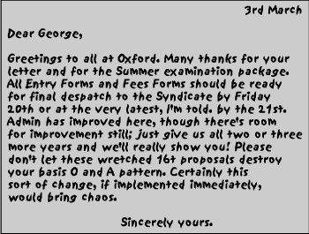
Steganography Example (A Puzzle for Inspector Morse)

Slide 21
Summary
polyalphabetic ciphers
Vigenère cipher
Autokey cipher
Vernam cipher
one-time pad
transposition ciphers
Rail Fence
Row Transposition
product ciphers and rotor machines
steganography

