Slide 1
CSCI 474/574 Introduction to Cryptography/Theory of Cryptography Chapter 4 Basic Concepts in Number Theory and Finite Fields
4.1 Modular Arithmetic and Extended Euclidean Algorithm
Notes:
Lecture slides by Lawrie Brown for “Cryptography and Network Security”, by William Stallings, Chapter Chapter 4 – “Basic Concepts in Number Theory and Finite Fields”.
Enhanced and Modified by Chuan Yue at the Colorado School of Mines.

Slide 2
Introduction
will mainly introduce finite fields
of increasing importance in cryptography
AES, Elliptic Curve, CMAC
concern operations on “numbers”
where what constitutes a “number” and the type of operations varies considerably
start with basic number theory concepts
divisibility, Euclidian algorithm, modular arithmetic
Notes:
Enhanced and Modified by Chuan Yue at the Colorado School of Mines.
Finite fields have become increasingly important in cryptography. A number of cryptographic algorithms rely heavily on properties of finite fields, notably the Advanced Encryption Standard (AES) and elliptic curve cryptography. The main purpose of this chapter is to provide the reader with sufficient background on the concepts of finite fields to be able to understand the design of AES and other cryptographic algorithms that use finite fields. We begin, in the first three sections, with some basic concepts from number theory that are needed in the remainder of the chapter; these include divisibility, the Euclidian algorithm, and modular arithmetic.
Chuan: AES (Chap. 5), Elliptic Curve (Chap. 10), CMAC(Chap. 12, Cipher-based Message Authentication Code)

Slide 3
Divisors
say a non-zero number b divides a if for some m have a=mb (a,b,m all integers)
that is b divides into a with no remainder
denote this b|a
and say that b is a divisor of a
eg. all of 1,2,3,4,6,8,12,24 divide 24
eg. 13 | 182; –5 | 30; 17 | 289; –3 | 33; 17 | 0
Notes:
Define concept of “divisors”. We say that a nonzero b divides a if a=m.b for some m, where a, b, and m are integers. That is, b divides a if there is no remainder on division. Can denote this as b|a, and say that b is a divisor of a. For example, the positive divisors of 24 are 1,2,3,4,6,8,12, and 24. And have 13 | 182; –5 | 30; 17 | 289; –3 | 33; 17 | 0.

Slide 4
Properties of Divisibility
If a|1, then a = ±1.
If a|b and b|a, then a = ±b.
Any b != 0 divides 0.
If a | b and b | c, then a | c (transitive property)
e.g. 11 | 66 and 66 | 198 → 11 | 198
If b|g and b|h, then b|(mg + nh)
for arbitrary integers m and n
e.g. b = 7; g = 14; h = 63; m = 3; n = 2
hence 7|14 and 7|63 → 7|(3 x 14 + 2 x 63)
Notes:
Enhanced and Modified by Chuan Yue at the Colorado School of Mines.
Subsequently, we will need some simple properties of divisibility for integers, which are as follows:
• If a|1, then a = ±1.
• If a|b and b|a, then a = ±b.
• Any b ! 0 divides 0.
• If a | b and b | c, then a | c
• If b|g and b|h, then b|(mg + nh) for arbitrary integers m and n. e.g. b = 7; g = 14; h = 63; m = 3; n = 2. 7|14 and 7|63. To show: 7|(3 x 14 + 2 x 63) We have (3 x 14 + 2 x 63) = 7(3 x 2 + 2 x 9) And it is obvious that 7|(7(3 x 2 + 2 x 9))
Chuan:
(1) prove if a | b and b | c, then a | c
(2) prove If b|g and b|h, then b|(mg + nh) for arbitrary integers m and n; write it on the board

Slide 5
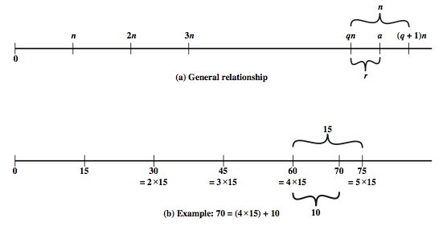
Integer Division Algorithm
divide nonnegative integer a (dividend) by positive integer n (divisor) get integer q (quotient) and integer r (remainder) such that:
a = qn + r where 0 <= r < n; q = floor(a/n)
r is “a mod n”,also referred to as a residue
q and r are unique
Notes:
Given any positive integer n and any nonnegative integer a, if we divide a by n, we get an integer quotient q and an integer remainder r that obey the following relationship: a = qn + r, where 0 <= r < n; q = floor(a/n) which is referred to as the division algorithm. The remainder r is often referred to as a residue.
Figure 4.1a demonstrates that, given a and positive n, it is always possible to find q and r that satisfy the preceding relationship. Represent the integers on the number line; a will fall somewhere on that line (positive a is shown, a similar demonstration can be made for negative a). Starting at 0, proceed to n, 2n, up to qn such that qn <= a and (q + 1)n > a. The distance from qn to a is r, and we have found the unique values of q and r.
For example:
a = 11; n = 7; 11 = 1 x 7 + 4; r = 4 q = 1
a = –11; n = 7; –11 = (–2) x 7 + 3; r = 3 q = –2
Figure 4.1b provides another example.
Chuan: It is a theorem. The proof consists of two parts — first, the proof of the existence of q and r, and second, the proof of the uniqueness of q and r. See: https://en.wikipedia.org/wiki/Euclidean_division

Slide 6
Greatest Common Divisor (GCD)
a common problem in number theory
gcd (a,b) of a and b is the largest integer that divides both a and b
E.g., gcd(60,24) = 12
define gcd(0, 0) = 0, gcd(a,0) = |a| for a !=0
often want no common factors (except 1), define such numbers as relatively prime
E.g. gcd(8,15) = 1
hence 8 & 15 are relatively prime
Notes:
One of the basic techniques of number theory is the Euclidean algorithm, which is a simple procedure for determining the greatest common divisor of two positive integers. Use the notation gcd(a,b) to mean the greatest common divisor of a and b. The positive integer c is said to be the greatest common divisor of a and b if c is a divisor of a and of b; and any divisor of a and b is a divisor of c. We also define gcd(0, 0) = 0.
State that two integers a and b are relatively prime if their only common positive integer factor is 1, ie GCD(a,b)=1.

Slide 7
Euclidean Algorithm
A simple procedure for finding d = gcd (a, b)
gcd(|a|, |b|) = gcd (a, b) = gcd (b, a)
no harm to assume a >= b > 0
Euclid(a,b)
if (b=0) then return a;
else return Euclid(b, a mod b);
E.g., gcd(60,24) = 12; gcd(8,15) = 1
Notes:
We now describe an algorithm credited to Euclid for easily finding the greatest common divisor of two integers. This algorithm has significance subsequently in this chapter. The Euclidean algorithm is an efficient way to find the GCD(a,b), and is derived from the observation that if a & b have a common factor d (ie. a=m.d & b=n.d) then d is also a factor in any difference between them, vis: a-p.b = (m.d)-p.(n.d) = d.(m-p.n). See text for more detailed proof. Euclid's Algorithm keeps computing successive differences until it vanishes, at which point the greatest common divisor has been reached. Some pseudo-code from the text for this algorithm is shown.

Slide 8
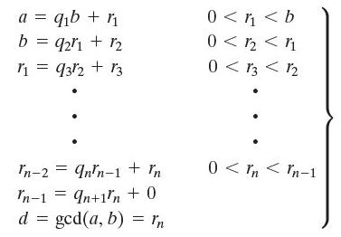
Euclidean Algorithm Proof
Calculate d= gcd (a, b)
If r₁==0, then d=b;
else prove d=gcd(b, r₁);
d|a, d|b; d|(a-q₁b) → d|r₁
thus, d <= gcd(b, r₁)
Any arbitrary c that c|b and c|r_{1 ,} (i.e., c <=gcd(b, r₁))
thus, c | (q₁b + r₁) → c | a,
thus, c <= gcd(a, b) = d
Take c = gcd(b, r₁), we have:
gcd(b, r₁) <= d <= gcd(b, r₁)
thus, d=gcd(b, r₁);
Notes:
Added by Chuan Yue at the Colorado School of Mines.
Chuan: last step, c is arbitrary divisor of b and r1, thus, we take c=gcd(b, r1), thus gcd(b, r1) <= d.

Slide 9
Example GCD(1970,1066)
1970 = 1 x 1066 + 904 gcd(1066, 904)
1066 = 1 x 904 + 162 gcd(904, 162)
904 = 5 x 162 + 94 gcd(162, 94)
162 = 1 x 94 + 68 gcd(94, 68)
94 = 1 x 68 + 26 gcd(68, 26)
68 = 2 x 26 + 16 gcd(26, 16)
26 = 1 x 16 + 10 gcd(16, 10)
16 = 1 x 10 + 6 gcd(10, 6)
10 = 1 x 6 + 4 gcd(6, 4)
6 = 1 x 4 + 2 gcd(4, 2)
4 = 2 x 2 + 0 gcd(2, 0)
Notes:
Illustrate how we can compute successive instances of GCD(a,b) = GCD(b,a mod b).
Note this MUST always terminate since will eventually get a mod b = 0 (ie no remainder left).
Answer is then the last non-zero value. In this case GCD(1970,1066)=2.

Slide 10
GCD(1160718174, 316258250)
Dividend Divisor Quotient Remainder
a = 1160718174 b = 316258250 q1 = 3 r1 = 211943424
b = 316258250 r1 = 211943424 q2 = 1 r2 = 104314826
r1 = 211943424 r2 = 104314826 q3 = 2 r3 = 3313772
r2 = 104314826 r3 = 3313772 q4 = 31 r4 = 1587894
r3 = 3313772 r4 = 1587894 q5 = 2 r5 = 137984
r4 = 1587894 r5 = 137984 q6 = 11 r6 = 70070
r5 = 137984 r6 = 70070 q7 = 1 r7 = 67914
r6 = 70070 r7 = 67914 q8 = 1 r8 = 2516
r7 = 67914 r8 = 2516 q9 = 31 r9 = 1078
r8 = 2516 r9 = 1078 q10 = 2 r10 = 0
There are other GCD algorithms, but Euclidean Algorithm is very efficient!
Notes:
This example shows hpw to find d = gcd(a, b) = gcd(1160718174, 316258250), shown in tabular form. In this example, we begin by dividing 1160718174 by 316258250, which gives 3 with a remainder of 211943424. Next we take 316258250 and divide it by 211943424. The process continues until we get a remainder of 0, yielding a result of 1078

Slide 11
Modular Arithmetic
define modulo operator “a mod n” to be remainder when a is divided by n
where positive integer n is called the modulus
a = qn + r 0<=r<n; q=floor(a/n)
a = floor(a/n) * n + (a mod n)
e.g, 11 mod 7 = 4; -11 mod 7 = 3
a and b are congruent modulo n if:
a mod n = b mod n
when divided by n, a & b have same remainder
a ≡ b (mod n), eg. 100 ≡ 34 mod 11
Notes:
Given any positive integer n and any nonnegative integer a, if we divide a by n, we get an integer quotient q and an integer remainder r. In modular arithmetic we are only interested in the remainder (or residue) after division by some modulus, and results with the same remainder are regarded as equivalent. Two integers a and b are said to be congruent modulo n, if (a mod n) =(b mod n).

Slide 12
Modular Arithmetic Operations
(mod n) operator maps all integers into the set
Z_{n} = {0, 1, . . . , (n – 1)}
can perform arithmetic operations within the confines of this set → modular arithmetic
Rules for addition, subtraction, and multiplication carry over into modular arithmetic
Notes:
Note that the (mod n) operator maps all integers into the set of integers {0, 1, . . . (n – 1)}, denoted Z_{n}. This is referred to as the set of residues, or residue classes (mod n). We can perform arithmetic operations within the confines of this set, and this technique is known as modular arithmetic. Finding the smallest nonnegative integer to which k is congruent modulo n is called reducing k modulo n. Then note some important properties of modular arithmetic which mean you can modulo reduce at any point and obtain an equivalent answer.

Slide 13
Properties of Modular Arithmetic Operations
[(a mod n) + (b mod n)] mod n = (a + b) mod n
[(a mod n) – (b mod n)] mod n = (a – b) mod n
[(a mod n) x (b mod n)] mod n = (a x b) mod n
e.g.
[(11 mod 8) + (15 mod 8)] mod 8 = 10 mod 8 = 2 (11 + 15) mod 8 = 26 mod 8 = 2
[(11 mod 8) – (15 mod 8)] mod 8 = –4 mod 8 = 4 (11 – 15) mod 8 = –4 mod 8 = 4
[(11 mod 8) x (15 mod 8)] mod 8 = 21 mod 8 = 5 (11 x 15) mod 8 = 165 mod 8 = 5
Notes:
Modular arithmetic exhibits the properties shown, see text for details & proofs.
Here are examples of the three properties:
Given 11 mod 8 = 3; 15 mod 8 = 7
[(11 mod 8) + (15 mod 8)] mod 8 = 10 mod 8 = 2 (11 + 15) mod 8 = 26 mod 8 = 2
[(11 mod 8) – (15 mod 8)] mod 8 = –4 mod 8 = 4 (11 – 15) mod 8 = –4 mod 8 = 4
[(11 mod 8) x (15 mod 8)] mod 8 = 21 mod 8 = 5 (11 x 15) mod 8 = 165 mod 8 = 5
Chuan:
mention these properties especially the third one will be used frequently in Chap. 8.
write them on board.

Slide 14
Modulo 8 Addition in Z₈
+ | 0 | 1 | 2 | 3 | 4 | 5 | 6 | 7
0 | 0 | 1 | 2 | 3 | 4 | 5 | 6 | 7
1 | 1 | 2 | 3 | 4 | 5 | 6 | 7 | 0
2 | 2 | 3 | 4 | 5 | 6 | 7 | 0 | 1
3 | 3 | 4 | 5 | 6 | 7 | 0 | 1 | 2
4 | 4 | 5 | 6 | 7 | 0 | 1 | 2 | 3
5 | 5 | 6 | 7 | 0 | 1 | 2 | 3 | 4
6 | 6 | 7 | 0 | 1 | 2 | 3 | 4 | 5
7 | 7 | 0 | 1 | 2 | 3 | 4 | 5 | 6
The matrix is symmetric about the main diagonal
Identity element I for addition: (I+x) mod 8 = x
Additive inverse exists to each integer in modular addition:
(x+y) mod 8 = 0
Notes:
Example showing addition in Z₈, from Stallings Table 4.2a. Table 4.2 provides an illustration of modular addition and multiplication modulo 8. Looking at addition, the results are straightforward and there is a regular pattern to the matrix. Both matrices are symmetric about the main diagonal, in conformance to the commutative property of addition and multiplication. As in ordinary addition, there is an additive inverse, or negative, to each integer in modular arithmetic. In this case, the negative of an integer x is the integer y such that (x + y) mod 8 = 0. To find the additive inverse of an integer in the left-hand column, scan across the corresponding row of the matrix to find the value 0; the integer at the top of that column is the additive inverse; thus (2 + 6) mod 8 = 0.

Slide 15
Modulo 8 Multiplication in Z₈
x | 0 | 1 | 2 | 3 | 4 | 5 | 6 | 7
0 | 0 | 0 | 0 | 0 | 0 | 0 | 0 | 0
1 | 0 | 1 | 2 | 3 | 4 | 5 | 6 | 7
2 | 0 | 2 | 4 | 6 | 0 | 2 | 4 | 6
3 | 0 | 3 | 6 | 1 | 4 | 7 | 2 | 5
4 | 0 | 4 | 0 | 4 | 0 | 4 | 0 | 4
5 | 0 | 5 | 2 | 7 | 4 | 1 | 6 | 3
6 | 0 | 6 | 4 | 2 | 0 | 6 | 4 | 2
7 | 0 | 7 | 6 | 5 | 4 | 3 | 2 | 1
The matrix is symmetric about the main diagonal
Identity element I for multiplication: (I * x) mod 8 = x
Multiplicative inverse exists to some integers in mod 8 multiplication:
(x * y) mod 8 = 1
Notes:
Continuing the example showing multiplication in Z₈, from Stallings Table 4.2b. Both matrices are symmetric about the main diagonal, in conformance to the commutative property of addition and multiplication. Similarly, the entries in the multiplication table are straightforward. In ordinary arithmetic, there is a multiplicative inverse, or reciprocal, to each integer. In modular arithmetic mod 8, the multiplicative inverse of x is the integer y such that (x x y) mod 8 = 1 mod 8. Now, to find the multiplicative inverse of an integer from the multiplication table, scan across the matrix in the row for that integer to find the value 1; the integer at the top of that column is the multiplicative inverse; thus (3 x 3) mod 8 = 1. Note that not all integers mod 8 have a multiplicative inverse; more about that later.

Slide 16
Residue Classes (mod n)
(mod n) operator maps all integers into the set
Z_{n} = {0, 1, . . . , (n – 1)} → set of residues, or residue classes
Each integer in Z_{n} represents a residue class
[r] = {a: a is an integer, a ≡ r (mod n) }
e.g., the residue classes (mod 4) are:
[0] = {..., - 16, - 12, - 8, - 4, 0, 4, 8, 12, 16, ...}
[1] = {..., - 15, - 11, - 7, - 3, 1, 5, 9, 13, 17, ...}
[2] = {..., - 14, - 10, - 6, - 2, 2, 6, 10, 14, 18, ... }
[3] = {..., - 13, - 9, - 5, - 1, 3, 7, 11, 15, 19, ... }
Finding the smallest nonnegative integer to which k is congruent modulo n is called reducing k modulo n
Notes:
Of all the integers in a residue class, the smallest nonnegative integer is the one used to represent the residue class.

Slide 17
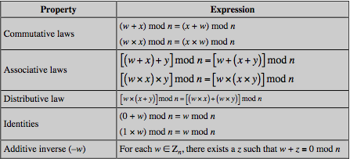
Properties of Modular Arithmetic for Integers in Z_{n}
Notes:
If we perform modular arithmetic within Z_{n}, the properties shown in Table 4.3 hold for integers in Z_{n} We show in the next section that this implies that Z_{n} is a commutative ring with a multiplicative identity element. Note that unlike ordinary arithmetic, the following statement is true only with the attached condition:
if (a x b) = (a x c) (mod n) then b = c (mod n) if a is relatively prime to n
In general, an integer has a multiplicative inverse in Z_{n} if that integer is relatively prime to n. Table 4.2 cin the text shows that the integers 1, 3, 5, and 7 have a multiplicative inverse in Z 8, but 2, 4, and 6 do not.

Slide 18
Modular Arithmetic Special Properties
if ( a + b) ≡ ( a + c) ( mod n) then b ≡ c ( mod n)
e.g., ( 5 + 23) ≡ ( 5 + 7) ( mod 8) → 23 ≡ 7( mod 8)
due to the existence of additive inverse
add additive inverse –a to both sides to prove
if (a * b) ≡ (a * c) (mod n) then b ≡ c (mod n) if a is relatively prime to n
e.g., ( 5 * 23) ≡ ( 5 * 7) ( mod 8) → 23 ≡ 7( mod 8)
if multiplicative inverse exists for a mod n
if an integer is relatively prime to n, then this integer has a multiplicative inverse in Z_{n}
Notes:
Of all the integers in a residue class, the smallest nonnegative integer is the one used to represent the residue class.
Chuan: show the proof of if ( a + b) ≡ ( a + c) ( mod n) then b ≡ c ( mod n)

Slide 19
Extended Euclidean Algorithm
calculates not only GCD but also x & y (with opposite signs): ax + by = d = gcd(a, b)
useful for later crypto computations, e.g, RSA
follow sequence of divisions for GCD but assume at each step i, can find x & y:
r = ax + by
at end find GCD value and also x & y
Notes:
We now proceed to look at an extension to the Euclidean algorithm that will be important for later computations in the area of finite fields and in encryption algorithms such as RSA. For given integers a and b, the extended Euclidean algorithm not only calculate the greatest common divisor d but also two additional integers x and y that satisfy the following equation: ax + by = d = gcd(a, b). It should be clear that x and y will have opposite signs.
Can extend the Euclidean algorithm to determine x, y, d, given a and b. We again go through the sequence of divisions indicated in Equation Set (4.3) and we assume that at each step i, we can find integers x and y that satisfy r = ax + by. In each row, we calculate a new remainder r , based on the remainders of the previous two rows. We know from the original Euclidean algorithm that the process ends with a remainder of zero and that the greatest common divisor of a and b is d = gcd(a, b) = r n. But we also have determined that d = r n = axn + byn.

Slide 20
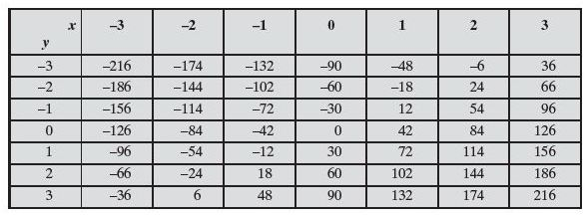
Partial Table of Values for 42x+30y
gcd(42, 30) = 6 = 42 * -2 + 30 * 3
For given integers a and b, the smallest positive value of ax+by is equal to gcd(a, b).
Notes:
Enhanced and Modified by Chuan Yue at the Colorado School of Mines.
Chuan: recall If b|g and b|h, then b|(mg + nh). Thus, 6 is the divisor of all the values in the table.

Slide 21
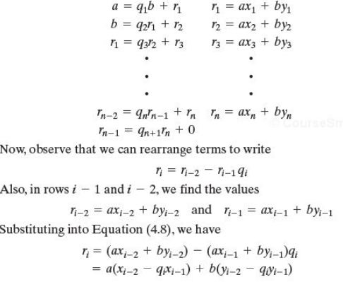
Extended Euclidean: x_{i}, y_{i}
Assume:
r_{i-2} = ax_{i-2} + by_{i-2}
r_{i-1} = ax_{i-1} + by_{i-1}
_{Prove:}
r_{i} = ax_{i} + by_{i}
(induction basis? and hypothesis?)
We can derive:
x_{i} = x_{i-2} - q_{i}x_{i-1}
y_{i} = y_{i-2} - q_{i}y_{i-1}
(iterative formulas)
Notes:
Added by Chuan Yue at the Colorado School of Mines.

Slide 22
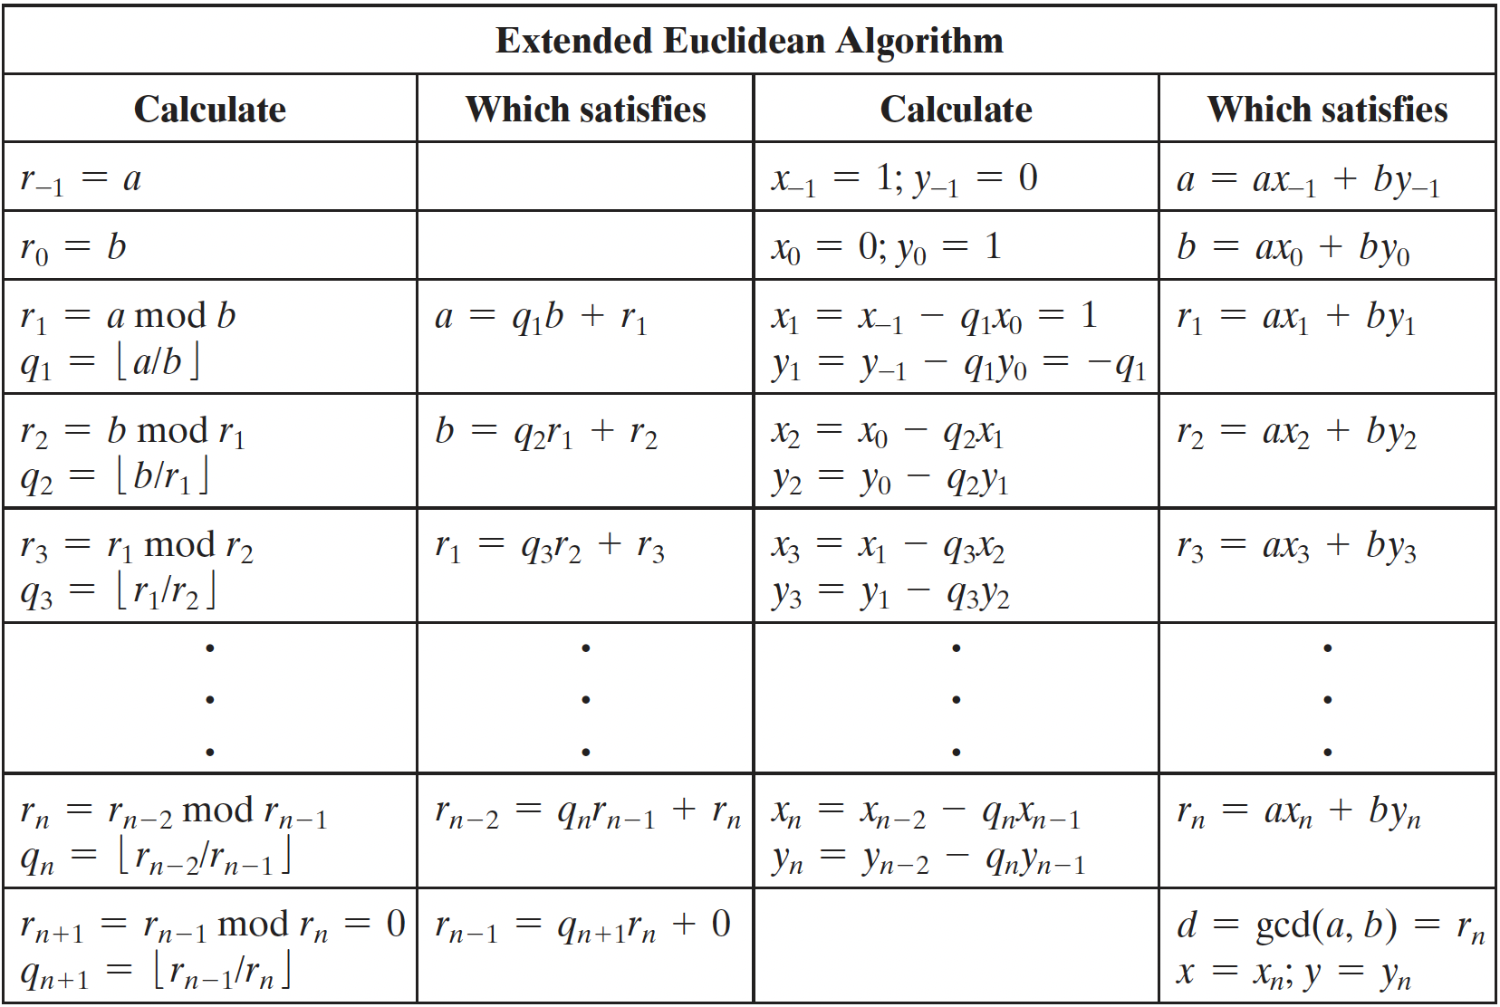
Extended Euclidean Algorithm
Notes:
Added by Chuan Yue at the Colorado School of Mines.

Slide 23
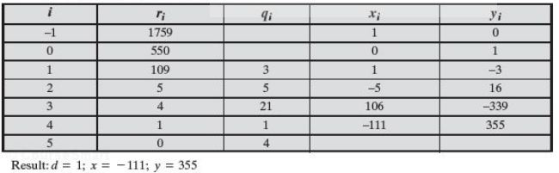
Extended Euclidean Algorithm Example
a = 1759, b = 550;
solve for: 1759 * x + 550 * y = d = gcd(1759, 550)
gcd (a, b)=1, thus the multiplicative inverse of b (mod a) is y;
in this example, multiplicative inverse of 550 (mod 1759) is 355.
(if y were negative, we would add 1759 to it)
Notes:
Enhanced and Modified by Chuan Yue at the Colorado School of Mines.
Example showing how to find the inverse of 550 in GF(1759), adapted from Stallings Table 4.4. In this example, let us use a = 1759 and b = 550 and solve for 1759x + 550y = gcd(1759, 550). The results are shown in Table 4.4. Thus, we have 1759 x (–111) + 550 x 355 = –195249 + 195250 = 1.

Slide 24
Summary
Divisibility
Integer Division Algorithm
GCD and Euclidean Algorithm
Set Z_{n}
Modular arithmetic and properties
Extended Euclidean Algorithm

