Slide 1
CSCI 474/574 Introduction to Cryptography/Theory of Cryptography Chapter 4 Basic Concepts in Number Theory and Finite Fields
4.2 Finite Fields
Notes:
Lecture slides by Lawrie Brown for “Cryptography and Network Security”, by William Stallings, Chapter Chapter 4 – “Basic Concepts in Number Theory and Finite Fields”.
Enhanced and Modified by Chuan Yue at the Colorado School of Mines.

Slide 2
Group
A group G, denoted by {G, • }, is a set of elements with a binary operation, denoted by •, that associates to each ordered pair (a, b) of elements in G an element (a • b) in G, such that the following axioms are obeyed:
(A1) closure: a and b belong to G, then a • b is in G
(A2) associative : (a • b) • c = a • (b • c)
(A3) has identity element e: e • a = a • e = a
(A4) each a has an inverse element a⁻¹: a • a⁻¹ = a⁻¹ • a = e
if (A5) commutative: a • b = b • a
then forms an abelian group
e.g., integers under addition, real numbers under addition, nonzero real numbers under multiplication
A group could be finite or infinite
Notes:
Groups, rings, and fields are the fundamental elements of a branch of mathematics known as abstract algebra, or modern algebra. In abstract algebra, we are concerned with sets on whose elements we can operate algebraically; that is, we can combine two elements of the set, perhaps in several ways, to obtain a third element of the set. These operations are subject to specific rules, which define the nature of the set. By convention, the notation for the two principal classes of operations on set elements is usually the same as the notation for addition and multiplication on ordinary numbers. However, it is important to note that, in abstract algebra, we are not limited to ordinary arithmetical operations.
A group G, sometimes denoted by {G, • }, is a set of elements with a binary operation, denoted by •, that associates to each ordered pair (a, b) of elements in G an element (a • b) in G, such that the following axioms are obeyed: Closure, Associative, Identity element, Inverse element.
Note - we have used . as operator: could be addition +, multiplication x or any other mathematical operator. A group can have a finite (fixed) number of elements, or it may be infinite. Note that integers (+ve, -ve and 0) using addition form an infinite abelian group. So do real numbers using multiplication.

Slide 3
Cyclic Group
define exponentiation within a group as a repeated application of the group operator
example: a³ = a.a.a
and let identity be: e=a⁰
let a^{-n}=(a’)^{n} where a’ is the inverse of a
a group is cyclic if every element of G is a power of a fixed element
i.e., b = a^{k} for some a and every b in G
e.g., integers under addition
a is said to be a generator of the group
A cyclic group is always abelian, may be finite or infinite
Notes:
Enhanced and Modified by Chuan Yue at the Colorado School of Mines.
Define exponentiation in a group as the repeated use of the group operator. Note that we are most familiar with it being applied to multiplication, but it is more general than that.
If the repeated use of the operator on some value a in the group results in every possible value being created, then the group is said to be cyclic, and a is a generator of (or generates) the group G.

Slide 4
Ring
{R, +, x}: a set of elements with two operations (addition and multiplication) which satisfies:
an abelian group with respect to addition (A1 ~ A5)
(M1) closure under multiplication
(M2) associative of multiplication
(M3) distributive laws: a(b+c)=ab+ac; (a+b)c =ac+bc
A commutative ring is a ring satisfies:
(M4) Commutativity of multiplication: ab=ba
e.g, Z_{n} together with arithmetic operation modulo n
An integral domain is a commutative ring satisfies:
(M5) Multiplicative identity “1” exists, such that 1a=a1=a (Z_{n} …)
(M6) No zero divisors: ab=0 → either a is 0 or b is zero
(check, Modulo 8 Multiplication in Z₈)
Notes:
Enhanced and Modified by Chuan Yue at the Colorado School of Mines.
Next describe a ring. In essence, a ring is a set in which we can do addition, subtraction [a – b = a + (–b)], and multiplication without leaving the set, and which obeys the associative and distributive laws. We denote a Ring as {R,+,.}
With respect to addition and multiplication, the set of all n-square matrices over the real numbers form a ring. The set of integers with addition & multiplication form an integral domain.
Chuan: An element that is both a left and a right zero divisor is simply called a zero divisor.
One example, check Table 4.2 (b)
Another example of a zero divisor in the ring of 2-by-2 matrices is the matrix:
1
2
http://en.wikipedia.org/wiki/Zero_divisors

Slide 5
Field
{F, +, x}: a set of elements with two operations (addition and multiplication) which satisfies:
axioms A1 ~ A5 and M1 ~ M6
M7: multiplicative inverse exists for each a (except 0), i.e., there is a⁻¹ such that aa⁻¹ = a⁻¹a = 1
In essence, a field is a set in which we can do addition, subtraction, multiplication, and division without leaving the set.
subtraction: a-b=a+(-b); division a/ b = a( b⁻¹)
e.g, rational numbers, real numbers, integers (not)
Notes:
Lastly define a field. In essence, a field is a set in which we can do addition, subtraction, multiplication, and division without leaving the set. Division is defined with the following rule: a/b = a (b^{–1}). We denote a Field as {F,+,.}
Examples of fields are: rational numbers, real numbers, complex numbers. Note that integers are NOT a field since there are no multiplicative inverses (except for 1).

Slide 6
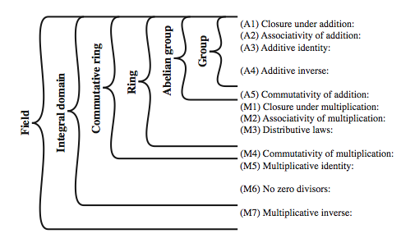
Group, Ring, Field
Notes:
These are terms we use for different sorts of "number systems", ones obeying different sets of laws. From group to ring to field we get more and more laws being obeyed, as shown here in Stallings Figure 4.2.
As a memory aid, can use the acronym for groups: CAIN (Closure Associative Identity iNverse) & ABEL. Mostly we need to compute with Rings, if not Fields. When we do arithmetic modulo a prime, we have a field.

Slide 7
Finite (Galois) Fields
finite fields play a key role in cryptography
can be shown the order (number of elements) in a finite field must be a power of a prime: p^{n}
The finite field of order p^{n,} denoted GF(p^{n})
GF stands for Galois Fields
in particular often use the fields:
GF(p)
GF(2^{n})
Notes:
Infinite fields are not of particular interest in the context of cryptography. However, finite fields play a crucial role in many cryptographic algorithms. It can be shown that the order of a finite field (number of elements in the field) must be a positive power of a prime, & these are known as Galois fields, in honor of the mathematician who first studied finite fields, & are denoted GF(p^n). We are most interested in the cases where either n=1 - GF(p), or p=2 - GF(2^n).

Slide 8
Galois Fields GF(p)
GF(p) is the set of integers {0,1, … , p-1} with the arithmetic operations modulo prime p
i.e., Z_{p} together with modulo p → commutative ring
multiplicative identity 1 exists (M5)
p is prime, no zero divisors (M6)
p is prime, multiplicative inverse exists for each w != 0
i.e., exists w⁻¹ such that w⁻¹ w ≡ w w⁻¹ ≡ 1 (mod p) (M7)
Thus, GF(p) a finite field; arithmetic is “well-behaved” and can do addition, subtraction, multiplication, and division without leaving the field GF(p)
Notes:
Enhanced and Modified by Chuan Yue at the Colorado School of Mines.
Start by considering GF(p) over the set of integers {0…p-1} with addition & multiplication modulo p. This forms a “well-behaved” finite field. Can find an inverse using the Extended Euclidean algorithm.

Slide 9
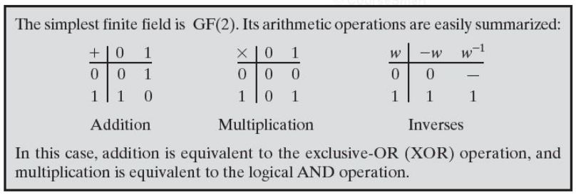
GF(2)
Notes:
Added by Chuan Yue at the Colorado School of Mines.

Slide 10
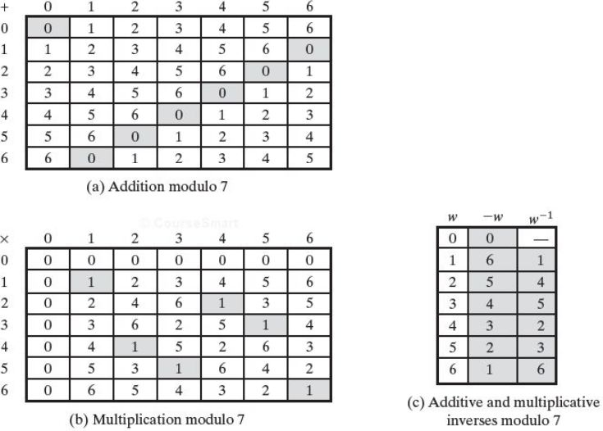
GF(7)
Notes:
Table 4.5 shows arithmetic operations in GF(7). This is a field of order 7 using modular arithmetic modulo 7. As can be seen, it satisfies all of the properties required of a field (Figure 4.2). Compare this table with Table 4.2. In the latter case, we see that using modular arithmetic modulo 8, is not a field.

Slide 11
Calculate Multiplicative Inverse of an Element in GF(p)
Using extended Euclidean algorithm
ax + by = d = gcd(a, b)
if a is prime and b < a, then ax + by = 1 = gcd (a, b)
[( ax mod a) + ( by mod a)] mod a = 1 mod a
by mod a = 1; Thus, b⁻¹ = y
E.g., calculate multiplicative inverse of 550 in GF(1759)
1759x + 550y = 1 = gcd(1759, 550), using extended Euclidean algorithm, yields y = 355, thus 550⁻¹ = 355
Notes:
Start by considering GF(p) over the set of integers {0…p-1} with addition & multiplication modulo p. This forms a “well-behaved” finite field. Can find an inverse using the Extended Euclidean algorithm.

Slide 12
Polynomial Arithmetic
A polynomial of degree n (integer n>= 0):
f(x) = a_{n}x^{n} + a_{n-1}x^{n-1} + … + a₁x + a₀ = ∑ a_{i}x^{i}
a_{i} are elements of a set S, called coefficient set (integers for us)
abstract algebra, not interested in the value of x
Three classes of polynomial arithmetic
ordinary polynomial arithmetic
polynomial arithmetic with coefficients mod p, i.e., in GF(p)
polynomial arithmetic with coefficients mod p, i.e., in GF(p), and polynomials modulo a polynomial m(x).
Objective: define fields of order p^{n} (GF(p^{n}), esp., GF(2^{n}))
Notes:
Next introduce the interesting subject of polynomial arithmetic, using polynomials in a single variable x, with several variants as listed above.
Note we are usually not interested in evaluating a polynomial for any particular value of x, which is thus referred to as the indeterminate.

Slide 13
Ordinary Polynomial Arithmetic
add or subtract corresponding coefficients
multiply all terms by each other
e.g.
let f(x) = x³ + x² + 2 and g(x) = x² – x + 1
f(x) + g(x) = x³ + 2x² – x + 3
f(x) – g(x) = x³ + x + 1
f(x) x g(x) = x⁵ + 3x² – 2x + 2
Notes:
Polynomial arithmetic includes the operations of addition, subtraction, and multiplication, defined in the usual way, ie add or subtract corresponding coefficients, or multiply all terms by each other. The examples are from the text.

Slide 14
Polynomial Arithmetic with Coefficients in a Finite Field
coefficients are elements of some finite field F
thus polynomial division is possible
can write any polynomial in the form:
f(x) = q(x) g(x) + r(x); r(x) = f(x) mod g(x)
can interpret r(x) as being a remainder
if have no remainder say g(x) divides f(x)
if f(x) has no divisors other than itself & 1 say it is an irreducible (or prime) polynomial
Notes:
Consider variant where now when computing value of each coefficient do the calculation modulo some value, usually a prime. If the coefficients are computed in a field (eg GF(p)), then division on the polynomials is possible, and we have a polynomial ring. Are most interested in using GF(2) - ie all coefficients are 0 or 1, and any addition/subtraction of coefficients is done mod 2 (ie 2x is the same as 0x!), which is just the common XOR function.
Note that we can write any polynomial in the form of f(x) = q(x) g(x) + r(x), where division of f(x) by g(x) results in a quotient q(x) and remainder r(x). Can then extend the concept of divisors from the integer case, and show that the Euclidean algorithm can be extended to find the greatest common divisor of two polynomials whose coefficients are elements of a field.
Define an irreducible (or prime) polynomial as one with no divisors other than itself & 1. If compute polynomial arithmetic modulo an irreducible polynomial, this forms a finite field, and the GCD & Inverse algorithms can be adapted for it.

Slide 15
Polynomial Arithmetic with Coefficients in GF(2)
all coefficients are 0 or 1
Addition is equivalent to the XOR operation
Subtraction and addition are equivalent mod 2
1+1=1-1=0; 1+0=1-0=1; 0+1=0-1=1; 0+0=0-0=0; //XOR
Multiplication is equivalent to logical AND
A reducible f(x) over GF(2)
f(x)=x⁴+1=(x+1)(x³+x²+x+1)
Notes:
Consider variant where now when computing value of each coefficient do the calculation modulo some value, usually a prime. If the coefficients are computed in a field (eg GF(p)), then division on the polynomials is possible, and we have a polynomial ring. Are most interested in using GF(2) - ie all coefficients are 0 or 1, and any addition/subtraction of coefficients is done mod 2 (ie 2x is the same as 0x!), which is just the common XOR function.

Slide 16
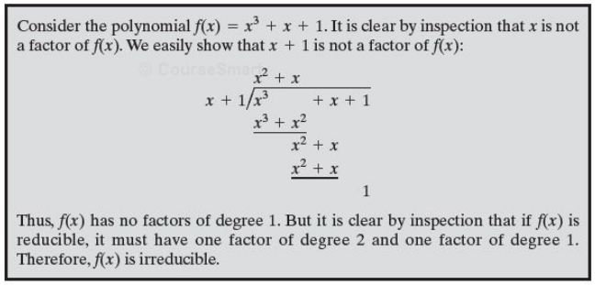
An irreducible or prime f(x) over GF(2)
Notes:
Added by Chuan Yue at the Colorado School of Mines.

Slide 17
Polynomial GCD
can find greatest common divisor for polynomials
c(x) = GCD(a(x), b(x)) if c(x) is the polynomial of greatest degree which divides both a(x), b(x)
can adapt Euclid’s Algorithm to find it:
Euclid(a(x), b(x))
if (b(x)=0) then return a(x);
else return
Euclid(b(x), a(x) mod b(x));
Notes:
We can extend the analogy between polynomial arithmetic over a field and integer arithmetic by defining the greatest common divisor as shown.
We began this section with a discussion of arithmetic with ordinary polynomials. Arithmetic operations are performed on polynomials (addition, subtraction, multiplication, division) using the ordinary rules of algebra. Polynomial division is not allowed unless the coefficients are elements of a field. Next, we discussed polynomial arithmetic in which the coefficients are elements of GF(p). In this case, polynomial addition, subtraction, multiplication, and division are allowed. However, division is not exact; that is, in general division results in a quotient and a remainder. Finally, we showed that the Euclidean algorithm can be extended to find the greatest common divisor of two polynomials whose coefficients are elements of a field. All of the material in this section provides a foundation for the following section, in which polynomials are used to define finite fields of order p^{n}.

Slide 18
Finite Fields of the Form GF(2^{n})
The order of a finite field must be of the form p^{n}
GF(p) (i.e., Z_{p} with modulo p) is a finite field
n>1, operations mod p^{n} do not produce a field
For convenience and implementation efficiency, expect to work with integers in range 0 to 2^{n}-1
Z₂₅₆ mod 256 does not form a field
Z₂₅₁ mod 251 forms a field, with wasted integers
Multiplication in Z_{256,} Z₈ … maps unevenly
Thus, finite fields of the form GF(2^{n}) are attractive
Notes:
Chuan: note, 251 is prime.

Slide 19
Modulo 8 Multiplication in Z₈
+ | 0 | 1 | 2 | 3 | 4 | 5 | 6 | 7
0 | 0 | 0 | 0 | 0 | 0 | 0 | 0 | 0
1 | 0 | 1 | 2 | 3 | 4 | 5 | 6 | 7
2 | 0 | 2 | 4 | 6 | 0 | 2 | 4 | 6
3 | 0 | 3 | 6 | 1 | 4 | 7 | 2 | 5
4 | 0 | 4 | 0 | 4 | 0 | 4 | 0 | 4
5 | 0 | 5 | 2 | 7 | 4 | 1 | 6 | 3
6 | 0 | 6 | 4 | 2 | 0 | 6 | 4 | 2
7 | 0 | 7 | 6 | 5 | 4 | 3 | 2 | 1
The matrix is symmetric about the main diagonal
Multiplicative inverse exists to some integers in mod 8 multiplication:
(x * y) mod 8 = 1
Number of nonzero multiplication results is not uniform:
Integer 1 2 3 4 5 6 7
Z₈ 4 8 4 12 4 8 4
cryptographically weaker …
Notes:
Continuing the example showing multiplication in Z₈, from Stallings Table 4.2b. Both matrices are symmetric about the main diagonal, in conformance to the commutative property of addition and multiplication. Similarly, the entries in the multiplication table are straightforward. In ordinary arithmetic, there is a multiplicative inverse, or reciprocal, to each integer. In modular arithmetic mod 8, the multiplicative inverse of x is the integer y such that (x x y) mod 8 = 1 mod 8. Now, to find the multiplicative inverse of an integer from the multiplication table, scan across the matrix in the row for that integer to find the value 1; the integer at the top of that column is the multiplicative inverse; thus (3 x 3) mod 8 = 1. Note that not all integers mod 8 have a multiplicative inverse; more about that later.

Slide 20
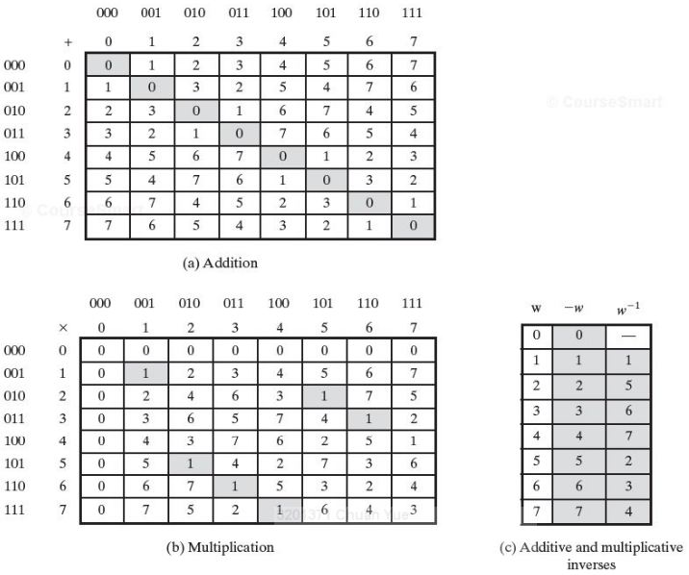
GF(2³)
We will show how polynomial arithmetic provides a means for constructing this desired field
Number of nonzero multiplication results is uniform:
Integer 1 2 3 4 5 6 7
GF(2³) 7 7 7 7 7 7 7
Notes:
Added by Chuan Yue at the Colorado School of Mines.

Slide 21
Modular Polynomial Arithmetic
Consider the set S of all polynomials of degree n-1 or less over the field Z_{p}
f(x) = a_{n-1}x^{n-1} + a_{n-2}x^{n-2} + … + a₁x + a₀ = ∑ a_{i}x^{i}
where each a_{i} takes on a value in the set {0,1,…,p-1}
There are a total of p^{n} different polynomials in S.
e.g., p=2, and n=3, the 2³ different polynomials are:
0 x+1 x²+x
1 x² x²+x+1
x x²+1
With the appropriate definition of arithmetic operations, each such set S is a finite field!
Notes:
Added by Chuan Yue at the Colorado School of Mines.

Slide 22
Definition of Arithmetic Operations for S
Follows ordinary polynomial arithmetic with refinements 2 and 3
Arithmetic on the coefficients is performed modulo p, i.e., on GF(p)
If multiplication results in a polynomial of degree greater than n-1, then the polynomial is reduced modulo some irreducible polynomial m(x) of degree n. That is, we divide by m(x) and keep the remainder. f(x) = q(x) m(x) + r(x); r(x) = f(x) mod m(x)
Such a S forms a finite field (proof similar to that for GF(p))! And this is a way to construct GF(2^{n}) (all finite fields of a given order are isomorphic – same structure and bijective mapping)!
E.g, construct GF(2³): there are only two degree-3 irreducible polynomials: x³+x²+1 and x³+x+1 (proved before)
Notes:
Added by Chuan Yue at the Colorado School of Mines.

Slide 23
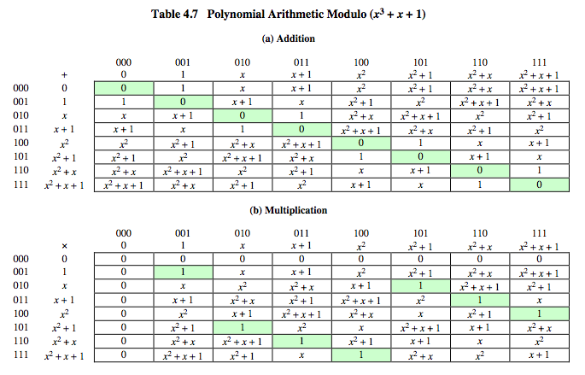
Example GF(2³)
Polynomial representation of the tables on slide 20.
Notes:
Enhanced and Modified by Chuan Yue at the Colorado School of Mines.
Example shows addition & multiplication in GF(2³) modulo (x³+x+1), from Stallings Table 476.
Chuan: keep in mind that S is the set of all polynomials of degree n-1 or less over the field Z_{p}
These two tables are the polynomial representation of the tables on slide 20

Slide 24
Computational Example
in GF(2³) have (x²+1) is 101₂ and (x²+x+1) is 111₂
so addition is
(x²+1) + (x²+x+1) = x
101 XOR 111 = 010₂
and multiplication is
(x+1)*(x²+1) = x*(x²+1) + 1*(x²+1)
= x³+x+x²+1 = x³+x²+x+1
011 * 101 = (101)<<1 XOR (101)<<0 =
1010 XOR 101 = 1111₂
polynomial modulo reduction (get q(x) & r(x)) is
(x³+x²+x+1 ) mod (x³+x+1) = 1*(x³+x+1) + (x²) = x²
1111 mod 1011 = 1111 XOR 1011 = 0100₂ (see later)
Notes:
Show here a few simple examples of addition, multiplication & modulo reduction in GF(2³).
Note the long form modulo reduction finds p(x)=q(x).m(x)+r(x) with r(x) being the desired remainder.

Slide 25
Computational Considerations
since coefficients are 0 or 1, can represent any such polynomial as a bit string
f(x) = a_{n-1}x^{n-1} + a_{n-2}x^{n-2} + … + a₁x + a₀ = ∑ a_{i}x^{i}
(a_{n-1} , a_{n-2} , …… , a₁ , a₀)
addition becomes XOR of these bit strings
coefficients is arithmetic over the finite field Z_{p}
multiplication needs an efficient way
by shift & XOR
Notes:
A key motivation for using polynomial arithmetic in GF(2^{n}) is that the polynomials can be represented as a bit string, using all possible bit values, and the calculations only use simple common machine instructions - addition is just XOR, and multiplication is shifts & XOR’s. See text for additional discussion. The shortcut for polynomial reduction comes from the observation that if in GF(2^{n}) then irreducible poly g(x) has highest term x^{n} , and if compute x^{n} mod g(x) answer is g(x)- x^{n}

Slide 26

Efficient Multiplication
Calculate f(x) * g(x) mod m(x)
e.g., m(x) = (x⁸ + x⁴ + x³ + x + 1), used by AES in GF(2⁸)
Observations:
x⁸ mod m(x) = m(x) - x⁸ = ( x⁴ + x³ + x + 1)
In general in GF(2^{n}), n-degree p(x): x^{n} mod p(x) = p(x) – x^{n}
any f(x) = b₇x⁷ + b₆x⁶ + b₅x⁵ + b₄x⁴ + b₃x³ + b₂x² + b₁x + b₀
x * f(x) =
(b₇x⁸ + b₆x⁷ + b₅x⁶ + b₄x⁵ + b₃x⁴ + b₂x³ + b₁x² + b₀x) mod m(x) =
b₆x⁷ + b₅x⁶ + b₄x⁵ + b₃x⁴ + b₂x³ + b₁x² + b₀x (if b₇ == 0), or
(m(x) - x⁸) + b₆x⁷ + b₅x⁶ + b₄x⁵ + b₃x⁴ + b₂x³ + b₁x² + b₀x (if b₇ == 1)
Notes:
Enhanced and Modified by Chuan Yue at the Colorado School of Mines.
A key motivation for using polynomial arithmetic in GF(2^{n}) is that the polynomials can be represented as a bit string, using all possible bit values, and the calculations only use simple common machine instructions - addition is just XOR, and multiplication is shifts & XOR’s. See text for additional discussion. The shortcut for polynomial reduction comes from the observation that if in GF(2^{n}) then irreducible poly g(x) has highest term x^{n} , and if compute x^{n} mod g(x) answer is g(x)- x^{n}

Slide 27
Efficient Multiplication Example
Calculate f(x) * g(x) mod m(x)
E.g., f(x) = x⁶ + x⁴ + x² + x + 1; g(x) = x⁷ + x+1;
m(x) = (x⁸ + x⁴ + x³ + x + 1), used by AES in GF(2⁸)
f(x) * g(x) = f(x) + x * f(x) + x⁷ * f(x)
f(x) is there
x * f(x) is just a shift
x² * f(x) = x * (x * f(x)); calculate with the method on last slide
x³ * f(x) = x * (x² * f(x)); calculate with the method on last slide
……
x⁷ * f(x) = x * (x⁶ * f(x)); calculate with the method on last slide
Multiplication can be completely done by shift & XOR!
Notes:
Added by Chuan Yue at the Colorado School of Mines.

Slide 28
Finding the multiplicative Inverse
Adapt the extended Euclidean algorithm to find the multiplicative inverse of a polynomial
Find the multiplicative inverse of b(x) mod a(x)
The degree of b(x) is less than the degree of a(x)
If a(x) is irreducible,
then gcd [a(x), b(x)] =1
If a(x)v(x) + b(x)w(x) = d(x) = 1
then b(x)⁻¹= w(x), similar to previous proof
Notes:
There is an equivalent technique for defining a finite field of the form GF(2^{n}) using the same irreducible polynomial, based on powers of a generator of the group, which gives a nice implementation of multiplication. The generator can be found from the root of the irreducible polynomial, as discussed in the text.

Slide 29
Summary
concept of groups, rings, fields
Finite (Galois) Fields
Finite fields GF(p)
Polynomial arithmetic in general and in GF(2^{n})

