Slide 1
Kotlin coroutines Applications, implementation, history
Kasper Østerbye
Wednesday April 18th, 2018
Slides and more at: https://github.com/kaspercphbusiness/ITUKotlin
Notes:
Who is this Kasper Guy?

Slide 2
Overview
Two applications
Sequences/Streams
Asynchronous calls
Implementation
Transformation into state-machines
Watch the two video’s (not now!):
https://github.com/Kotlin/kotlin-coroutines
History
Simula 1968 had coroutines
Streams was best in Icon 1977

Slide 3
Sequence (Java Streams)
An a potentially infinite sequence which can only be read one element at a time.
Has been in programming for a LONG time
http://www-formal.stanford.edu/jmc/recursive.pdf (page 21, 1960)
Today they are used – a lot – to handle data that comes from files, over the net, from sensors, from …
Kotlin libraries for this improve on java libraries in many (small practical ways) using convenient extension methods

Slide 4
Sequence example
val newestSeason = ewe.getOffSpring() // Sequence of lambs
.filter{ it.gramPerDay() > 0} // medtag ikke før første vejning
.map { it.yearBorn() }
.max()
val sum = ewe.getOffSpring()
.filter{ it.yearBorn() >= newestSeason - 2 }
.filter{ it.gramPerDay() > 0 }
.map{ it.gramPerDay() }
.sum();

Slide 5
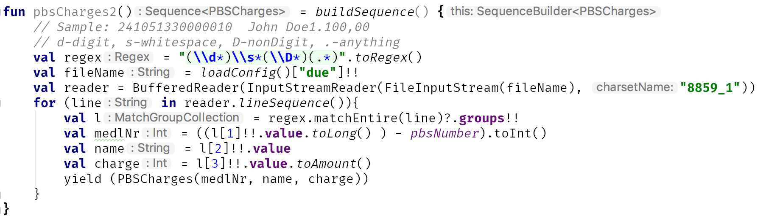
Sample use of yield

Slide 6
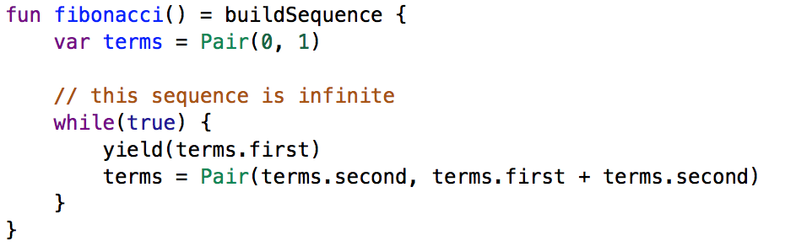
The classic Fibonacci example

Slide 7
An extended example
https://try.kotlinlang.org/#/UserProjects/ue1bhr9vk3mc2q8rfnmojo5qtu/v88qbu3eg7dc3ubhrdijac279v
The yieldall and yield in the binary tree
The yield in the person generator

Slide 8
The key difference between C# yield and Kotlin yield
In kotlin it is a library call!
See http://developers-club.com/posts/168571/ for the amazing details…

Slide 9
Implementation of yield (conceptually)
See ipad notes

Slide 10
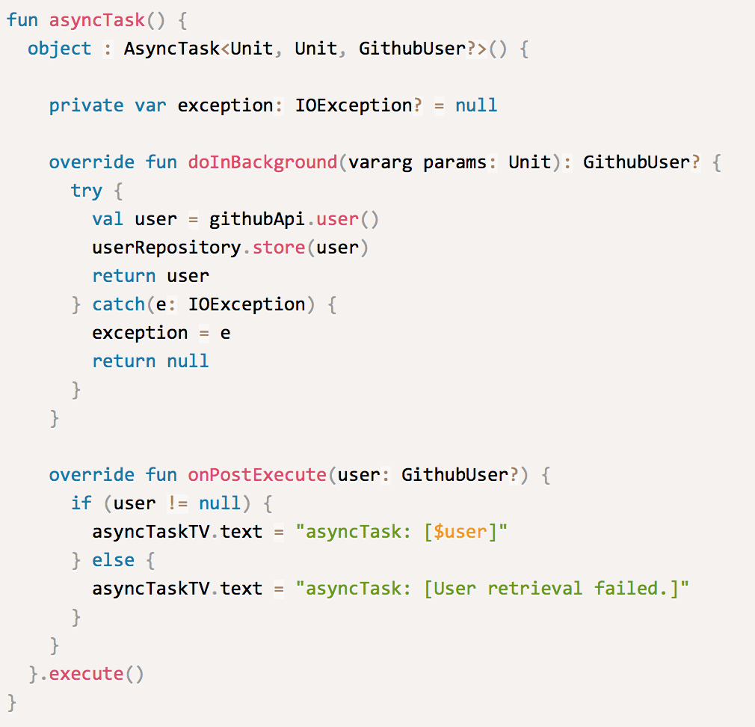
Async task and kotlin async
The function “asyncTask” is called as response to some user action
asyncTaskTV is just a way to say it should be shown on the gui
Shamelessly stolen and adapted from: https://medium.com/@haarman.niek/async-await-in-android-f0202cf31088

Slide 11
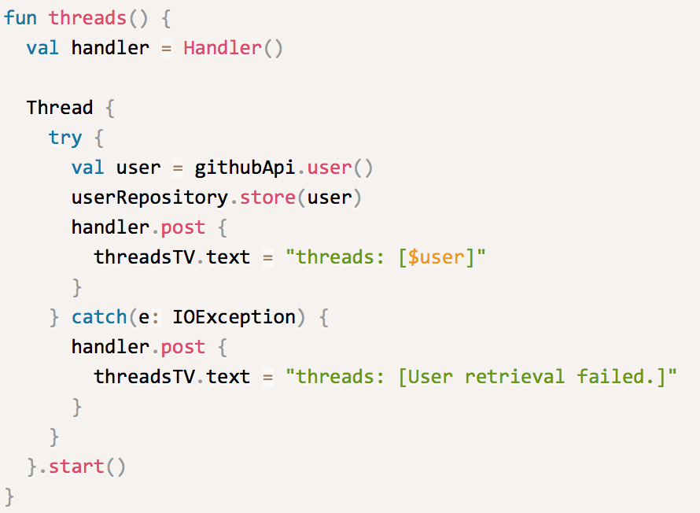
A tread solution
The function “threads()” is called as response to some user action

Slide 12
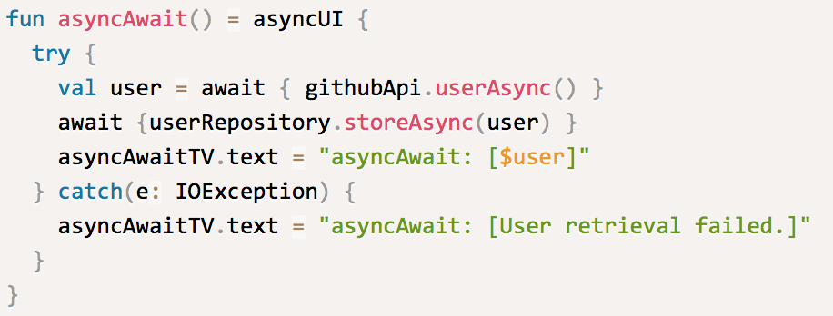
Kotlin coroutine solution
The function “asyncAwait()” is called as response to some user action
Done using libraries,
The function asyncAwait runs in the GUI thread
await will
release the GUI thread while the body executes
resume execution on the GUI thread after await.
There are many experiments happening on how to make the best abstraction.

Slide 13
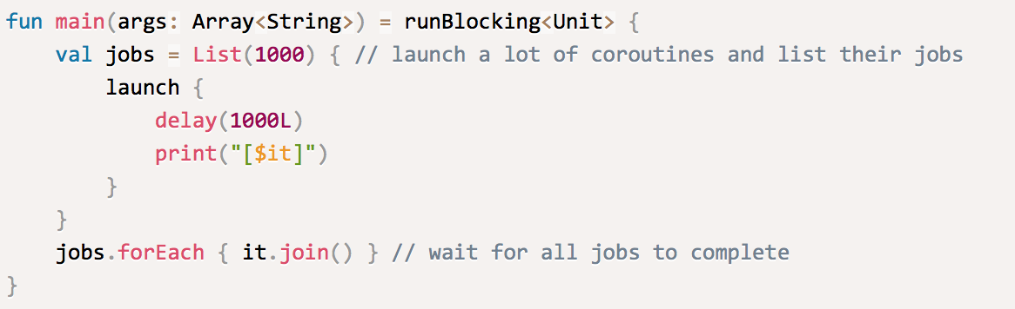
Lightweight
https://try.kotlinlang.org/#/UserProjects/uomjlipmn8u6v0odjt6pdplj62/e2mos3kjf5jojl4rkjmhshb11t
‘
Only one coroutine is running at anyone time here.
The “runBlocking” function:
Makes the body into a coroutine by itself
Blocks until all internal co-routines are finished (which is when they have all joined)
Try to refactor stuff out of the launch method

Slide 14
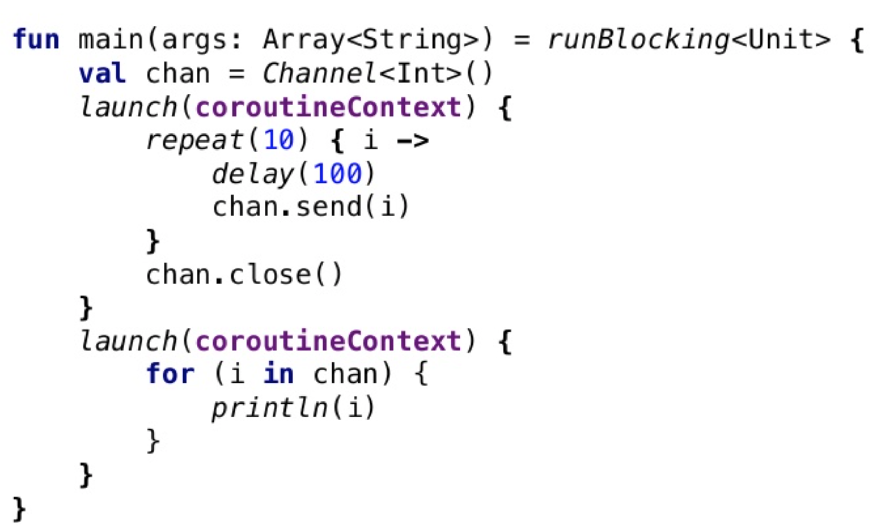
Communication over channels (CSP)

Slide 15
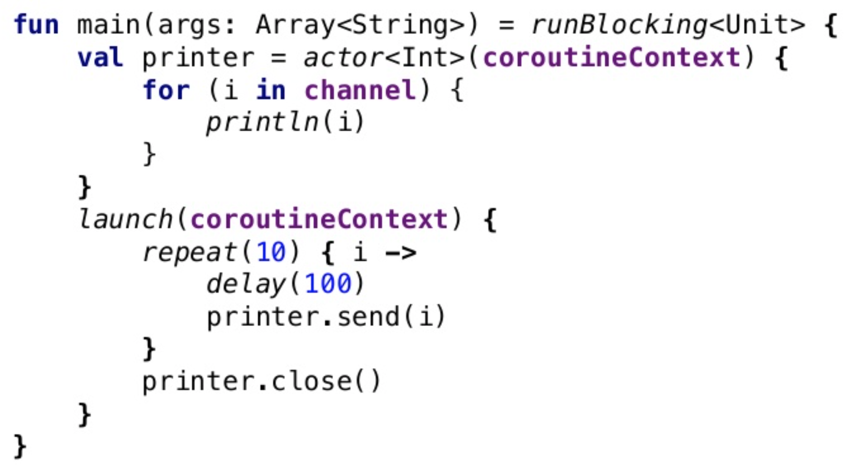
Actor (co-routine with inbox)

Slide 16
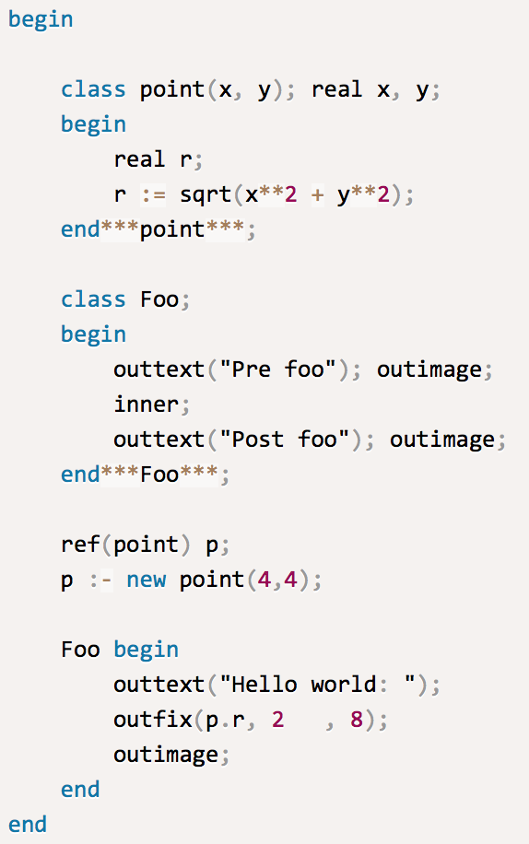
Pieces of history - Simula (1968)

Slide 17
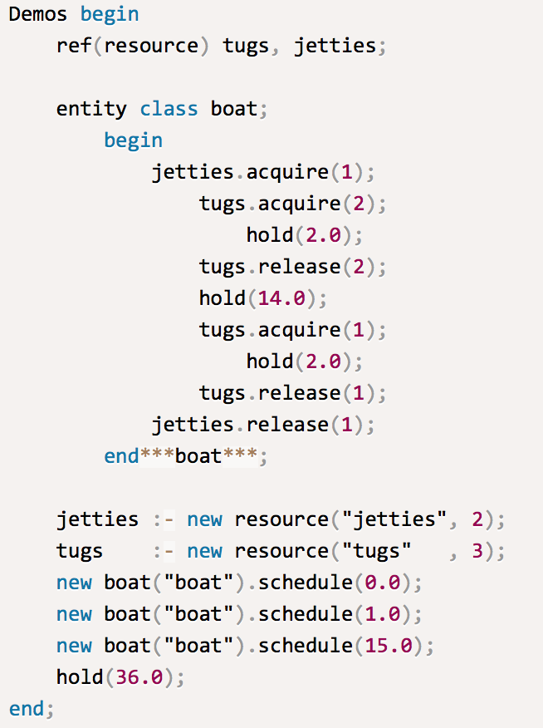
Simula – simulation using coroutines
Notes:
```pascal
Demos begin
ref(resource) tugs, jetties;
entity class boat;
begin
jetties.acquire(1);
tugs.acquire(2);
hold(2.0);
tugs.release(2);
hold(14.0);
tugs.acquire(1);
hold(2.0);
tugs.release(1);
jetties.release(1);
end***boat***;
jetties :- new resource("jetties", 2);
tugs :- new resource("tugs" , 3);
new boat("boat").schedule(0.0);
new boat("boat").schedule(1.0);
new boat("boat").schedule(15.0);
hold(36.0);
end;
```

