Slide 1
Kotlin (on Android) No News is good News
Kasper Østerbye
Wednesday February 14th
Notes:
Who is this Kasper Guy?

Slide 2
What makes a good programming language
For whom
Researchers:
The language support something hard in a convenient syntax
The support is proven to be correct
The support is efficient
The compiler finds and reports if the features are not used correcty
Nearly uninteresting if errors are not found until runtime.
At least one of the above are novel (not done before in other languages)
It is cool if it is useful too…
Developers:
The language support something useful in a convenient syntax
The language allows for third parties to write awesome libraries.
The support is proven to be correct
The support is efficient
The compiler finds and reports if the features are not used correcty
Errors found at runtime is so much better than not being able to write your code nicely.
It has to be useful – cool is good too.
Notes:
Not quite as sharp in real – but to publish a paper you have to follow the left column

Slide 3
Kotlin at a glance
It is meant to be used on the java (and java-script) platforms.
It can use all the existing Java libraries out of the box
Kotlin classes can be called from Java (directly)
It looks somewhat like Swift in its syntax
Your language experience?:
Java:
C#:
F#:
Javascript:
Scala:
C/C++:
…:
Notes:
Forth, Smalltalk, Pascal, Modula, Simula, Beta, C++, C, Processing, Arduino, Lisp, Scheme, Visual Basic, Icon, Prolog, Machine code, binary, pocket calculators,

Slide 4
Practical
All the exercises and my demo will be on the online
try.kotlinlang.org
Google doc used in class: https://goo.gl/Kc28Hb
Notes:
Basically because I do not want you to pollute your Android studio, and because the true IDE just distracts from the learning at this stage.

Slide 5
Not only classes can be top level
Link to try.kotlinlang.org
In Java you have classes as top level.
In Kotlin all declarations can be toplevel, in particular:
Classes
Variables (var)
Constants/Values (val)
Functions
Objects
…

Slide 6
The small things
var and val
This is a return to old style. May have been annoyed in Java of the complicated way to declare constants:
public static final int MEANING = 42;
val MEANING = 24;

Slide 7
Null pointers
Kotlin has support for nullable types (and in particular non-nullable).
The practical usage is that you can write a function will never be called with a null reference!
var p : Person // not legal!
var pp : Person?
Look at examples, and the code demo’ed in class
Main points:
Compile time check
Focus on the call spot (which is where the problem is!)
Smart checks (if and when statements)
Possible to override a nullable (using !!)

Slide 8
Properties
This is close to religion for some (either way!)
In java terms a Property is a getter/setter pair.
kurt.setLastName(sonja.getLastName());
// kurt.lastName = sonja.lastName
somePerson.setName(null); // uups
Why do we make the fields private in the first place?

Slide 9
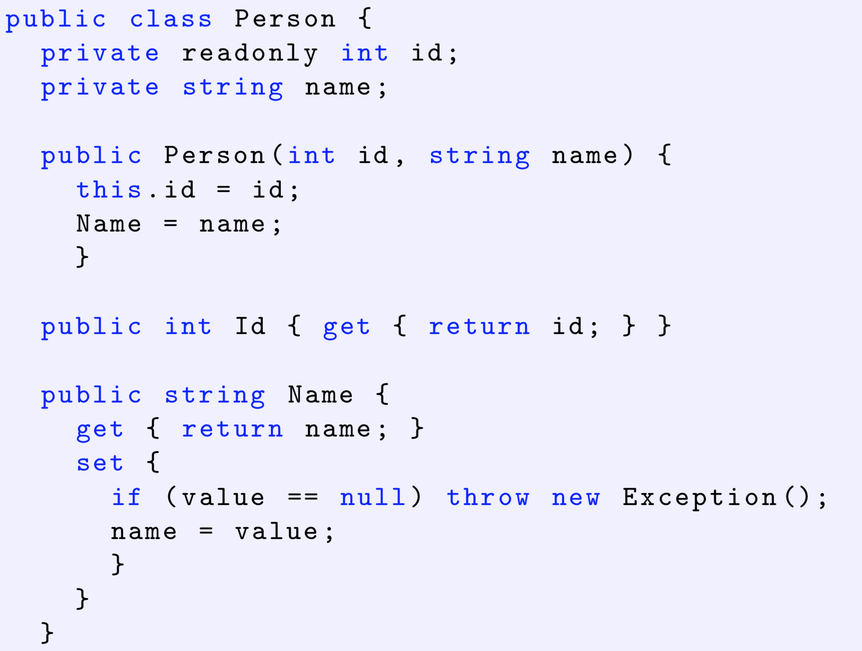
Properties from C# - I

Slide 10
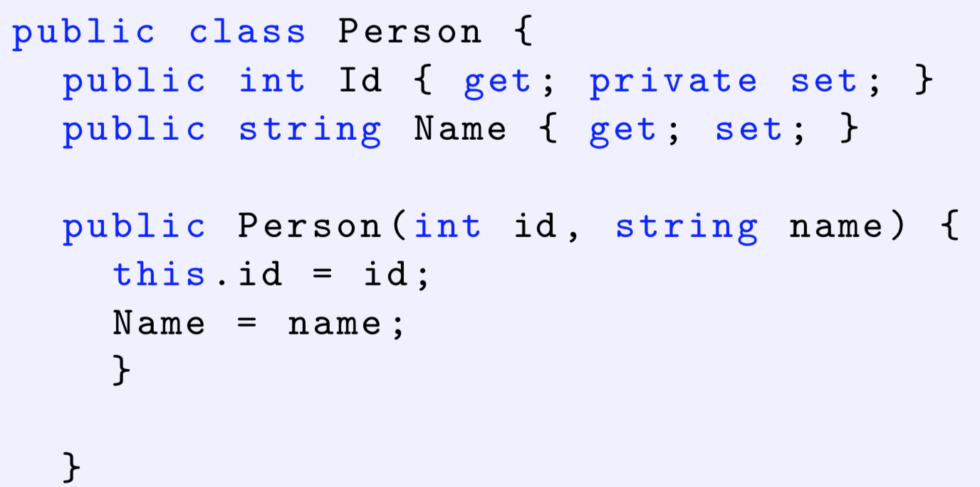
C# getter and setter
Now this is possible: kurt.LastName = sonja.LastName;

Slide 11
Kotlin properties
Comes in two usage scenarios:
General classes where you would have getter setter pairs, and some setters which perhaps does something interesting
Read only “data classes”. These typically hold info from a database or from other external sources.
Link to code

Slide 12
Kotlin extension methods
Very similar to those in C#
In essence it allow you to add methods to existing classes.
The usage scenario is to allow third party developers to add methods to existing classes in a manner which seems ”natural”.
fun age(p : Person) { … }
Gives the call
Int a = age(p)
But with an extension you can write (extension property…)
Int a = p.age
Demo: Extend Array<String> with a method oddLength : Boolean

Slide 13
Extensions to AndroidStudio
Kotlin has gotten some attention because it allow you to access textView (and similar things) in a more convenient manner than in Java:
// Java
findViewById<TextView>(R.id.textView).setText ("Hello, world!")
//Kotlin
textView.setText("Hello, world!")
This is actually not done with ”kotlin extension”, but as a compiler plug-in for android studio.
Why cannot it not be done without changing the compiler?

Slide 14
The last goodies
First class functions
In language a function is called first class if it can be:
Be stored in a variable
Can be passed as parameter
Can be the return value of an other function
Java is getting good at this on its own.
The typical usage scenario is in “call backs” and stream processing.

Slide 15
Call backs
btn = (Button)findViewById(R.id.firstButton);
btn.setOnClickListener(new View.OnClickListener(){
@Override
public void onClick(View v) {
toast("Hello folks")
}});
Actually, the above is really a lot of stuff to say “when user clicks the btn, a toast should be shown (toast are a bit more advanced to start actually).
In Kotlin you can reduce this to:
firstButton.setOnClickListener ({ v -> toast("Hello") } )
Which can be even further reduced:
firstButton.setOnClickListener { toast("Hello") }

Slide 16
A silly axample
Using extension methods and functions
Assume we are making a game, where something has to happen with a certain probability.
In Java:
if ( Math.random() < 0.75 ) {
toast(“Bingo”);
}
In Kotlin:
0.75 .perhaps {
toast(“Bingo”);
}

