Slide 1
Bachelor Eindwerk
Final presentation
-
ACED

Slide 2
Overview
Features
  Daycare & Preschool
  Data formats
  Refactoring
  Data visualisation
  Demographic profiles
  Workplace size distribution
  Simulation – Belgium
Demo

Slide 3
Features – Daycare & Preschool
Added daycare & preschool contacttypes
Configurable participation rates
Impact
  Seemingly negligible
  Small fraction of population
  Small contact pools

Slide 4
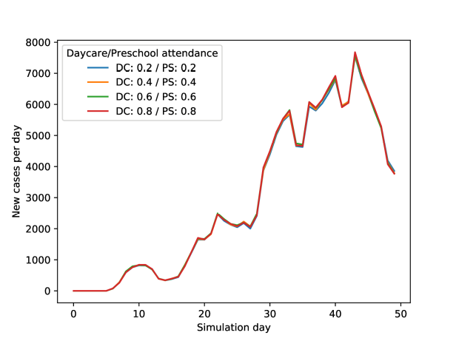


Daycare & Preschool - Results
20 runs, seeding rate = 0.2%, immunity rate = 70%, R0 = 15

Slide 5
Features – Data Formats
GeoGrid
  Added HDF5 import/export
  Switched over to Nlohmann JSON
  Time comparison
Households now use JSON (import)
 | Write time | Read time | Storage size
Protobuf | 7.4s | 2.0s | 14 MB
HDF5 | 34.5s | 23.3s | 159.8 MB
JSON | 23.2s | 7.9s | 119.2 MB
 | Read time | Storage size
CSV | 4s | 312 KB
JSON | 4s | 685 KB

Slide 6
Features – Refactoring
GeoGrid
  GeoGridBase (templatized): has locations
  GeoGrid: inherits from GeoGridBase, all other GeoGrid functionality
  VisGeoGrid: for use with visualiser & VisLocation
Location
  LocationBase: Name, ID & Coordinate
  SimLocation: Persons, contactpools
  VisLocation: Epidemiological data

Slide 7
Features – Data visualisation
Added EpiOuput viewer
  Can be configured (HDF5/JSON/Protobuf)
Created visualiser
  Separate program
  Reads and visualises EpiOutput
  Interactive interface

Slide 8
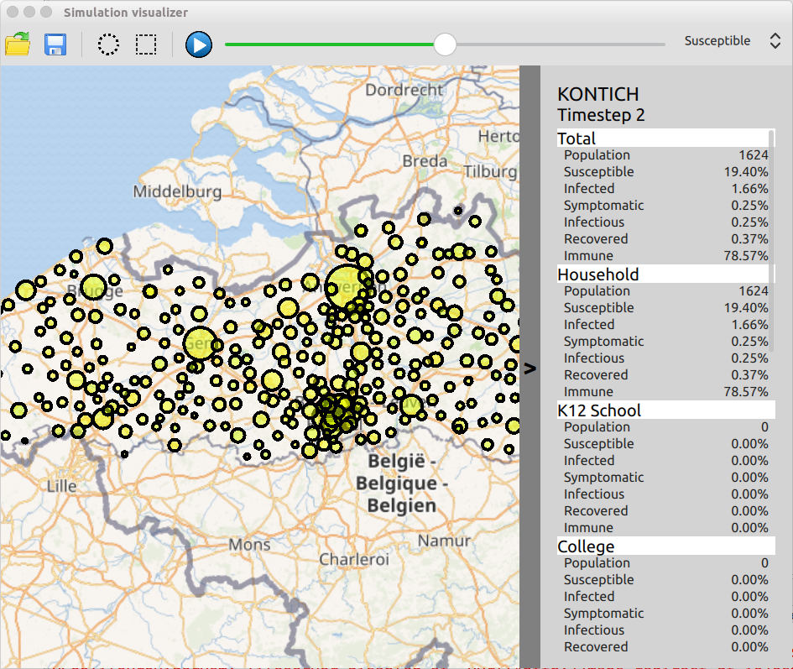
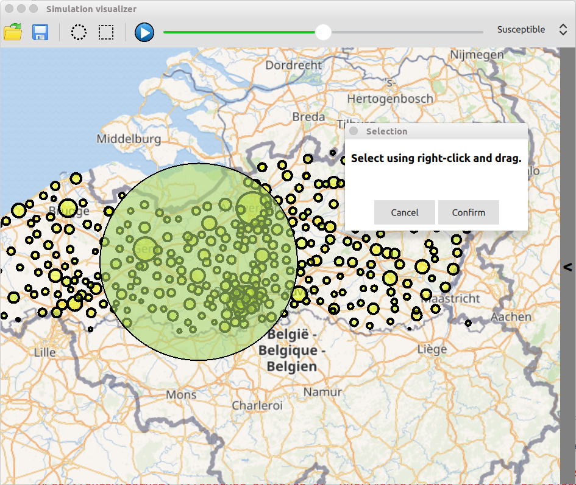
Features – Data visualisation

Slide 9
Features – Demographic Profiles
Can now populate using multiple reference sets
Created sets for Flanders:
  Reference for province
  Reference for centrum cities
  Sources: StatBel & https://provincies.incijfers.be

Slide 10
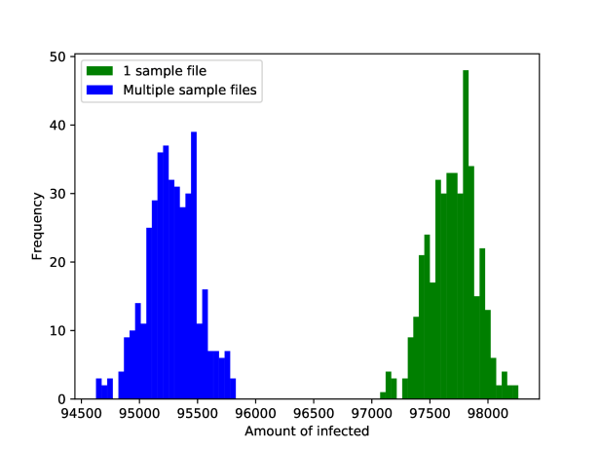
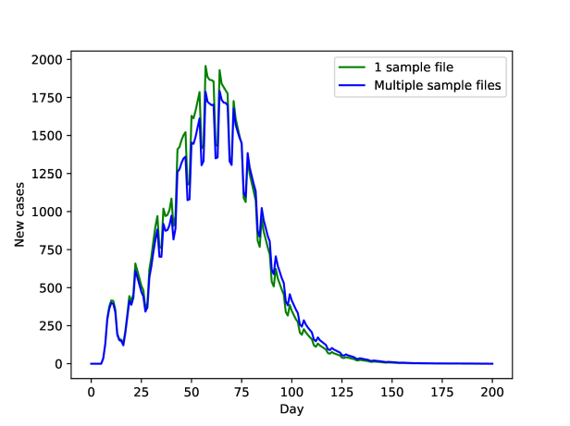
Demographic Profiles – Results
400 simulations, seeding rate = 0.2%, immunity rate = 80%, R0 = 11

Slide 11
Features – Workplace size distribution
Can now populate using a workplace distributions file
Algorithm:
  Determine size of workplace beforehand
  Assign weights based on size
  Weighted selection to populate workplaces

Slide 12
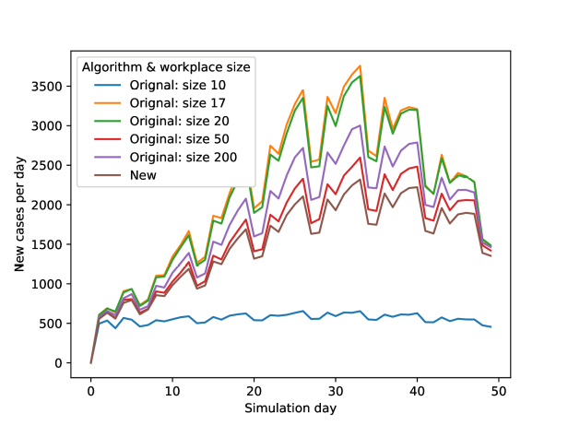
Workplace size distribution – Results
Seeding rate = 0.2%, immunity rate = 40%, R0 = 2

Slide 13
Features – Simulation: Belgium
Created files for Belgium:
  belgium_cities.csv to right format
  belgium_commuting.csv to right format
  household_config_belgium.xml added
  Population files for cities/provinces

Slide 14
Demo

