Slide 1
Multilevel Queue Scheduling: design, limits, and what it costs
A measured and verified study of MLQ, EDF, RM and mutual exclusion
Advanced Operating Systems — Exercise 6 seminar
Notes:
Good morning. In the next twenty minutes I will argue one thing: that our intuition about which scheduling algorithm is 'best' is usually wrong, and that the only way to settle it is to measure and, where possible, to prove. Everything I show you today comes from code I wrote and ran for this course, not from a textbook diagram.

Slide 2
1 — The problem
Notes:
Let me start by stating the problem precisely, because most of the confusion around scheduling comes from an imprecise statement of what we are optimising. Before we compare any two algorithms I want us to agree on what 'better' would even mean, and on why no single algorithm can be better at everything at once.

Slide 3
Multilevel Queue in one slide
• Several ready queues, each with its own priority and its own scheduling policy.
• A job is assigned to a queue once, by class: interactive, batch, system.
• Scheduling happens between queues first (fixed priority), then inside a queue (FCFS, SJF or RR).
• The between-queues rule is what makes it 'multilevel'; it is also where starvation comes from.
Notes:
Emphasise that MLQ is not one algorithm; it is a template. The interesting design decisions are how many queues, what policy inside each, and whether a job can ever move between queues. Fixed assignment is the classic MLQ; movable jobs make it a multilevel feedback queue, which is a different animal.

Slide 4
Design decisions that actually matter
• Number of queues: three is a convention, not a law.
• Policy per queue: RR for interactive, FCFS for batch.
• Time quantum inside an RR queue: too small wastes CPU on context switches, too large degenerates into FCFS.
• Aging: promote a job that has waited too long. With aging, starvation disappears; without it, it is guaranteed.
Notes:
This is the slide where the audience should write something down. The quantum choice is the one people get wrong: the folklore answer is 'about ten milliseconds', but the right answer depends on the cost of a context switch on your machine relative to your workload.

Slide 5
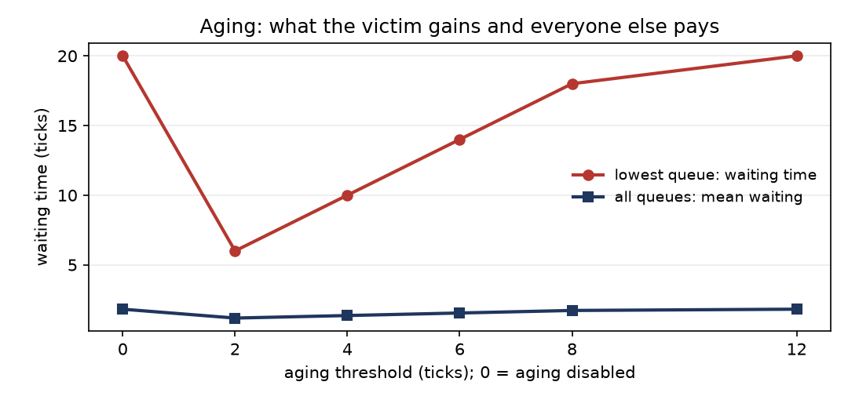
Design decision one: how patient should the scheduler be?
Aging threshold sweep. Red: waiting time of the lowest queue. Blue: mean waiting over all queues.
Notes:
This is the first design decision, and it is the one people usually skip. The red line is the job in the lowest queue; with aging switched off it waits twenty ticks. Turn aging on with a threshold of two and it waits six. Now look at the blue line, which is the cost to everyone else: it barely moves, and in fact it drops slightly. That is the argument for aging, and it is a measured argument rather than an appeal to fairness. At the right-hand end both lines flatten, because the threshold has grown past the length of the run and nothing is ever promoted. So there is a usable range, not a magic value.

Slide 6
2 — Method
Notes:
Before I show results, I want to spend two slides on how the results were obtained. This matters more than the numbers themselves, because a number without a method is just an assertion with a decimal point. I will separate the claims I measured from the claims I could actually prove, and I will not blur the two.

Slide 7
Two different kinds of claim
• Measured claims: 'under this workload and this machine, X was faster'. Sampling and timing.
• Proved claims: 'no execution of this algorithm ever breaks mutual exclusion'. Exhaustive enumeration.
• A passing test is a measured claim and can never become a proof.
• A proof is conditional on its model: here, sequential consistency and atomic loads and stores.
Notes:
This distinction runs through the whole project. In the scheduling part I can only measure. In the mutual exclusion part I could actually prove things, because the state spaces turned out to be tiny. I will come back to that.

Slide 8
3 — Results: scheduling
Notes:
Now the results. I will show four scenarios, then the comparison against the real-time algorithms. The four workloads are deliberately chosen to cover a comfortable load, a tight one, a case outside the periodic model, and a genuine overload, because an algorithm that only works at eighty percent utilisation is not finished.

Slide 9
Measured: MLQ against EDF and RM
Scenario | EDF misses | RM misses | MLQ misses | Utilisation
A — fair | 0 | 0 | 0 | 80.0 %
B — stress | 0 | 3 | 3 | 97.1 %
C — aperiodic | 0 | 3 | 0 | 90.0 %
D — overload | 31 | 10 | 10 | 100 % achieved
Notes:
Look at column two against column three. EDF never misses until the system is genuinely overloaded, and even then it misses differently. Now look at scenario C: MLQ actually beats RM there, even though MLQ has no notion of a deadline at all. That is luck, not design — and I say so in the paper.

Slide 10
What overload reveals
• At 123 % offered load, the processor still only achieves 100 %: the rest is simply work that cannot be done.
• EDF misses 31 jobs; RM and MLQ miss 10 each.
• EDF spreads the pain across all three tasks; RM and MLQ sacrifice the lowest-priority task almost completely.
• This is not 'EDF is worse at overload'. It is a different choice about who suffers.
Notes:
This is the slide I would defend in questions. A naive reading says EDF is worse because 31 is more than 10. The honest reading is that EDF refuses to protect any priority class, while RM and MLQ protect the high-priority tasks by abandoning the lowest one entirely. For a hard real-time system you usually want the second behaviour, and that is a design requirement, not a metric.

Slide 11
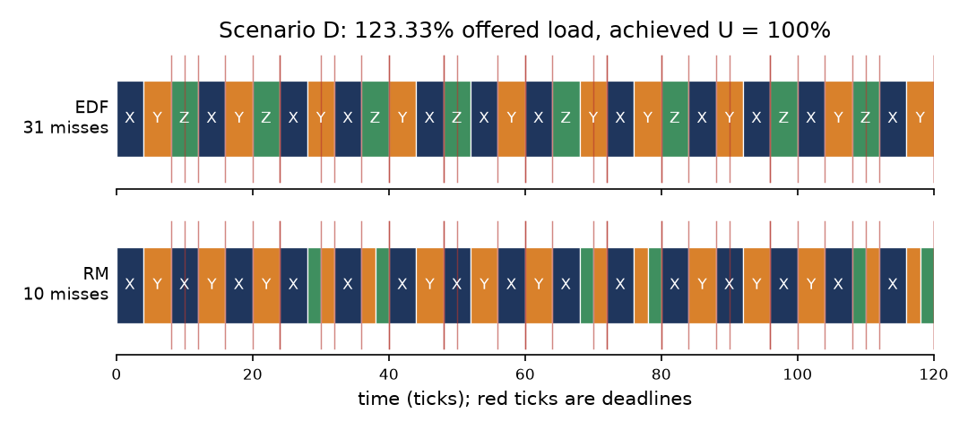
The same task set, two choices about who suffers
Scenario D, 123.33% offered load, 120 ticks. EDF above, RM below. Red ticks are deadlines.
Notes:
This slide is the one I would want people to remember. Same tasks, same 120 ticks, same processor. On the top, EDF: it refuses to protect any priority class, so all three tasks miss deadlines and the total is thirty-one. On the bottom, RM: it protects X and Y and abandons Z, and the total is only ten. If you only look at the miss count you conclude EDF is three times worse, and that conclusion is wrong. What actually differs is the choice about who suffers. In a hard real-time system you usually want the second behaviour on purpose, which makes it a requirement you write down, not a number you optimise.

Slide 12
Schedulability: what can be known
• For RM, the Liu–Layland bound n(2^(1/n) − 1) is sufficient but not necessary: at n = 3 it is 0.7798.
• Above the bound the test says nothing — you must run exact response-time analysis instead.
• For EDF with implicit deadlines, U ≤ 1 is both necessary and sufficient. No slack, no guessing.
• A random study over 2,329 task sets reproduced the familiar cliff: at 90–100 % utilisation only 17.8 % of sets were RM schedulable against 100 % for EDF.
Notes:
The bound is 0.7798 at n = 3 and approaches ln 2, about 0.693, as n grows. People quote the 0.69 figure as if it were the bound; it is the limit of the bound. And the random study is the honest way to say 'in practice': it is a sample of 2,329 sets with a fixed seed, so it is reproducible but it is still a sample.

Slide 13
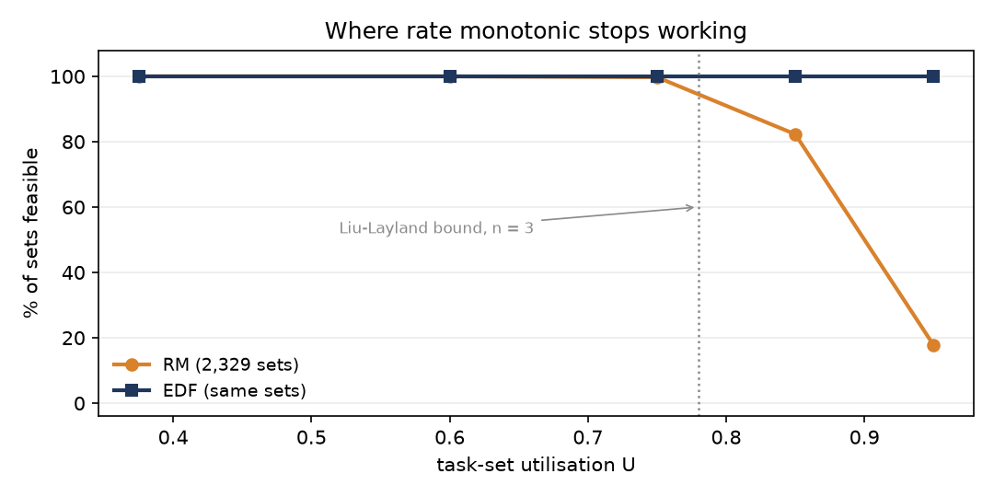
Where rate monotonic stops working
2,329 random task sets, seed 20250101, classified by utilisation.
Notes:
This is the headline number of the whole project. Orange is rate monotonic, blue is EDF, and the vertical axis is the percentage of randomly generated task sets that are schedulable. Below about seventy per cent utilisation the two are indistinguishable, both at a hundred per cent. Then the orange line falls off a cliff: 82.3 per cent in the next band, and 17.8 per cent in the top band. EDF stays flat at a hundred, exactly as the theory predicts for implicit deadlines. The dotted line is the Liu and Layland bound. Everything to its left is guaranteed by the bound alone; to its right the bound is silent and only the exact response-time test can answer.

Slide 14
4 — Results: mutual exclusion
Notes:
Second half. Same project, different question: not 'how fast' but 'is it correct'. Here I could stop measuring and start proving, because the state spaces of these mutual-exclusion algorithms turned out to be small enough to enumerate completely. That changes the kind of claim I am allowed to make.

Slide 15
Eight algorithms, checked exhaustively
Algorithm | States | Mutual exclusion | Deadlock free | Starvation free
Dekker | 324 | holds | yes | yes
Peterson | 199 | holds | yes | yes
lock variable | 60 | VIOLATED | yes | no
announce-then-spin | 55 | holds | NO | yes
test-and-set | 51 | holds | yes | NO
binary semaphore | 22 | holds | yes | yes
wrong lock order | 48 | holds | NO | yes
Mesa monitor | 54 | holds | yes | yes
Notes:
Eight algorithms, and the biggest state space is 324 states, which is why all of this can be exhaustive rather than sampled. Read the three failures, because they fail in three different ways. Lock variable loses safety. Announce-then-spin keeps safety and loses progress. Test-and-set keeps both and loses fairness. And the seventh row is my favourite: a perfectly correct primitive, used in the wrong order, deadlocks the whole system.

Slide 16
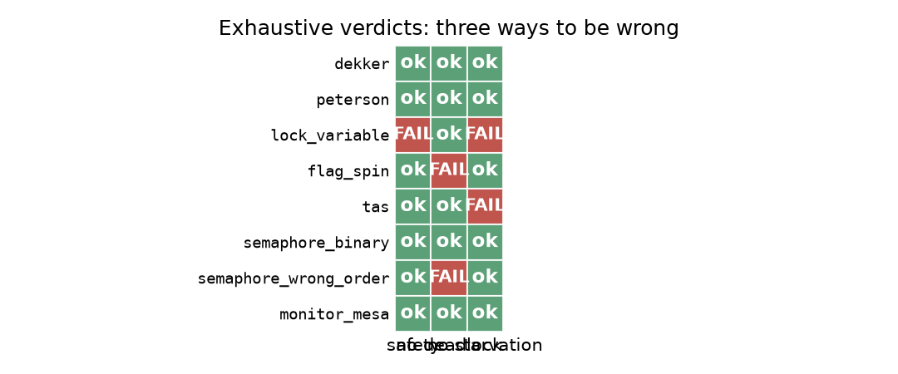
Three ways to be wrong
Every cell is an exhaustive verdict over the whole reachable state space, not a sample.
Notes:
I like this grid because it separates three things that testing tends to conflate. The lock-variable protocol loses safety: the read and the write are separate steps, so both processes can see the lock free. Announce-then-spin keeps safety and loses progress: both can announce before either looks. Test-and-set keeps both and loses fairness: nothing remembers who waited longest. Three columns, three distinct failure modes. And then look at the last-but-one row: the wrong-order semaphore has no red cell at all, because every property of the primitive holds, and it still deadlocks the program. That failure is in the caller, and no amount of verifying the primitive would have caught it.

Slide 17
Three failures, three lessons
• Look-then-announce: the read and the write are separate steps, so both processes can see 'free'. Safety lost.
• Announce-then-look: safe, but both can announce before either looks. Progress lost.
• Test-and-set: safe and live, but nothing remembers who waited longest. Bounded waiting lost.
• Each failure is invisible in a short test run.
Notes:
Note the symmetry between rows one and two: swapping the order of two adjacent lines converts a safety bug into a liveness bug. That is a genuinely surprising result and worth pausing on.

Slide 18
Deadlock is a usage error
• Four conditions are needed: mutual exclusion, hold-and-wait, no preemption, circular wait.
• None of them is about the quality of the lock.
• Measured: with opposite orders, thread 0 holds A and blocks on B while thread 1 holds B and blocks on A — every time.
• With a global lock order the identical program always finishes.
Notes:
I made this deterministic on purpose, with a barrier between the two acquisitions and a non-blocking second acquire, so it cannot be dismissed as scheduler luck. The takeaway for anyone writing multi-lock code: agree on an order, write it down, and enforce it in review.

Slide 19
Monitors: the abstraction that helps
• A monitor bundles state with the operations on it and guarantees one thread inside at a time.
• Condition variables let a thread wait for a predicate and release the lock while waiting.
• Under Mesa semantics a woken thread must re-check: measured at capacity 1, it had to wait again 1,383 times.
• That number is the argument for the while-loop, and it is not stylistic.
Notes:
If anyone asks why we do not just use `if`, the answer is on this slide: 1,383 times in one run, the predicate was false again by the time the woken thread got the lock back. Replace `while` with `if` and those become silent corruptions.

Slide 20
Readers and writers: fairness has a price
• Readers preference: 189,832 reads against 5 writes. The writer is overtaken essentially every time.
• Writers preference: the mirror image — 1,165,632 writes against 479,104 reads.
• Fair FIFO: a read share of 0.898, close to the arrival ratio of six readers to one writer, which is what fairness means.
• You cannot have maximum concurrency and no starvation simultaneously.
Notes:
Frame this as a trade-off, not a bug. Readers preference is the right answer when writes are rare and latency matters. Fair FIFO is the right answer when a stale write is dangerous. The point is to choose deliberately.

Slide 21
5 — Cost
Notes:
Finally, what all of this costs. These are medians over repeated runs, because a single timing on a shared machine is worthless. When I first measured this, the same workload varied by more than a factor of ten between runs, so reporting one number would have been reporting noise.

Slide 22
Under contention, blocking degrades gently
• Blocking mechanisms degrade gently: a blocked thread frees the CPU.
• With two or four threads the spinlock is actually faster — 554k and 624k ops/s against 525k and 532k. It only falls behind at eight threads: 477k against 494k and 511k.
• A spinlock is right only when the critical section is shorter than a context switch — true in a kernel, rarely in application code.
• If the lock holder is descheduled, every spinner wastes a whole time slice.
Notes:
Be careful here, because the obvious claim is wrong. At two and four threads the spinlock wins outright; the reason is that with a short critical section, spinning is cheaper than a kernel wait and wake. What changes at eight threads is not really the throughput, which only drops by about a quarter. It is the spin count: nearly six times the two-thread figure. That is CPU time bought by nobody, and on a machine where the lock holder can be descheduled it is a whole time slice wasted by every spinner. So the honest summary is not 'blocking is faster', it is 'blocking is predictable'.

Slide 23
6 — Conclusions
Notes:
Two minutes of conclusions, then questions. I will give you five take-aways, state the limitations of the work as plainly as I can, and then stop talking.

Slide 24
Limitations, stated plainly
• Single machine, shared sandbox, CPython with a GIL: the timings indicate relative cost, not absolute performance.
• The mutual-exclusion proofs cover two participants and assume sequential consistency.
• The schedulability study is a reproducible sample of 2,329 task sets, not a theorem.
• No claim here is about a specific commercial operating system.
Notes:
Do not skip this slide in the delivery. Stating limitations is what separates an engineering result from a marketing claim, and it is the first thing a good examiner will look for.

Slide 25
Reproducing everything
• Each exercise lives on its own branch, with its own README at the branch root.
• One command per artefact: the simulator, the experiment runner, the figure generator, the test suite.
• Reports are generated from content modules that read their numbers from the experiment output, so prose and code cannot drift apart.
• Bibliography entries were checked against publisher records; see REFERENCES.md.
Notes:
Point people at the repository. Everything in this deck is regenerable, including the deck itself, which is built by code/build_deck.py.

Slide 26
Questions
github.com/kaspian021/Multilevel-Queue-Scheduling
Notes:
Thank you. I am happy to take questions on any of the six exercises, and I can re-run any experiment live if that is useful.

