Slide 1
Research Name: Intel XeonProccesor
Name:
Nishu Akter
ID:UG02-48-18-017
Kaspia Tabbasom
ID:UG02-47-18-046
State University Of Bangladesh
Department Of Computer Science and Engineering

Slide 2
Abstract
In this research, we present an performance evaluation of a Intel Xeon Processor. This is the new version of Sandy Bridge processor for server and workstation market. It employs an integrated memory controller, dual Intel Quick Path Interconnect (QPI) port and integrated PCIe 3.0 controller. We assessed these architectural enhancements using the High Performance Computing Challenge (HPCC) benchmarks and NAS Parallel Benchmarks (NPB). For Interconnect analysis we have used the NetPIPE performance evaluator. We compare and contrast the results of cluster based on Intel Xeon Processor.

Slide 3
Outline
1.Introduction
2. Proposed methodogy
3. Advantages and disadvantages
4. Why this paper is unique?
5. Terminology usedin this paper
6. Conclusion
7. future work
8.Acknowledgments
9.Greetings

Slide 4
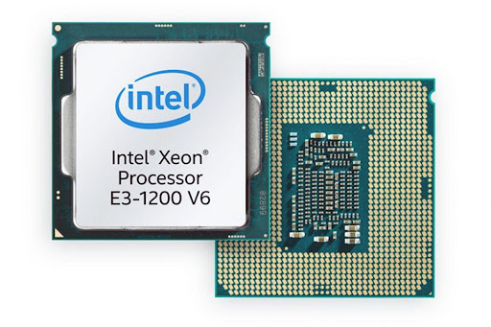
Introduction
An Intel Xeon processor is one of Intel's state-of-the-art central processing units (CPU). The Intel Xeon processors are definitely power processors. They have a large number of cores, and they also have special features that make them great for running intensive programs and mission-critical tasks. Many Supercomputer applications are unable to achieve good sustained performance due to memory bandwidth issue. The Sandy Bridge development team responded with a new architecture implemented in the Intel Xeon family. This new processor has been used to build a cluster with Fourteen Data Rate (FDR) InﬁniBand (IB) 14Gb/s data rate per lane. The architecture is a revolutionary product from several perspectives.

Slide 5
Proposed methodogy
The Intel Xeon processors are definitely power processors. They have a large number of cores, and they also have special features that make them great for running intensive programs and mission-critical tasks. Arguably the most important of these features is error-correcting code memory.
The Xeon used is the microprocessor as known as Knights Corner. The microprocessor has 57 physical in-order cores, and each one has 32 512-wide vector registers and supports four hardware threads. The device has a total of 6 GB GDDR main memory, and each core has 64 KB cache and 512 KB of cache. The Intel Xeon is built in a 22nm technology with Intel’s 3-D Trigate transistors. The operating system is the CentOS 7.0 with Intel MPSS version 3.7 and GDB 7.8 with Intel extensions. The tested device is protected with Machine Check Architecture (MCA) reliability solution, which includes ECC in memory structures .

Slide 6
Advantages
Intel Xeon is practically built for workstation computers.
The large number of cores and advanced RAM functions give it enough processing power and speed to handle the most intensive creative applications, from computer-aided design (CAD) to 4K video editing to 3D rendering.

Slide 7
Disadvantages
Some shortcomings that make Xeon processors unsuitable for most consumer-grade desktop PCs include lower clock rates at the same price point (since servers run more tasks in parallel than desktops, core counts are more important than clock rates). usually there is an absence of an integrated graphics processing unit (GPU).

Slide 8
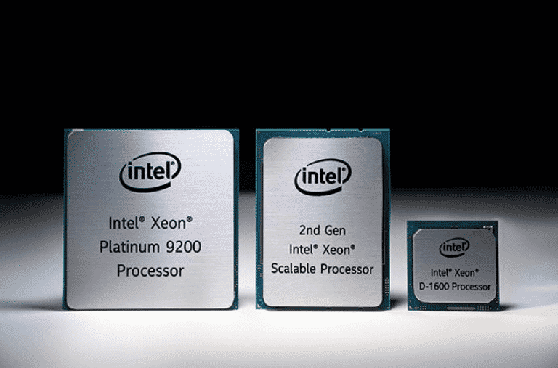
Why this paper is unique?
The Intel Xeon processors are definitely power processors. They have a large number of cores, and they also have special features that make them great for running intensive programs and mission-critical tasks. Arguably the most important of these features is error-correcting code memory.

Slide 9
Terminology used in this paper
Xeon processors support error checking and correcting memory so they are more stable and less prone to data corruption due to memory errors.
Xeon is a 400 MHz microprocessor from Intel for use in "mid-range" enterprise servers and workstations. On a server motherboard from Intel Xeon processors will be able to do multiprocessing sharing the same 100 MHz bus. Xeon is replacing the Pentium Pro as Intel's main enterprise microchip. Xeon is designed for Internet and large transactional database servers as well as for engineering, graphics, and multimedia applications that require moving a lot of data around quickly. Xeon is the high end of the Pentium line ( Celeron is the low end).

Slide 10
Conclusion
Though Intel has been the giant in the microprocessor industry, AMD(Advanced Micro Device) ,however, has been in the frontline of most innovative technologies. AMD manufacturer has succeeded in setting Intel on their toe. We are also considering of the opinion that if AMD was not in the processor world, probably Intel would have monopolized the industry. The slogan would have been “Intel and others”.
Further research can be carried out on a streamlined and thorough comparison on one subsystem in the Intel and AMD microarchitecture such as Memory Access technology or power management subsystem in a distributed environment.

Slide 11
Future work
Intel has revealed its most powerful generation of data centre processors yet as it looks to step up to the challenge of a smarter and more connected world. Advertisement The new Xeon Scalable processors provide the company’s greatest leap forward in performance in a decade, Intel says, “greatly aiding the development of compute-heavy technologies such as AI and 5G networks.This is our largest gen on gen performance improvement in the past decade”
..this is a revolutionary change.

Slide 12
Acknowledgments
I would like to thank my honourable Khan Md. Hasib Sir for his time, generosity and critical insights into this research.

Slide 13


