Slide 1
1. ASHKAM FEAT. ALI KARIMI
2. MIGIM KKK
3. EMROOZAM NASHOD
4. SARE SOBH
5. YAD

Slide 3
SORB

Slide 6



Slide 8

NET WORTH
80.7
10
STEVE BALLMER
BILLION
AGE: 67
NATURE CRISPE

Slide 9


NET WORTH
SOURCE OF WEALTH: MICROSOFT
10
80.7
STEVE BALLMER
BILLION
AGE: 67
NATURE CRISPE

Slide 10
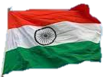
NET WORTH
SOURCE OF WEALTH: DIVERSIFIED
9
83.4
MUKESH AMBANI
BILLION
AGE: 65
NATURE CRISPE

Slide 11
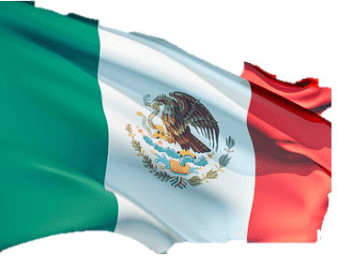
NET WORTH
SOURCE OF WEALTH: TELECOM
8
93.0
CARLOS SLIM HELÚ
BILLION
AGE: 83
& FAMILY
NATURE CRISPE

Slide 12
NET WORTH
SOURCE OF WEALTH: BLOOMBERG LP
7
94.5
MICHAEL BLUMBERG
BILLION
AGE: 81
NATURE CRISPE

Slide 13
NET WORTH
SOURCE OF WEALTH: MICROSOFT
6
104
BILL GATES
BILLION
AGE: 67
NATURE CRISPE

Slide 14

NET WORTH
SOURCE OF WEALTH: BERKSHIRE HATHAWAY
5
106
WARREN BUFFETT
BILLION
AGE: 92
NATURE CRISPE

Slide 15

NET WORTH
SOURCE OF WEALTH: ORACLE
4
107
LARRY ELLISON
BILLION
AGE: 78
NATURE CRISPE

Slide 16

NET WORTH
SOURCE OF WEALTH: AMAZON
3rd
114
JEFF BEZOS
BILLION
AGE: 59
NATURE CRISPE

Slide 17

NET WORTH
SOURCE OF WEALTH: SPACE X
2nd
180
ELON MUSK
BILLION
AGE: 51
NATURE CRISPE

Slide 18
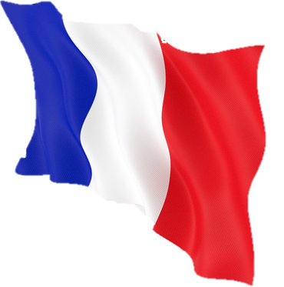

NET WORTH
SOURCE OF WEALTH: LVMH
1st
211
BERNARD ARNAULT
BILLION
AGE: 74
& FAMILY
NATURE CRISPE

Slide 20
