Slide 1
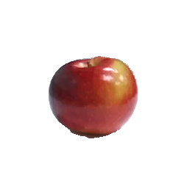
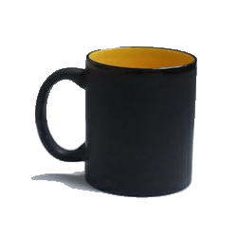


This is a red apple.
A coffee mug.
Modality 1: Text
Modality 2: RGB
Modality 3: Depth

Slide 2


This is a red apple.
A coffee mug.
Modality 1: Text
Modality 2: RGB
Modality 3: Depth

