Slide 1
XANDER LEARNING HUB
Run Your Entire School Online —
Enroll, Teach, Get Paid, Certify
The only platform built for language schools, training academies & education franchises
Study · Learn · Succeed Globally
Live at xanderglobalacademy.com · 2026

Slide 2
01
The Problem
Every day without a real platform, you lose enrollments

Slide 3
Your prospects are losing money every day
Sound familiar?
💸
🔀
😕
Revenue leaks
Tool chaos
Unprofessional image
Manual payments & follow-ups — students drop off before they pay
Zoom + WhatsApp + spreadsheets — nothing talks to each other
Learners judge credibility in 3 seconds — a weak site costs enrollments
⏳
📉
🏗️
Staff burnout
Can't scale
Build vs. buy trap
Hours wasted on admin instead of teaching
Adding a new campus or partner means starting from scratch
Custom dev costs $20K+ and takes 6–12 months
💡 Hook: "What if one platform enrolled students, collected payment, ran live classes, and issued certificates — under your brand, live this week?"
Xander Learning Hub · xanderglobalacademy.com · info@xanderglobalscholars.com
1

Slide 4
02
The Solution
One platform that runs your entire school

Slide 5
One platform. Zero chaos. Total control.
Already live — not a roadmap slide
Attract
Enroll
Teach
Grow
Stunning website, course catalog & meeting booking
Online signup, Stripe payments, instant confirmation
Live Zoom classes, materials, quizzes & recordings
Analytics, partner portals & marketing banners
Admin · Instructor · Learner · Partner — every role, one login ecosystem
Xander Learning Hub · xanderglobalacademy.com · info@xanderglobalscholars.com
2

Slide 6
The impact schools see
5 days
70%
To go live
Less admin time
From signup to first enrolled student
Automated enrollments, payments & emails
3×
1
More enrollments
Platform replaces 5+
Professional online presence converts better
LMS, Zoom, payments, booking, certificates
Xander Learning Hub · xanderglobalacademy.com · info@xanderglobalscholars.com
3

Slide 7
Built for education businesses that mean business
🌍
🎓
🏢
Language Schools
Training Academies
Corporate L&D
IELTS, TOEFL, DELF, business English
Professional & vocational programs
Upskill teams with proof of completion
🤝
🚀
🏛️
Franchise Networks
EdTech Startups
NGOs & Government
White-label portals per partner school
Launch fast without building from scratch
Skills programs at national scale
Xander Learning Hub · xanderglobalacademy.com · info@xanderglobalscholars.com
4

Slide 8
03
See It Live
Real screenshots from xanderglobalacademy.com

Slide 9
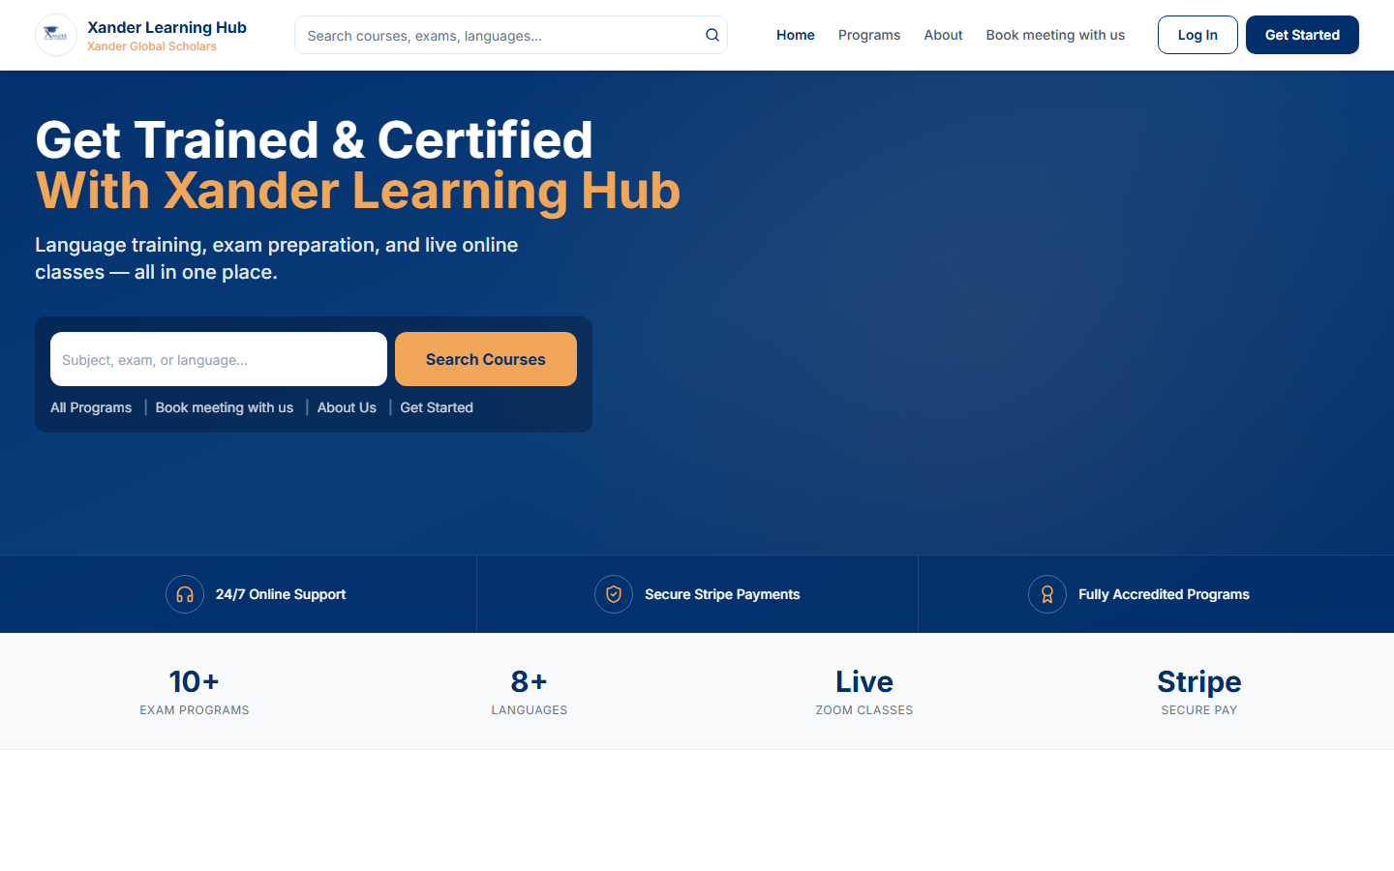
Your storefront — built to convert
First impressions win enrollments
● ● ●
xanderglobalacademy.com
Why it matters
Promo banners, featured programs, and bold calls-to-action. Parents and professionals judge credibility in seconds — this looks like a school they can trust.
Xander Learning Hub · xanderglobalacademy.com · info@xanderglobalscholars.com
5

Slide 10
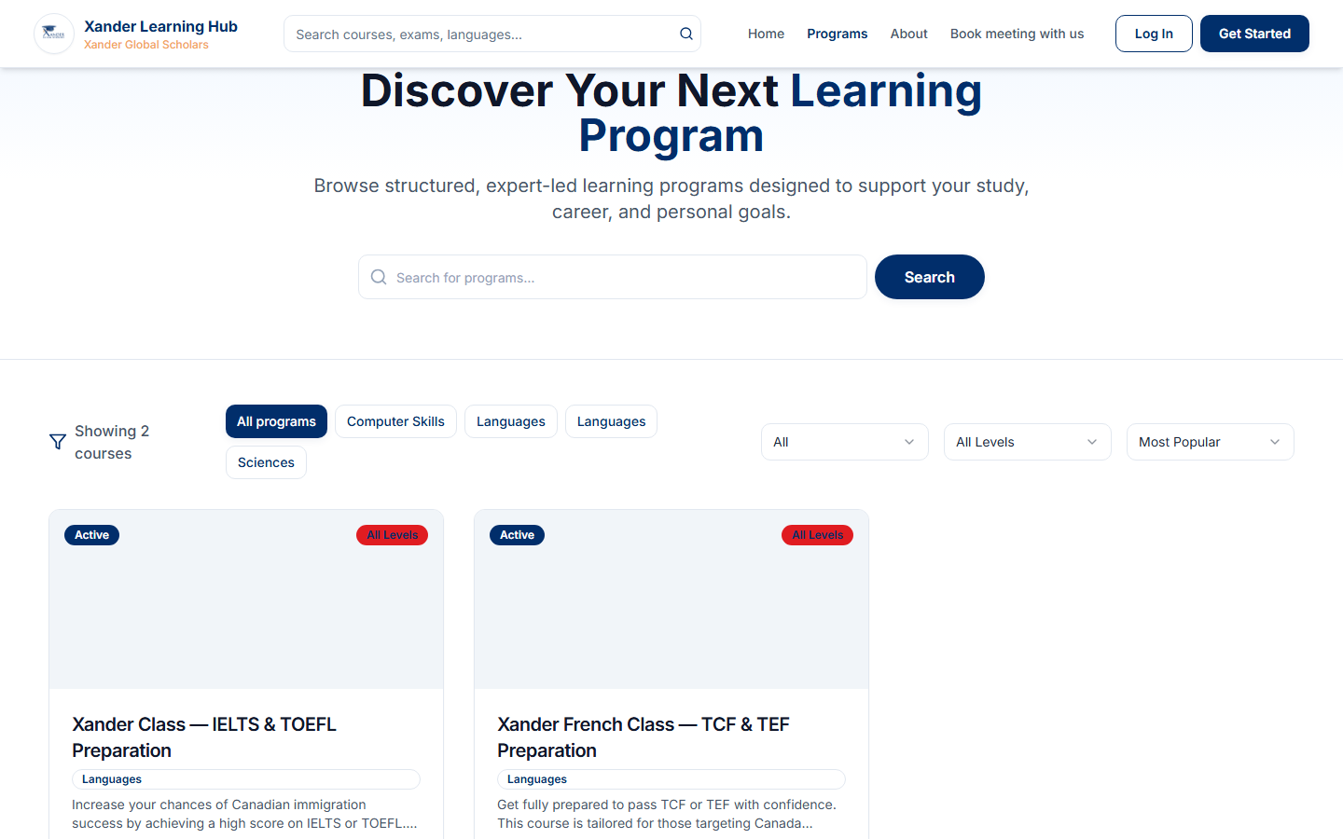
Sell programs 24/7
Revenue while you sleep
● ● ●
xanderglobalacademy.com
Why it matters
Course catalog with clear pricing. Learners browse, compare, and enroll without a phone call. No more "send me the fees on WhatsApp."
Xander Learning Hub · xanderglobalacademy.com · info@xanderglobalscholars.com
6

Slide 11
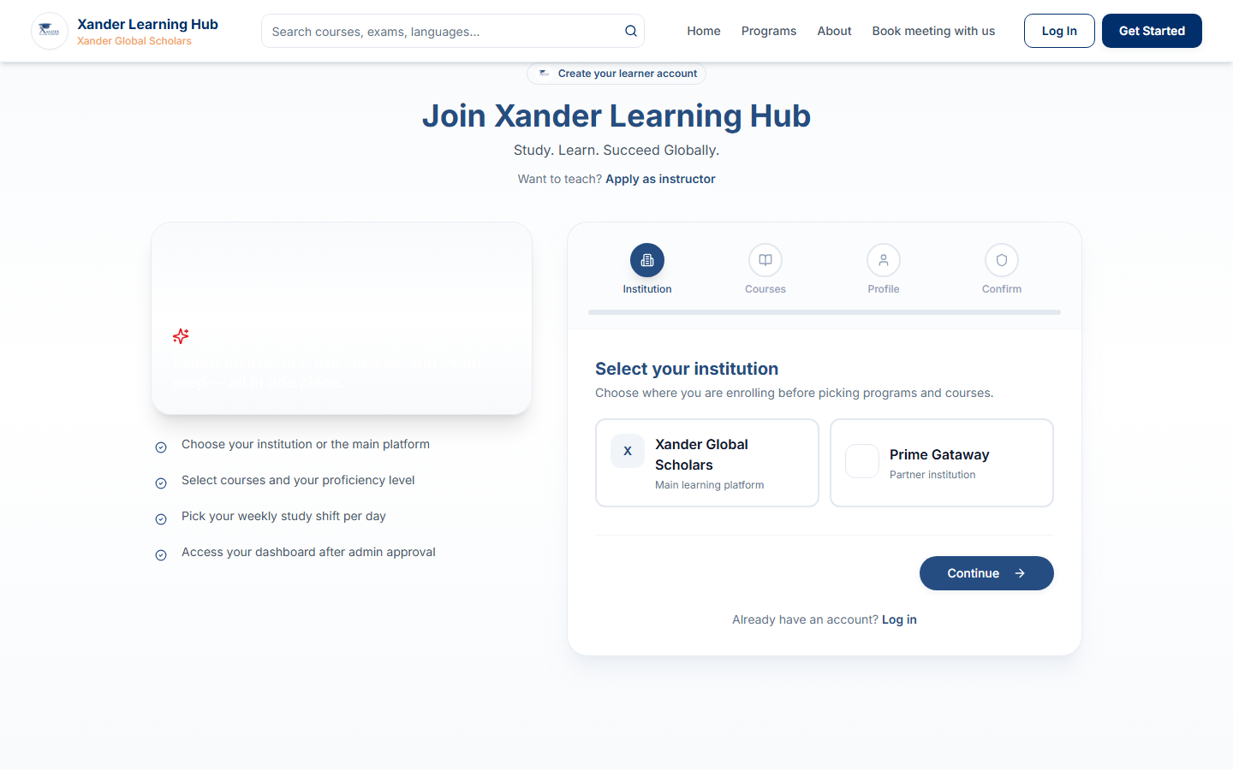
Enrollment in under 2 minutes
Friction kills sales
● ● ●
xanderglobalacademy.com
Why it matters
Branded signup with course and study-shift selection. Confirmation emails fire automatically. Your team approves — student starts learning same day.
Xander Learning Hub · xanderglobalacademy.com · info@xanderglobalscholars.com
7

Slide 12
Command center for your team
See everything. Control everything.
● ● ●
xanderglobalacademy.com
Why it matters
Dashboard
Command Center
Students
Students, revenue, courses, and live classes in one dashboard. No more switching between 5 browser tabs to answer one parent question.
248
$12.4K
18
Courses
Payments
Active Students
Monthly Revenue
Live Courses
Zoom
Reports
Xander Learning Hub · xanderglobalacademy.com · info@xanderglobalscholars.com
8

Slide 13
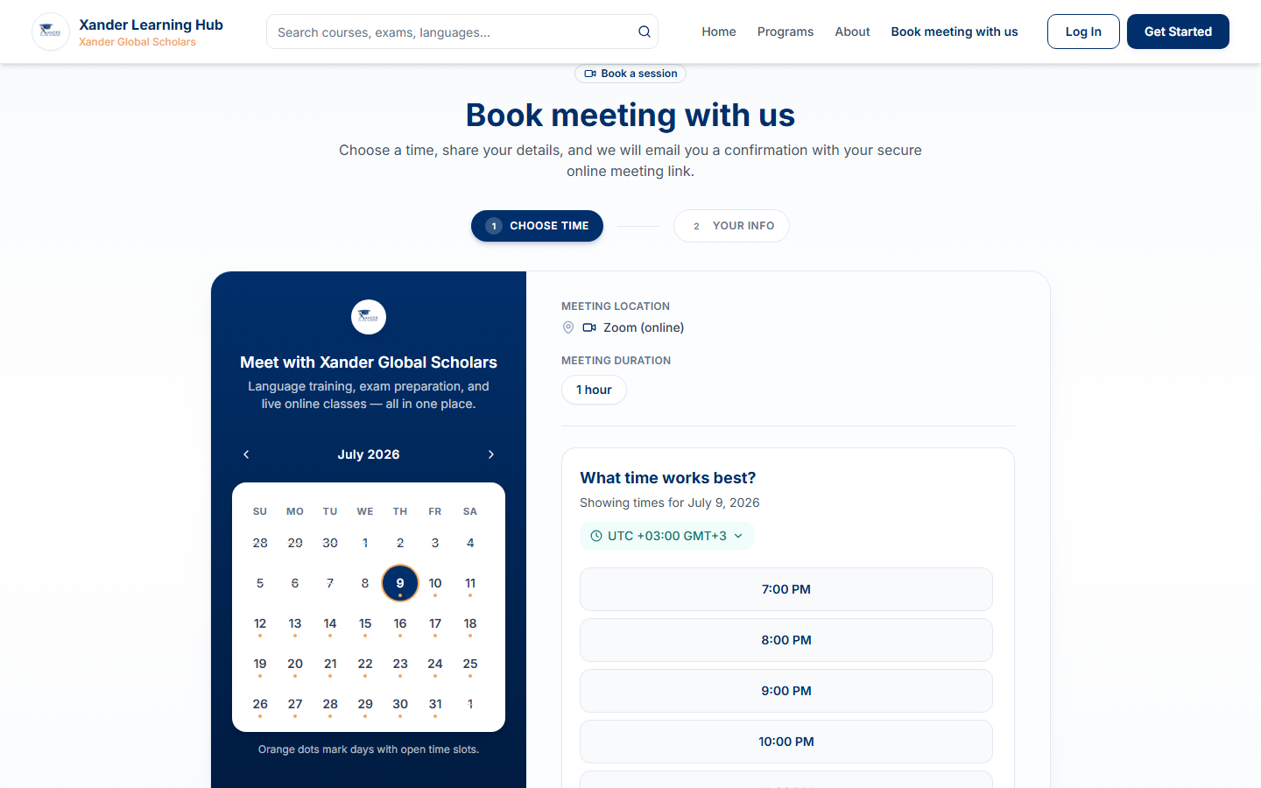
Leads book themselves
Never miss a prospect again
● ● ●
xanderglobalacademy.com
Why it matters
Calendly-style meeting booking built in. Prospects pick a slot, you approve, Zoom link sends automatically. Turn website visitors into sales calls.
Xander Learning Hub · xanderglobalacademy.com · info@xanderglobalscholars.com
9

Slide 14
04
Proof It Works
Schools like yours are already growing

Slide 15
CLIENT SUCCESS
Global Language Academy
IELTS & English · East Africa
180+
The Problem
What We Did
The Win
Enrollments on WhatsApp. Payments chased manually. Zoom links sent one-by-one — half the class missed sessions.
Launched 6 IELTS courses with Stripe, live scheduling, and branded portal. Live in 5 days.
94% fewer payment follow-ups
3× live class attendance
Auto certificates on completion
$8,200 new revenue in month 1
Learners in 8 weeks
"We went from embarrassing to impressive in one week. Parents finally trust us."
— Director, Global Language Academy
Xander Learning Hub · xanderglobalacademy.com · info@xanderglobalscholars.com
10

Slide 16
CLIENT SUCCESS
SkillsBridge Africa
Franchise Network · 4 Countries
4×
The Problem
What We Did
The Win
Each franchise used different tools. HQ had zero visibility. Corporate clients questioned brand consistency.
Deployed white-label partner portals — each school gets branded URL, scoped admin, central HQ reporting.
4 partners live in 30 days
Central revenue dashboard
2 new corporate contracts signed
40% faster onboarding
Faster partner launch
"We now sell school-in-a-box. Partners get a portal without hiring developers."
— CEO, SkillsBridge Africa
Xander Learning Hub · xanderglobalacademy.com · info@xanderglobalscholars.com
11

Slide 17
CLIENT SUCCESS
TechForward Institute
Corporate IT Training
100%
The Problem
What We Did
The Win
Training via email attachments. No progress tracking. Clients demanded proof of completion — we had none.
Live cohorts, AI quizzes, QR-verified certificates, and automated instructor payouts.
12 corporate batches delivered
Annual contract renewed
QR certificates closed the deal
Instructor payouts automated
Certificate verification
"The certificate QR code was the deal-closer. Clients scan and verify instantly."
— Head of Training, TechForward Institute
Xander Learning Hub · xanderglobalacademy.com · info@xanderglobalscholars.com
12

Slide 18
05
Investment
Transparent pricing. No surprises.

Slide 19
Simple pricing. Serious value.
No hidden fees · Cancel anytime · Annual plans save 20%
⭐ BEST VALUE
Launch
Scale
Enterprise
Perfect for pilots
Most schools choose this
For networks & franchises
$199
$399
Let's talk
/month
/month
✓ Up to 100 learners
✓ 5 courses · 2 instructors
✓ Stripe payments & receipts
✓ Zoom live classes
✓ Certificates & quizzes
✓ Email support
✓ Up to 500 learners
✓ Unlimited courses & staff
✓ Revenue & analytics dashboard
✓ Zoom recordings & cohorts
✓ Marketing banners & promos
✓ Meeting booking & webinars
✓ Priority support · 2-hr response
✓ Unlimited everything
✓ Partner institution portals
✓ Full white-label branding
✓ Dedicated onboarding manager
✓ 2-day team training included
✓ Custom integrations & API
✓ SLA + named account manager
🎁 Limited offer: Free setup + 2-day training for new schools signing before September 2026
Xander Learning Hub · xanderglobalacademy.com · info@xanderglobalscholars.com
13

Slide 20
Stop paying for 5 tools. Start growing.
WITHOUT XANDER
WITH XANDER SCALE
Website + LMS (Teachable/Moodle)
$79/mo
$399
Zoom Business
$22/mo
Calendly / booking tool
$15/mo
/month — everything included
Payment + invoicing tools
$35/mo
Website · LMS · Zoom · Payments · Booking · Certificates · Analytics · Support
Certificate / quiz platform
$29/mo
Developer maintenance
$50/mo
Save $-169+/month · ROI in the first enrollment cycle
Total: ~$230+/month
Xander Learning Hub · xanderglobalacademy.com · info@xanderglobalscholars.com
14

Slide 21
Why schools trust Xander Global Scholars
✓
Live & battle-tested
✓
Built for your market
Running in production at xanderglobalacademy.com — show, don't tell
African & global timezones, local payment flows, multilingual-ready
✓
Human onboarding
✓
Partner-ready
2-day Zero-to-Hero training — your team confident on day 3
Sell school-in-a-box with white-label portals per franchise
✓
All-in-one stack
✓
Real support
Zoom + Stripe + certificates + booking — no plugin puzzle
Book a meeting on the site — talk to humans, not chatbots
Xander Learning Hub · xanderglobalacademy.com · info@xanderglobalscholars.com
15

Slide 22
Handle any objection with confidence
"It's too expensive"
One enrollment often covers a month. Show the ROI slide — they save $230+/mo vs. 5 tools.
"We need more time"
Pilot in 5 days: 1 course, 20 learners, your logo. Low risk, high proof.
"We're not technical"
2-day training included. Admin is click-based — if you can use email, you can run this.
"We already use Moodle"
Moodle doesn't do Zoom cohorts, Stripe, partner portals & meeting booking in one UX.
"What about our data?"
Secure cloud hosting. Each institution's data is scoped and isolated.
"Can we brand it?"
Yes — logo, colors, custom portal URL. Partners get their own subdomain.
Xander Learning Hub · xanderglobalacademy.com · info@xanderglobalscholars.com
16

Slide 23
Your 15-minute winning demo
Practice until it's second nature
1
2
3
4
Wow them
Enroll
Control
Learn
Homepage + promo banner + star offer (2 min)
Live signup — pick course & shift (2 min)
Admin approves student & marks paid (3 min)
Learner dashboard — materials & live class (2 min)
5
6
7
Prove
Capture
Close
Certificate + Zoom recording (2 min)
Meeting booking → approval email (2 min)
Pricing + case study + pilot date (2 min)
Close line: "Your school could be live with your first paying student by next Friday. Shall we book your pilot?"
Xander Learning Hub · xanderglobalacademy.com · info@xanderglobalscholars.com
17

Slide 24
Your next 100 students
are already looking online.
Give them a school worth enrolling in.
Book Your Free Demo Today
info@xanderglobalscholars.com
xanderglobalacademy.com/meeting-registration
Free setup · 2-day training · Go live in 5 days

