Slide 1
XANDER LEARNING HUB
The All-in-One E-Learning Platform
for Schools, Training Centers & Global Education Brands
Study · Learn · Succeed Globally
Sales Pitch Deck · Xander Global Scholars · 2026

Slide 2
The challenge
What your prospects struggle with today

Slide 3
Pain points we solve
Scattered tools — Zoom here, payments there, spreadsheets everywhere
No branded learner experience — looks unprofessional to students & partners
Manual enrollment & payment tracking — errors, delays, lost revenue
Hard to scale live classes across time zones and cohorts
No certificates, analytics, or instructor payout automation
Expensive custom development — months to build, years to maintain
Sales hook: "What if one platform handled enrollment, payment, live classes, and certificates — under your brand?"
Xander Learning Hub | xanderglobalacademy.com | info@xanderglobalscholars.com
1

Slide 4
The solution
Xander Learning Hub

Slide 5
One platform. Complete control.
Beautiful public website with course catalog & online booking
Full admin dashboard — students, courses, payments, reports
Instructor portal — materials, quizzes, live classes, earnings
Learner portal — enroll, pay, learn, earn certificates
Partner institution portals — your clients get their own branded site
Built-in Zoom, Stripe, email notifications & marketing banners
Position as: All-in-one SaaS for education businesses — live today, not "coming soon".
Xander Learning Hub | xanderglobalacademy.com | info@xanderglobalscholars.com
2

Slide 6
Why organizations choose us
1
5+
Platform for everything
User roles built-in
Courses, payments, live classes, certificates
Admin, instructor, learner, partner, coordinator
24/7
100%
Online learning
Your brand
Materials, quizzes, progress anytime
White-label portals for partner institutions
Xander Learning Hub | xanderglobalacademy.com | info@xanderglobalscholars.com
3

Slide 7
Who is it for?
Ideal customers
Decision makers
Language schools & exam prep centers (IELTS, TOEFL, DELF…)
Universities & training academies
Corporate L&D departments
EdTech startups launching fast
Government & NGO skills programs
School owners & directors
Academic managers
IT / operations leads
Partnership & franchise managers
Training consultants
Xander Learning Hub | xanderglobalacademy.com | info@xanderglobalscholars.com
4

Slide 8
See it in action
Live platform screenshots — xanderglobalacademy.com

Slide 9
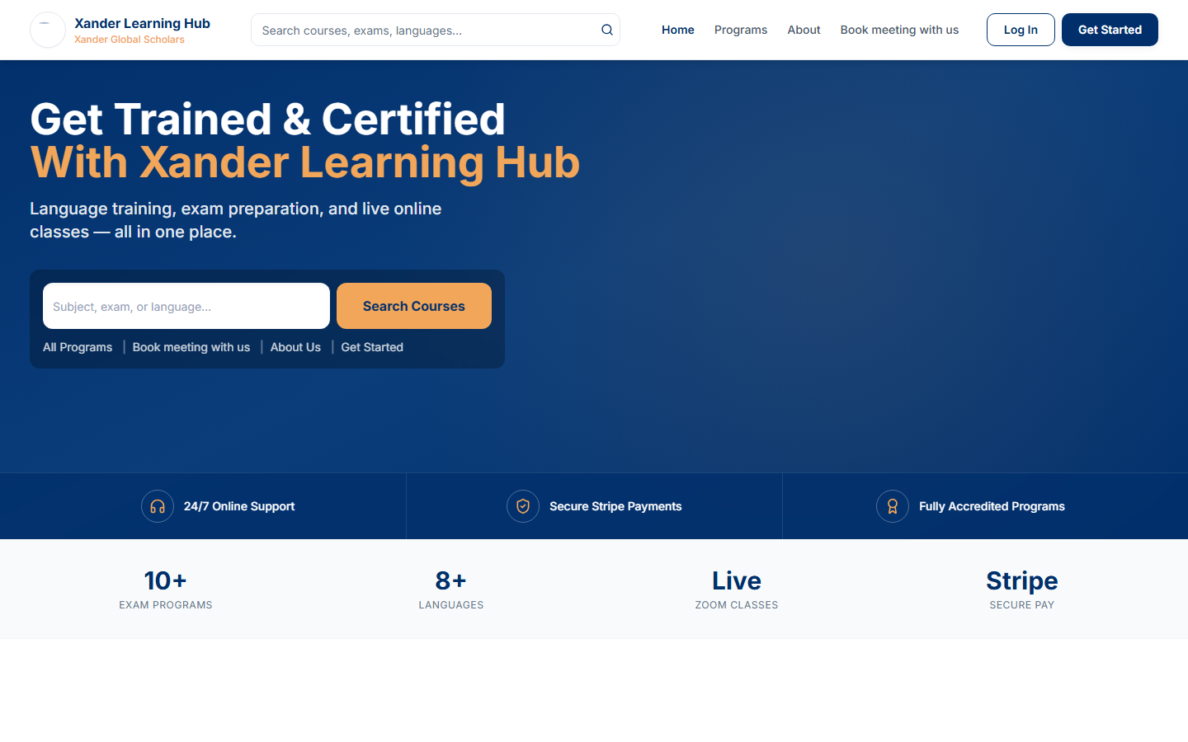
Homepage — professional first impression
● ● ●
xanderglobalacademy.com
Promo banners, featured programs, and clear calls to action. Replace with live screenshot: run node capture-screenshots.mjs
Xander Learning Hub | xanderglobalacademy.com | info@xanderglobalscholars.com
5

Slide 10
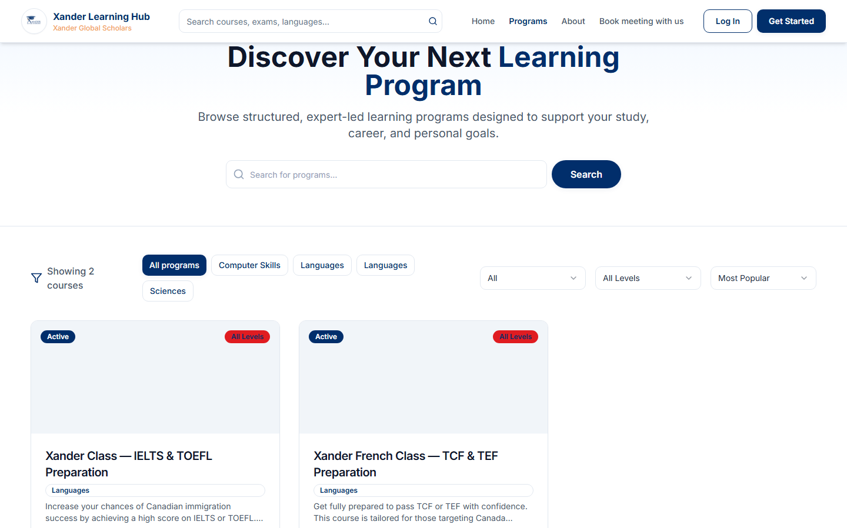
Course catalog — sell programs online
● ● ●
xanderglobalacademy.com
Searchable catalog with pricing, programs, and instant enrollment.
Xander Learning Hub | xanderglobalacademy.com | info@xanderglobalscholars.com
6

Slide 11
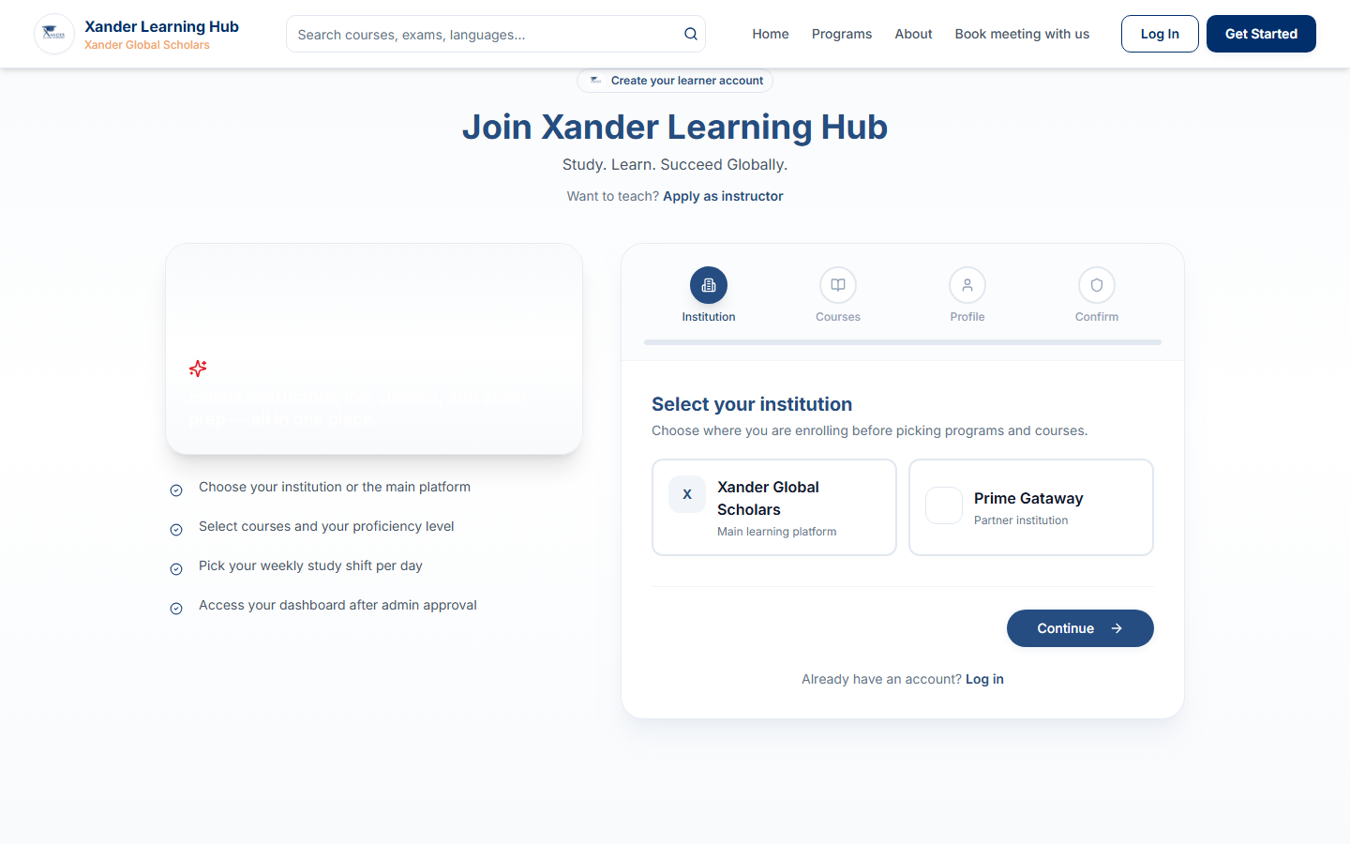
Learner signup — enroll in minutes
● ● ●
xanderglobalacademy.com
Branded registration with course selection and study shift — no paper forms.
Xander Learning Hub | xanderglobalacademy.com | info@xanderglobalscholars.com
7

Slide 12
Admin dashboard — full control center
● ● ●
xanderglobalacademy.com
Admin
Admin Dashboard
Dashboard
Students
248
$12.4k
18
Courses
Students
Revenue
Courses
Payments
Zoom
Marketing
Enrollment chart (6 months)
KPIs, enrollments, revenue, and one-click student management.
Xander Learning Hub | xanderglobalacademy.com | info@xanderglobalscholars.com
8

Slide 13
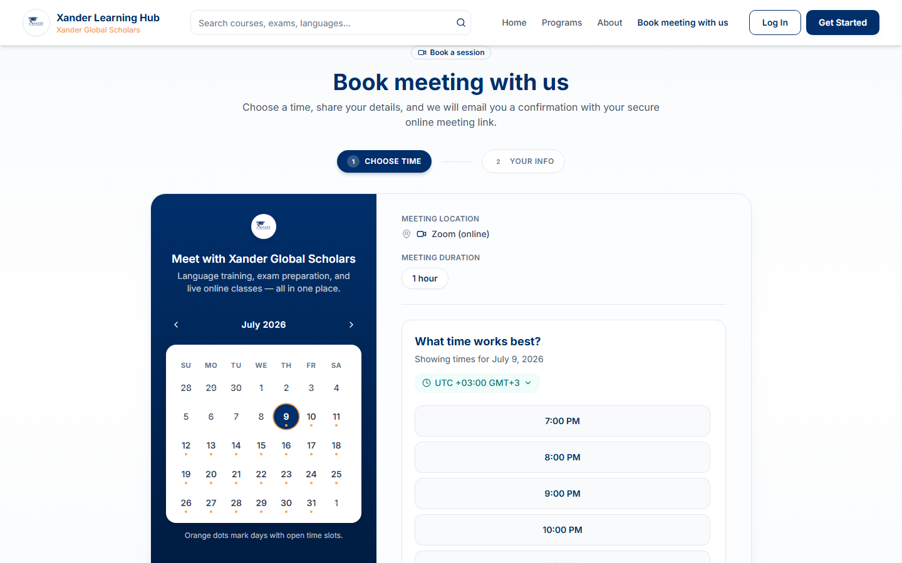
Meeting booking — Calendly-style lead capture
● ● ●
xanderglobalacademy.com
Prospects book appointments; staff approve and auto-send Zoom links.
Xander Learning Hub | xanderglobalacademy.com | info@xanderglobalscholars.com
9

Slide 14
Success stories
Real-world results from education businesses

Slide 15
Success Story
Global Language Academy
IELTS & English Training · Kigali
Challenge
Solution
Results
Ran enrollments on WhatsApp and Google Sheets. No online payments. Instructors shared Zoom links manually — learners often missed classes.
Launched Xander Learning Hub with 6 IELTS courses, Stripe payments, and live class scheduling. Branded signup page live in 5 days.
✓ 180 learners onboarded in 8 weeks
✓ 94% reduction in payment follow-ups
✓ 3× more live class attendance
✓ Certificates issued automatically
"We went from chaos to a professional school in one week. Parents trust us now because everything looks official."
Xander Learning Hub | xanderglobalacademy.com | info@xanderglobalscholars.com
10

Slide 16
Success Story
SkillsBridge Africa
Franchise Partner Network · 4 countries
Challenge
Solution
Results
Each franchise partner used different tools. No central reporting. Brand inconsistency hurt credibility with corporate clients.
Deployed partner institution portals — each franchise gets branded /join/school-name URL with scoped admin access.
✓ 4 partner schools live in 30 days
✓ Central revenue dashboard for HQ
✓ 40% faster partner onboarding
✓ Corporate clients signed 2 new contracts
"We sell school-in-a-box now. Partners love having their own portal without building technology."
Xander Learning Hub | xanderglobalacademy.com | info@xanderglobalscholars.com
11

Slide 17
Success Story
TechForward Institute
Corporate IT Training · Remote teams
Challenge
Solution
Results
Delivered training via email attachments and ad-hoc Zoom. No progress tracking, no certificates, no way to prove ROI to clients.
Uploaded course materials, scheduled live cohorts with waiting room, enabled AI quizzes and QR-verified certificates.
✓ 12 corporate batches completed
✓ 100% certificate verification rate
✓ Client renewed annual contract
✓ Instructors paid automatically via payout module
"Our clients finally see proof of training completion. The certificate QR code was the deal-closer."
Xander Learning Hub | xanderglobalacademy.com | info@xanderglobalscholars.com
12

Slide 18
Pricing & packages
Transparent plans your sales team can present

Slide 19
Pricing Plans
Flexible plans — customize for your prospect
MOST POPULAR
Starter
Professional
Enterprise
$149
$349
Custom
/month
/month
Up to 100 active learners
5 courses & 2 instructors
Stripe payments
Zoom live classes
Certificates & quizzes
Email support
Up to 500 active learners
Unlimited courses & instructors
Revenue & analytics dashboard
Zoom recordings & cohorts
Marketing banners
Meeting booking system
Priority support
Unlimited learners
Partner institution portals
White-label branding
Dedicated onboarding
2-day staff training included
Custom integrations
SLA & account manager
Annual billing: save 15% · Setup fee waived for Q3 2026 pilots · All prices USD
Xander Learning Hub | xanderglobalacademy.com | info@xanderglobalscholars.com
13

Slide 20
Add-ons & Implementation Services
Service | Details | Price
2-Day Staff Training (Zero to Hero) | Included in Enterprise · $800 standalone | On-site or virtual
Data Migration | From spreadsheets / old LMS | $500 – $2,000
Custom Branding Setup | Logo, colors, portal content | $300 one-time
Extra Partner Institution Portal | Per white-label school | $99/month each
Dedicated Zoom Setup | OAuth + recording config | $200 one-time
Priority Support Package | Same-day response SLA | $150/month
Xander Learning Hub | xanderglobalacademy.com | info@xanderglobalscholars.com
14

Slide 21
ROI: Replace 5 tools with 1
Website + LMS
$79/mo
Zoom Business
$22/mo
Calendly Pro
$12/mo
Payment gateway fees
varies
Certificate tool
$29/mo
Typical stack: $140+/month + dev time
Xander Learning Hub Professional: $349/month — everything included
Xander Learning Hub | xanderglobalacademy.com | info@xanderglobalscholars.com
15

Slide 22
Competitive advantages
✓ Live & deployed — not a prototype or mockup
✓ Zoom + Stripe + certificates integrated out of the box
✓ Multi-tenant partner institutions — scale B2B sales
✓ African & global timezone support built-in
✓ Calendly-style meeting booking for lead generation
✓ Admin "View as learner" — world-class support tool
✓ Customizable marketing without touching code
Objection handler: "We already use Moodle/Teachable" → Those don't include Zoom cohorts, partner portals, and local payment flows in one stack.
Xander Learning Hub | xanderglobalacademy.com | info@xanderglobalscholars.com
16

Slide 23
Objection handling cheat sheet
"Too expensive" → Show ROI slide: replaces 5 tools at $140+/mo
"We need time" → Pilot with one course + 20 learners in week 1
"Our team isn't technical" → 2-day training; admin UI is click-based
"What about data?" → Hosted on secure cloud; institution data scoped
"Can we brand it?" → Yes — full partner portal branding
"Integration?" → Zoom, Stripe, email — already connected
Xander Learning Hub | xanderglobalacademy.com | info@xanderglobalscholars.com
17

Slide 24
Demo script
15-minute winning demo flow

Slide 25
Step-by-step sales demo (memorize this)
1. Homepage — show promo banner + star offer + course catalog (2 min)
2. Learner signup — pick course + study shift (2 min)
3. Admin — approve student & enrollment, mark paid (3 min)
4. Learner dashboard — materials, live class, certificate (2 min)
5. Zoom — create meeting or show recording playback (2 min)
6. Meeting booking — public form → approve → email (2 min)
7. Close — show pricing + case study + book pilot date (2 min)
Always end with: "Your institution could be live with your first course by [date]."
Xander Learning Hub | xanderglobalacademy.com | info@xanderglobalscholars.com
18

Slide 26
Why Xander Global Scholars?
Mission: Study. Learn. Succeed Globally.
Proven platform running in production at xanderglobalacademy.com
Language training, exam prep & professional development focus
Human support — book a meeting directly on the website
Training & onboarding for your whole team
Roadmap driven by real school operations
Xander Learning Hub | xanderglobalacademy.com | info@xanderglobalscholars.com
19

Slide 27
Ready to transform your training business?
Book a live demo · Start your institution portal · Launch your first course this week
info@xanderglobalscholars.com
xanderglobalacademy.com · Book meeting with us online

