Slide 1

Intelligent Search Across Organizational Knowledge
University of Camerino
MSc Computer Science (AI) · Complex Systems Design
QUESTION
“Can I work from home?”
FOUND, DIFFERENT WORDS
Internal smart-working regulation, Article 3
source · page · passage id
AI Puzzle piece P14 · Final presentation
Ahmad Kassar
Professor: Flavio Corradini · November 2026
Notes:
Hello, I am Ahmad Kassar. My project is piece P14 of the AI Puzzle: a search engine for the documents of an organization. The idea in one picture: the user asks a question with his own words, the document uses different words, and the system still finds the right passage and shows exactly where it comes from.

Slide 2
Keyword search misses what people mean
User asks
“Can I work from home?”
Document says
“smart working arrangements”
0.16
User asks
“Fuel refund for a trip”
Document says
“mileage allowance for missions”
nDCG@10 of keyword search (BM25) on paraphrased questions, out of 1.0
No shared words, so a keyword search finds nothing. But for codes and article numbers ("Art. 12, comma 3") keyword search is still the best tool.
Measured in this project, 24 test queries
Notes:
The problem: people use everyday words, documents use formal or legal words. In the left examples there is not a single word in common, so classic keyword search fails. My own measurement confirms it: on paraphrased questions keyword search scores only 0.16 out of 1. But keyword search is still very good for article numbers and codes, so I do not throw it away: I combine it with semantic search.

Slide 3






What P14 does, in four steps
1 · Ingest
2 · Index
3 · Search
4 · Cite
Read PDF, Word, TXT and HTML safely; split into passages with stable ids
Turn every passage into a vector of 384 numbers (Qdrant) and a keyword index (SQLite)
Search by keyword and by meaning at the same time, then merge the two rankings
Return passages with document, article, page and offsets
Respects permissions
Each user sees only the documents allowed for their role.
Honest when unsure
If the evidence is weak, it says so instead of guessing.
Notes:
Four steps. One: ingestion, the system reads documents and cuts them into small passages, each with a stable id. Two: indexing. A small AI model turns each passage into 384 numbers that represent its meaning; texts with the same meaning get close numbers. Three: search, by keyword and by meaning together. Four: every result comes with its exact source. Two more rules: permissions are respected, and the system says when it is not sure.

Slide 4
P14 is a hub of the AI Puzzle
Send documents to index
Use the search
P11 Document reading
P14
Intelligent search
one REST / OpenAPI contract
P24 External assistant
P15 Meeting memory
P12 Document generation
P25 Expert knowledge
P15 · P25 Meetings, experts
Useful on its own, and ready to connect. In this project P24 and P12 are implemented as working mock consumers; P11, P15 and P25 are documented.
Notes:
The course framework has 26 pieces. Each piece must work alone and be ready to connect with the others. The links you see here are written in the framework itself: three pieces can send documents to P14, and four pieces can use its search. For the project I built two of these consumers as small working programs, P24 and P12; the others are documented.

Slide 5
Simple architecture: one service, two stores
Demo UI (Streamlit)
P24 mock
P12 mock
Document owner
REST API /v1 (FastAPI) API key → user role · search · documents · passages · feedback · version
Ingestion
Safe parser · passages with stable ids · embeddings · owner approval before search
Search (the AI core)
BM25 + dense search with the permission filter inside · rank fusion · citations · evidence check
Qdrant (Docker) 10,689 vectors, 384 numbers each
SQLite documents, passages, keyword index, logs
Notes:
The architecture is intentionally simple: one Python FastAPI service, one Qdrant database in Docker for the vectors, and one SQLite file for documents, the keyword index and the logs. Everything runs on my laptop, at zero cost. All clients, including the mocks of other pieces, use the same API. Important: the permission filter is applied inside both searches, not after, so a restricted passage can never leak.

Slide 6
Case study: a fictional public body, “Ente Demo”
32
25
10,689
real Italian official acts
synthetic internal documents
passages indexed
Normattiva and Gazzetta Ufficiale; not covered by copyright (art. 5, L. 633/1941)
Written by an LLM and clearly labelled; public, internal and restricted levels
from 57 documents in PDF, Word, TXT and HTML
Plus a public benchmark (BEIR SciFact, CC BY 4.0) used only as a sanity check. Internal documents are only 0.5% of the text: like a needle in a haystack of legislation, which makes the permission tests meaningful.
Notes:
I had no access to a real organization, so I built a fictional one, Ente Demo. The laws are real and public: official acts of the Italian State are not covered by copyright. The internal documents are synthetic, written with an AI tool, and I say it clearly everywhere. In total 57 documents and more than ten thousand passages.

Slide 7
How I measured it: tune, freeze, then test
1 · Tune
40 queries
Choose the AI model and the “not sure” threshold
2 · Freeze
SHA-256 hash
Lock the 70 test queries before any tuning
3 · Test
one run
Compare three systems, report every number
B0
Keyword search only (BM25): the baseline
Metrics: nDCG@10, Recall@10, MRR, correct source in top 3, latency, permission leaks. The 110 questions and their answers were drafted with an LLM: their review is my main open task.
S1
Semantic search only (dense vectors)
S2
Hybrid: B0 + S1 merged with rank fusion
Notes:
A scientific evaluation, not just a demo. I split 110 questions: 40 for tuning, 70 for the test. The important point: I locked the test questions with a hash before any tuning, so I could not adapt the system to the test. Then I compare three systems: keyword only, semantic only, and hybrid. One honest limit: the questions were drafted with an AI tool, so they need a human review.

Slide 8
Semantic and hybrid search clearly beat keyword search
+0.15
nDCG@10 gain of hybrid over keyword search (p = 0.0001)
S1 and S2 are close on this corpus: the difference between them is not significant.
Notes:
These are the real results on the frozen test set. Semantic and hybrid search are clearly better than keyword search on every metric. The gain in nDCG is 0.15, and the statistical test gives p equal to 0.0001, so it is not luck. Honestly, between semantic only and hybrid the difference on my data is small and not significant.

Slide 9
The biggest win: questions in everyday words
×3
On paraphrased questions semantic search scores 0.47 vs 0.16 for keywords.
English questions over Italian documents: keyword search finds nothing, the multilingual model works.
Notes:
This is the most important slide. With keyword-like questions all systems work well. With paraphrased questions, everyday Italian versus legal language, keyword search collapses to 0.16, while semantic search reaches 0.47: about three times better. This is exactly the problem P14 must solve.

Slide 10
My targets: four met, one missed
Target (mine, not official) | Measured (S2) | Result
T1 · Hybrid ≥ keyword on nDCG@10 and Recall@10 | 0.60 / 0.76 vs 0.45 / 0.56 | Met
T2 · Correct source in top 3 ≥ 80% | 76.7% | Missed
T3 · Correct “not sure” on out-of-scope ≥ 70% | 70% | Met
T4 · Response time p95 < 1.5 s | 77 ms | Met
T5 · Zero permission leaks | 0 leaks in 18,576 checks | Met
Why T2 was missed: legal vocabulary that users never use, the right document but a neighbouring section, and some correct answers that were not labelled. A reranker is the next step.
Notes:
I fixed these targets before running the test, and they are my own, not official requirements. Four are met. One is missed: the correct source is in the top three in 76.7 percent of cases, below my 80 percent. I report it honestly, and the error analysis explains why: mostly legal words that users do not use.

Slide 11
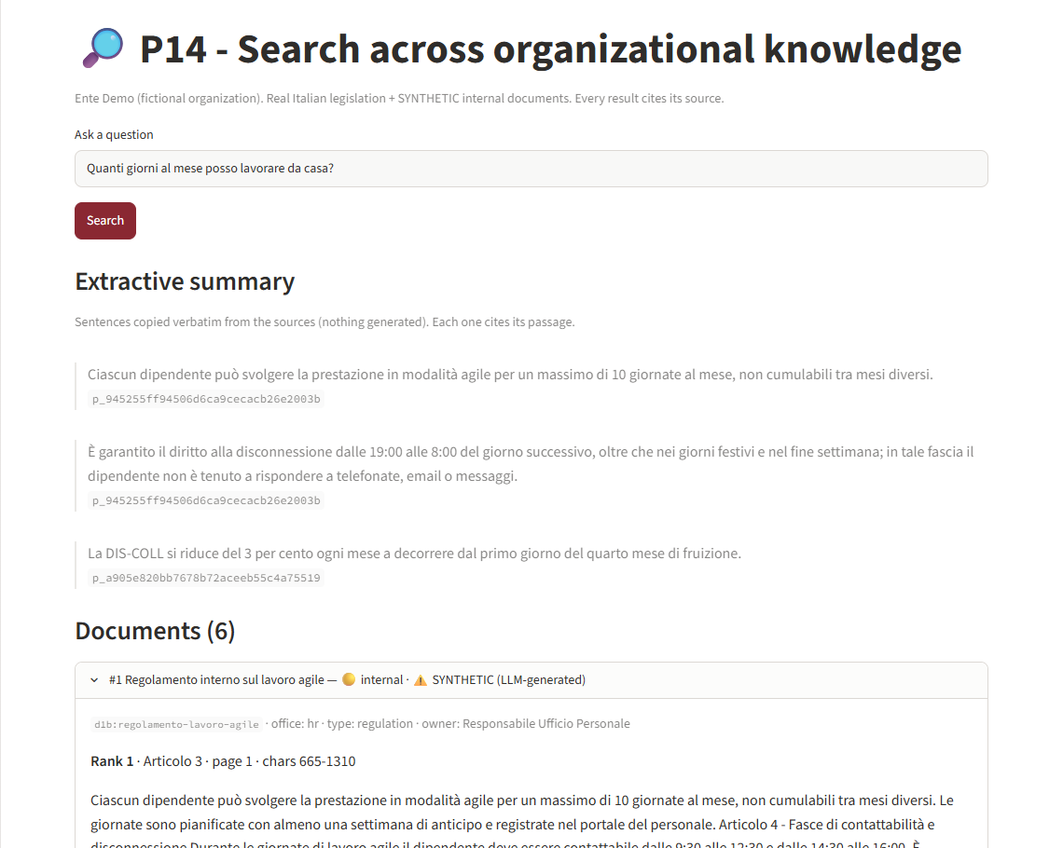

Demo: every answer shows its source
Question in everyday Italian
“Quanti giorni al mese posso lavorare da casa?”
Answer from the internal rule
Smart-working regulation, Article 3: max 10 days per month
Verifiable
Every sentence carries its passage id, page and offsets
Notes:
This is the real demo interface. An employee asks, in everyday Italian, how many days a month she can work from home. The first result is the internal smart-working regulation, article 3. The summary only copies sentences from the documents, and each sentence shows the id of its passage, so anyone can check it.

Slide 12
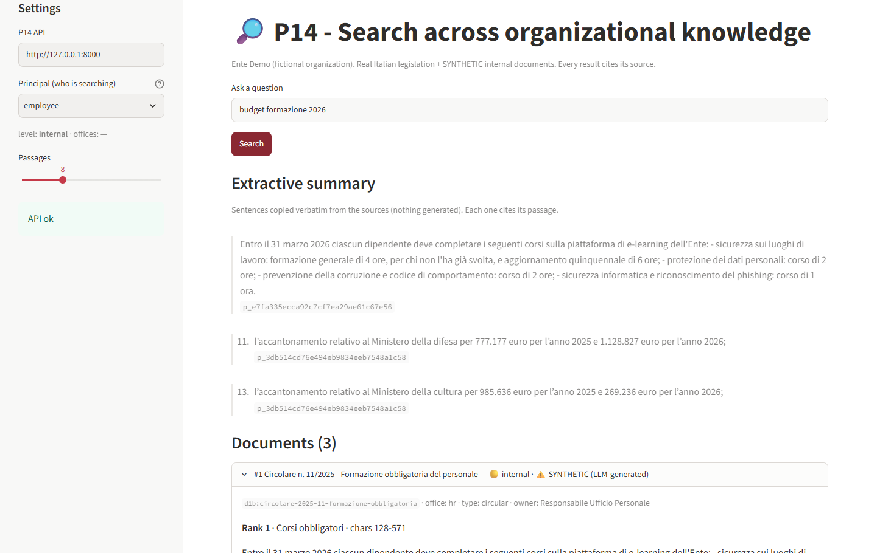
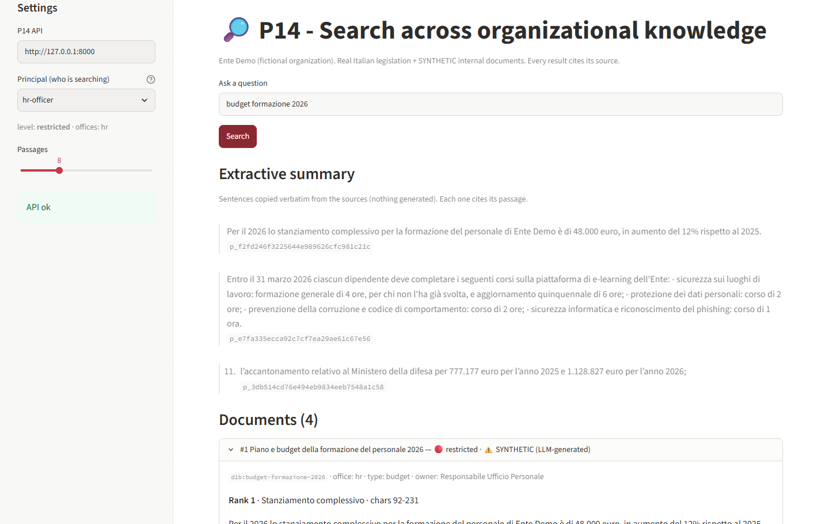
Same question, different permissions
Employee: the restricted budget is not visible
HR officer: the restricted budget is ranked first
Tested automatically: 0 leaks in 18,576 checks (9 roles × 70 queries × 3 systems).
Notes:
Permissions. On the left an employee asks about the 2026 training budget: the restricted budget document does not appear. On the right the HR officer asks the same question and sees it first. This is not only a demo: an automated test checked more than eighteen thousand results and found zero leaks.

Slide 13
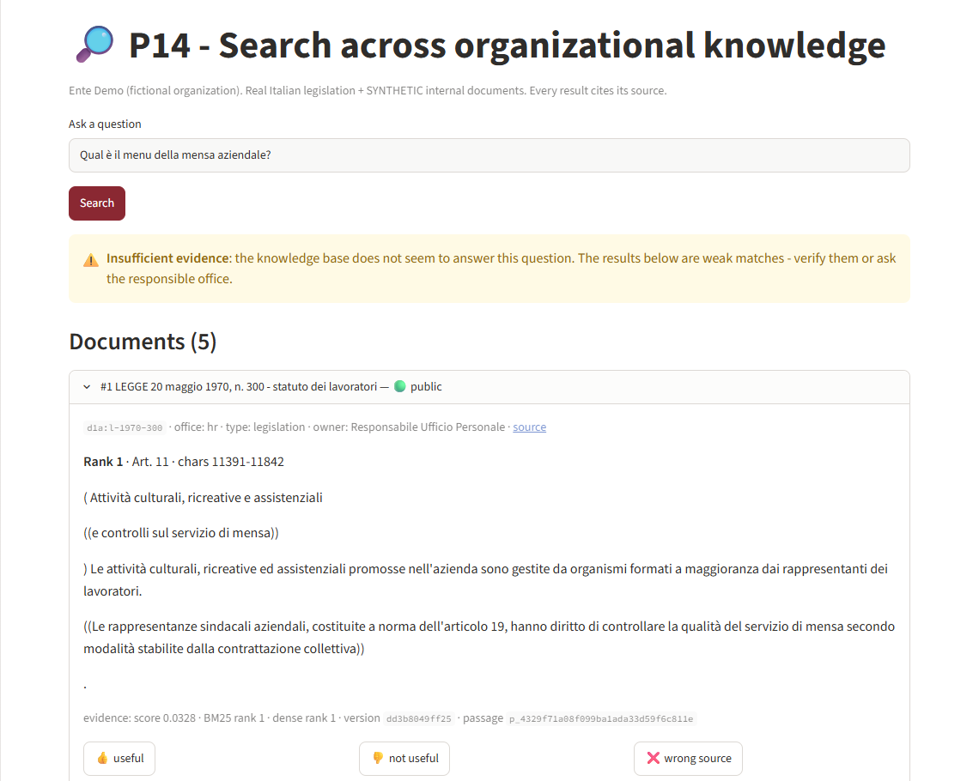



A person stays in control
Owner approval
A document becomes searchable only after its owner approves it
Says when unsure
The canteen menu is not in the documents: the system warns instead of guessing
Everything traced
Each answer records model, index version, passages and user feedback
Shadow mode
The new system can run silently next to the old one before it is trusted
Notes:
Human oversight. A person approves every document. When a question cannot be answered, like the canteen menu, the system warns instead of inventing. Everything is logged with versions, so every answer can be reproduced. And there is a shadow mode, to test the new system silently before trusting it; here it is simulated because there are no real users.

Slide 14
Ready to connect: a tested contract
POST /v1/search ranked passages, citations, evidence, versions
P24 External assistant
Sees only public passages; answers only from them; hands the case to a person when evidence is weak.
GET /v1/passages/{id} resolve a cited passage again
POST /v1/documents ingest a document, then owner approval
P12 Document generation
Builds a draft where every statement carries a passage id, checked again before use.
POST /v1/feedback store the user’s judgement
OpenAPI + JSON Schemas, with real input and output examples. A test fails if the API drifts from the contract.
Notes:
For the final composition of the puzzle, other groups need a stable contract. P14 exposes a versioned REST API described with OpenAPI. Passage ids are stable hashes, so another piece can cite a passage and find it again later. I implemented two consumers as mocks: P24, the assistant for citizens, and P12, document generation. One honest observation: once P24 answered from a weak public passage. Permissions held, but it shows why a reranker and a human check are useful.

Slide 15
Limits and next steps
Honest limits
Next steps
No real organization: internal documents are synthetic
Test questions and answers drafted with an LLM: need human review
Small test set: 60 in-scope and 10 out-of-scope queries
Real time saved by users not measured
Add a cross-encoder reranker to fix wrong sections
Calibrate the “not sure” threshold per language
Independent human judges for the test set
A real shadow phase with real users
Notes:
Being honest about limits is part of the method. There is no real organization, the evaluation questions need a human review, and the test set is small. The next steps follow directly from the error analysis: a reranker, a threshold per language, independent judges and a real shadow phase.

Slide 16
In one sentence
A small, fully local search system that understands meaning, always shows its sources, respects permissions, and is measured against keyword search, ready to plug into the AI Puzzle.
0.60 vs 0.45
0.47 vs 0.16
0 leaks
47 ms
nDCG@10, hybrid vs keyword
on paraphrased questions
in 18,576 permission checks
median response time
Thank you. Questions?
AI tools assisted drafting and coding; all decisions and results were reviewed by the author.
Notes:
To summarise: a small local system that understands meaning, always shows its sources, respects permissions, and is measured honestly against keyword search. Thank you, I am happy to answer questions.

