Slide 1

01
UNIVERSITY OF CAMERINO · FINAL PROJECT
STUDENT ASKS · ARABIC
متى آخر موعد لتقديم طلب المنحة الدراسية؟
UniBridge
UNIBRIDGE ANSWERS · ARABIC
الموعد النهائي هو 28 أغسطس 2026. [1]
TITLE
A multilingual assistant that answers international students from official Italian documents, in their own language, with the Italian source of every sentence.
[1] ERDIS call 2026/2027, Art. 10 · «entro il 28 agosto 2026, pena l'esclusione dal concorso»
17 LANGUAGES
it en ar fr es pt de ro sq uk ru tr fa ur hi bn zh
COURSE
Complex Systems Design
AUTHOR
Ahmad Kassar
SUPERVISOR
Prof. Flavio Corradini
20 sec
Notes:
UniBridge helps international students in Camerino with the rules they must follow: fees, career, admission and the regional scholarship. A student asks in their own language; the answer comes back in the same language, and each sentence points to the Italian passage it comes from. Here a question in Arabic and the deadline found in Article 10 of the call.

Slide 2
Objectives and research question
02
PURPOSE AND RESEARCH QUESTION
Can an assistant help international students with Italian rules without inventing anything?
PROBLEM
Fees, career rules, admission and the regional scholarship are described in Italian documents. Missing a deadline excludes a student from the scholarship (Art. 10 of the call). General chatbots do not show their source and can invent dates.
RESEARCH QUESTION
How well can search over official documents, a translation step and a verified language-model answer serve questions asked in many languages, and when must the system say "I don't know"?
OBJECTIVES
O1
Cited answers
Each sentence ends with its passage; the Italian original next to it.
O2
Every language
Detect it, search across languages, answer in it.
O3
Scholarship guide
Eligibility, checklist and calendar from fixed rules.
O4
Knowing the limits
Decline out-of-scope questions; e-mail to the right office.
PRIMARY METRICS
nDCG@10 · recall@10 · citation precision · answer language
DIAGNOSTIC METRICS
false "I don't know" · permission leaks · cost per answer · latency
55 sec
Notes:
The problem: rules in Italian, students who read other languages, and chatbots that do not cite. The research question asks how far search, translation and a verified answer can go, and when the system must stop and say 'I don't know'. Four objectives, each with the metric that measures it.

Slide 3
Three phases, one author
03
HOW THE WORK WAS ORGANISED
Each phase ends with a check that the next one depends on
PHASE 1
PHASE 2
PHASE 3
Search and evaluation method
hybrid search, permissions, frozen test sets
Documents and questions
official sources, FAQ questions, translations
WORK PLAN
Search by language
keyword, dense, hybrid; the Arabic test
Answers and verification
model answer, verifier, e-mail draft
Scholarship guide and languages
fixed rules, checklist, 17 languages
Demo and documents
screenshots, report, presentation
Gate 1
Search tested (permissions, contracts); evaluation method reproducible.
Gate 2
Test questions frozen with a SHA-256 hash before any tuning.
Gate 3
All tests green; every number checked against the result files.
60 sec
Notes:
I organised the work in three phases and did it alone. Phase one: the search and the evaluation method. Phase two: the documents and the questions, and the search measured by language. Phase three: the answers with verification, the scholarship guide, the extension to seventeen languages, and the demo and documents. Each phase ends with a check the next one relies on.

Slide 4
What each phase delivered
03
HOW THE WORK WAS ORGANISED
PHASE 1
Foundation
Safe parsing of PDF, Word and HTML; passages with stable ids; keyword and multilingual search with rank fusion; permissions applied inside the search; citations; a REST API with frozen contracts; the evaluation method.
PHASE 2
Data and first findings
42 official documents with licence and hash; roles for visitors, students and offices; real questions from official FAQ pages; English and Arabic versions; search measured by language. Finding: keyword search fails on Arabic.
PHASE 3
The assistant
Answers with a verifier and an extractive fallback; "I don't know" with an office e-mail; the scholarship guide; 17 languages; demo, report and presentation. Shown on Friday.
WORK PLAN
60 sec
Notes:
What each phase produced. The foundation was reused unchanged; the data phase gave the first finding about Arabic; the last phase built the assistant itself.

Slide 5
System flow and software architecture
04
ARCHITECTURE
One service · four components · an optional language model
01
Documents
Official sources parsed into passages with document, section and page. 2,330 passages.
02
Search
Keyword + multilingual embeddings, rank fusion; the user's permissions applied inside the search.
03
Answer
The model answers only from the numbered passages; a verifier drops unsupported sentences.
04
Student or office
Answer with Italian sources, or "I don't know" and an Italian e-mail draft. Nothing is sent automatically.
ARCHITECTURE
Without a key
No model configured: extractive answers, Italian sentences from the documents.
Passages are data
Wrapped in tags the text cannot close; the prompt says they are never instructions.
Cost control
Temperature 0, cached responses, every call logged, hard stop at 5 USD.
120 sec
Notes:
Four steps: documents become passages, the search finds them with the user's permissions, the model answers only from them and a verifier checks every sentence, and the student gets the answer or a draft for the office. Without a key the system still works with extractive answers.

Slide 6
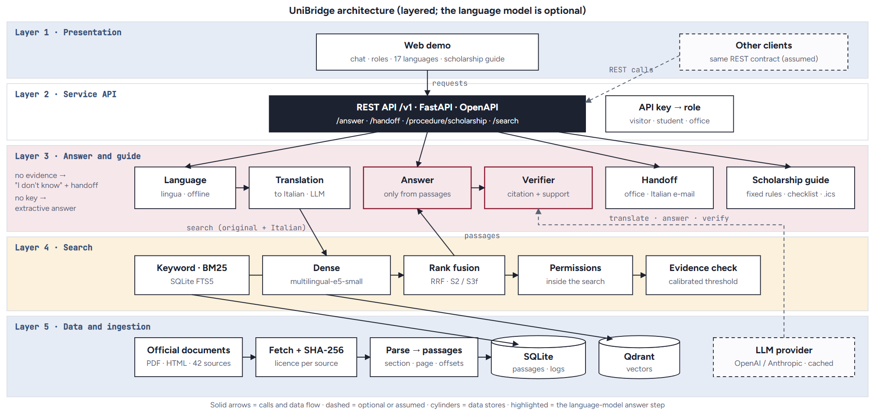
Five-layer structure
04
ARCHITECTURE
Five layers · one deployable service · an optional language model
ARCHITECTURE
Solid arrows: calls and data flow · dashed: optional or assumed. Without a key the language model and the dashed links disappear and answers are extractive.
120 sec
Notes:
The architecture in five layers. On top the web demo, and other clients through the same REST contract. The API maps the key to a role. The answer layer detects the language, translates the question, answers only from passages and verifies every sentence; next to it the handoff and the scholarship guide. Below, the search: keyword and dense, fused, with the permission filter and the evidence check. At the bottom the official documents, fetched with their hash, parsed into passages and stored in SQLite and Qdrant. The language model is external and optional.

Slide 7
A question and its constraints
05
FROM QUESTION TO ANSWER
One question follows the same route in every language
01
Language
Detected offline among 17 languages.
02
Search as written
Passages that share meaning or words with the question.
03
Translate and fuse
Italian translation, second search, rankings fused.
04
Answer and verify
One claim per sentence, each with [Pn]; unsupported sentences removed.
05
Show
Answer in the student's language next to the Italian original.
STUDENT JOURNEY
Weak evidence
No passage passes the threshold: "I don't know" in the student's language + e-mail draft.
Out of scope
A question about football or a gym: "I don't know", no e-mail.
Permissions
A visitor never gets an answer built from a student-only notice.
60 sec
Notes:
Every question follows the same route. The translation step matters most for languages far from Italian. Three constraints: weak evidence leads to 'I don't know' and an e-mail; out-of-scope questions get 'I don't know' without e-mail; and permissions are never crossed.

Slide 8
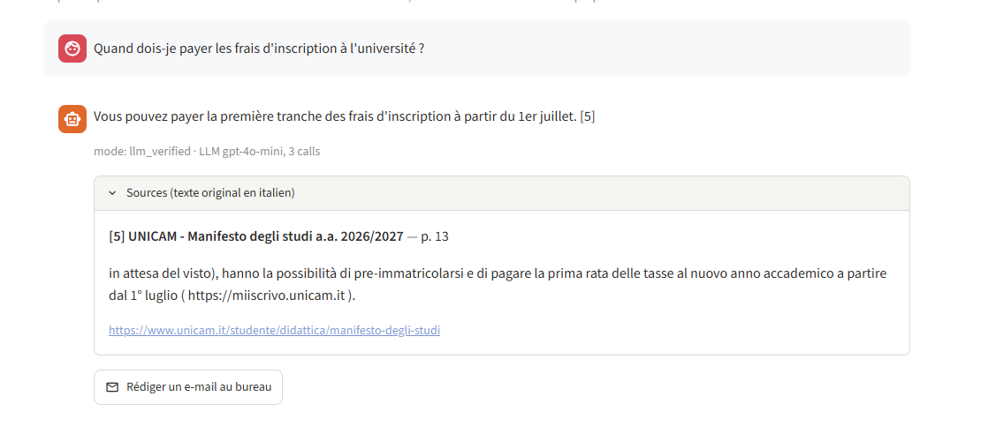
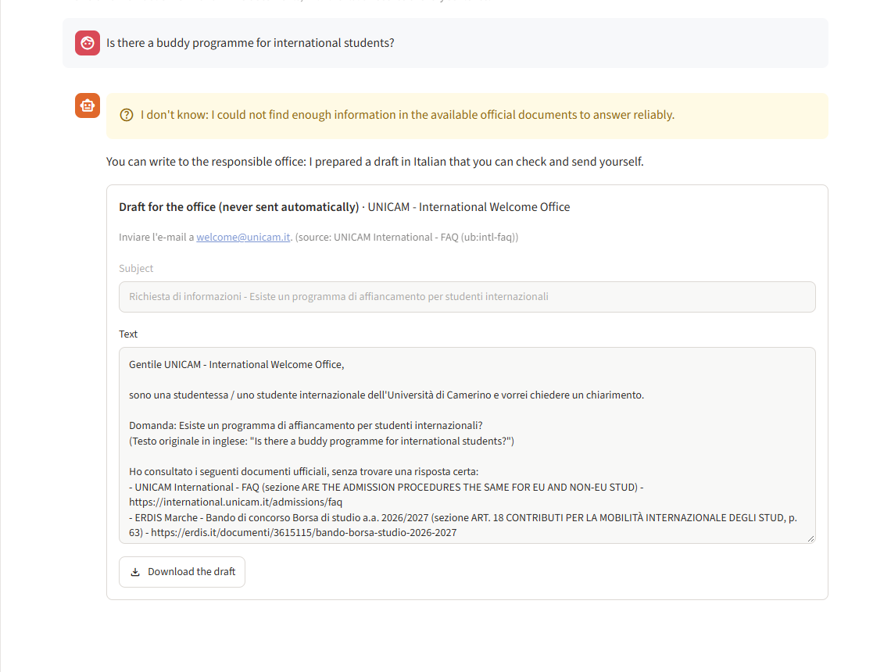
In the demo
05
FROM QUESTION TO ANSWER
STUDENT JOURNEY
Left: a French question, answered in French with the Italian source. Right: a visitor asks about a student-only programme and gets "I don't know" with a draft for the international office.
60 sec
Notes:
Two moments from the demo. A French question answered in French, with the Italian passage shown next to it. And a visitor asking about the buddy programme, which is described only in a student-only notice: the visitor gets 'I don't know' and a draft e-mail.

Slide 9
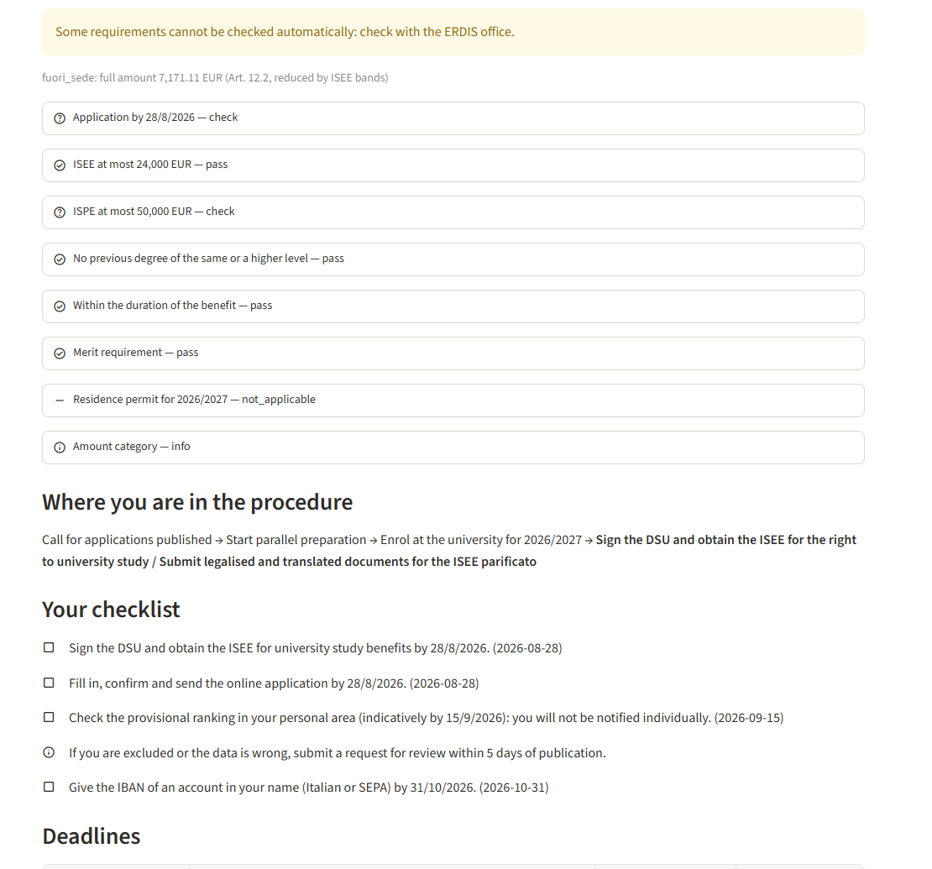
Scholarship guide
05
FROM QUESTION TO ANSWER
No language model
Credits by year, ISEE and ISPE limits, previous degree, residence permit and deadlines are checked by code, each rule with its article.
Where you are
The steps done and the next ones, from the student's facts and the date.
STUDENT JOURNEY
15 of 15 test scenarios correct
Fictional students with the checklist written from the call.
Nothing stored
Credits and ISEE stay in the request; never logged, never sent to the language model.
60 sec
Notes:
The guide is the part with no language model: eligibility has consequences, so the rules are code, each with its article of the call. Fifteen fictional students with their expected checklist are all correct.

Slide 10
Data sources and protocol
06
EVIDENCE
DATA SOURCE | INTENDED USE | REMAINING GAP
42 official documents | Corpus: 2,330 passages with section, page and offsets | One university and one call; a snapshot
Official FAQ questions (42 Italian) | Questions with known answers: the FAQ answer and the article it cites | Few questions per topic
Translations: 30 English, 30 Arabic, 616 in 14 more languages | The same questions in every language | Machine translations; native review pending
6 synthetic notes (labelled) | Test the roles: student-only and office-only content | Not real notices
DATA & EVALUATION
EVALUATION PROTOCOL
Tune on one split · freeze the test split with a SHA-256 hash · measure once · compare systems with paired randomization tests.
150 sec
Notes:
The corpus is official documents; the Italian test questions come from official FAQ pages, so the answer is known. The other languages are machine translations and still need native speakers. The test sets were frozen before any tuning.

Slide 11
Keyword search fails on Arabic
06
EVIDENCE
100%
of the 26 Arabic test questions: keyword search finds no relevant passage in the top 10.
DATA & EVALUATION
Permissions
0 leaks in 16,626 checked passages.
150 sec
Notes:
The first finding. For every Arabic test question, keyword search finds nothing relevant: the languages share no words. Multilingual embeddings recover part of it, but Arabic stays far below Italian.

Slide 12
Translate the question, then fuse
06
EVIDENCE
ALL 102 QUESTIONS
0.41 → 0.51
nDCG@10 with fusion · p = 0.0012
DATA & EVALUATION
English
Translation alone is worse: English questions find the English version of the call, which the ground truth rarely marks. Measured, not yet confirmed.
150 sec
Notes:
The model translates the question into Italian before the search. For Arabic this roughly doubles the score. For English translation alone is worse, probably because of the English version of the call. Fusing both rankings is the robust choice and is significant overall.

Slide 13
17 languages
06
EVIDENCE
99.8%
questions whose language is detected correctly
DATA & EVALUATION
99.5%
answers written in the language of the question
WITHOUT FUSION
"Insufficient evidence" for 74% of in-scope questions; 11% with fusion (p = 0.0001).
150 sec
Notes:
After the first evaluation I extended UniBridge to 17 languages and evaluated the same questions, translated and frozen, without any tuning. Fusion improves the ranking in every one of the fourteen added languages; without it the system would wrongly say 'insufficient evidence' for most of their questions.

Slide 14
Answers: extractive, model, model + verifier
06
EVIDENCE
102 TEST QUESTIONS | EXTRACTIVE (NO MODEL) | MODEL, NO VERIFIER | MODEL + VERIFIER
Answered (not "I don't know") | 69 of 102 | 87 of 102 | 86 of 102
Citation precision | 0.41 | 0.78 | 0.78
Sentences without a valid citation | 0% | 7% | 0%
Answer in the language of the question | 93% | 100% | 100%
"I don't know" on out-of-scope questions | 100% | 100% | 100%
Cost per answer (USD) | 0 | 0.00023 | 0.00032
Latency, median (ms) | 28 | 2,111 | 2,976
DATA & EVALUATION
The verifier's check uses the same model, so it is not an independent measure of faithfulness; a human review of 30 answers is the independent check (pending). In the 14 added languages citation precision is 0.87.
150 sec
Notes:
With the model, citation precision roughly doubles compared with sentences copied from the documents, and many more questions get an answer. The verifier removes every sentence without a valid citation, at the price of a few more 'I don't know' and a longer wait. Every out-of-scope question gets 'I don't know'. The cost is a fraction of a cent per answer.

Slide 15
What is done and what comes next
07
OUTCOME
01 · Assistant
Answers in 17 languages, each sentence with its Italian source.
02 · Guide
Eligibility, checklist and calendar from fixed rules.
03 · Evidence
Frozen test sets, results per language, reproducible numbers.
DISCUSSION
Questions?
Demo, report and code ready to show on Friday.
LIMITS
Non-Italian questions are machine translations; the ground truth misses some relevant passages; the verifier sometimes removes too much; one university, one call.
QUESTIONS
NEXT STEPS
Questions written by real international students and checked by native speakers; human review of answers; more documents after licence checks; per-language "I don't know" thresholds.
Use of AI tools: a coding assistant for code and documents; a language model for translations and answers (0.41 USD for the whole project). Declared in the report.
Ahmad Kassar · Complex Systems Design
30 sec + Q&A
Notes:
What is done: the assistant, the guide and the evidence. The main limit is the data: the non-Italian questions are machine translations. Next: real questions from international students, checked by native speakers. Thank you, I am happy to show the demo.

