Slide 1

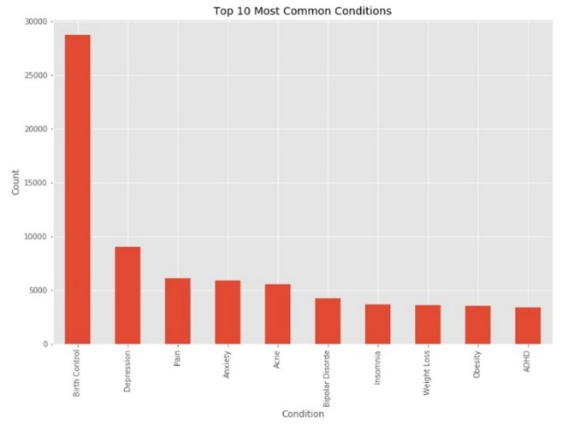
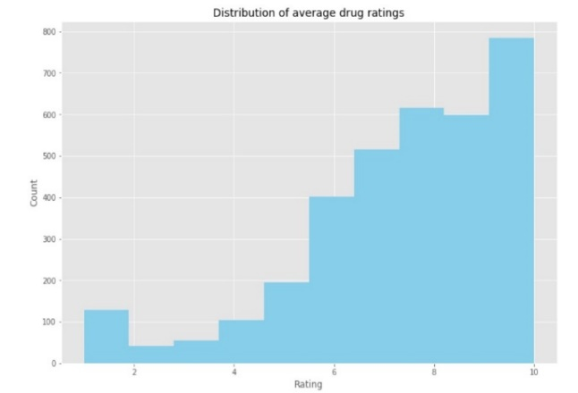
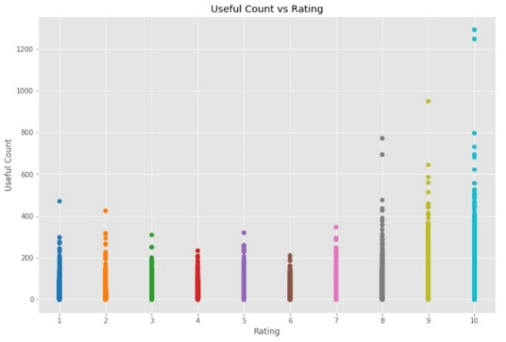
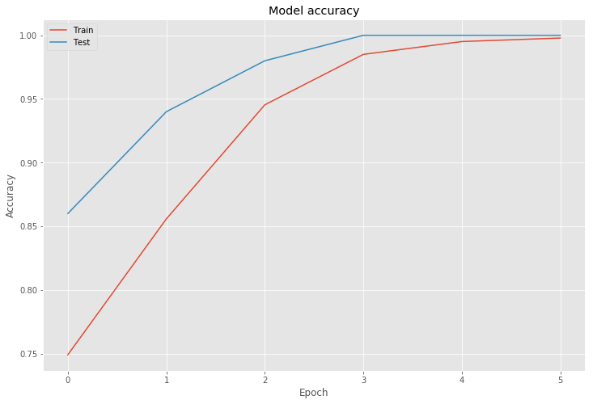
====
RECOMMENDATION OF MEDICINE BASED ON DRUG REVIEWS
154181G S.M.K.P. Senarathne 154075 I.M.P. Pathirana 154151P R.T. Jagoda 154198N L.T. Munasinghe 154081B Perera K.L.K.C.
Introduction
Methodology
Our goal is to implementing a recommendation system for patients based on drug reviews. The implementation mainly consists with data exploration, data preprocessing and building data models.
The reviews are based on sentimental analysis which is an automated process of understanding an opinion of a given subject.
Data exploration
As the initial part preliminary data exploration is performed to retrieve data on most common conditions, overall best and worst reviewed drugs and usefulness vs review score
Data preprocessing
Missing value removal : Do data imputations to replace them
Condition pre-processing : Delete the sentences and delete the condition only one drug
Review pre-processing : Conversions
Data Modelling
Simple Linear Regression on sentimental analysis
Random forest classification on reviews
Classification with Keras
Review score using neural networks
K-clustering on review analysis
Dictionary based sentimental analysis
Evaluation
Data exploration
Data Pre-processing
Model
Evaluate
Drug Review Data
Missing Value Removal
Conditional Pre-processing
Evaluation
From confusion matrix obtained from the classification with Sk-Learn and Random Forests it yielded 75% accuracy
The model accuracy obtained from Keras classification.
From the simple linear regression technique, the predictive score an error of 2.3 .
The prediction of review scores using the artificial neural networks gave a mean absolute error of 1.5.
Feature Analysis done by K-clustering
Cluster set 1: Cluster set 2:
cluster 1 accuracy: 0.614. number of words for cluster: 769 cluster 1 accuracy: 0.6385. number of words for cluster: 1000
cluster 2 accuracy: 0.6065. number of words for cluster: 543 cluster 2 accuracy: 0.674. number of words for cluster: 1000
cluster 3 accuracy: 0.6825. number of words for cluster: 2031 cluster 3 accuracy: 0.6045. number of words for cluster: 1000
cluster 4 accuracy: 0.6095. number of words for cluster: 455 cluster 4 accuracy: 0.659. number of words for cluster: 1000
Review rating based drug reviews using 4 clusters
Here we evaluate only model accuracy , recall , precision and F- measure
Problem in Brief
Model | Accuracy | Recall | Precision | F-measure
Random Forest | 0.75 | 0.9 | 0.199 | 0.325
Keras classification | 0.91 | 0.82 | 0.91 | 0.86
Simple linear regression | 0.6 | 0.75 | 0.67 | 0.74
ANN | 0.83 | 0.97 | 0.48 | 0.65
Recommendation of drugs without side effects to the patients
Finding the best review from a pool of drug reviews.
Finding the most appropriate drug for a sickness.
Limitations
Literature Cited
Sentiment analysis using sentiment word dictionary has low reliability when the number of positive and negative words is small
UsefulCount may tend to be higher for older reviews as the number of cumulated site visitors increases. Therefore, we should have also considered time when normalizing usefulCount.
Only about 5000 data can be used for K-Mean Clustering based on 4 clusters because less computational power
[1] S. A. A. a. W. Bhaya, "Review of Data Preprocessing Techniques in Data Mining".
[2]P. G. Jasdeep Singh Malik, "A Comprehensive Approach Towards Data Preprocessing Techniques & Association Rules".
[3]Z. B.-w. Shen Rong, "The research of regression model in machine learning field".
Dataset
Using UCI ML Drug review dataset with these attributes :
uniqueID
drugName
condition
reviewPatient
Date
usefulCount
Results and Conclusion
Neural network using Keras classification gives the best overall accuracy of 91.4%. We choose the model here based only on the accuracy.
Depending on the approach this could have been framed as either a classification or regression problem
When developing insights and meaningful conclusions, feature exploration is suitable.
Working with NLP problems, artificial neural networks and recurrent neural networks are beneficial.
K- Clustering is not appropriate because of less accuracy

