Slide 1

Literature Review: The Machine Learning Approach to Spotify’s Discover Weekly Playlists
Author: Kassie Garcia
Course: CS4253 Machine Learning
Notes:
my project consists of reviewing several different pieces of literature: mostly, it was literature published from Spotify employees and interns. Some of it may be outdated, as most of this information comes from when Discover Weekly was first implemented, and we can probably assume their recommendation system now does a lot more work with neural networks. So, my review here will cover the Machine Learning approach that Discover Weekly was first built on.

Slide 2
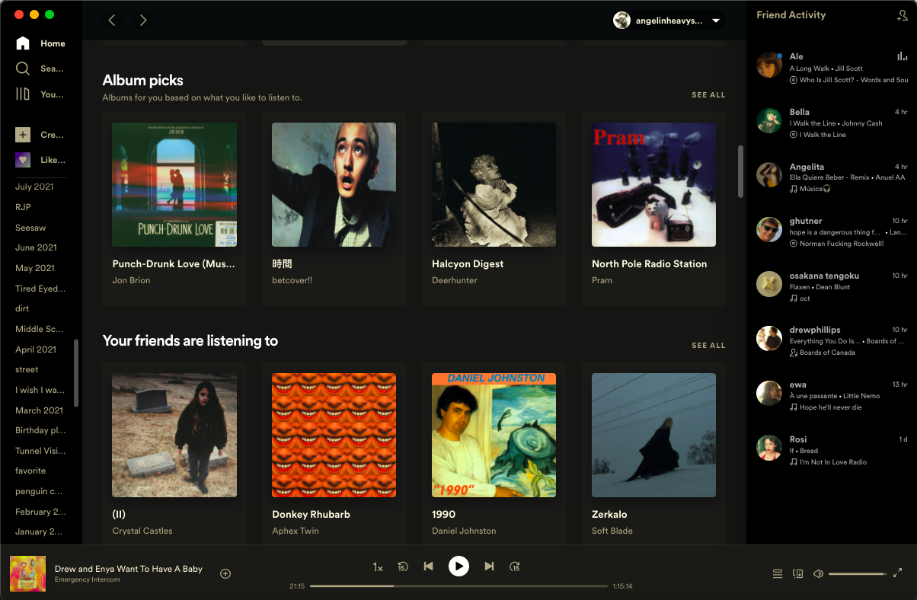
Introduction: What is Spotify?
Spotify Homepage
World’s most popular on-demand music streaming service
422 million active users as of Q1 2022
188 million users who subscribe to Spotify’s services
Offers access to digital items such as music, podcasts, and videos from creators from all over the world

Slide 3
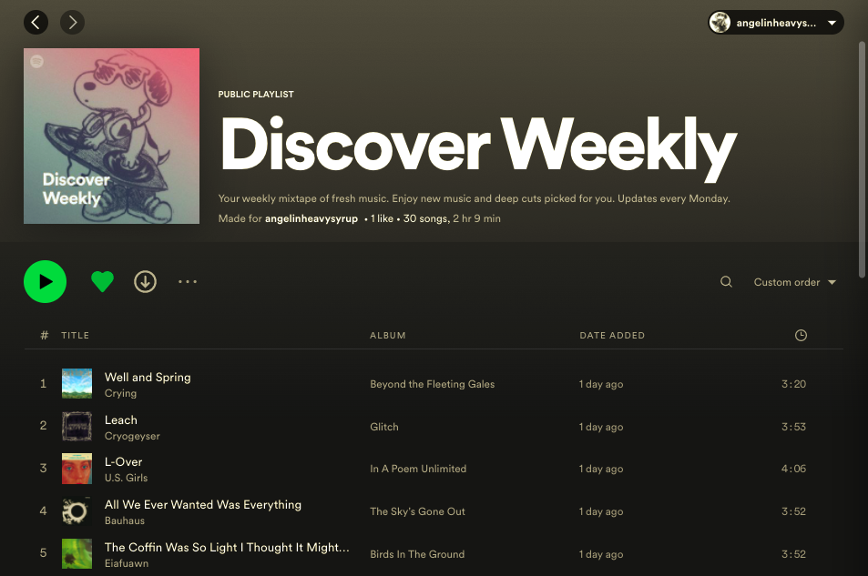
Introduction: What is Discover Weekly?
Discover Weekly Playlist
Spotify’s Discover Weekly is a music recommendation system that curates a unique playlist of songs tailored to a user’s interests and personality.
Launched in July 2015
30 songs
Updates every Monday with a new set of songs
Consists of songs from genres I often listen to, such as: indie rock, post-punk, pop, and more.
Also, will recommend new songs from bands I have liked.

Slide 4
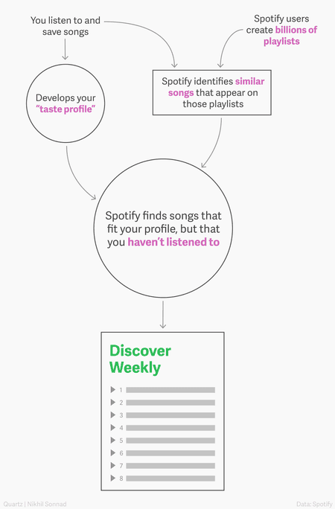
Basic Outline of Discover Weekly
Every Monday morning, Spotify’s recommendation system will use your listening data (taste profile) to find songs that fit your profile, but that you have never listened to before.
Spotify’s system makes sure to recommend ‘similar’ songs that are also new or unpopular, not just whatever song is popular at the time.

Slide 5
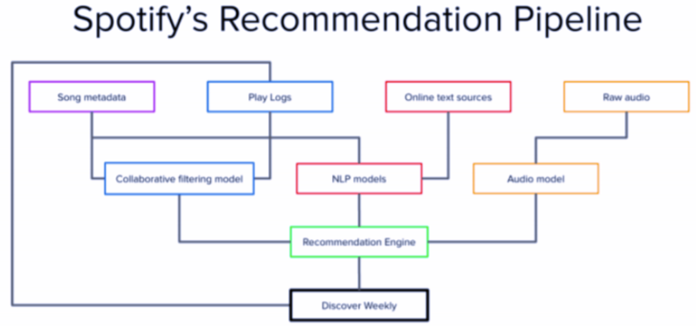

The Spotify Recommendation Pipeline
Discover Weekly is created from Spotify’s Recommendation Engine, which is based on three main Machine Learning techniques:
Collaborative Filtering
Natural Language Processing (NLP)
Raw Audio Modeling
The goal of Discover Weekly is to find “hidden gems” for a user’s listening experience.
We do not want to just recommend what is popular.
These ML Techniques help to achieve this goal.

Slide 6
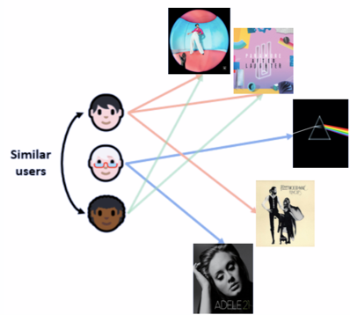
ML Techniques: Collaborative Filtering
What is Collaborative Filtering?
Collaborative Filtering is a Machine Learning technique which analyze both your behavior and others’ behaviors in order to make a good recommendation of an item.
Basic Idea
if there are 2 users, user A and user B, who listen to the same songs and interact with these songs in a similar manner, then it is likely that their music tastes are similar as well.
This information can then be used to recommend user A the music that user B has saved, but user A has not listened to yet, and vice versa.
If user B and user C are determined as similar, then we may recommend Paramore songs to user B, and Adele songs to user C.

Slide 7


Collaborative Filtering: The KNN Approach
KNN Diagram
To build a Collaborative Filtering Model, the Spotify Recommendation System will collect metrics on a user’s data.
Saves
Shares
Skip Rate
Stream Count
User ratings
Collaborative Learning Modeling is based upon the K-Nearest Neighbors (KNN) approach.
KNN is a ML method which is used to calculate the distance of ”neighbor” users to the target user.
KNN is being used to find neighbor users who have similar preferences to a target user, and then we group these users accordingly.
A user’s preferences is found based on the data metrics that Spotify had previously collected on these users.
Then, from these groups of users found using KNN, we can use item-based collaborative filtering to then recommend new songs to our target user based on the song preferences found in the group of similar users.
Notes:
The Machine Learning Model behind Collaborative Filtering

Slide 8
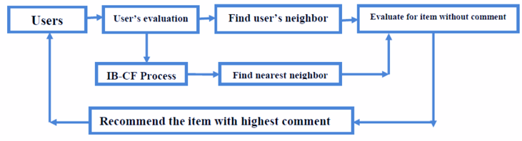

Collaborative Filtering and Discover Weekly
C.F. Flowchart for the Spotify Recommendation System
This diagram is a flowchart which details the steps of the collaborative filtering modeling used by Spotify.
The flowchart is a loop, where the target user gets recommended a song that has the highest comment.
A comment is basically like a score of how much the user is predicted to enjoy the song
This flow will loop continuously, searching through the data on both the neighbors and the target user preferences, until it finds a song from the neighbor’s music taste that is similar enough to recommend to the target user (has the highest score).
After around 30 songs are found, a Spotify Discover Weekly playlist will then be shared with the target user that is filled with song recommendations that the user is predicted to enjoy.
Notes:
SO, how is Collaborative Filtering used specifically in Discover Weekly?

Slide 9
Collaborative Filtering: Issues
Collaborative filtering does a decent job at music recommendation, but there are some downsides.
Collaborative filtering is content-agnostic
meaning it only uses the consumption data associated with an item, and not data on the item itself.
For Example, it only collects data on the user (saves, shares, skip rate, etc.) instead of data on the actual songs it is recommending (genre, beat, etc.).
Because it is content-agonistic, popular songs get recommended the most.
This is the opposite of what Spotify wants! Remember how we said our goal is to find “hidden gems?”
Because it is content-agonistic, it has a Cold-Start Problem.
The cold-start problem is where we have a user which is new to Spotify and has no preferences yet, and therefore it becomes increasing difficult to recommend new and unpopular songs to them.
Because of the issues raised by collaborative filtering, Spotify needed a new approach: Natural Language Processing.

Slide 10
ML Techniques: Natural Language Processing with Spotify’s ‘The Echo Nest’ Technology
What is Natural Language Processing?
What is The Echo Nest?
Natural Language Processing (NLP) is the second ML technique Spotify uses to recommend songs.
NLP is a ML technique which combines computational linguistics and ML models to allow a system to process human language data (either in text of voice form) and understand the full meaning of this language data.
In 2014, Spotify acquired The Echo Nest.
The Echo Nest is a music intelligence platform which implements NLP technology to mine music blogs and determine which artists are considered hidden gems, new, and unpopular.
The Echo Nest is used to find the adjectives frequently used in reference to artists or songs, and it is finding out which other underground artists are being discussed along with them.

Slide 11
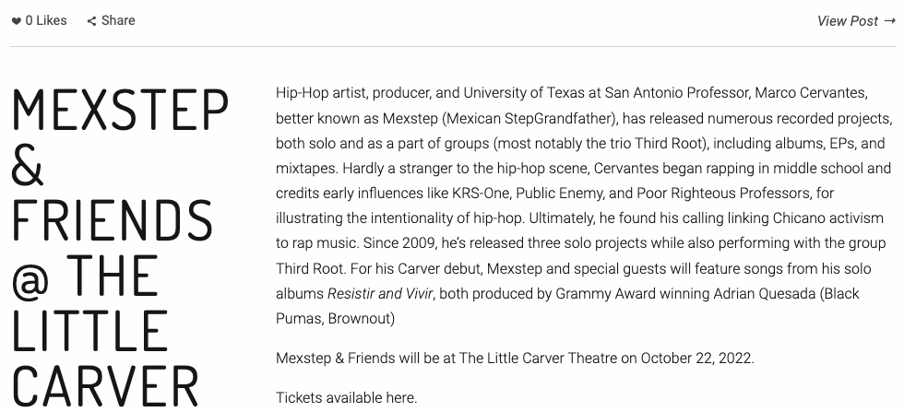
Natural Language Processing with Spotify’s ‘The Echo Nest’ Technology: An Example
Local Music Blog: KRTUindie.org
For instance, a blogger may write a review on a new up-and-coming artist from San Antonio, Mexstep, that has a “90s Hip-Hop” sound.
If Mexstep continues making music, and writers continue to write about them, eventually the NLP bots will pick up that this is a new “hidden gem” type of artist to recommend to users who are known for liking “90s Hip-Hop”.
Notes:
For example, the way that NLP is used by ”the echo nest” is that it searches through websites and blogs that focus on local music.
So, The Echo Nest will go through blog posts, and find what unpopular bands are being talked about, and use the adjectives they are described with to further categorize these bands.
For instance, in San Antonio, one local music blog is KRTUindie.org.
A blogger may write a review on a new up-and-coming artist from San Antonio, Mexstep, that has a “90s Hip-Hop” sound.
If Mexstep continues making music, and writers continue to write about them, eventually the NLP bots will pick up that this is a new “hidden gem” type of artist to recommend to users who are known for liking “90s Hip-Hop”.

Slide 12
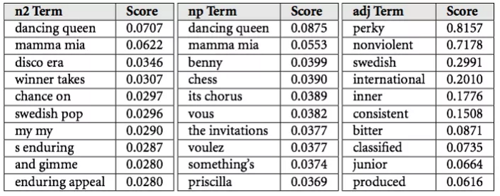
Natural Language Processing and Discover Weekly
The Echo Nest technology would bucket the data collected using NLP into “top terms”.
Each song has top terms associated with it. Each term has an associated score. This score is the probability that a user will describe the song or artist with that term.
In this figure, “perky” and “nonviolent” are the two terms most relevant to this example song.
These top terms are then used (in combination with collaborative filtering) to recognize the similarities between songs.
If two songs are similar, and one is unknown to the target user, then we can add it to a user’s Discover Weekly Playlist.
This works especially well at finding “hidden gems” or unpopular songs!
Notes:
SO, how is NLP used specifically in Discover Weekly?
For example, we see some of the top terms used to describe a random song. In this instance, “perky” and “nonviolent” are the 2 terms with the highest score.

Slide 13
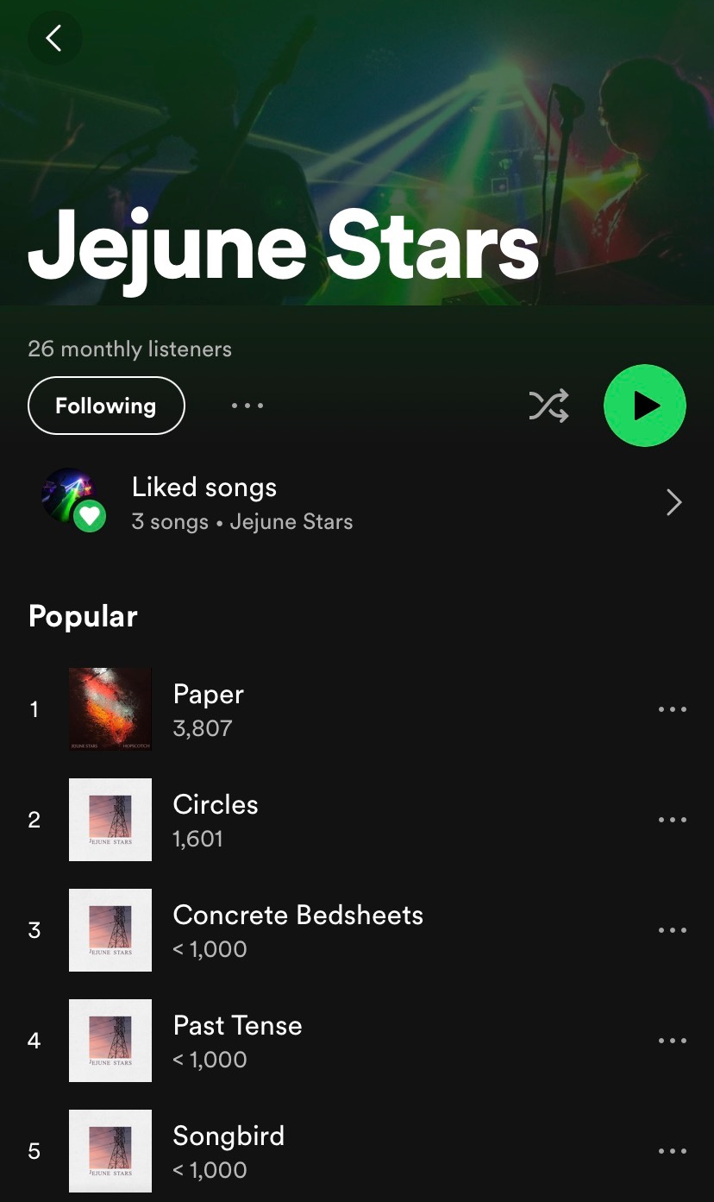

Natural Language Processing: Issues
NLP was able to successfully recommend unpopular songs, which CF modeling was not able to do.
However, NLP models will fail to find music if the online coverage / social media coverage is very low.
This means that our models will fail to find new songs to recommend to a target user.
For example, say we uploaded a new song with only 10 streams so far. Because it has so little streams, Collaborative Filtering would not pick up on it. Also, because our song hasn’t been mentioned online, the NLP models will fail to find it as well.
How will we be able to find new songs? Audio Analysis Modeling !

Slide 14
ML Techniques: Audio Analysis Modeling
Audio Analysis Modeling is a deep learning technique used to analyze audio signals from sound data recorded on digital devices.
Audio Models analyze the song itself! (finds the key, tempo, pitch, etc.)
Audio Models take new songs into account when recommending music
On Spotify, Audio Models are used to analyze (raw audio) songs in order to categorize it.
The process of the actual analysis is done by using Convolutional Neural Networks.
Notes:
So, the third and final machine learning technique used by Spotify is Audio Analysis Modeling.

Slide 15
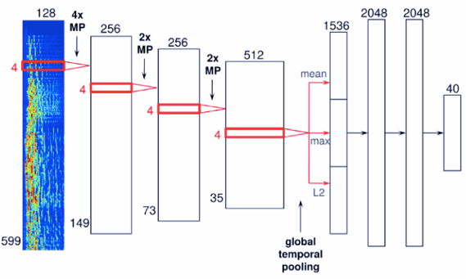
CNN in Audio Analysis Modeling
Convolutional Neural Networks (CNN) is an ANN architecture which is used to solve difficult image-driven pattern recognition tasks, such as facial recognition.
However, in Spotify, CNN is used to evaluate audio signals instead of image pixels.
Here, we can see an example of the CNN architecture used in Audio Analysis Modeling. The network has four convolutional layers (left side) and three dense layers (right side).
The audio signal input is concatenated together to form a spectrogram (far left). Then, the audio signals go through the four convolutional layers, after which they will pass through a global temporal pooling layer, which will compute the metrics of the features learned across the time of the song.
CNN Architecture used in Audio Analysis Modeling

Slide 16
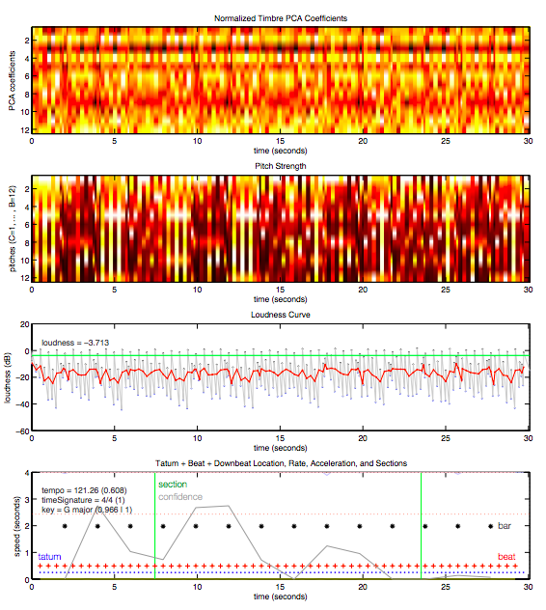
CNN in Audio Analysis Modeling and Discover Weekly
After the processing of the song was complete, the CNN architecture will determine certain estimations on the song’s features, such as: key signature, time signature, dynamics, tempo, loudness, pitch, and more.
Here, we can see the plot of the data found for key features in the 30 second song snippet of “Around the World” by the artist Daft Punk.
In these plots, we see that our Audio Analysis Model used CNN to find data on the song’s loudness, pitch strength, beat, and more key features.
Once our Audio Model found data on a song’s key features, the recommendation system will use it to find similarities between songs in the user’s listening history and new songs which are within Spotify’s database.
From there, the recommendation system can add these new songs into the user’s Discover Weekly playlist for their enjoyment.
Plot of key features found in song snippet

Slide 17
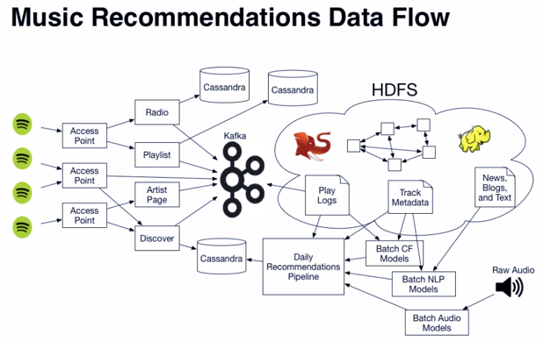











The 3 ML Techniques: Conclusion
Spotify’s Recommendation Ecosystem
we have now covered the 3 ML techniques behind Spotify’s Recommendation System / Discover Weekly playlists.
We learned that the Collaborative Filtering technique is great for recommending popular songs based on similar users, but not so great at recommending unpopular songs with a small number of streams.
The Natural Language Processing technique solves this issue by finding what songs / artists are generating “buzz” on the internet, and therefore it can find unpopular songs. The issue is that both Collaborative Filtering and NLP fail to find new songs to recommend that don’t have any “buzz” yet.
To find new songs, we use Audio Analysis Modeling as the final technique to analyze the songs, find data on their key features, and then recommend these new songs.
When Spotify’s Recommendation System implements all 3 techniques, it successfully creates a Discover Weekly playlist that will recommend new songs, popular songs, and unpopular songs which all cater to a user’s musical interests.
These 3 techniques are all part of a bigger Recommendation Ecosystem!
This ecosystem is also used to build pre-made playlists, radio recommendations, and more.
We covered the Discover Weekly Recommendation System, but these techniques are also used in Radio, Pre-Made Playlists, and Artist Recommendations as well!
Notes:
Discover Weekly is just one part of the Ecosystem
The recommendation system is also used for generating pre-made playlists, such as playlists based on a certain mood
-Evening party playlist -workout playlist -Rainy Day playlist
Also used to find “similar artists” to put under an artist’s page
Also used to generate a radio station based on an artist or a genre

Slide 18
References
“Spotify revenue and Usage Statistics (2022),” Business of Apps, 06-Sep-2022. [Online]. Available: https://www.businessofapps.com/data/spotify-statistics/. [Accessed: 18-Oct-2022].
S. Dieleman, “Recommending Music on Spotify with Deep Learning,” benanne, 05-Aug-2014. .
T. Hodgson, “Spotify and the democratization of music,” Popular Music, vol. 40, no. 1, pp. 1–17, 2021.
M. Madathil, “Music recommendation system spotify - collaborative filtering,” 2017. [Online]. Available: https://hpac.cs.umu.se/teaching/sem-mus-17/Reports/Madathil.pdf. [Accessed: 16-Oct-2022].
A. E. Nixon, “Building a memory based collaborative filtering recommender,” Medium, 25-Feb-2021. [Online]. Available: https://towardsdatascience.com/how-does-collaborative-filtering-work-da56ea94e331. [Accessed: 18-Oct-2022].
Y. Ding and C. Liu. “Exploring drawbacks in music recommendation systems”. Bachelor Thesis in Informatics, 2015.
IBM Cloud Education, “What is natural language processing?,” IBM. [Online]. Available: https://www.ibm.com/cloud/learn/natural-language-processing. [Accessed: 16-Oct-2022].
P. Daru, “Spotify's algorithm,” djinit.ai, 16-Apr-2020. [Online]. Available: https://djinit-ai.github.io/2020/04/16/Spotify%27s-algorithm.html. [Accessed: 18-Oct-2022].
S. Ciocca, “How does Spotify know you so well?,” Medium, 08-Apr-2020. [Online]. Available: https://medium.com/s/story/spotifys-discover-weekly-how-machine-learning-finds-your-new-music-19a41ab76efe. [Accessed: 18-Oct-2022].
K. O'Shea and R. Nash, “An introduction to Convolutional Neural Networks,” arXiv.org, 02-Dec-2015. [Online]. Available: https://arxiv.org/abs/1511.08458. [Accessed: 18-Oct-2022].
V. Murali, “Building Data Pipelines for music recommendations at Spotify,” SlideShare, 2015. [Online]. Available: https://www.slideshare.net/vidhyamurali/building-data-pipelines-for-music-recommendations-at-spotify. [Accessed: 18-Oct-2022].
A. Pasick, “The magic that makes Spotify's discover weekly playlists so damn good,” Quartz. [Online]. Available: https://qz.com/571007/the-magic-that-makes-spotifys-discover-weekly-playlists-so-damn-good/. [Accessed: 18-Oct-2022].
“Mexstep & Friends,” KRTU Indie Overnight, 06-Oct-2022. [Online]. Available: http://www.krtuindie.org/blog. [Accessed: 18-Oct-2022].

