Slide 1

Functional Genomics and Drug Targets: The Role of Paralogues and Essentiality in Drug Safety
Hussein Kassir

Slide 2





Current Project Investigates Functional Genomics and Drug Targets
Hypothesis: Side effects may arise from drug action on paralogues, not just primary targets
Identify enrichment of certain SE clusters within the different essentiality categories
How can it help in Drug Development
Gene Essentiality
Drug Target Validation
Drug Target Stratification
Paralogy
Side Effects prediction
Notes:
If a drug’s known side effects match the biological roles of its paralogues could suggests off-target mechanisms. Therefore, if we can stratify those SE we can predict safety and toxicity patterns
Ex: essential genes in pathogens or cancer but not in humans would suggest that is an excellent target for drugs

Slide 3
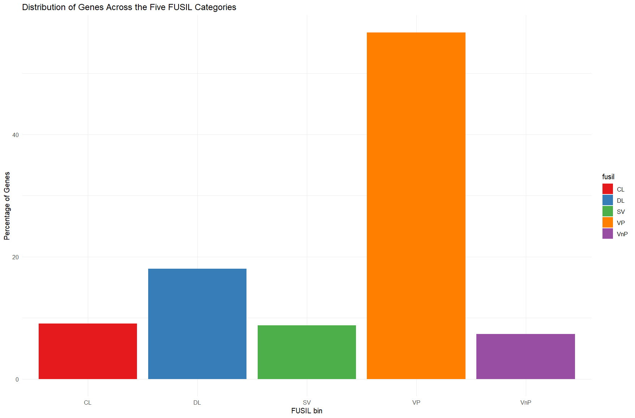
Current Project Investigates Functional Genomics and Drug Targets
Cacheiro et al. (2020) Propose a cross-species gene classification across the Full Spectrum of Intolerance to Loss-of-function (FUSIL)
Provides a framework to categorize genes based on essentiality and phenotypic data.
Data for 7060 Genes
Cellular lethal (CL): essential for both cell and organism survival
Developmental lethal (DL): not essential for cells, but critical for the organism
Sub-viable (SV): reduced survival
Viable (V):
VP: viable with phenotypes
VnP: viable with no phenotype

Slide 4
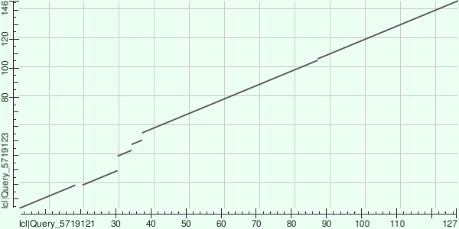
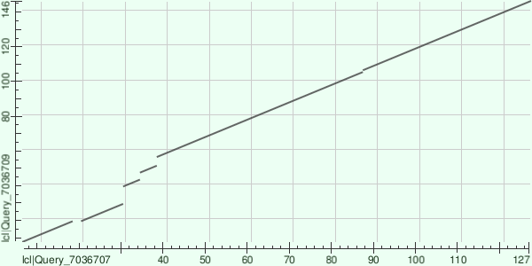
Understanding Paralogy & Gene Essentiality
What is a Gene Paralogue ?
Paralogues, in addition to Orthologues, are two types of a homologous genes.
Homologs have common origins, however, they may or may not have a common activity
Identified using homology searches and sequence similarity
Orthologs evolved from a common ancestral gene through speciation
Paralogues evolved through a gene duplication event
Sequence Similarity between Human Alpha and Beta Globin Genes ( Paralogues)
Sequence Similarity between Human Alpha and Chicken Beta Globin Genes ( Ortholgues)
Koonin et al. (2005)
Notes:
Orthologs are genes in different species that evolved from a common ancestral gene through speciation. Paralogs are genes within the same species (or occasionally across species) that arose from a gene duplication event.
Orthologs Tend to have similar function
Paralogues Tend to Have different function
protein language models (PLMs) and predicted structures from AlphaFold, raises the possibility that alternative similarity metrics could better capture functional similarity between paralogs

Slide 5
Early globin gene
Gene Duplication
α-chain gene
ß-chain gene
mouse α
human α
cattle α
cattle ß
human ß
mouse ß
Orthologs (α)
Orthologs (ß)
Paralogs (cattle)
Homologs
Orthologs – diverged after speciation – tend to have similar function
Paralogs – diverged after gene duplication – some functional divergence occurs
Alastair Kerr, PhD

Slide 6
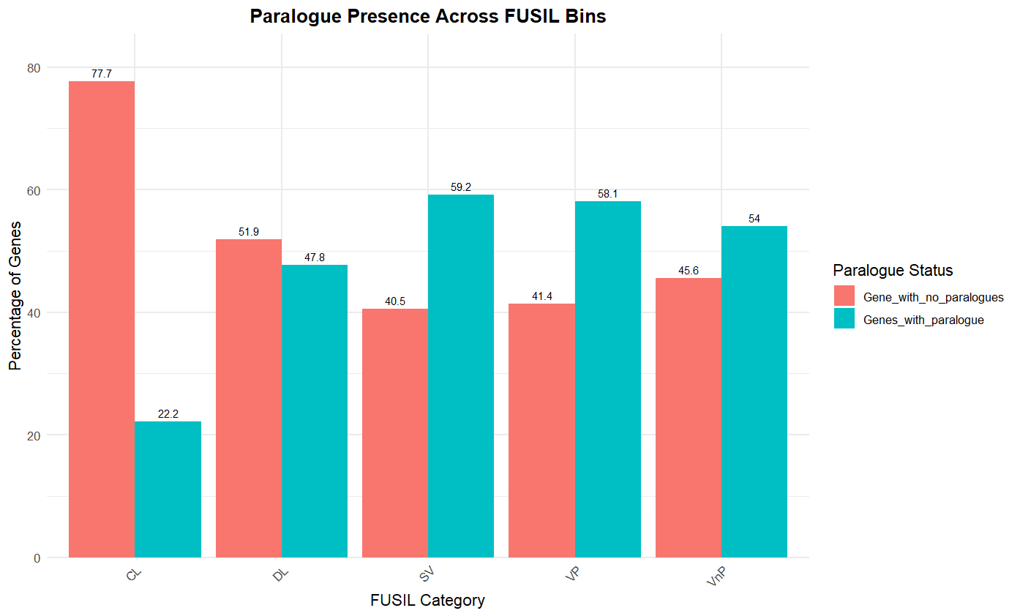
Observe Discrepancies in Paralogy among the FUSIL Categories
Genes that are more essential exhibit a significantly lower percentage of paralogues
Almost 80% of the CL and 50% of the DL genes have no Paralogues
No Paralogue = Sequence Similarity Not Present or < 30%
Notes:
It is worth mentioning that I crated a function in R that would produce a matrix of 1/0 for paralogue presence while accounting for PC genes for the different similarity thresholds.
Just so if it is relevant to your research. You don’t have to do it again.
"Our findings show a clear inverse relationship between gene essentiality and the presence of paralogues.
For example, nearly 80% of CL genes—the most essential—have no paralogues, suggesting they are functionally unique and irreplaceable.
This makes them risky drug targets from a safety perspective."

Slide 7
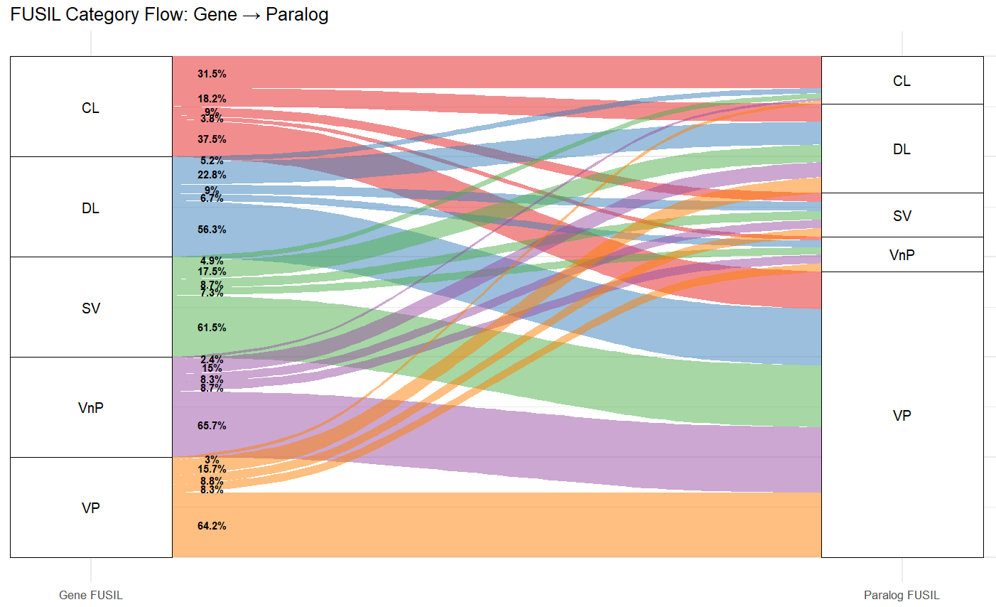
Discrepancies in FUSIL Category Between the Query Gene & Its Paralogues
Assigned a FUSIL Category to the paralogues of each FUSIL Gene
Observed how the FUSIL bin changes between the query genes their paralogues
Trend where increasing gene essentiality corresponds with paralogues being retained within the same FUSIL category
Except for VP genes, but this could be attributed to the number of genes in that category

Slide 8
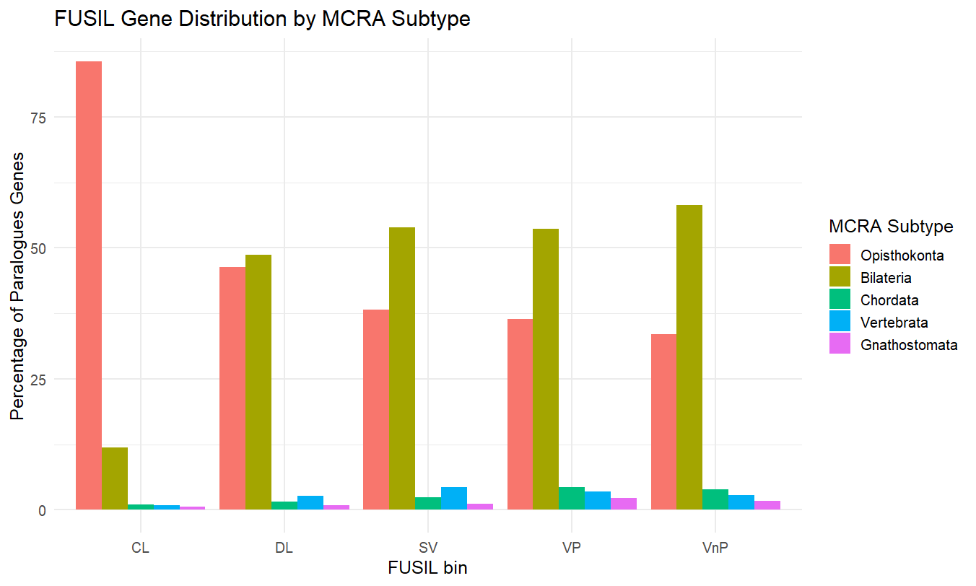
Essential Genes Tend to Originate from More Ancient Ancestor Gene
More essential genes (CL and DL) tend to have paralogues with older MCRA subtypes (e.g., Opisthokonta and Bilateria)
In CL (most essential), nearly 80% of paralogues trace back to Opisthokonta.
Less essential genes ( SV, VP and VnP) have more recent MCRAs (e.g., Chordata, Vertebrata, Gnathostomata)
Notes:
This suggests that vital functions have been conserved through evolution, and these genes are central to survival."

Slide 9
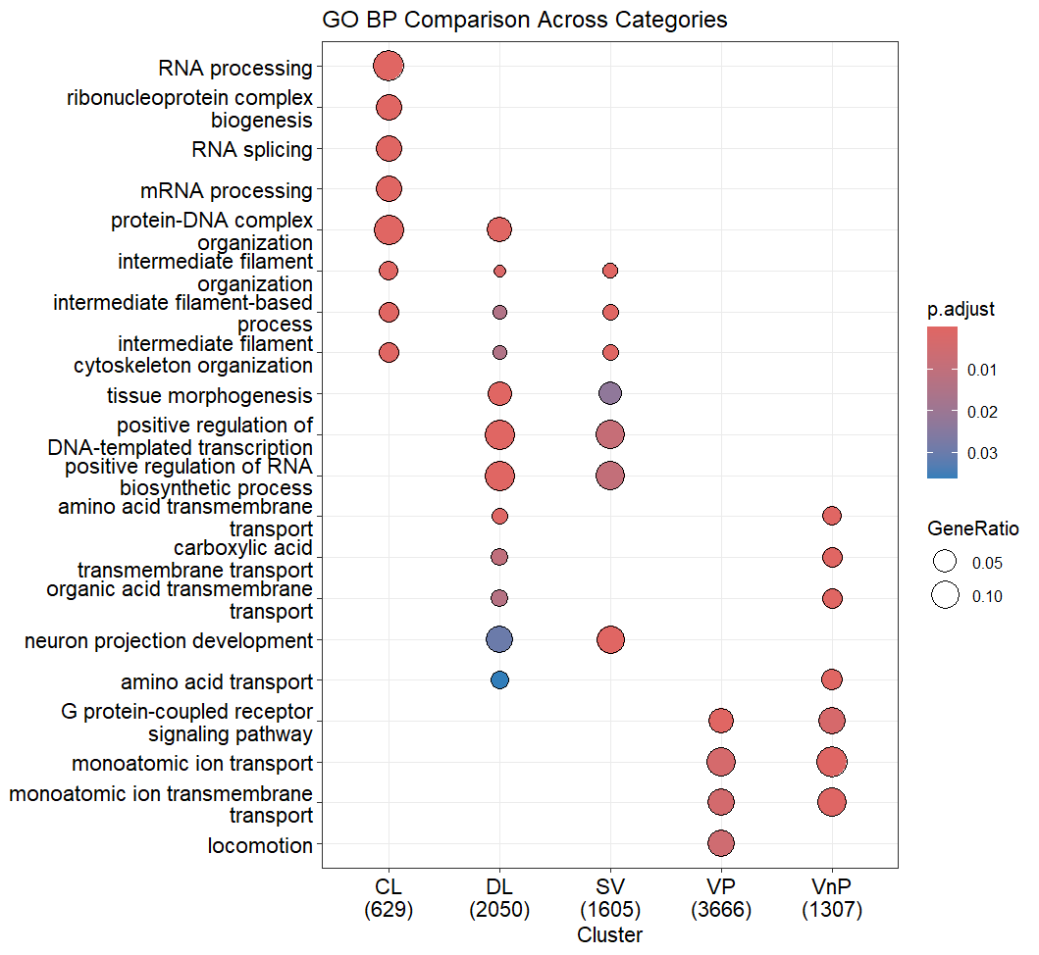
Enrichment Analysis of FUSIL Paralogues
Performed GO enrichment analysis of paralogues
Grouped by the FUSIL category of the query gene
Paralogues often share similar biological functions with their query gene
This is expected, as paralogues are defined by both sequence and functional similarity
No significant functional overlap was observed between the most essential genes (CL) and the least essential ones (VP, VnP). This highlights a clear division in the biological roles of essential and non-essential genes.
Notes:
CL and DL categories (more essential genes) are enriched in:
Core cellular processes like RNA processing, splicing, and mRNA processing
Chromatin and transcription regulation
Cytoskeleton and intermediate filament organization
VP and VnP (less essential genes) show enrichment in:
Transport-related processes (ion, amino acid, organic acid)
GPCR signaling and locomotion

Slide 10
Drug Targets & Gene Essentiality
Notes:
The majority of drugs are targeted toward cancer and systemic chronic diseases. Genetic and nervous system disorders also show growing attention.
However, a wide tail of rare or neglected diseases remains under-targeted — highlighting both gaps and opportunities in the drug development landscape.

Slide 11
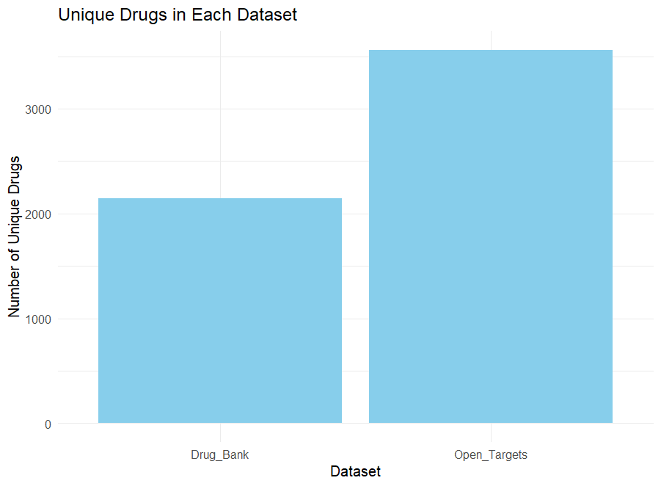
Drug Databases Overview
Drug databases are similar but not the same
Difference in number of gene/targets and drugs curated
Notes:
More drugs that are curated are in the open Targets databse.
I tried looking for a reason for this discrepancy I could not find anything that would explain tis besides different criteria in considering what an active molecule. Also different in a drug being approved in certain areas while not in other area. Given that drugbank is mainly a US effort,.

Slide 12
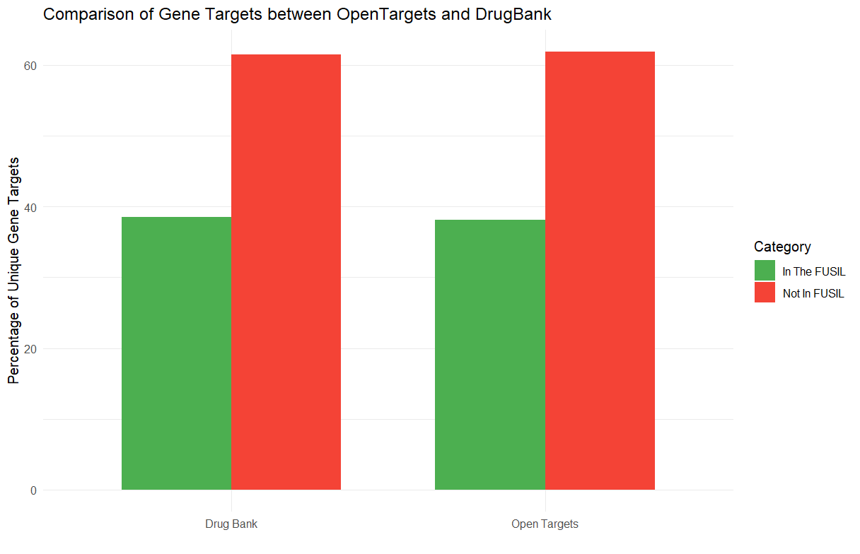
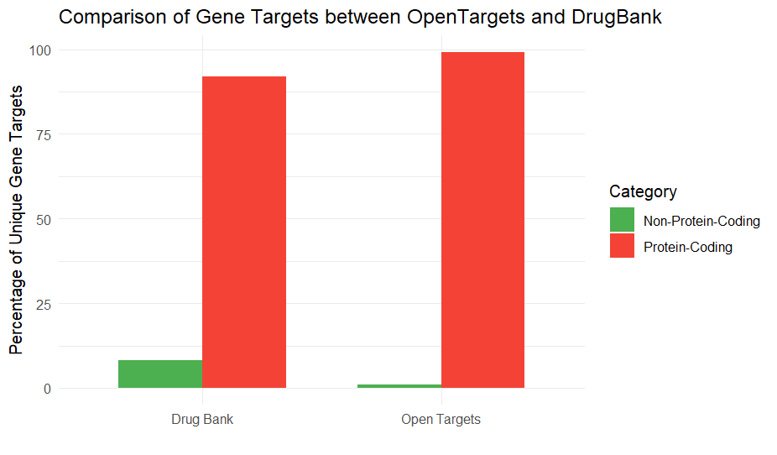
Cross-Dataset Comparison of Target Types: FUSIL Genes and Protein-Coding Genes in OpenTargets and DrugBank
Protein-coding genes dominate in both datasets
Notes:
Protein-coding genes are the standard focus for therapeutic targeting in current datasets.

Slide 13

Missing potential of non-coding DNA in drug development
Increasing evidence towards developing compound that target non-coding DNA
Compounds that target ncRNAs have the potential to control expression of disease-related genes ( Matsui et al. 2017 )
Example: several lncRNAs, such as HOTAIR, SPRY4-IT1, BANCR, and PVT1, is altered in human NSCLC and gastric cancer. ( Chen et al., 2017 )
Novel mechanism if action require novel technologies and therefore will involve equally novel challenges
Notes:
Most literature are that talk about non-coding DNA as having therapeutic potential are from 2016 to 2018.

Slide 14
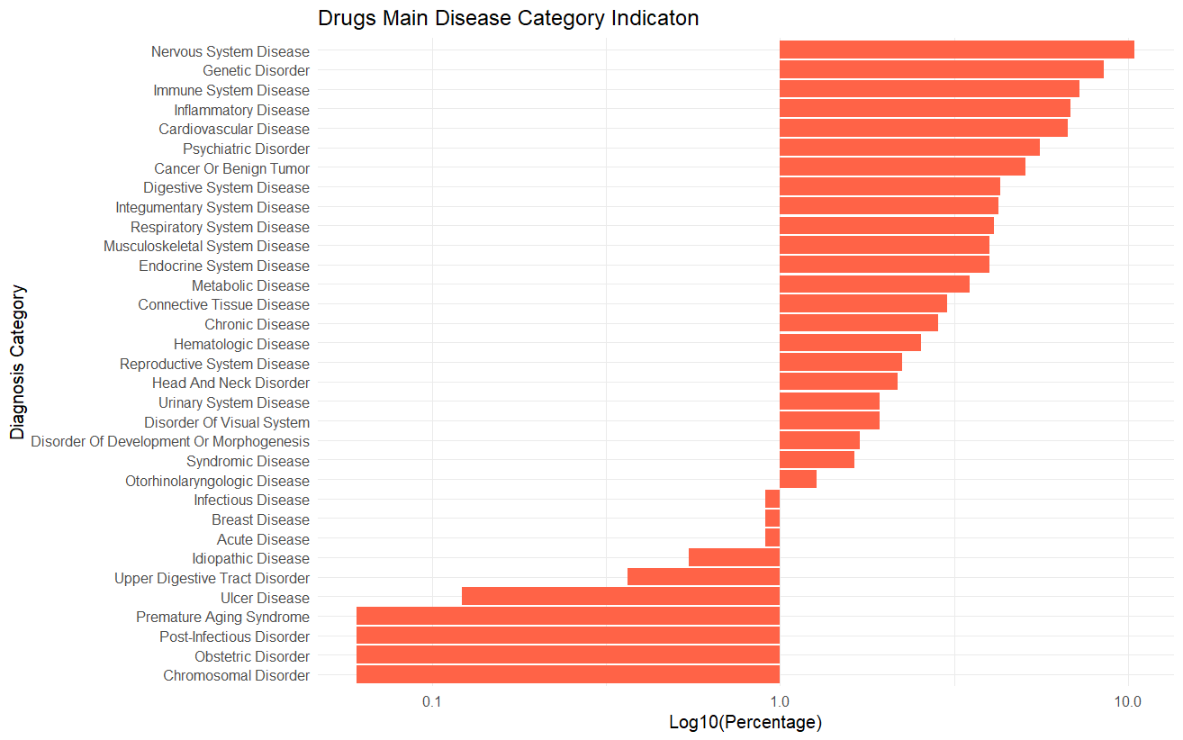
Drug Targeting by Disease Category
Notes:
The majority of drugs are targeted toward cancer and systemic chronic diseases. Genetic and nervous system disorders also show growing attention.
However, a wide tail of rare or neglected diseases remains under-targeted — highlighting both gaps and opportunities in the drug development landscape.

Slide 15
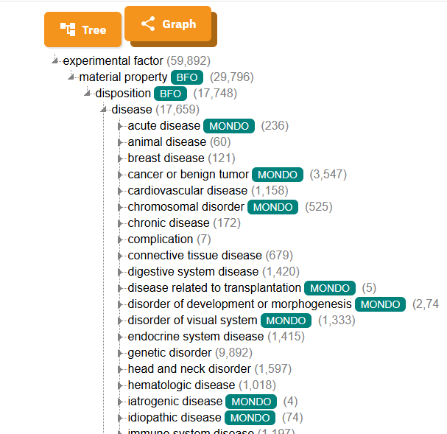
Establishing a higher-level (Ancestor) term
Aim to group diseases in an ancestor term to facilitate analysis
Mapped specific disease terms to their corresponding higher-level biological categories using HPO/MP script.

Slide 16
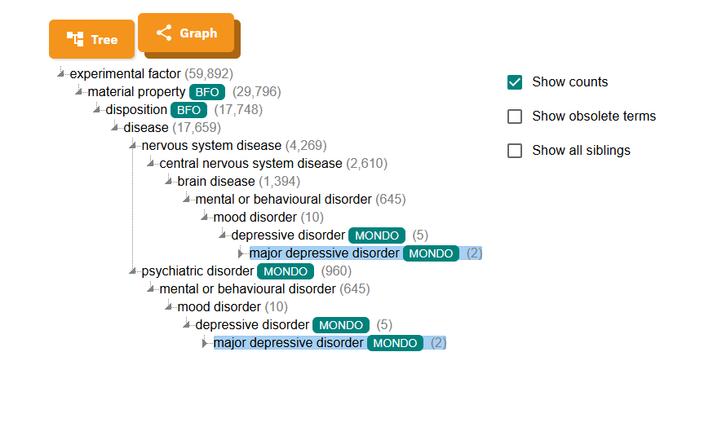
EFO Mapping Challenge:
Many disease terms mapped to multiple, different higher-level categories
Affects consistency with the analysis.

Slide 17
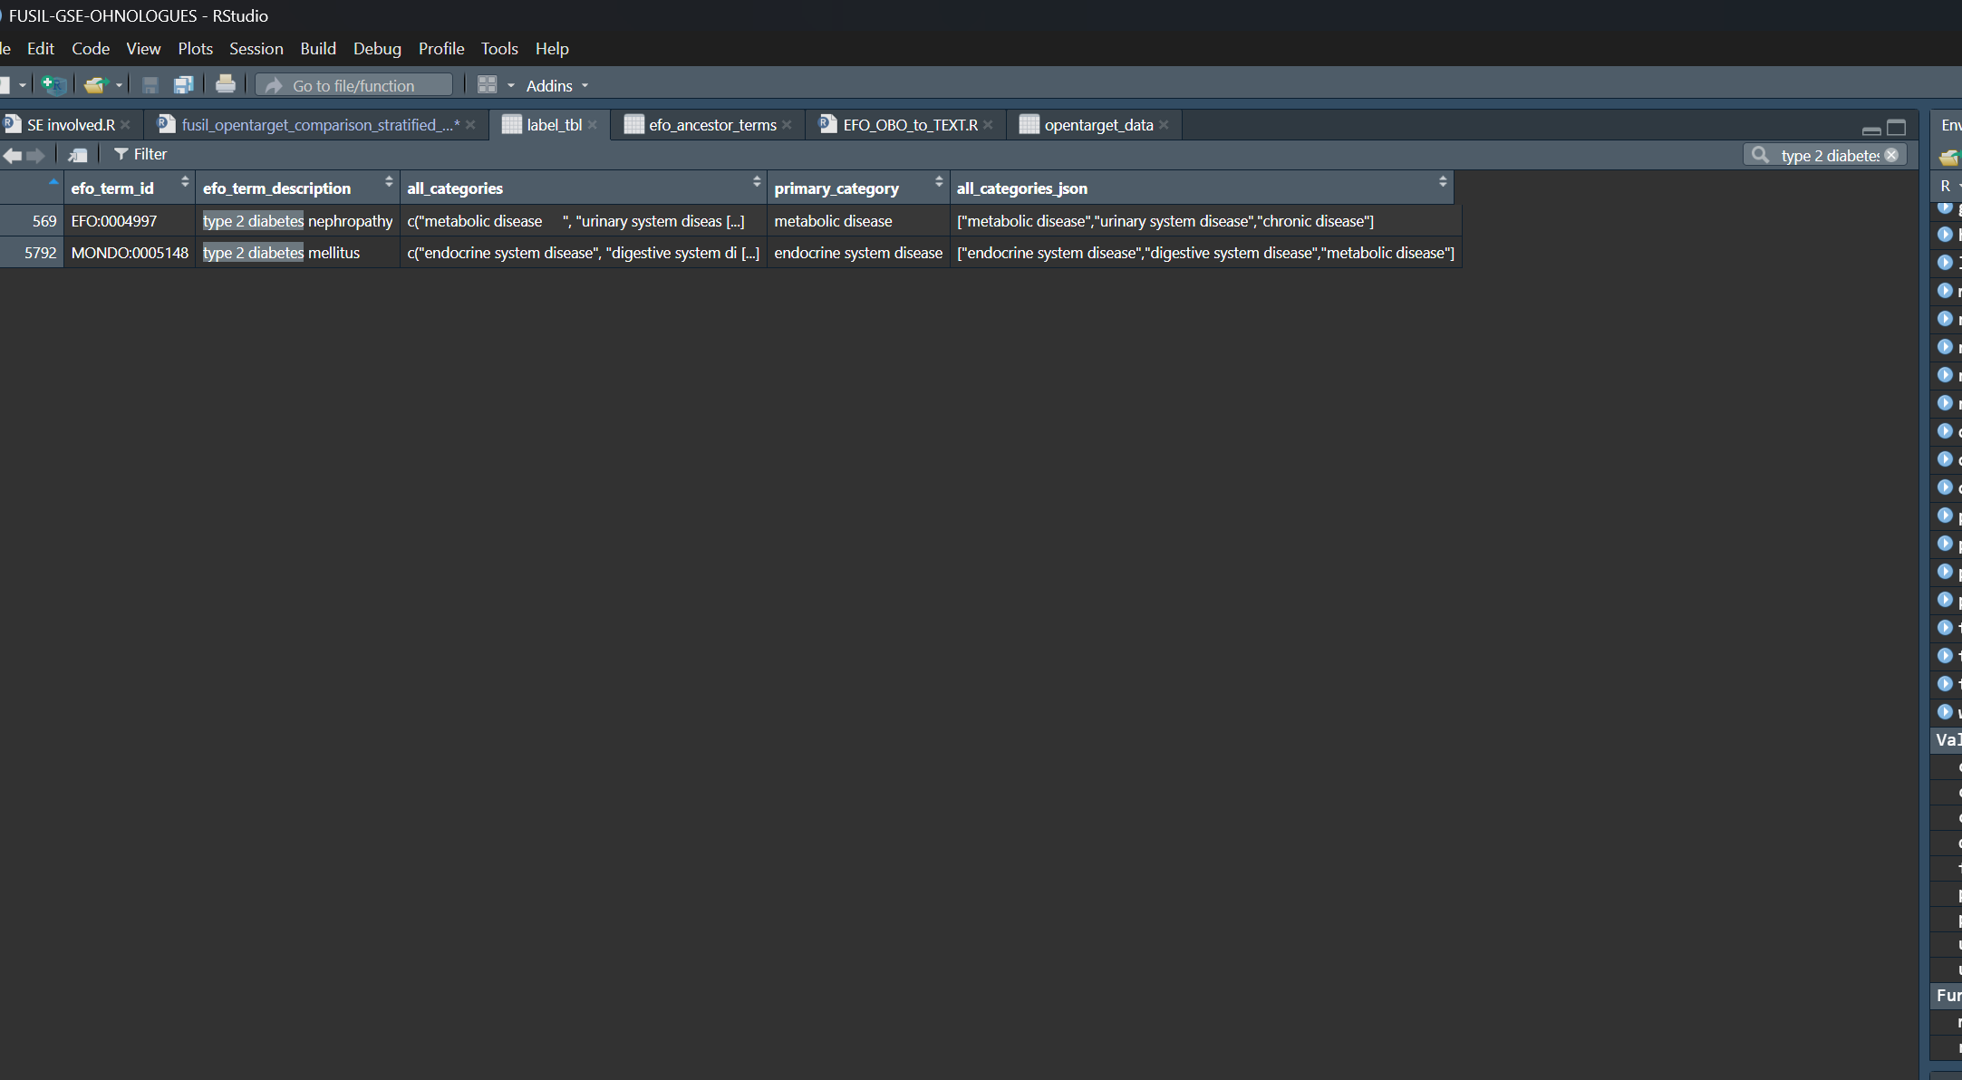
Strategy to Resolve Ambiguous Mapping
Defined a priority list of high-level biological categories
Ranked and assigned each term to its most relevant primary ancestor
However, the selection of "primary" disease categories was based on a custom-defined priority list

Slide 18
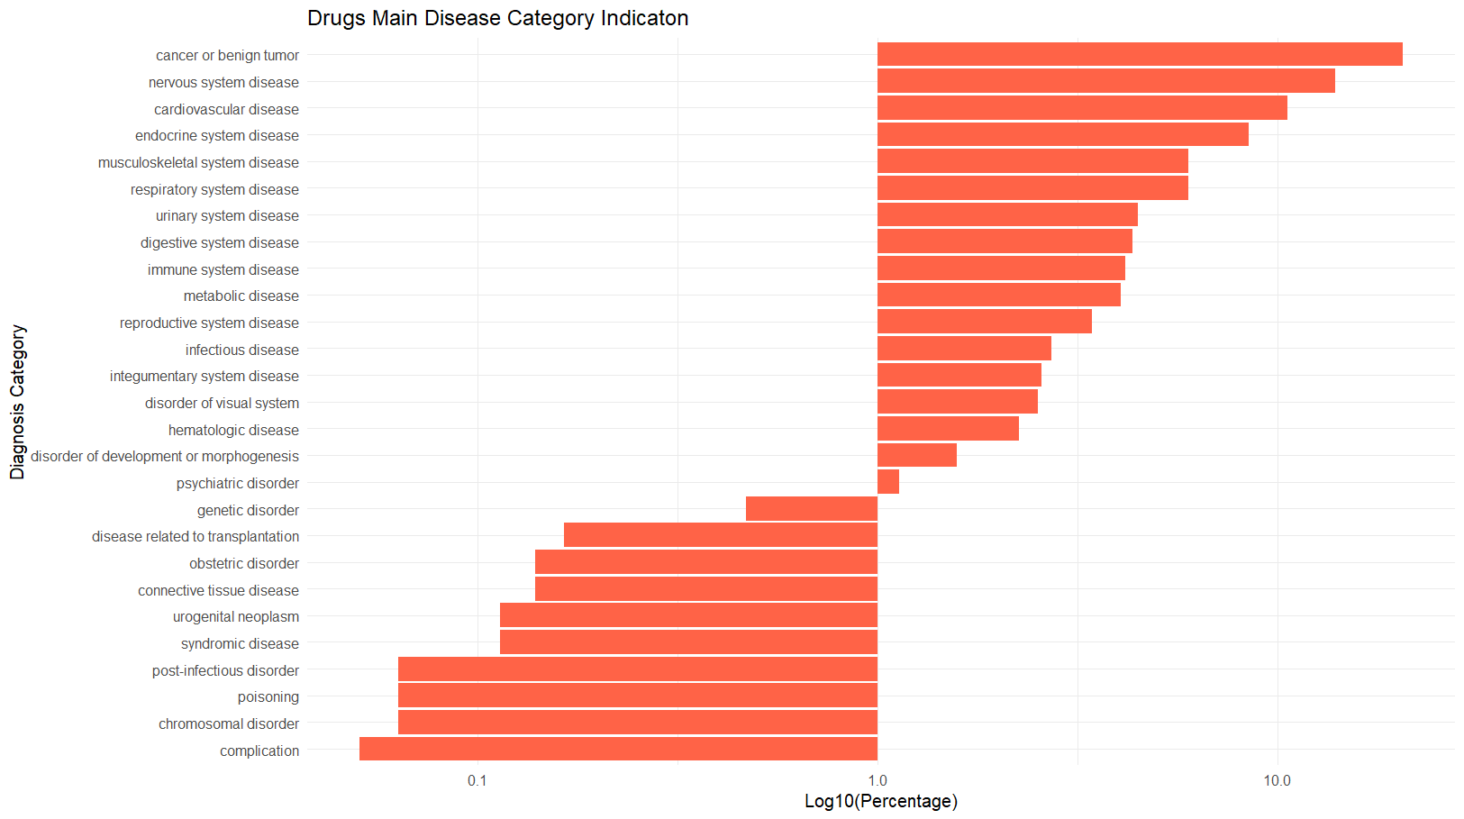
Drug Targeting by Disease Category ( Function Applied)
Heavy Targeting of Cancer and tumor related disorders
Reflects major R&D investment in oncology
Possibly due to the high disease burden and commercial potential

Slide 19
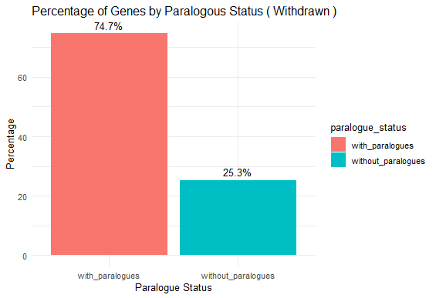
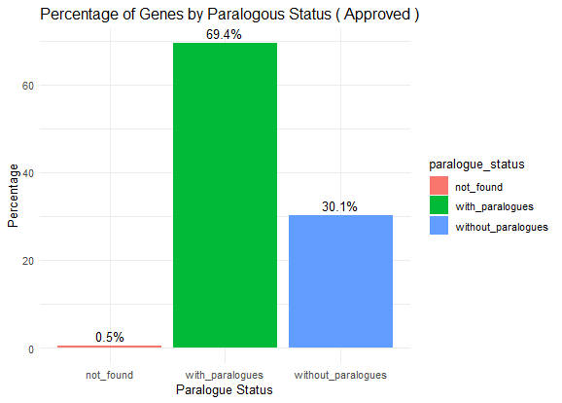
Paralogue Patterns Differ in Approved vs. Withdrawn Drugs?
Approved drug targets ,approximately 69.4% of genes have paralogues ,while 30.1% lack them
Similar pattern for the withdrawn drugs, with a slightly higher percentages of genes with paralogues
Paralogues could act like double-edged sword
May increase safety through redundancy, or increase risk via off-target effects
Depends on the context ( Target Essentiality, Disease..)
Notes:
When a gene has paralogues, loss or inhibition of its function may be compensated by its paralog, which could reduce the risk of toxicity
On the flip side, targeting a gene with paralogues increases the chance of cross-reactivity — where the drug affects related genes unintentionally.
Roughly 69% of approved drug targets have paralogues—similar to withdrawn drugs.
So, paralogue presence alone isn’t a predictor of approval, but it may influence safety outcomes."

Slide 20
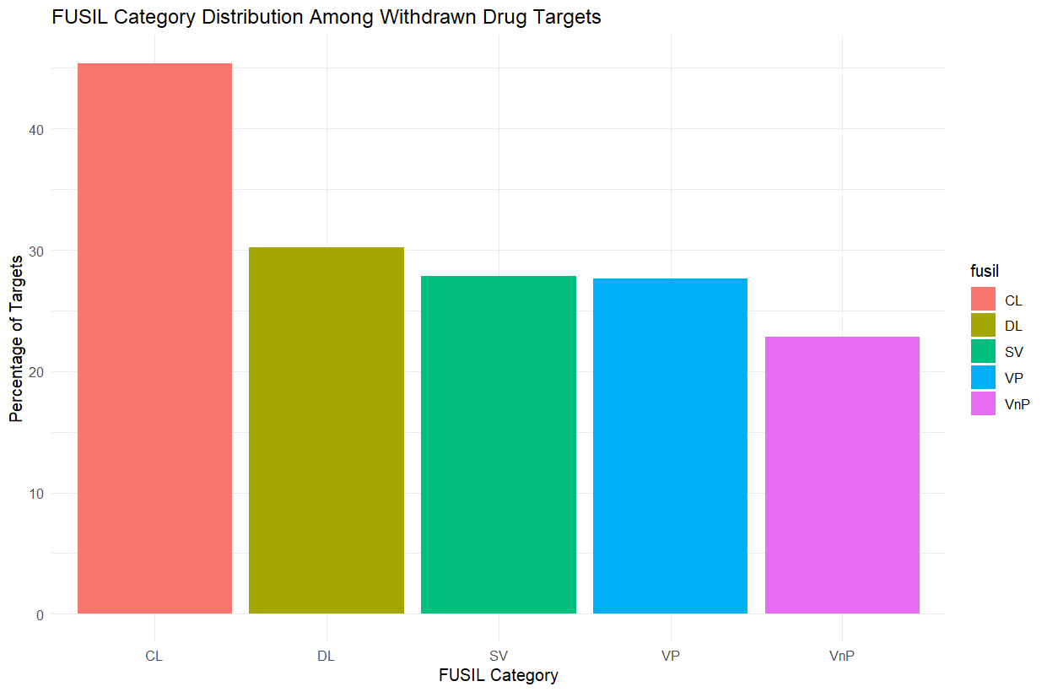
Withdrawn Drug Targets Within the FUSIL
Most withdrawn drugs with known gene targets act on essential genes (CL category)
Suggests that targeting essential genes may increase the risk of adverse effects
Highlights a potential link between gene essentiality and drug safety failure
Notes:
Targeting a gene or a gene product that have fundamental cellular and biological processes could lead to increased toxicity and more likely the molecule would not pass safety checks.

Slide 21
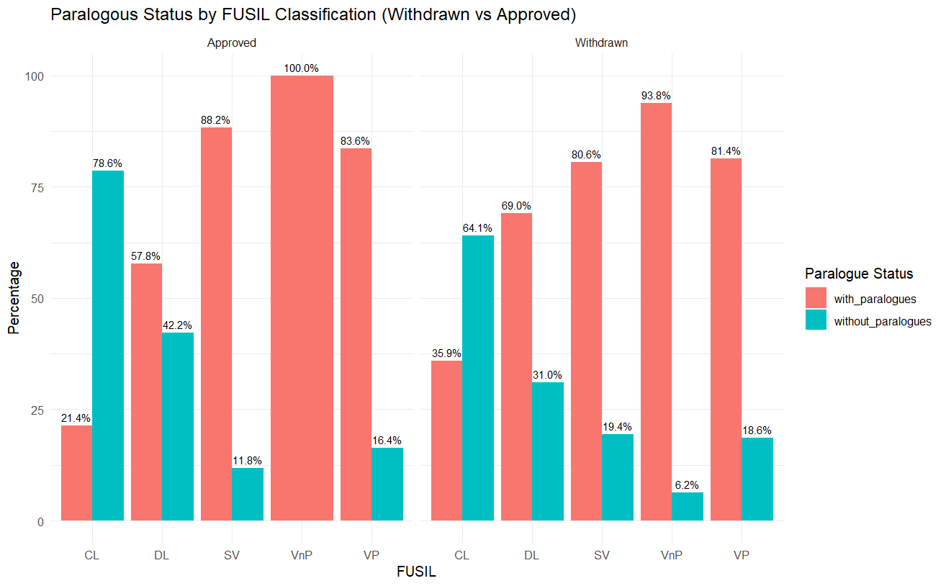
Difference in Paralogy Between Approved and Withdrawn Drug Targets
Most gene targets have paralogues , with minimal differences between the 2 categories
Observe a higher percentage of gene targets that have paralogues across the FUSIL categories, except CL

Slide 22
Paralogy alone is not a sufficient predictor of drug safety
Context Matters: Not all paralogues are equally expressed, active, or accessible in every tissue
Some Paralogues may compensate, others may interfere or interact, which leads to a complex and varying effects
Its impact is multifactorial and could depend on expression patterns, binding specificity, and tissue context.

Slide 23
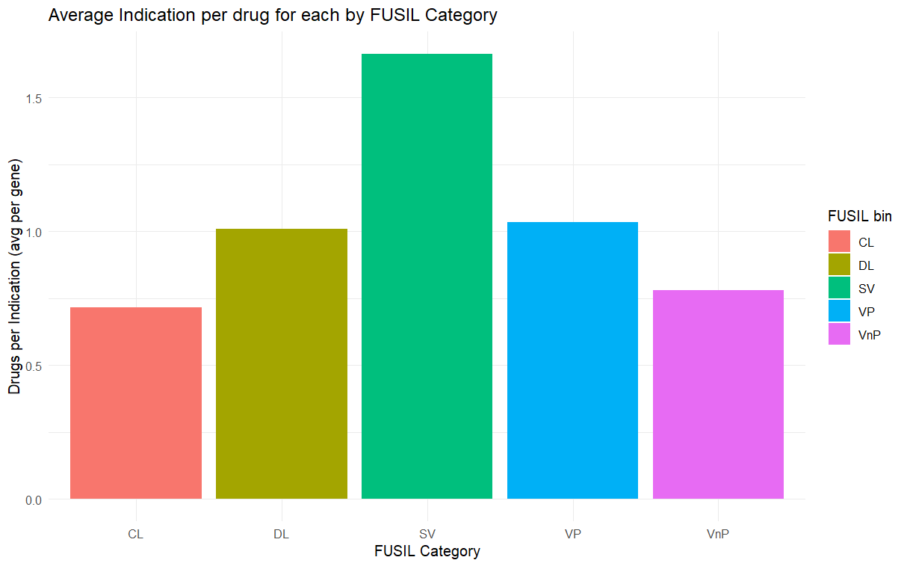
Indication Trends Across FUSIL Bins
Essential genes (CL) have fewer indications per gene
  These genes could be considered high risk, therefore, more chance of side effects
  This toxicity could prevent their boarder application
SV are targeted across more indications.
  Less essential = more flexible: Drugs can be repurposed across multiple diseases with lower risk of systemic disruption
  Commercial Incentive

Slide 24
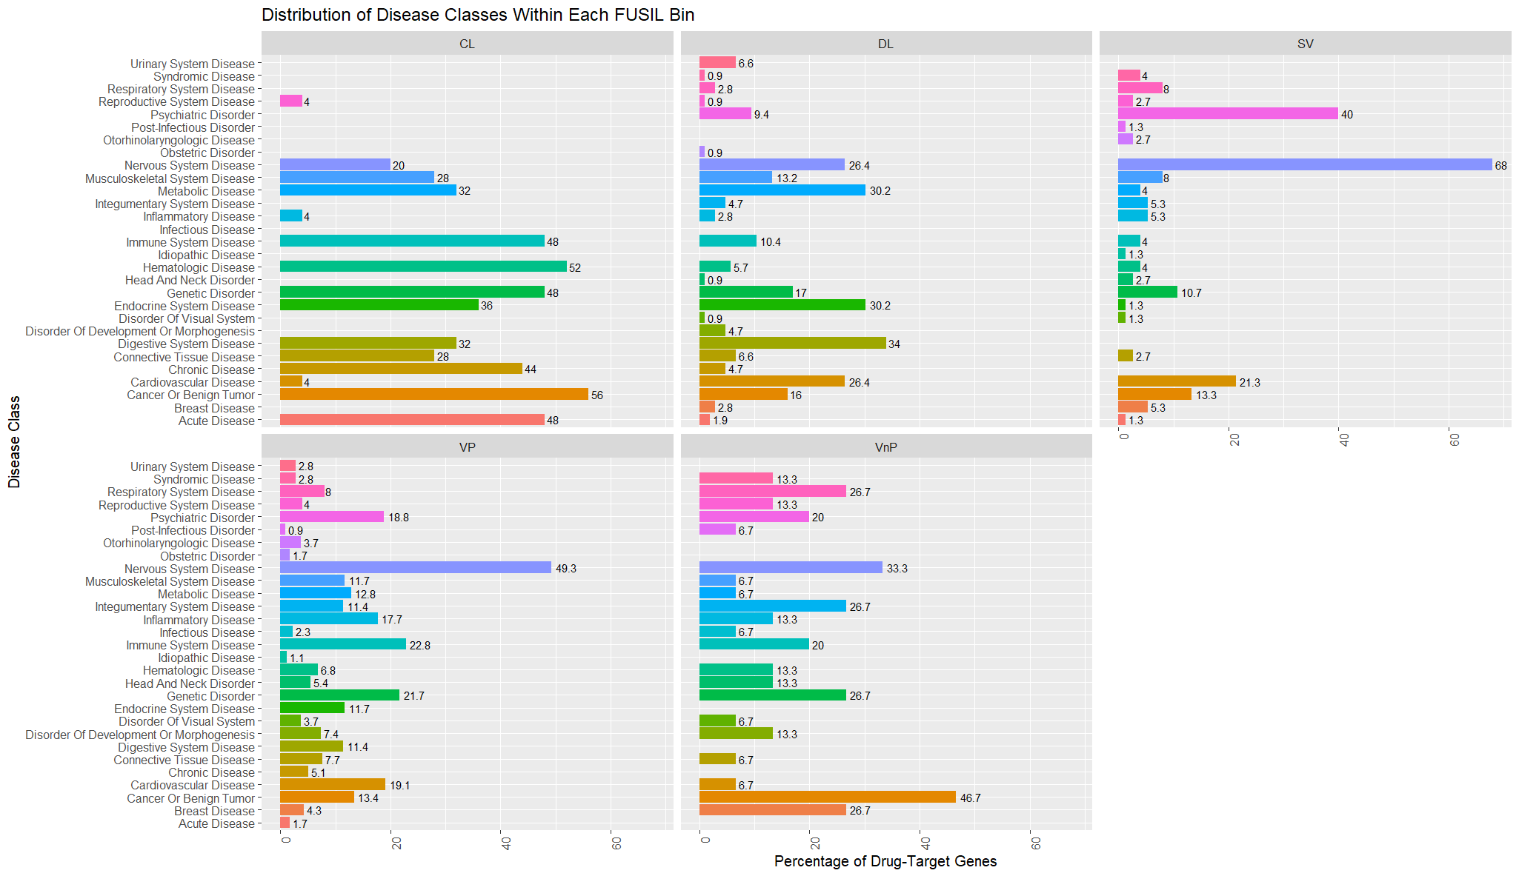
Drug Targets Vary by Disease/Indication and Essential Gene Category

Slide 25
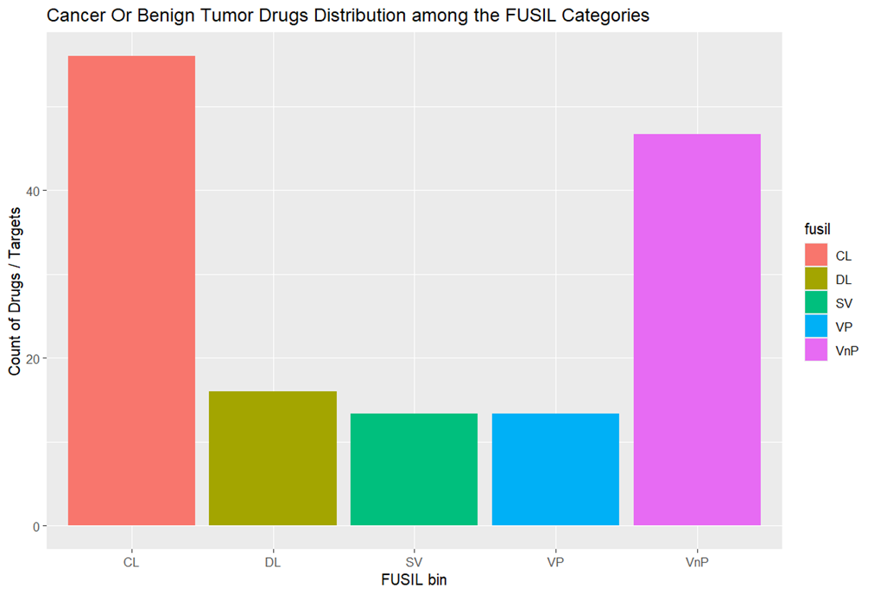
Cancer Drug Targets Cluster in more Essential Genes! Maybe?
Cancer drug targets are especially enriched for CL (Cellular Lethal) genes.
Cancer therapies often aim to kill rapidly dividing cells, which makes essential genes attractive.
Therapeutic rationale for aggressively disrupting vital pathways in cancer cells
Explains the cytotoxicity and the many side effects of cancer drugs.
Need to investigate why Cancer Drugs have a high proportion of VnP Targets.

Slide 26
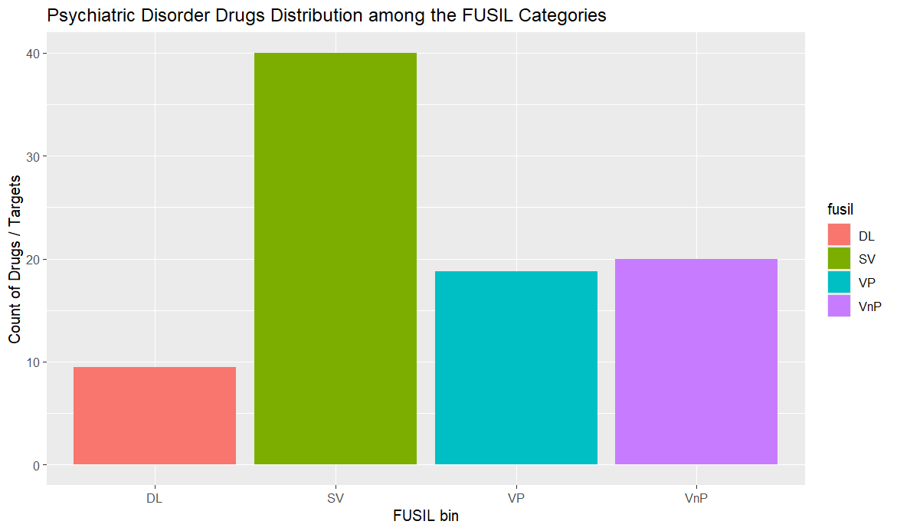
Psychiatric Disorder Drug Targets Cluster in Less Essential Genes
SV (Subviable) genes have the highest number of psychiatric drug targets
No psychiatric drugs target CL (Cellular Lethal) genes
Psychiatric drugs are often used long-term

Slide 27
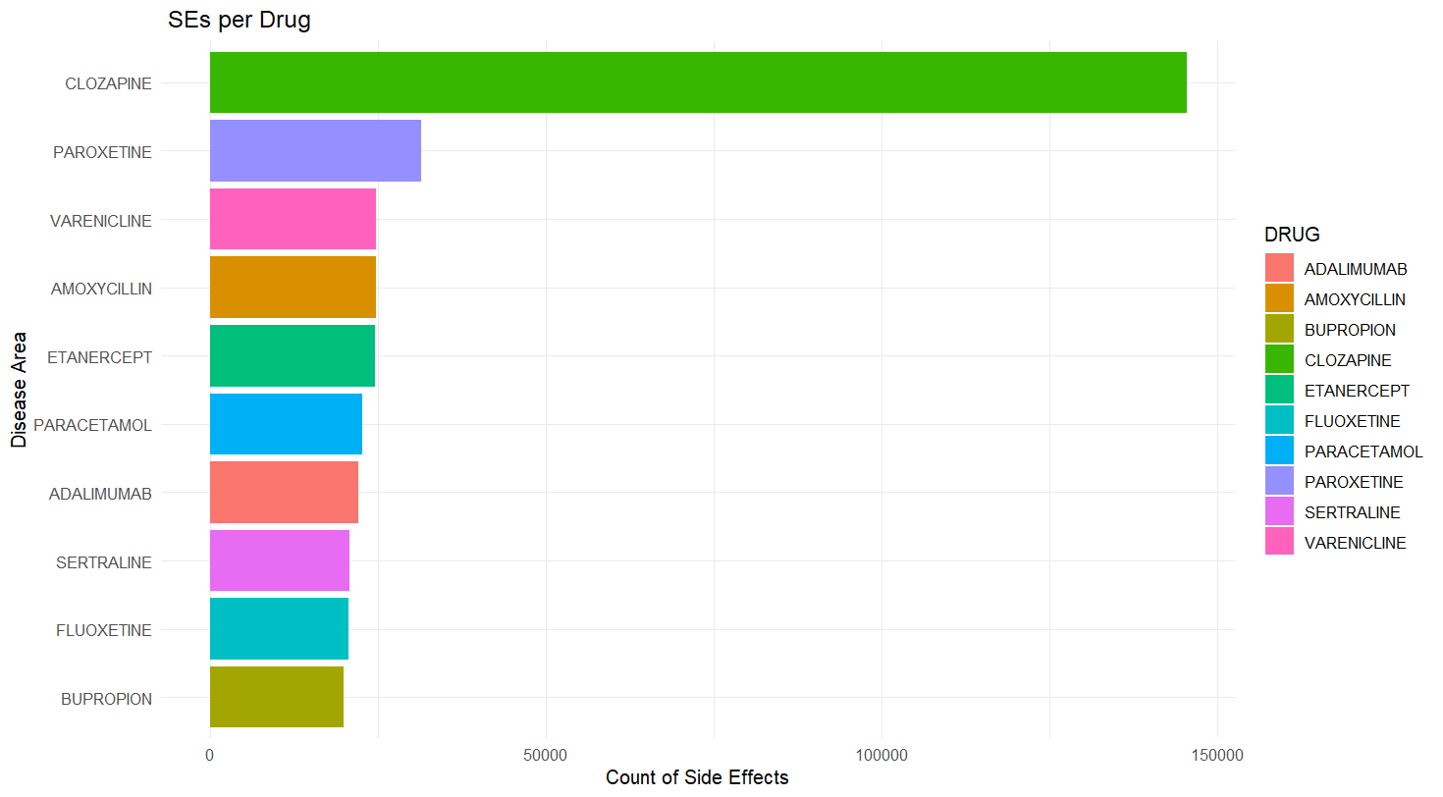
Clozapine and Other CNS Drugs Show High Side Effect Counts
Clozapine had a significant higher number of Side effects reported than any other Drug
Other CNS/psychiatric drugs (Paroxetine, Varenicline, Sertraline, Fluoxetine, Bupropion) are also in the top 10
It’s a highly effective Drug in treating TX resistant psychiatric disorders ( Schizophrenia)
Black Box Warning for Thrombocytopenia
Despite it’s BBW and limited use, still presented with the most Side effects report
Could be explained by the extreme monitoring , polypharmacy, chronic use.
Notes:
Some drugs may accumulate SE reports because they’re:
Heavily prescribed, or
Subject to close regulatory monitoring.
Paracetamol and amoxicillin are highly use drugs. Could explain the number of Side effects

Slide 28
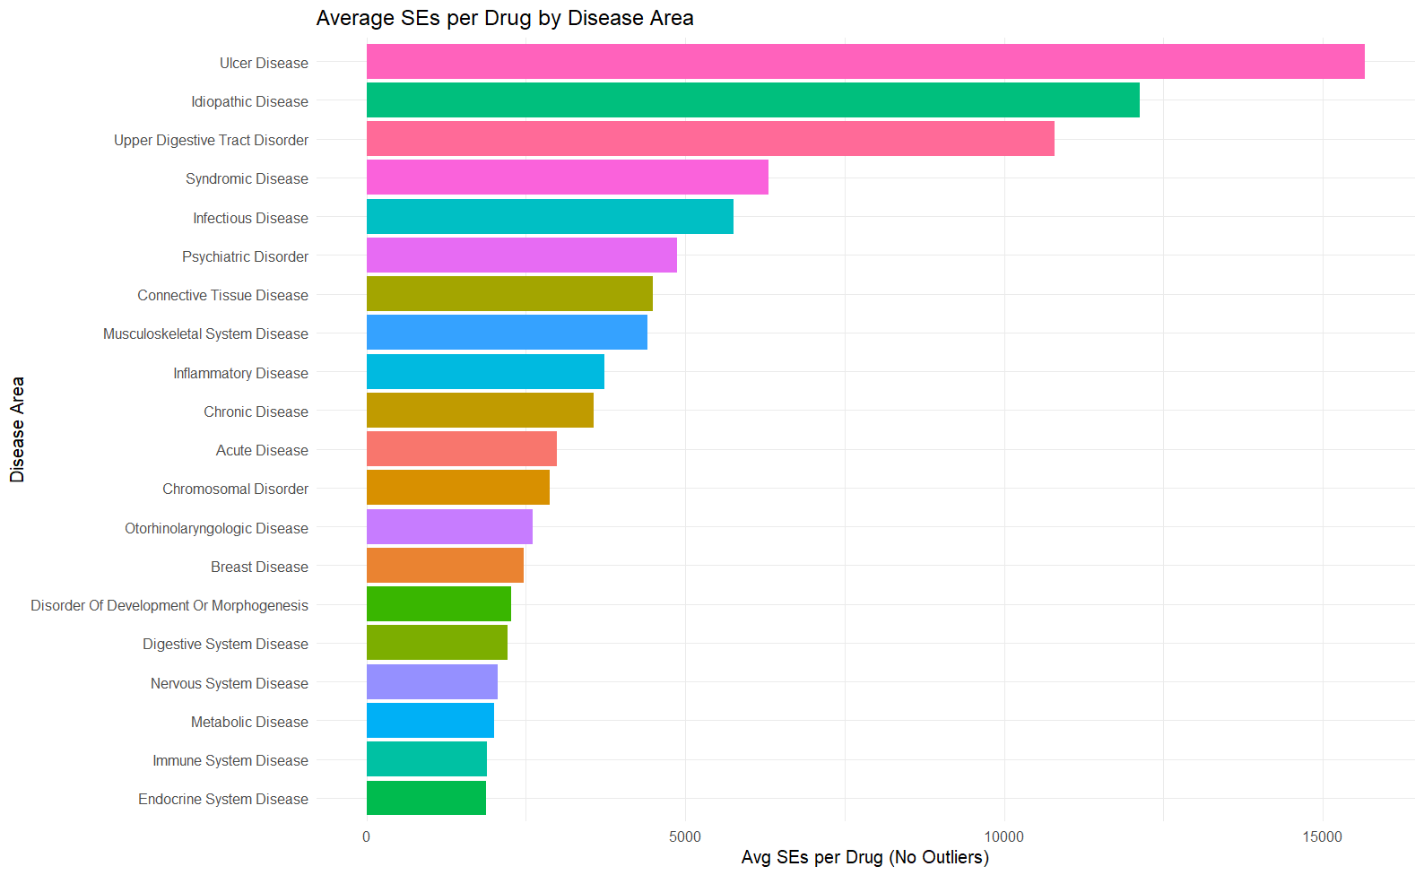
Side Effect Burden Varies by Disease Area

Slide 29
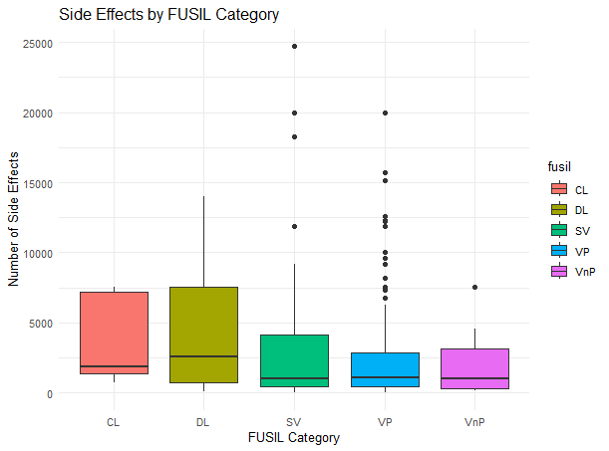
Drugs Targeting Essential Genes Show Greater Side Effect Variability
The median and interquartile range (IQR) are both highest for CL & DL genes
Could suggests that drugs targeting highly essential genes tend to result in more side effects on average
Feeds back to the hypothesis that modulating the function of essential genes will produce broad, system-wide physiological effects
Could support using gene essentiality (FUSIL) as a predictor of drug safety risk

Slide 30
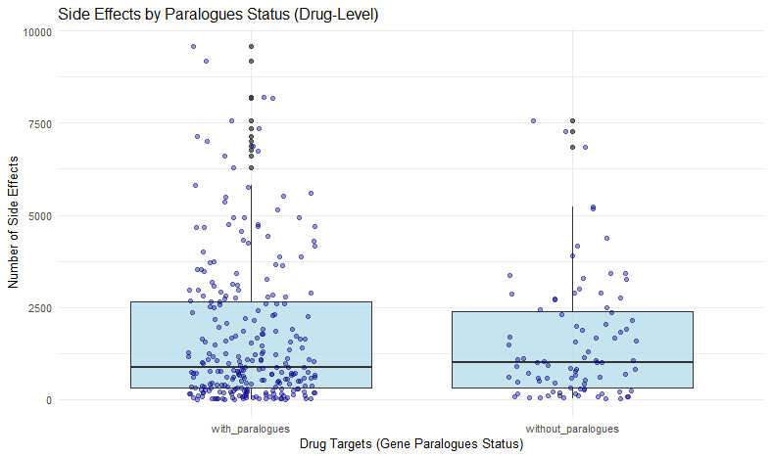
Paralogues VS Side Effects
The median number of side effects appears slightly lower for drugs targets genes with paralogues compared to those without.
However, both groups have similar overall spread and variability
There's no strong visual indication that having a paralogue consistently affects side effects patterns

Slide 31
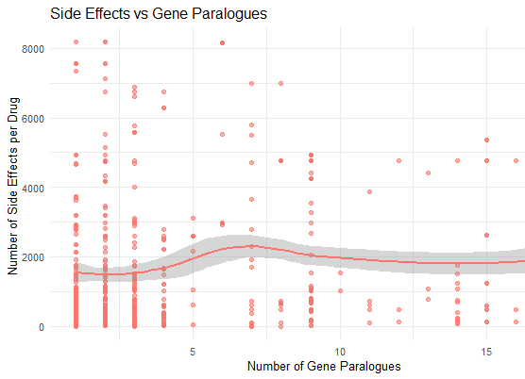
Do More Paralogues Mean More Side Effects
No clear Trend between the number of paralogues for a gene target and the number of Side effects reported
Correlation test did not yield a significant P value (p-value = 0.684)

Slide 32
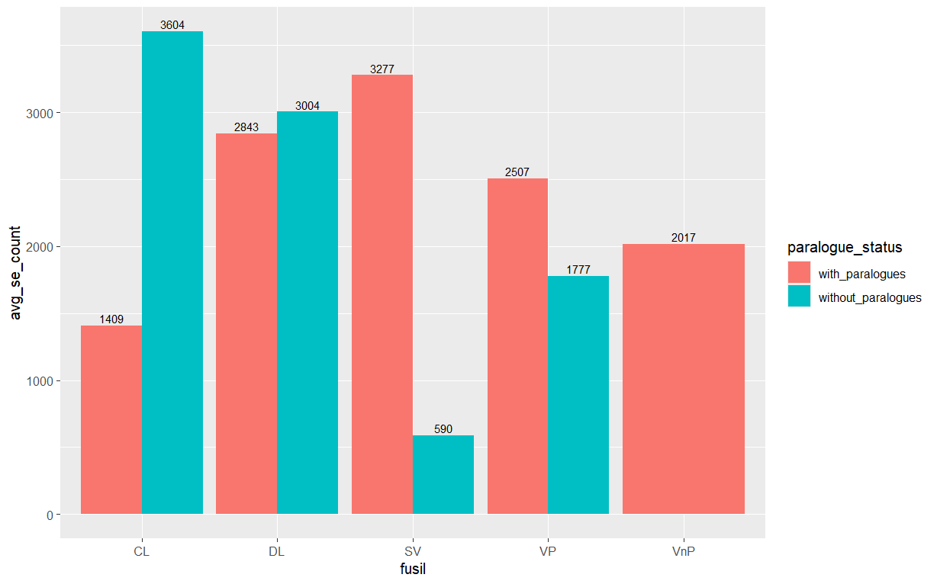
Gene Essentiality and Paralogy Vs Drug Side Effect Burden
In essential Genes, paralogues might be protective ( Buffering effect)
In less essential genes, paralogues may increase risk of side effect due to off target activity
Explained by drug development modalities :
In essential genes, extreme specificity is crucial to avoid systemic toxicity
Less essential genes (SV, VP, VnP), the safety threshold is often less strict, which could increase the likelihood of off-target activity due to paralogues.

Slide 33

Cautious Interpretation
The dataset is imbalanced, with limited representation for many drugs and genes
Information is limited to few drugs and genes , especially in the CL and DL categories.
Tentative Insight:
  Within the VP (Viable with Phenotype) category, there appears to be a notable increase in side effects for drugs targeting genes with paralogues
  Paralogous genes may contribute to broader pharmacological effects, potentially increasing side effect burden

Slide 34

Future approaches
Statistical analyses to better interpret results
Dissect the datasets and explore specific genes, disease areas, or essentiality categories
Integrate other omics such as transcriptomics or proteomics data

