Slide 1

CPE/CSC 486: Human-Computer Interaction
Franz J. Kurfess
Professor
Computer Science Department
California Polytechnic State University
San Luis Obispo, CA, U.S.A.
fkurfess@calpoly.edu

Slide 2
Usage of the Slides
these slides are intended for the students of my CPE/CSC 486 “Human-Computer Interaction” class at Cal Poly SLO
most of them are based in the “Interaction Design” textbook
www.id-book.com
if you want to use them outside of my class, please let me know (fkurfess@calpoly.edu)
some of them are based on other sources, which are identified and cited
I usually put together a subset for each quarter as a “Custom Show” (in PowerPoint)
to view these, go to “Slide Show => Custom Shows”, select the respective quarter, and click on “Show”
in Keynote, some slides are hidden to achieve the same effect
I make the slides available in Keynote (.key), PowerPoint (.pptx) and PDF format. Keynote and PowerPoint don’t show hidden slides, but the PDF version shows all slides in the deck, and doesn’t mark which ones are hidden.
© Franz J. Kurfess

Slide 3


Course Overview
Introduction
Cognitive Foundations
Input-Output Devices
Interaction Spaces
Interaction Styles
Interaction with Mobile Devices
Speech-Based Interaction
User Assistance
Natural User Interfaces
Case Studies
Project Presentations
©2011
© Franz J. Kurfess

Slide 4
Chapter Overview Cognitive Foundations
Motivation
Objectives
Cognition
cognitive models
Cognitive Processes
attention, memory, perception, learning, problem-solving, planning, reasoning, decision-making
Mental Models
Human Information Processing
External Cognition
memory, computation
Important Concepts and Terms
Chapter Summary
© Franz J. Kurfess

Slide 5
Bridge-In
© Franz J. Kurfess

Slide 6
Pre-Test
© Franz J. Kurfess

Slide 7
Motivation
interaction between humans and computers requires knowledge about capabilities and limitations
humans in this chapter
computers in the next chapter
cognitive models examine information processing capabilities of humans
critical for information transmission between humans and computers
through sensors and actuators, the human body interacts with the real world
information transmission takes place through real-world information channels
© Franz J. Kurfess

Slide 8
Objectives
to learn about cognitive models for the human mind
to understand the cognitive capabilities and limitations of humans
to be familiar with the most critical sensors and actuators used for information transmission
to evaluate the suitability of transmission channels and methods
depends on context, tasks, environments
© Franz J. Kurfess

Slide 9
Evaluation Criteria
© Franz J. Kurfess

Slide 10

Overview
What is cognition?
What are users good and bad at?
Describe how cognition has been applied to interaction design
Mental Models
Internals classic theories of cognition
More recent external theories of cognition
www.id-book.com
2
©2011
©2011

Slide 11
Why do we need to understand users?
Interacting with technology is cognitive
Need to take into account cognitive processes involved and cognitive limitations of users
Provides knowledge about what users can and cannot be expected to do
Identifies and explains the nature and causes of problems users encounter
Supply theories, modelling tools, guidance and methods that can lead to the design of better interactive products
www.id-book.com
3
©2011
©2011

Slide 12
Cognitive Psychology
Psychology
understanding of human behavior and underlying mental processes
Cognition
mental processes occurring in our brain
perception
memory
attention
learning
reasoning
understanding
awareness
skill acquisition
creativity
…

Slide 13
Cognition Modes
Experiential Cognition
involves perception, action, and reaction to events
requires expertise and engagement
focuses on observation of and interaction with the environment
Reflective Cognition
involves thinking, comparing, decision-making
focus on internal mental states and activities

Slide 14
Cognition and HCI
utilization of human cognitive abilities to interact with computers
adaptation to the limitations of computer interfaces
augmentation of human capabilities
eye glasses, hearing aids, …
here: focus on use of computing technology to overcome human limitations
externalization of tasks that are difficult or unpleasant for humans
calculations
memorizations
communication

Slide 15
Cognitive processes
Attention
Perception and recognition
Memory
Learning
Reading, speaking and listening
Problem-solving, planning, reasoning and decision-making
www.id-book.com
4
©2011
©2011
Notes:
It is important to note that many of these cognitive processes are interdependent: several may be involved for a given activity. It is rare for one to occur in isolation. For example, when you try to learn material for an exam, you need to attend to the material, perceive and recognize it, read it, think about it, and try to remember it. Below we describe the various kinds in more detail, followed by a summary box highlighting core design implications for each. Most relevant for interaction design are attention and memory which we describe in greatest detail.

Slide 16

Attention
Selecting things to concentrate on at a point in time from the mass of stimuli around us
Allows us to to focus on information that is relevant to what we are doing
Involves audio and/or visual senses
Focussed and divided attention enables us to be selective in terms of the mass of competing stimuli but limits our ability to keep track of all events
Information at the interface should be structured to capture users’ attention, e.g. use perceptual boundaries (windows), colour, reverse video, sound and flashing lights
www.id-book.com
5
©2011
©2011

Slide 17
Experiment
Identify an item in a listing on the screen
two different arrangements
Setup
task description is shown
timer starts when screen display is shown
timer stops when the participant has found the correct item
speak the correct answer
People
participants
facilitator explains the task, assists the user
observer measures time
©2011
© Franz J. Kurfess

Slide 18
Activity: Find the price of a double room at the Holiday Inn in Bradley
tell the observer the price once you’ve found it
www.id-book.com
6
©2011
©2011

Slide 19
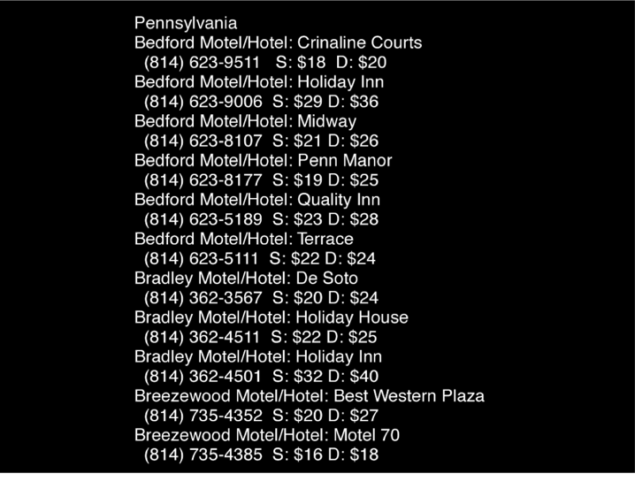
Activity: Find the price of a double room at the Holiday Inn in Bradley
www.id-book.com
6
©2011
©2011

Slide 20
Activity 2: Find the price for a double room at the Quality Inn in Columbia
www.id-book.com
7
©2011
©2011

Slide 21
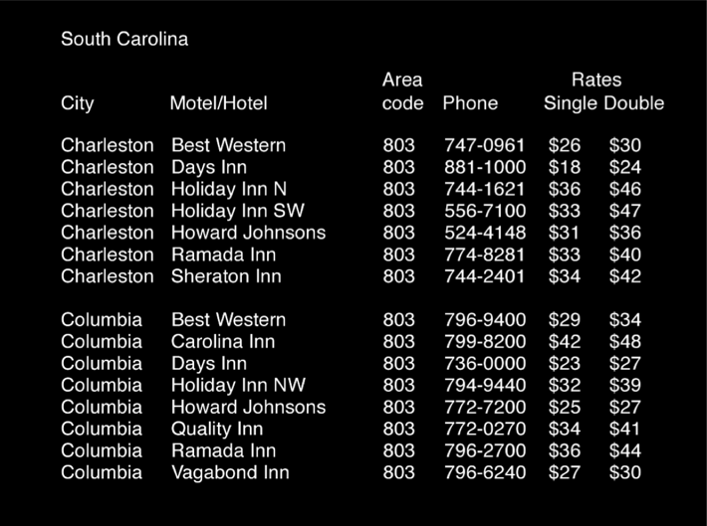
Activity: Find the price for a double room at the Quality Inn in Columbia
www.id-book.com
7
©2011
©2011

Slide 22
Evaluation Activities 1, 2
Tullis (1987) found that the two screens produced quite different results
1st screen - took an average of 5.5 seconds to search
2nd screen - took 3.2 seconds to search
Why?,
both displays have the same density of information (31%)
Spacing
In the 1st screen the information is bunched up together, making it hard to search
In the 2nd screen the characters are grouped into vertical categories of information making it easier
www.id-book.com
8
©2011
©2011

Slide 23
Activity 3:
Dial the number of the hotel with the cheapest double room in Charleston
signal completion after you’ve entered the phone number
no need to actually connect the call
www.id-book.com
7
©2011
© Franz J. Kurfess

Slide 24
Activity: Find the price for a double room at the Quality Inn in Columbia
www.id-book.com
7
©2011
©2011

Slide 25
Evaluation Activity 3
more challenging than Activity 3
calculations
short term memory
translation of visual input into action
©2011
© Franz J. Kurfess

Slide 26
Activity 4:
almost the same as Activity 3
most expensive instead of cheapest
spoken text instead of visual display
Dial the number of the hotel with the most expensive single room in Bradley
signal completion after you’ve entered the phone number
no need to actually connect the call
www.id-book.com
7
©2011
© Franz J. Kurfess
Notes:
to do this in Keynote for the next slide:
quit presentation mode
highlight text
right-click Speech => Start Speaking

Slide 27
Activity: Find the price for a double room at the Quality Inn in Columbia
Pennsylvania Bedford Motel/Hotel: Crinaline Courts (814) 623-9511 S:$18 D:$20 Bedford Motel/Hotel: Holiday Inn (814) 623-9006 S: $29 D: $36 Bedford Motel/Hotel: Midway (814) 623-8107 5: $21 D: $26 Bedford Motel/Hotel: Penn Manor (814) 623-8177 5: $19 D: $25 Bedford Motel/Hotel: Quality Inn (814) 623-5189 S: $23 D: $28 Bedford Motel/Hotel: Terrace (814) 623-5111 S: $22 D: $24 Bradley Motel/Hotel: De Soto (814) 362-3567 5: $20 D: $24 Bradley Motel/Hotel: Holiday House (814) 362-4511 3: $22 D: $25 Bradley Motel/Hotel: Holiday Inn (814) 362-4501 S: $32 D: $40 Breezewood Motel/Hotel: Best Western Plaz. (814) 735-4352 S: $20 D: $27 Breezewood Motel/Hotel: Motel 70 (814) 735-4385 5: $16 D: $18
www.id-book.com
7
©2011
© Franz J. Kurfess
Notes:
to do this in Keynote before showing this slide:
quit presentation mode
highlight text
right-click Speech => Start Speaking

Slide 28
Evaluation Activity 3
more challenging than Activity 3
calculations
short term memory
translation of visual input into action
© Franz J. Kurfess

Slide 29
Multitasking and attention
Is it possible to perform multiple tasks without one or more of them being detrimentally affected?
Ophir et al (2009) compared heavy vs light multi-taskers
heavy were more prone to being distracted than those who infrequently multitask
heavy multi-taskers are easily distracted and find it difficult to filter irrelevant information
www.id-book.com
9
©2011
©2011

Slide 30
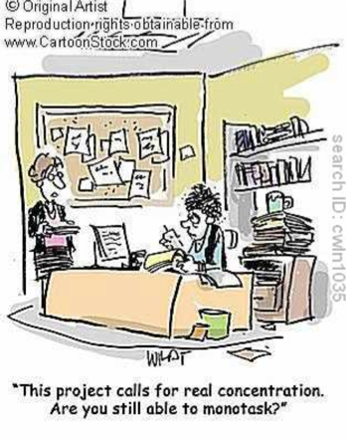
www.id-book.com
10
©2011
©2011

Slide 31
Design implications for attention
Make information salient when it needs attending to
Use techniques that make things stand out like color, ordering, spacing, underlining, sequencing and animation
Avoid cluttering the interface with too much information
Avoid using too much because the software allows it
www.id-book.com
11
©2011
©2011

Slide 32
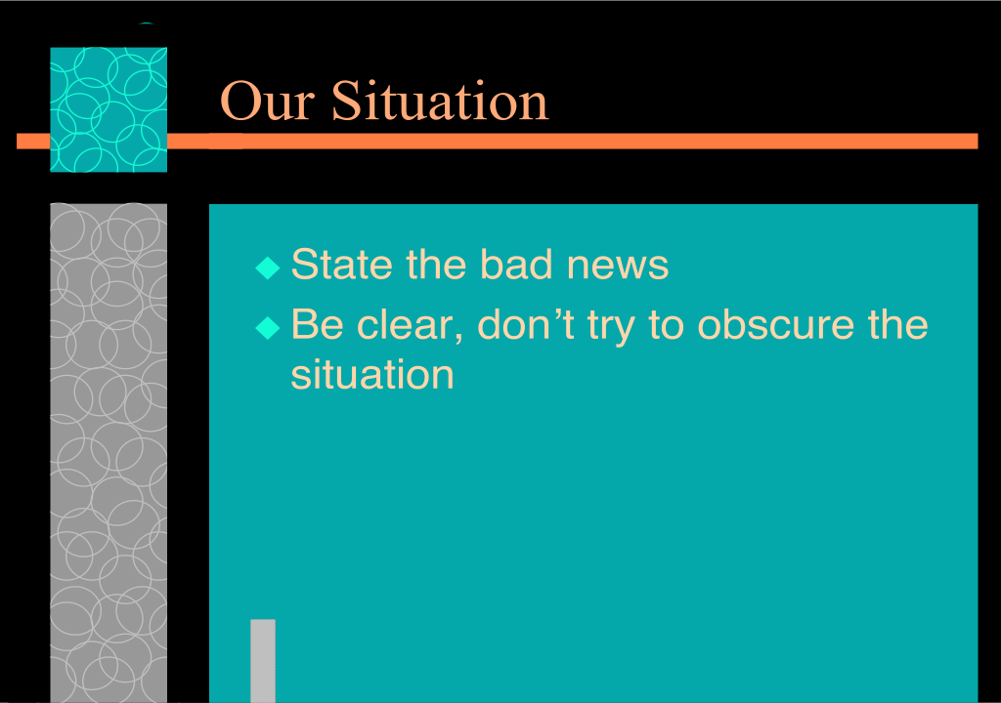
An example of over-use of graphics
www.id-book.com
12
©2011
©2011

Slide 33
Perception
How information is acquired from the world and transformed into experiences
Obvious implication is to design representations that are readily perceivable, e.g.
Text should be legible
Icons should be easy to distinguish and read
www.id-book.com
13
©2011
©2011

Slide 34

Is color contrast good? Find Landing
www.id-book.com
14
©2011
©2011

Slide 35

Are borders and white space better? Find French
www.id-book.com
15
©2011
©2011

Slide 36
Activity
Weller (2004) found people took less time to locate items for information that was grouped
using a border (2nd screen) compared with using color contrast (1st screen)
Some argue that too much white space on web pages is detrimental to search
Makes it hard to find information
Do you agree?
www.id-book.com
16
©2011
©2011

Slide 37

Which is easiest to read and why?
www.id-book.com
17
©2011
©2011

Slide 38
Design implications
Icons should enable users to readily distinguish their meaning
Bordering and spacing are effective visual ways of grouping information
Sounds should be audible and distinguishable
Speech output should enable users to distinguish between the set of spoken words
Text should be legible and distinguishable from the background
Tactile feedback should allow users to recognize and distinguish different meanings
www.id-book.com
18
©2011
©2011

Slide 39
Memory
Involves first encoding and then retrieving knowledge
We don’t remember everything - involves filtering and processing what is attended to
Context is important in affecting our memory (i.e. where, when)
We recognize things much better than being able to recall things
www.id-book.com
19
©2011
©2011

Slide 40
Processing in memory
Encoding is first stage of memory
determines which information is attended to in the environment and how it is interpreted
The more attention paid to something…
The more it is processed in terms of thinking about it and comparing it with other knowledge…
The more likely it is to be remembered
e.g. when learning about HCI, it is much better to reflect upon it, carry out exercises, have discussions with others about it, and write notes than just passively read a book, listen to a lecture or watch a video about it
www.id-book.com
20
©2011
©2011

Slide 41
Context is important
Context affects the extent to which information can be subsequently retrieved
Sometimes it can be difficult for people to recall information that was encoded in a different context:
“You are on a train and someone comes up to you and says hello. You don’t recognize him for a few moments but then realize it is one of your neighbors. You are only used to seeing your neighbor in the hallway of your apartment block and seeing him out of context makes him difficult to recognize initially”
www.id-book.com
21
©2011
©2011

Slide 42
Activity
Try to remember the dates of your grandparents’ birthday
Try to remember the cover of the last movies you streamed, bought or rented
Which was easiest? Why?
People are very good at remembering visual cues about things
e.g. the color of items, the location of objects and marks on an object
They find it more difficult to learn and remember arbitrary material
e.g. birthdays and phone numbers
www.id-book.com
22
©2011
©2011

Slide 43
Recognition versus recall
Command-based interfaces require users to recall from memory a name from a possible set of 100s
GUIs provide visually-based options that users need only browse through until they recognize one
Web browsers, MP3 players, etc., provide lists of visited URLs, song titles etc., that support recognition memory
www.id-book.com
23
©2011
©2011

Slide 44
The problem with the classic ‘7±2’
George Miller’s (1956) theory of how much information people can remember
People’s immediate memory capacity is very limited
Many designers think this is useful finding for interaction design
But…
www.id-book.com
24
©2011
©2011

Slide 45
What some designers get up to…
Present only 7 options on a menu
Display only 7 icons on a tool bar
Have no more than 7 bullets in a list
Place only 7 items on a pull down menu
Place only 7 tabs on the top of a website page
But this is wrong? Why?
www.id-book.com
25
©2011
©2011

Slide 46
Why?
Inappropriate application of the theory
People can scan lists of bullets, tabs, menu items for the one they want
They don’t have to recall them from memory having only briefly heard or seen them
Sometimes a small number of items is good
But depends on task and available screen estate
www.id-book.com
26
©2011
©2011

Slide 47
Personal information management
Personal information management is a growing problem for many users
vast numbers of documents, images, music files, video clips, emails, attachments, bookmarks, etc.,
where and how to save them all, then remembering what they were called and where to find them again
naming most common means of encoding them
but can be difficult to remember, especially when have 1000s and 1000s
How might such a process be facilitated taking into account people’s memory abilities?
www.id-book.com
27
©2011
©2011

Slide 48
Personal information management
Memory involves 2 processes
recall-directed and recognition-based scanning
File management systems should be designed to optimize both kinds of memory processes
e.g. Search box and history list
Help users encode files in richer ways
Provide them with ways of saving files using colour, flagging, image, flexible text, time stamping, etc
www.id-book.com
28
©2011
©2011

Slide 49
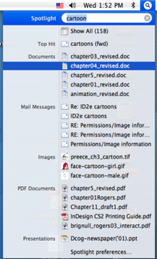
Is Apple’s Spotlight search tool any good?
www.id-book.com
29
©2011
©2011

Slide 50
Memory aids
SenseCam developed by Microsoft Research Labs
a wearable device that intermittently takes photos without any user intervention while worn
digital images taken are stored and revisited using special software
Has been found to improve people’s memory, suffering from Alzheimers
www.id-book.com
30
©2011
©2011

Slide 51
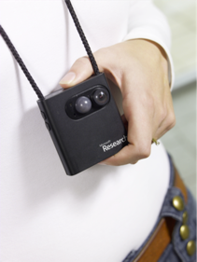
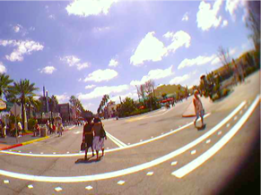
SenseCam
www.id-book.com
31
©2011
©2011

Slide 52
Design implications
Don’t overload users’ memories with complicated procedures for carrying out tasks
Design interfaces that promote recognition rather than recall
Provide users with various ways of encoding information to help them remember
e.g. categories, color, flagging, time stamping
www.id-book.com
32
©2011
©2011

Slide 53
Learning
How to learn to use a computer-based application
Using a computer-based application to understand a given topic
People find it hard to learn by following instructions in a manual
prefer to learn by doing
www.id-book.com
33
©2011
©2011

Slide 54
Design implications
Speech-based menus and instructions should be short
Accentuate the intonation of artificially generated speech voices
they are harder to understand than human voices
Provide opportunities for making text large on a screen
www.id-book.com
34
©2011
©2011

Slide 55
Reading, speaking, and listening
The ease with which people can read, listen, or speak differs
Many prefer listening to reading
Reading can be quicker than speaking or listening
Listening requires less cognitive effort than reading or speaking
Dyslexics have difficulties understanding and recognizing written words
www.id-book.com
35
©2011
©2011

Slide 56
Applications
Speech-recognition systems allow users to interact with them by using spoken commands
e.g. Google Voice Search app
Speech-output systems use artificially generated speech
e.g. written-text-to-speech systems for the blind
Natural-language systems enable users to type in questions and give text-based responses
e.g. Ask search engine
www.id-book.com
36
©2011
©2011

Slide 57
Design implications
Design interfaces that encourage exploration
Design interfaces that constrain and guide learners
Dynamically linking concepts and representations can facilitate the learning of complex material
www.id-book.com
37
©2011
©2011

Slide 58
Problem-solving, planning, reasoning and decision-making
All involves reflective cognition
e.g. thinking about what to do, what the options are, and the consequences
Often involves conscious processes, discussion with others (or oneself), and the use of artifacts
e.g. maps, books, pen and paper
May involve working through different scenarios and deciding which is best option
www.id-book.com
38
©2011
©2011

Slide 59
Design implications
Provide additional information/functions for users who wish to understand more about how to carry out an activity more effectively
Use simple computational aids to support rapid decision-making and planning for users on the move
www.id-book.com
39
©2011
©2011

Slide 60
Mental models
Users develop an understanding of a system through learning about and using it
Knowledge is sometimes described as a mental model:
How to use the system (what to do next)
What to do with unfamiliar systems or unexpected situations (how the system works)
People make inferences using mental models of how to carry out tasks
www.id-book.com
40
©2011
©2011

Slide 61
Mental models
Craik (1943) described mental models as:
internal constructions of some aspect of the external world enabling predictions to be made
Involves unconscious and conscious processes
images and analogies are activated
Deep versus shallow models
e.g. how to drive a car and how it works
www.id-book.com
41
©2011
©2011

Slide 62
Everyday reasoning and mental models
You arrive home on a cold winter’s night to a cold house. How do you get the house to warm up as quickly as possible? Set the thermostat to be at its highest or to the desired temperature?
(b) You arrive home starving hungry. You look in the fridge and find all that is left is an uncooked pizza. You have an electric oven. Do you warm it up to 375 degrees first and then put it in (as specified by the instructions) or turn the oven up higher to try to warm it up quicker?
www.id-book.com
42
©2011
©2011

Slide 63
Heating up a room or oven that is thermostat-controlled
Many people have erroneous mental models (Kempton, 1996)
Why?
General valve theory, where ‘more is more’ principle is generalised to different settings (e.g. gas pedal, gas cooker, tap, radio volume)
Thermostats based on model of on-off switch model
www.id-book.com
43
©2011
©2011

Slide 64
Heating up a room or oven that is thermostat-controlled
Same is often true for understanding how interactive devices and computers work:
poor, often incomplete, easily confusable, based on inappropriate analogies and superstition (Norman, 1983)
e.g. elevators and pedestrian crossings - lot of people hit the button at least twice
Why? Think it will make the lights change faster or ensure the elevator arrives!
www.id-book.com
44
©2011
©2011

Slide 65
Exercise: ATMs
Write down how an ATM works
How much money are you allowed to take out?
What denominations?
If you went to another machine and tried the same what would happen?
What information is on the strip on your card? How is this used?
What happens if you enter the wrong number?
Why are there pauses between the steps of a transaction? What happens if you try to type during them?
Why does the card stay inside the machine?
Do you count the money? Why?
www.id-book.com
45
©2011
©2011

Slide 66
How did you fare?
Your mental model
How accurate?
How similar?
How shallow?
Payne (1991) did a similar study and found that people frequently resort to analogies to explain how they work
People’s accounts greatly varied and were often ad hoc
www.id-book.com
46
©2011
©2011

Slide 67
Mental Models and HCI
functional mental models
emphasis on how devices or systems work
operational mental models
emphasis on the behavior of systems
interaction mental models
emphasis on interaction
deep vs. shallow models

Slide 68
Functional Mental Model
internal model of how a system works
can be used to capture a user’s understanding of the device
often used to reason about the expected behavior of a system
influences interaction with the system
Example: Thermostat
“valve” model
“switch” model

Slide 69
Operational Mental Model
internal model of how a system behaves
emphasis on behavior
may depend on context, environment, system mode, …
influenced by functional and interaction models

Slide 70
Interaction Mental Model
internal model in the mind of a user for interactions with a system
less emphasis on the internal functions

Slide 71
Gulfs of execution and evaluation
The ‘gulfs’ explicate the gaps that exist between the user and the interface
The gulf of execution
the distance from the user to the physical system
The gulf of evaluation
the distance from the physical system to the user
Bridging the gulfs can reduce cognitive effort required to perform tasks
Norman, 1986; Hutchins et al, 1986
www.id-book.com
47
©2011
©2011

Slide 72
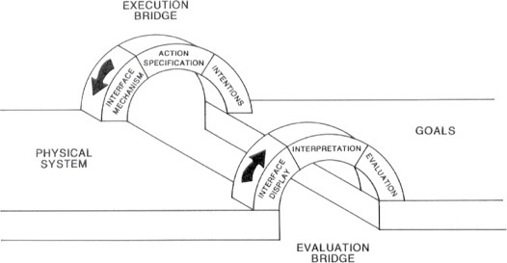
Bridging the gulfs
www.id-book.com
48
©2011
©2011
Notes:
Figure 3.8

Slide 73

Information processing
Conceptualizes human performance in metaphorical terms of information processing stages
www.id-book.com
49
©2011
©2011
Notes:
A number of comparisons have been made, including conceptualizing the mind as a reservoir, a telephone network, and a digital computer. One prevalent metaphor from cognitive psychology is the idea that the mind is an information processor. Information is thought to enter and exit the mind through a series of ordered processing stages. Within these stages, various processes are assumed to act upon mental representations. Processes include comparing and matching. Mental representations are assumed to comprise images, mental models, rules, and other forms of knowledge.

Slide 74
Model Human processor
(Card et al, 1983)
Models the information processes of a user interacting with a computer
Predicts which cognitive processes are involved when a user interacts with a computer
Enables calculations to be made of how long a user will take to carry out a task
www.id-book.com
50
©2011
©2011

Slide 75
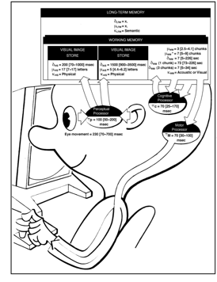
The human processor model
www.id-book.com
51
©2011
©2011

Slide 76
Limitations
based on modeling mental activities that happen exclusively inside the head
do not adequately account for how people interact with computers and other devices in real world
www.id-book.com
52
©2011
©2011

Slide 77
Technology Influence
historically, human cognitive models have relied on the most recent technological developments
now: computers
earlier:
electricity
clockworks
pneumatic and hydromatic methods
steam, water, air
pipes, valves
©2011

Slide 78
External cognition
Concerned with explaining how we interact with external representations (e.g. maps, notes, diagrams)
What are the cognitive benefits and what processes are involved
How they extend our cognition
What computer-based representations can we develop to help even more?
www.id-book.com
53
©2011
©2011

Slide 79
Externalizing to reduce memory load
Diaries, reminders, calendars, notes, shopping lists, to-do lists
written to remind us of what to do
Post-its, piles, marked emails
where placed indicates priority of what to do
External representations:
Remind us that we need to do something (e.g. to buy something for mother’s day)
Remind us of what to do (e.g. buy a card)
Remind us when to do something (e.g. send a card by a certain date)
www.id-book.com
54
©2011
©2011

Slide 80
Computational offloading
When a tool is used in conjunction with an external representation to carry out a computation (e.g. pen and paper)
Try doing the two sums below (a) in your head, (b) on a piece of paper and c) with a calculator.
234 + 456 =??
CCXXXIIII + CCCCXXXXXVI = ???
Which is easiest and why? Both are identical sums
www.id-book.com
55
©2011
©2011

Slide 81
Annotation and cognitive tracing
Annotation involves modifying existing representations through making marks
e.g. crossing off, ticking, underlining
Cognitive tracing involves externally manipulating items into different orders or structures
e.g. playing Scrabble, playing cards
www.id-book.com
56
©2011
©2011

Slide 82
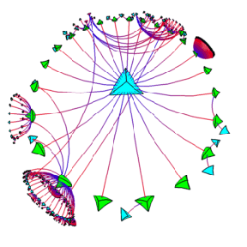
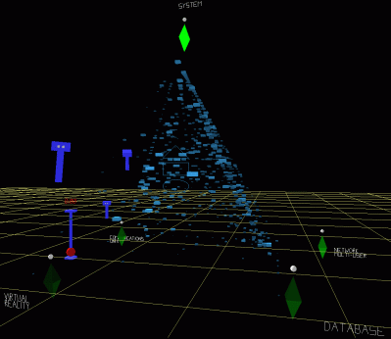
Design implication
Provide external representations at the interface that reduce memory load and facilitate computational offloading
e.g. Information visualizations have been designed to allow people to make sense and rapid decisions about masses of data
www.id-book.com
57
©2011
©2011

Slide 83
Distributed cognition
Concerned with the nature of cognitive phenomena across individuals, artifacts, and internal and external representations (Hutchins, 1995)
Describes these in terms of propagation across representational state
Information is transformed through different media (computers, displays, paper, heads)
www.id-book.com
58
©2011
©2011

Slide 84
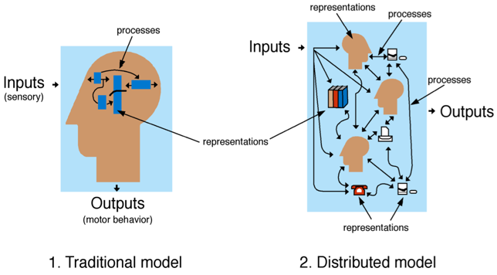
How it differs from information processing
www.id-book.com
59
©2011
©2011

Slide 85
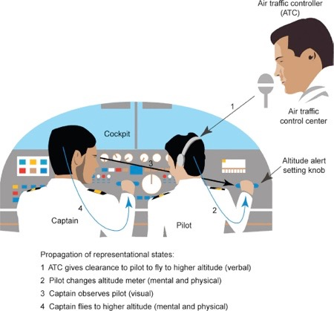
www.id-book.com
60
©2011
©2011

Slide 86
What’s involved
The distributed problem-solving that takes place
The role of verbal and non-verbal behavior
The various coordinating mechanisms that are used (e.g. rules, procedures)
The communication that takes place as the collaborative activity progresses
How knowledge is shared and accessed
www.id-book.com
61
©2011
©2011

Slide 87
Important Concepts and Terms
attention
cognition
decision-making
external memory
externalization
human-machine interface
information processing
listening
memory
mental model
perception
planning
problem-solving
reading
reasoning
speaking

Slide 88
Summary
Cognition involves several processes including attention, memory, perception and learning
The way an interface is designed can greatly affect how well users can perceive, attend, learn and remember how to do their tasks
Theoretical frameworks, such as mental models and external cognition, provide ways of understanding how and why people interact with products
This can lead to thinking about how to design better products
www.id-book.com
62
©2011
©2011

Slide 89
©2011

