Slide 1

CPE/CSC 486: Human-Computer Interaction
Franz J. Kurfess
Professor
Computer Science Department
California Polytechnic State University
San Luis Obispo, CA, U.S.A.
fkurfess@calpoly.edu

Slide 2


Usage of the Slides
these slides are intended for the students of my CPE/CSC 486 “Human-Computer Interaction” class at Cal Poly SLO
some of them are based on the “Interaction Design” textbook
www.id-book.com
if you want to use them outside of my class, please let me know (fkurfess@calpoly.edu)
some of them are based on other sources, which are identified at the bottom of the respective slide
©2011
© Franz J. Kurfess

Slide 3
Course Overview
Speech-Based Interaction
User Assistance
Natural User Interfaces
Case Studies
Project Presentations
Introduction
Cognitive Foundations
Interaction Spaces
Input-Output Devices
Interaction Styles
Interaction with Mobile Devices
© Franz J. Kurfess

Slide 4
Chapter Overview Interacting with Devices
Output Devices
Survey
Characteristics
Performance
Advantages and Problems
Important Concepts and Terms
Chapter Summary
Agenda
Motivation
Objectives
Input Devices
Survey
Characteristics
Performance
Advantages and Problems
© Franz J. Kurfess

Slide 5
I/O Alternatives
List two alternatives to the screen (CRT, LCD) as main computer output and the keyboard as main computer input device
what are critical properties of screen, keyboard?
what are the consequences for HCID?
Screen
Alternative 1:
Alternative 2:
Keyboard
Alternative 1:
Alternative 2:
© Franz J. Kurfess
Notes:
anecdote, demonstration, example to informally introduce the topic
evoke the participants’ interest and curiosity
set the stage for the more formal introduction
make students more comfortable

Slide 6
Information transfer rates
Information transfer rates of popular I/O devices
output
computer screen
laser printer
loudspeakers
input
keyboard
mouse
microphone (speech input)
scanner
digital camera

Slide 7
Experiment: Combining Interaction
try to use two pointing devices simultaneously
e.g. mouse and trackpad on laptop
two mice on a desktop
Experiment 1: Move one device vertically, and the other horizontally.
What is the resulting movement of the cursor?
Could such a setup have advantages for certain tasks?
Experiment 2: Try pressing two different buttons on the two different devices simultaneously.
e.g. left button on the mouse, right button on the trackpad
What is the outcome?
Are there good uses of this setup?

Slide 8
Motivation
the devices used for input and output determine the nature and capacity of information transferred between human and computer
characteristics of the I/O devices influence user interface design to a large degree
the choice of an inappropriate or inadequate design will diminish the performance of the task
combinations of I/O devices can increase the usability of a system

Slide 9
Objectives
identify the main I/O devices used in computer systems
know the important characteristics of these devices
evaluate the suitability of I/O devices for particular purposes or tasks
be able to select an appropriate combination of I/O devices for a specific task

Slide 10
Evaluation Criteria
recall
important I/O devices and their properties
recognition
which of a list of I/O devices has certain properties
analysis
according to given criteria, how well does a device perform a certain task
evaluation
is a particular I/O device suitable for a certain task
what is the performance of a device for a task
criteria to measure performance

Slide 11
Devices vs. Controls
devices
self-contained system elements connected to computers
controls
parts of a system that allow interaction with the user
primarily used for inputs
There isn’t always a clear distinction between the two terms.

Slide 12
Input and Output Devices
I/O devices are hardware elements
connection between the physical human effectors (hands, vocal cords) and sensors (eyes, ears), and the input and output channels of computers
also enable communication between users and software
usually their properties and behavior can be adapted through software
task demands and user preferences affect the choice of input and output devices to use
e.g. the need for hands-free or silent operation
special devices or setups for users with disabilities
[Mustillo]

Slide 13
Controls
usually software elements shown on the display
used to set preferences and make choices
some familiar controls:
menus
radio buttons, check buttons, toggles, sliders
some hardware controls:
contrast, brightness, etc. on screens
volume on speakers
some controls are used for both input and output
show users choices or current setting
volume knobs with markers for the current setting
allow users to operate the control
example: printer control
[Mustillo]
© Franz J. Kurfess

Slide 14
Input-Output Devices
Characteristics Input Devices
Characteristics Output Devices

Slide 15
Properties of Input Devices
Sampling rate
Resolution
Latency
Noise
Position mode
Gain
Degrees of freedom
Direct vs. indirect
Footprint
Device acquisition time
Schedlbauer, M. J. (2007). A Survey of Manual Input Devices. Technical report, University of Massachusetts.

Slide 16
Property | Explanation
Sampling rate | The sampling rate determines how often measurements from the physical sensors embedded in the input device are taken and sent to the computer system. Increased sampling rates produce finer control over the input (Hinckley, 2003).
Resolution | Resolution is a metric of the number of unique measurements the input device can send to the computer.
Latency | Latency, or lag, is the time that elapses between the physical actuation of the input device and the resulting on-screen feedback. Latencies above 100 msec. interfere with cognitive performance (MacKenzie and Ware, 1993).
Noise | Noise is the result of sensing errors due to hardware malfunctions or design inadequacies. Increased noise leads to sampling problems and loss of accuracy.
Position mode | The position mode can be either absolute or relative. For an absolute input device, each position on the sensing surface corresponds to a specific location on the screen. In a relative positioning mode, each input is a functional translation from the current point. A touch screen is an absolute input device, whereas a mouse is a relative input device.
Gain | Gain is also referred to as the Control-Display (C-D) ratio. C-D is the ratio of the distance that the on-screen cursor moves in relation to the physical movement of the input device. An increased gain allows for a smaller footprint, i.e., less space is necessary for the input device. The function that controls the gain (C-D ratio) is frequently configurable through software. Studies have shown that there is no optimal setting for gain (Accot and Zhai, 2001) and that increased gain frequently leads to higher error rates (MacKenzie and Riddersma, 1994).
Degrees of freedom | Degrees of freedom is a measure of the number of dimensions that the input device senses.
Direct vs. indirect | If the input surface is also the display surface, then the input device is direct. An example of such a device is a touch-screen. Most other input devices are indirect in that the on-screen cursor is controlled through an intermediary device such as a mouse, joystick, or stylus.
Footprint | Footprint refers to the amount of space that is required for input. For example, a mouse has a large and variable footprint, whereas a trackball has a smaller but fixed footprint.
Device acquisition time | Device acquisition time refers to the time it takes to grasp the input device before control can be exerted.
Schedlbauer, M. J. (2007). A Survey of Manual Input Devices. Technical report, University of Massachusetts.

Slide 17
Properties of Output Devices
Refresh rate
Resolution
Latency
Noise
Position mode
Gain
Degrees of freedom
Direct vs. indirect
Footprint
Device acquisition time
Schedlbauer, M. J. (2007). A Survey of Manual Input Devices. Technical report, University of Massachusetts.

Slide 18
Property | Explanation
Refresh rate | The refresh rate determines how often the physical actuators embedded in the output device are updated by the computer system. Higher refresh rates produce smoother transitions between output state.
Resolution | Resolution is the number of unique output elements in the output device can modified by the computer.
Latency | Latency, or lag, is the time that elapses between the command issued by the computer and the physical actuation of the output device.
Noise | Noise is the result of output errors due to hardware malfunctions or design inadequacies. Increased noise leads to loss of accuracy ad decreased output quality.
Position mode | The position mode can be either absolute or relative. For an absolute output device, each position on the display surface corresponds to a specific location on the virtual display. In a relative positioning mode, each output is a functional translation from the current point. A computer screen is an absolute input device, whereas a plotter is a relative input device.
Gain | Gain is also referred to as the Control-Display (C-D) ratio. C-D is the ratio of the distance that the on-screen cursor moves in relation to the physical movement of the input device. An increased gain allows for a smaller footprint, i.e., less space is necessary for the input device. The function that controls the gain (C-D ratio) is frequently configurable through software. Studies have shown that there is no optimal setting for gain (Accot and Zhai, 2001) and that increased gain frequently leads to higher error rates (MacKenzie and Riddersma, 1994).
Degrees of freedom | Degrees of freedom is a measure of the number of dimensions that the output device can navigate in.
Direct vs. indirect | If the output surface is also the control surface, then the output device is direct. An example of such a device is a touch-screen. Most other output devices are indirect in that the output reference point (cursor) is controlled through an intermediary device such as a mouse, joystick, or stylus.
Footprint | Footprint refers to the amount of space that is required for output. For example, a computer projector has a large and variable footprint, whereas a screen has a smaller but fixed footprint. The footprint may include the vertical dimension as well.
Device acquisition time | Device acquisition time refers to the time it takes to grasp the output device before control can be exerted.
modified, adapted from Schedlbauer, M. J. (2007). A Survey of Manual Input Devices. Technical report, University of Massachusetts.

Slide 19
Degrees of Freedom (DOF)
important aspect of input and output devices
linear
allows movement along a line
position of the pointing device changes
requires more space to operate
examples
slider - one linear DOF
mouse - two linear DOF
angular
changes angular direction of an input device
position of the device is fixed
limited
examples
knob - one angular DOF
tilt mouse wheel - two angular DOF
Hinckley, K., Jacob, R., & Ware, C. (2004). Input/output devices and interaction techniques. CRC Computer Science and Engineering Handbook.

Slide 20
Input Devices
purpose
entering data into a computer system
issuing instructions (commands) to a computer
input device
transforms data from the user into a form that a computer system can process
together with appropriate software (device drivers)
[Mustillo]

Slide 21
Overview Input Devices
need to specify the objects and actions of interaction
what should be done
how can it be done
logical equivalence of input devices
different devices can be used for the same input tasks
examples
mouse, trackpad, pen
mouse, cursor keys
keyboard, pen
keyboard, microphone with speech recognition
[Mustillo]
Notes:
Describe two activities that are easy to do with the mouse, but difficult or impossible with cursor keys, and vice versa.
Easy with mouse:
diagonal movements
selection of text blocks
Easy with cursor keys:
small movements close to current position
beginning/end of line (separate keys)

Slide 22
Categories of Input Devices
keys and buttons
keyboards
most common (QWERTY, Dvorak, chord, alphabetic)
keypads
alphabetic, numeric, telephone, calculator, special purpose (remote controls)
buttons
discrete entry device
initiates the transfer of a signal when pressed
function keys
invoke specific actions
cursor keys
navigation on the screen
[Mustillo]

Slide 23
Keys, Buttons, and Switches
what are important differences between the following three input devices:
keys
buttons
switches

Slide 24
Categories of Input Devices (cont.)
pointing devices
purpose
control the movement of the cursor on the screen
manipulation of objects on GUIs
examples
light pen
mouse
touch screen
trackball
puck in rink
pen and tablet (as used in PDAs)
joystick
thumb wheel (used in some cell phones)
footmouse
tadpole (combination mouse and joystick)
[Mustillo]

Slide 25
Categories of Input Devices (cont.)
audio - voice/speech
microphone
visual - digital input devices
scanners
digital cameras and charged-coupled devices (CCDs)
light sensors
screen brightness adjustment
not typically used for user interaction
[Mustillo]

Slide 26
Keyboards as Input Devices
QWERTY keyboard
Dvorak keyboard
alphabetical keyboard
chord keyboard
numeric keypad
[Mustillo]

Slide 27
QWERTY Keyboard
uses the most common arrangement of alpha and numerical keys.
required when input data are variable
many users are trained for using it
very slow for untrained users
not designed for 10-finger typing
keys are distributed strangely
left hand has to work harder than the right
[Mustillo]

Slide 28
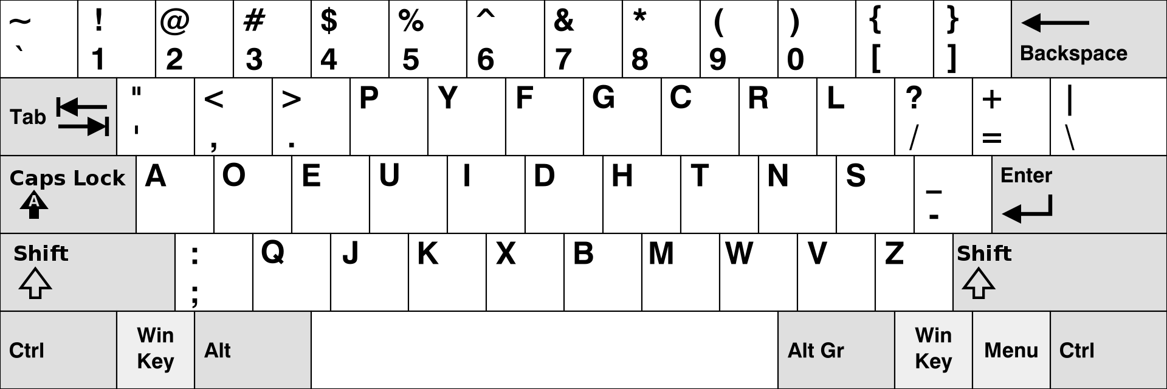
Alternative Keyboard Layout
What is the name for this layout?
What are its advantages and problems?
Public Domain, https://commons.wikimedia.org/w/index.php?curid=874943

Slide 29

Dvorak Keyboard
layout is arranged according to the frequency of letter patterns and sequences in the English language.
users trained with QWERTY need retraining
not widely used
http://upload.wikimedia.org/wikipedia/en/9/9e/Dvorak_keyboard2.png
[Mustillo]
Notes:
frequency of letters and the patterns are different for different languages

Slide 30
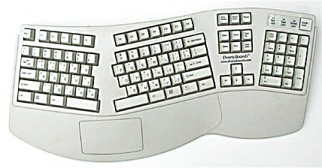
Ergonomical Dvorak Keyboard
http://www.ergocanada.com/images/dvorty_2001dqe.jpg

Slide 31
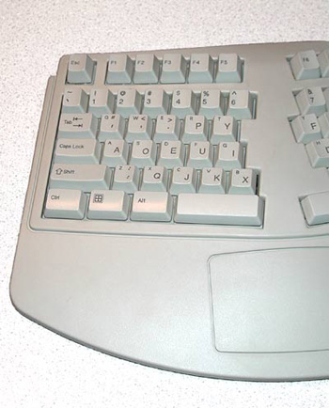
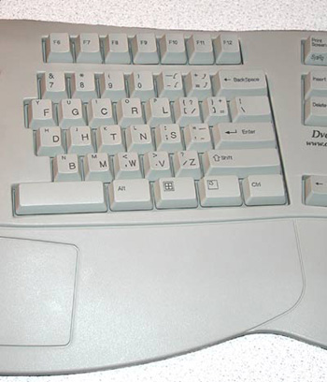
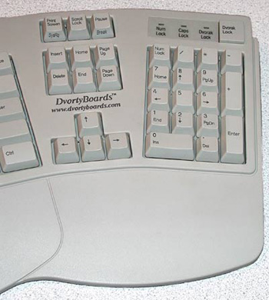
Ergonomical Dvorak Keyboard - Zoom
http://www.ergocanada.com/images/dvorty_2001dqe_right.jpg

Slide 32
Alphabetical Keyboard
arrangement of keys in alphabetical order
suitable for untrained users
slower than the QWERTY or Dvorak keyboards
in general, avoid its use for PC applications
confusing for most users
[Mustillo]
Notes:
different alphabets for different languages

Slide 33

Chord Keyboard
several keys are pressed simultaneously
allows the input of many characters or even words with few keys
comes in several variations
very fast for trained users
used in court, parliament
requires training to use and to read output
can be coupled with a Braille or speech-output device
http://images-partners.google.com/images?q=tbn:80WypgWsfCA7bM:tim.griffins.ca/writings/images/w_accukey.jpg
[Mustillo]
Notes:
For a chord keyboard with five binary keys, what is the number of letters or words that can be generated in one step? Assume that at least one and at most five keys can be pressed simultaneously.

Slide 34
Numeric Keypad
calculator
number keys, arithmetic operator keys, decimal point, Enter.
telephone
0 to 9, *, #,
no letters q or z
except on some newer cellular phones
inconsistent design
1-2-3 vs. 7-8-9 in the top row
good for entering numerical data
both can be very fast, easy to use
[Mustillo]
Notes:
Why do you think calculators and telephones use different key pads?
Which of the two designs is older?

Slide 35
Keyboard Design
some aspects governed by ISO 9241 rec. standard
key size
width: 12-15 mm, minimum surface area 110 mm2
key travel
key displacement: 1.5 - 6.0 mm
force required to depress key
defined in terms of newtons
minimum force: 0.14 n
limits: 0.25 n - 1.0 n, ideal 0.5 - 0.8 n
feedback
types: kinesthetic (movement), tactile (feel), auditory, visual (on display)
all important, but tactile feedback is especially critical
[Mustillo]
Notes:
Many people prefer one keyboard over another, even if both are from the same manufacturer. For you personally, what aspects of features make you prefer one keyboard?

Slide 36
Special Keys and Facilities
Device
Cursor control keys
“Soft” function keys
or control keys
“Hard” function keys
Scroll bars and
arrows
Screen buttons
Description
Four keys with arrows showing the
direction in which a cursor on the screen will move when the key is pressed
Keys that are pressed in combination with other keys (e.g., <control>).
Labeled keys that perform a specific function (e.g., <page down>).
Characteristics of a window that
enable the user to move the contents of a window up or down.
Areas of the screen that perform a
function on selection. Sometimes also called soft keys or soft buttons.
Key Features/Remarks
Used for moving around a screen display.
Keys are programmed to perform an action. Good for commonly used functions, and for providing rapid execution of commands. Can be difficult to remember. No standard arrangement.
Cursor keys and the <enter> key are examples. Less obscure than soft keys since they are usually explicitly labeled.
Scrolling facilities can be provided through the use of cursor keys and function keys, or by clicking a pointing device such as a mouse on a scroll bar or arrow.
Usually labeled boxes or circles. Can be pressed or clicked.
[Mustillo]

Slide 37
Scanners as Input Devices
Device
Bar code reader
Optical character reader (OCR)
Document scanner
Magnetic ink character recognition (MICR)
Optical mark reader (OMR)
Description
Pen- or gun-like device that reads black and white printed or magnetic
bar code. Can also be embedded under a counter.
Device that reads characters automatically.
High-speed scanner that reads whole pages.
Device that interprets characters with the use of special ink.
Device that detects the position of marks made on documents.
Key Features/Remarks
Suitable where the amount of data is limited, and is not subject to rapid change. Example: supermarkets.
Can handle a variety of data. Characters need to be well formed (i.e., hand-written characters may be misinterpreted).
Used for inputting large amounts of text, diagrams, and pictures.
Similar to OCR, but more reliable. Used mostly in banks (e.g., see the bottom of your check book).
Specially designed forms are required so that the marks are correctly located. Example: Course evaluation sheets
[Mustillo]

Slide 38
Pointing Devices
selection of entities on a computer display
identification of the entity
selection
manipulation
distinction between multiple operations

Slide 39
Activity: Pointing Devices
identify three pointing devices
what key aspects differentiate the devices
consider technology, methods, and usability

Slide 40
Pointing Devices
Device | Description | Key Features/Remarks
Dataglove | Wired glove that allows the wearer to grasp objects in 3D space. | Used for manipulating objects and gesturing. Now being studied for virtual environments.
Footmouse | A form of pedal that pivots. | The direction that the pedal is moved in causes a cursor on the screen to move correspondingly. Useful when hands are otherwise occupied or for physically challenged users.
Gesture Devices | Small transmitting device held by the user, employed together with a receiving device associated with the computer. | The receiving device places the position and movement of the transmitting device in space. Facial gestures may be used in combination with speech.
Graphics tablet | Flat panel that is placed on a table near the computer display. The tablet surface represents the display. | Movement of a stylus across a surface causes a cursor to move across the screen or a line to be drawn. Very good for graphical input.
Joystick | Small stalk that can be moved in any direction within a fixed socket. | Often used for cursor-positioning tasks where precision is required. Requires a high level of concentration to use. Fine control is limited.
[Mustillo]

Slide 41
More Pointing Devices
Device | Description | Key Features/Remarks
Device | Pen that emits a light beam when a button is pressed. | Good for pointing and simple input. Has to be used against a vertical plane, not very accurate, difficult to use if grip is weak.
Light pen | Continuous input device with one or more buttons for discrete input. Unlike the trackball or joystick, it is not fixed, so the user can move it around on a flat surface. | Most common and popular. Highly versatile. May be tethered or wireless (radio, infrared); mechanical (rollers), optical (requires a special pad). Objects are manipulated by pressing control button(s) embedded in the mouse.
Mouse | A pen is used with a small electronic notebook. Data can be entered using familiar techniques involving menus, forms, etc. | Most impressive feature is ability to input free-hand drawings and handwriting. Must be taught to recognize hand writing. Some gesture recognition is possible.
Pen and notepad | Special screen that detects the position of a finger touching it. | Stationary. Needs frequent cleaning. Very easy to use. Not very accurate
Touch screen | Rotatable ball embedded in a surface in a fixed socket. Similar to a mouse turned upside down. | Can be moved by drawing the fingers or the palm of the and over the surface or by flicking. Requires little force. Fast, and does not require a good grip for accurate use.
Trackball | Digital image or video camera. | Ability to capture images or video.
[Mustillo]

Slide 42
Mouse as Input Device
How many buttons are best?
ongoing human factors debate
0 (Apple Magic Mouse)
whole surface is touch-sensitive
single switch when pressed down
1 (old Apple mice)
easier to double click a single button to select an item than to remember which button points and which extends
2 (Xerox, Microsoft)
one to point and the other to extend (special commands)
largest population among mouse species
3 (modern mice, Unix workstations)
more functions directly available
confusing at first; gets easier with practice
novice or infrequent users often forget which button does what
4+ (more sophisticated mice, especially for gaming)
other selectors
scroll wheel (with tilt?)
touch surface
[Mustillo]
Notes:
In principle it is possible to combine a chord keyboard with a mouse, which would result in a very flexible, very fast data entry and pointing device. What are the practical limitations for this combination?

Slide 43
Mouse Control
advantages
works in small spaces
can adjust granularity of movement
inexpensive
user can keep eye on display
fairly direct relationship between hand and cursor movement
direction, distance, speed
diagonal and continuous movement
problems
hand must be removed from the keyboard
require space beside keyboard movements
relative mode only
mechanical mice pick up dust and other debris
require a certain amount of learned eye-hand coordination
awkward and difficult for first-time users
[Mustillo]

Slide 44
Touch Screens
advantages
direct manipulation
direct eye-hand coordination
several technologies to choose from
pressure-sensitive, resistive, infrared, capacitive
faster and easier to learn than other input devices;
no command memorization needed
user may be led through correct command sequence
good for infrequent use
minimal training needed, high user acceptance
continuous motion in all directions
no extra desk space
no moving parts
[Mustillo]

Slide 45
Touch Screens (cont)
problems
very fast, but not very accurate
“fat” fingers
limited resolution
difficult to select small targets
very slow text and data entry
finger/arm may obscure screen
overlays may lead to parallax
inadvertent activation
screen can get dirty (oil from fingers)
susceptible to temperature and humidity
arm fatigue for conventional computer monitors
should be limited to low-frequency usage
[Mustillo]

Slide 46
Speech Recognition
conversion of spoken language to commands or data
advantages over other input methods:
more natural form of communication
less training required
does not require the use of hands or other limbs
user can carry out multiple other actions
opportunities for physically disabled users
problems
limitations of speech recognition systems
error prone
susceptible to environmental noise
impractical in situations where quiet is required
natural language capability is not yet attainable by speech recognition systems
speech input is not suitable for all input tasks
[Mustillo]
Notes:
Identify three tasks or applications each that are or are not suitable for the use of speech recognition as input method.
Suitable:
Not suitable:

Slide 47
Speech Recognition (cont.)
Device
Isolated word
recognition (also
known as discrete
word recognition)
Continuous speech
recognition
Speaker-dependent
recognition (also
known as speaker-
trained recognition)
Speaker-independent
recognition
Speaker-adaptive
recognition
Key Features
Limited vocabulary. Pauses between words. Users typically need some training.
Less limited vocabulary, but works by recognizing words from a continuous stream of speech. More susceptible to error than isolated word recognition, but does not require special raining of users.
System learns to recognize the speaker, who must train the system. Template matching. Easier to implement than speaker-independent systems, but highly sensitive to user characteristics (e.g., cold, different locations, etc.)
Fairly large vocabulary. Based on phonemes. Many speech tokens needed. Problems with accents, non-native speakers.
Requires arbitration between speaker-trained and speaker-independent recognition.
Description
Individual words
Recognition of words within strings of words
Recognition only for specific users
Recognition for all users
Combines speaker-dependent and speaker-independent recognition
[Mustillo]

Slide 48
Eye and Head Movement
Key Features/Remarks
Electrodes have to be secured to the skin to detect muscle movement, and are therefore subject to general body movement. Uncomfortable and confining. Not well suited for tracking over small target or where fine control is required.
User must maintain a stable image on the fovea. Not easy to achieve or maintain. Not great for tracking small targets or where fine control is required.
Keyboard is a display on the computer screen. The system detects slight movements of the user’s head and moves the cursor accordingly. To operate a key, the user must locate the cursor, and then blow on a blow switch in the headset mouth piece. This type of device can be used by severely handicapped users (e.g., Stephen Hawkings).
Device
Electrophysiological
sensing
Photo-electric
reflection
Head movement
tracking
Description
Records muscle movement.
Records movements in reflected light from the eye.
Lightweight headset, transmits ultrasonic signals to a special measurement unit.
[Mustillo]

Slide 49
Brain-Computer Interaction
simplified versions of electroencephalograms (EEGs)
interpretation of brain waves
limited success as computer control and interaction devices

Slide 50
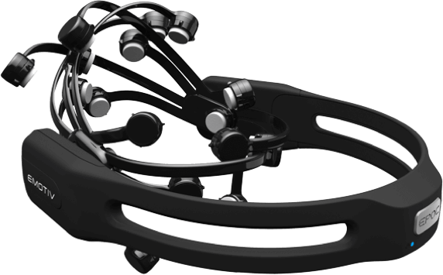
Example: Emotiv Epoc
BCI device
14 channels for signals recorded through saline based electrodes
9 axis head motion sensors
price <$1,000, plus software

Slide 51
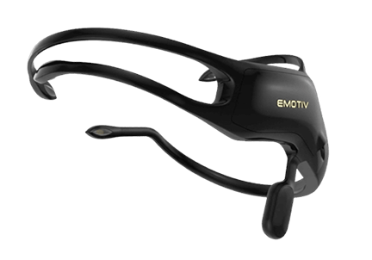
Example: Emotiv Insight
BCI device
5 channels, semi-dry polymer sensors
9 axis head motion sensors
price <$500, plus software

Slide 52
Natural Input Devices
cameras and similar devices that allow interpretation of “natural” human activities
observation of movements for a task
gestures
requires distinction between
control activity
signals to the computer that something relevant is going to happen
intentional activity
purposefully performed within a task
spurious activity
activity unrelated to the task at hand

Slide 53
Eye/Gaze Tracking
camera follows the gaze of a user
often used in usability and physiology experiments
recording and analysis of user attention
requires high resolution
sometimes used as input device
selection of commands or options through eye movement
low resolution is sufficient
user monitoring
used in some cars to detect driver fatigue

Slide 54
Head Tracking
head movement to convey control information to the computer
motion sensors detect head movement
limited range of movements

Slide 55
Selecting Input Devices
the input device should
match physiological / psychological characteristics of users, their training, and their expertise
e.g. older adults may be hampered with arthritis, and may be unable to type; inexperienced users may be unfamiliar with keyboards and keyboard layouts, etc.
be appropriate for the tasks to be performed
e.g. a drawing task requires a device that allows continuous movement; selecting an option from a list requires an input device that permits discrete movement, etc.
be suitable for the intended work and environment
e.g. speech input may be useful when there is no keypad or keyboard, or when the eyes and hands are busy, but is unsuitable in noisy conditions; automatic scanning is suitable if there is a large amount of data to be gathered, etc.
[Mustillo]
Notes:
Identify the most suitable (combination of) input devices for the following tasks, irrespective of costs:
control of a microwave
standalone electronic recipe book
electronic wallet
smart house control console

Slide 56
Output Devices
convert information coming from a computer system into some form perceptible by humans
visual
auditory (non-speech, speech)
tactile
tactile output for visually-impaired and blind users (e.g., Braille)
[Mustillo]
Notes:
List five factors that contribute to the success of the screen as output device for computers. Consider technology, physiology, and usability for your choice of factors.

Slide 57
Visual Output Devices
character-based displays
liquid-crystal displays [LCDs],flat-panel displays [FPDs]
used in stationary devices, in telephones, calculators, etc.
graphics displays
CRTs, LCDs, and other FPDs, 3D
HRES graphic displays used in stationary output devices, cockpits, or helmet-mounted displays
printing devices
color vs. black and white; dot matrix, laser, inkjet
fax
plotters (colored pens)
microfiche or microfilm
require special equipment to read
videotape
displayed via graphics display (TV screen)
[Mustillo]
Notes:
Today’s computers typically use a 17” color monitor with a resolution of about 1,000x1,000 pixels, at least 8 bit color, and a refresh rate of 70 hertz or higher. What is the information transfer capacity of this visual channel (bit/second)?
Most of the time, these monitors are used for text processing. What is the information transfer capacity in the text mode, assuming that only ASCII characters are used, with no variations in font or style. Also take into account the limitations of humans for reading text.
Combining the above results, what is the percentage of the overall information transfer capacity used in text-only mode?

Slide 58
Auditory Output Devices
tone generators
beeps, alerting tones
alarms
warning signals
digitized speech
digitally recorded human speech
text-to-speech synthesis
speech generated by concatenating basic speech sounds according to rules
[Mustillo]

Slide 59
Sound as Output
auditory icons
non-speech sounds used to provide information about current events
examples:
emptying a trash can, opening windows, moving, copying or deleting files, etc.
arrival of a new e-mail message
should be optional
annoying
may disturb others
[Mustillo]

Slide 60
Sound as Output (cont.)
sound used to alert users
examples:
invalid computer operations (beep)
emergency tones (WW II - siren)
sound used to solicit user input
examples:
“At the tone, say...” “<beep><beep> ...” user input
sound used to differentiate products and product families
corporate “earcons”, auditory logos, commercial brand-lining, distinctive music
examples:
Macintosh startup sound
Windows launch sound
“Intel Inside”
[Mustillo]

Slide 61
Auditory Output Methods
Key Features/Remarks
Fragments of speech are digitally recorded and then re-assembled and played back to produce the desired words and sentences. Limited value, tedious, discontinuities are often difficult to mask. Examples: speaking clock,numbers in bank transactions via phone, routing of messages.
Synthesis of words and sentences is controlled by rules of phonemics and rules that relate to the context of a sentence or phrase. Used in conjunction with a database. Pitch and tone can be varied, but the speech produced can sound unnatural, synthetic, tinny, and mechanical. Improving (e.g., stock quotation system).
Device
Speech output
concatenation
Speech output: text-
to-speech synthesis
Description
Digital playback of concatenated speech utterances.
Conversion of text to speech with synthetic playback.
[Mustillo]

Slide 62
Recent Developments in I/O Devices
handwriting recognition/personal digital assistants
3M Palm Pilot, Go Corp., Sony, Toshiba
smart card
thin plastic card, embedded µprocessor and memory
information about a user (e.g., employee ID, credit details, etc.) is stored on the card.
outputs information to special card readers.
biometric device
advanced smart card that contains characteristics about a user such as fingerprints, voice prints, retina prints, or signature dynamics.
[Mustillo]
Notes:
What are the key differences between reading handwriting via optical character recognition from paper, and handwriting recognition as in handheld computers like Apple’s Newton or the Palm Pilot?
off-line vs. on-line
bitmaps vs. strokes
feedback from writer
contextual analysis

Slide 63
Recent Developments (cont.)
haptic devices
make it possible for users to touch, with their hands and fingers, virtual computer models as if they were real-world physical objects
i.e., feel an object’s mass, explore its texture, and work with its form and shape
not many on the market; one of the more interesting ones is from a company called “haptic” (www.haptic.com)\
[Mustillo]

Slide 64
Haptic Applications
name three applications for which you believe haptic input and output would greatly increase their usability

Slide 65
Limitations of Haptic Devices
identify three limitations for the realization and usage of haptic devices
fundamental limitations
physics, physiology
technology
user acceptance

Slide 66
Recent Developments (cont.)
wearable computer
Private Eye™ (Reflection Technology)
user wears a single high-resolution LCD over one eye, while looking out the other eye; image projected at infinity
coupled with a portable computer, and other input devices
Wearable Computer™ (Computing Devices International)
portable, body-mounted, voice-activated computer
recently tested in Bosnia, presently being adopted by the U.S. Armed Services
Sixth Sense
combination of camera and projector
helmet-mounted display with speech interface
military applications, “aim-fire” scenarios
[Mustillo]

Slide 67
Touchy Mouse
Logitech’s WingMan Force Feedback mouse
www.logitech.com
incorporates tactile feedback
user can feel the edges, contours, densities of virtual objects
can make navigation more intuitive
uses a special mousepad with rods connected to tiny motors

Slide 68
Touchy Mouse Usage
identify and briefly describe three tasks or actions where you believe that the tactile feedback from the mouse would be useful
e.g. emphasis of default actions in popup windows, limits of documents

Slide 69
Recent Research Areas
texture sensation
sandpaper system (MIT)
uses a motor-driven, force-feedback joystick that uses tiny virtual springs to simulate motion while the user moves the joystick over patches of computationally created textures displayed on a screen
tracking
Active Badge™ system (Olivetti/DEC)
tracks people inside a building
used as a communications device
can be turned off for privacy
[Mustillo]

Slide 70
Recent Research Areas (cont.)
gesture, speech, and gazing
two-handed gesturing by voice, and selection by gaze (CMU)
“Turn that block upside down.”
[Mustillo]

Slide 71
Future Trends
smart rooms
can identify people and interpret their actions
house that knows where your kids are and tells you if they are getting into trouble
can supervise students during exams ;-)
research being conducted at MIT
Person Finder - Pfinder
incorporates video cameras for recognizing faces, expressions, gestures
microphones for speech recognition
smart home
performs activities according to user’s preferences and usual actions
[Mustillo]
Notes:
In a smart home, it might be useful to provide some feedback to the user before performing some activities, e.g. like turning the lights off. Discuss three output methods as candidates for that feedback, and indicate which one you personally would prefer.
E.g.
speech
display on central control console
display on remote control

Slide 72
Future Trends (cont.)
smart clothes
sort of a personal assistant that you wear
tells you the name of people you meet, directions to your next meeting, etc.
built-in computer, camera, microphones, other sensors
camera built into the frame of eyeglasses that captures images
face-recognition software that tells you the name of the person you are looking at by whispering his or her name into your ear
[Mustillo]

Slide 73
Capabilities and Limitations
of I/O Devices

Slide 74
“Degrees of Freedom”
dimensions
spatial
1D
2D
2.5D
3D
temporal
1D

Slide 75
Information Transmission
transfer of information between the device and a human
or another device
measured in bits/second
best estimate if no exact measures are available
examples
screen
2,000 x 1,000 pixels
32 bits color depth
100 Hertz refresh rate
keyboard
~ 100 keys
~ 5 modifier keys
~ 10 keys/second typing rate

Slide 76
Persistence
duration of the availability of the signal
transient
fleeting
overwritten by succeeding signals
permanent
stays available as long as needed

Slide 77
Navigation
“movement” of the user within the interaction space
screen: pointing device
sound, video: forward, rewind, pause

Slide 78
Activity:
Input Device Characteristics
select an input device and analyze its capabilities and limitations based on the previous categories
degrees of freedom
information transmission
persistence
navigation
do these categories capture the essential characteristics of the device?
if not, suggest additional ones

Slide 79
Activity:
Output Device Characteristics
select an output device and analyze its capabilities and limitations based on the previous categories
degrees of freedom
information transmission
persistence
navigation

Slide 80
Evaluation
based on previously defined evaluation criteria

Slide 81
Post-Test
discussion of a specific I/O device for a particular task
advanced remote control for TV program selection
suitability of I/O methods for certain tasks
e.g. speech recognition for Web navigation
search the Web for novel I/O devices and methods
futuristic I/O devices
assume that you have whatever technology you want, and describe the “ideal” I/O device for a certain task
Notes:
evaluate the learning success of the participants
provide feedback to the students about their achievements
ask for feedback on unclear or difficult parts
point out possible gaps and difficulties
encourage suggestions for improvement

Slide 82
Important Concepts and Terms
auditory input/output
brain-computer interaction (BCI)
button
camera
controls
cursor keys
display
handwriting recognition
human-machine interface
input devices
joystick
key
keyboard
microphone
monitor
mouse
output devices
pointing devices
printing devices
scanner
screen
speech recognition
speech synthesis
sound
switch
tactile input/output
trackball
touch screen
usability
use case scenarios
visual input/output

Slide 83
Additional Reading
Gaver, W.W. (1986). Auditory icons: Using sound in computer interfaces. Human-Computer Interaction, 2(2), 167-177.
Pentland, A.P. (1996). Smart rooms. Scientific American, 274(4), 68-76. (April issue).
[Mustillo]

Slide 84
Chapter Summary
overview of important devices for input to and output from the computer
the characteristics of a device determine its suitability for particular methods and tasks
the selection of I/O devices and methods influences the usability of a user interface substantially
research in novel I/O devices and methods tries to overcome the limitations of screen and paper as most important output, and keyboard and mouse as input devices

