Slide 1
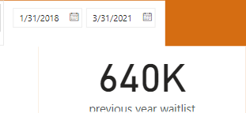
This IS THE PREVIOUS WAITLIST WE ARE ASKED TO FIND
Previous waitlist

Slide 2
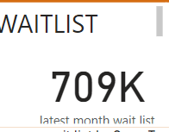
This shows the previous waitlist
Possible reason:Decrease: A waitlist reduction might be attributed to:Increased hospital capacity or streamlined processes.or
Shifts in patient demographics or treatment trends.
Shifts in patient demographics or treatment t
Year on year comparision waitlit trend
Below is the latest wailist of the hospital that is the current year.and this increase as a result of rising demand for inpatient and outpatient demand for service
Or resource limitation such as staffing,or bed capacity constraint .it increase with 69% from the previous year .

Slide 3
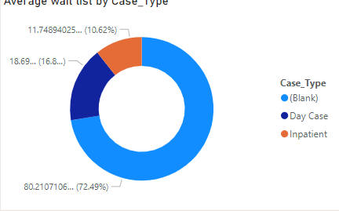
This visualization shows the case type distribution
Our analysis of the waitlist data reveals a significant skew in case types. Outpatients make up the vast majority of the waitlist, at approximately 72.49%. In comparison, inpatients account for roughly 10.62% of the waitlist, and other case types comprise the remaining 16.8%.
Visualization:
A pie chart effectively showcases this distribution, with the largest segment representing outpatients, followed by inpatients, and the remaining case types combined in a smaller segment.

Slide 4
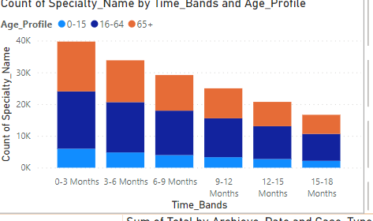
analyzing How the duration of hospital stays vary across different age groups of patients?
I observed a significant increase in patient volume from the 0-3 month band to the 3-6 month band (previously discussed). This trend continues, with a slight decrease from the 3-6 month band to the 6-9 month band (18836 to 14011 patients) and a further decrease from the 6-9 month band to the 9-12 month band (14011 to 12241 patients). he rise in patient volume between 0-3 months and 3-6 months could be linked to specific medical conditions or procedures more common in that age group.
Patient volume (number of patients) and length of stay (average number of days spent in the hospital) are separate pieces of information. While they might be related (e.g., a higher volume could indicate longer stays for some procedures), and the longer stay is about 64+

Slide 5
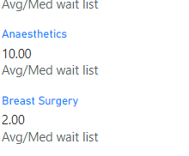
The top 5 wailist by speciality
This visualization shows the top waitlist by speciality and the include anaesthetics,breast surgery,cardiology etc

Slide 6
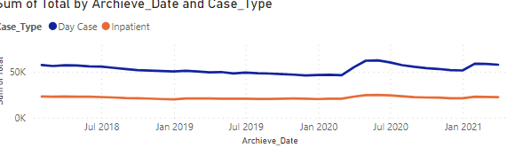
the monthly trends observed among patients with different case type
This represent the monthly trend of an Inpatient case type

Slide 7
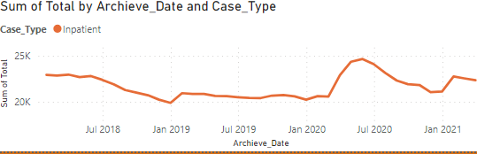
This visualization shows the monthly trend
Of an outpatient which ranges from July 2018-jan 2021in the archieve_date

Slide 8
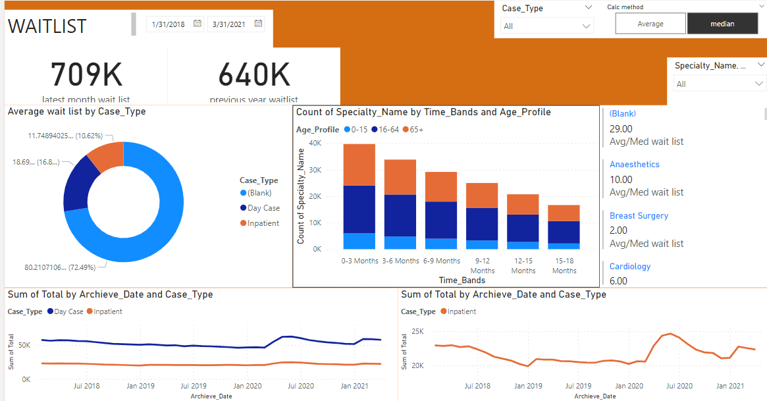
Dashboard representing all the visualization

Slide 9
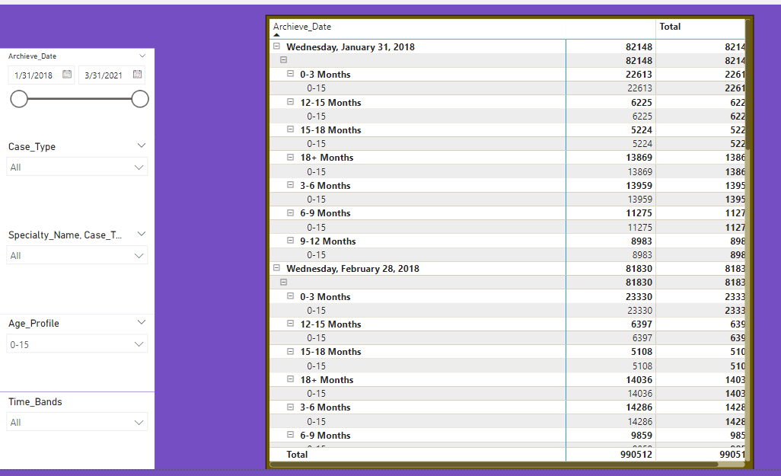
I use table to further analyise the monthly trend with a slicer of case type,age profile ,and count speciality

