Slide 1
Analysis of the Relationship between Regional Economic Growth and Obesity by using Lasso Regression
Eungyu KIL
Sungkyunkwan Univ.
College of Software.

Slide 2
Outline
Data Collection & Processing
Model Establishment
Performance Evaluation
Conclusion

Slide 3
Data Collection & Processing
Various City Indicators
GDP
- Well-known Economic Indicator
- But GDP of cities is not provided as Public Data
- Used to see which indicators can replace GDP
Past Obesity Rate
- Used to predict future Obesity Rate

Slide 4
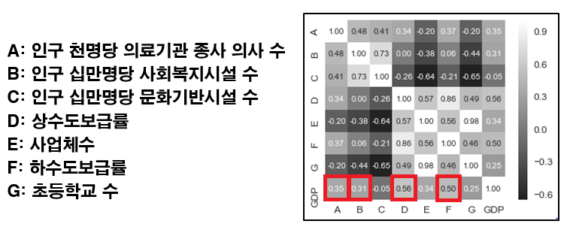
Data Collection & Processing
Economic Indicators
- Based on the relationship with GDP
- Based on Pearson Correlation Coefficient
Fig. 1. Heatmap of Correlation between GDP and Indicators

Slide 5
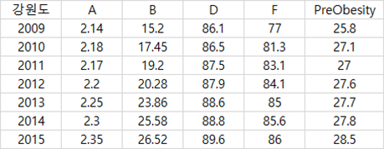
Model Establishment
Learning Model
- Based on the Growth Rate (2008 ~ 2015)
- Learning Data : Gangwondo
- Testing Data : Gangneung, Wonju
Fig. 2. Learning Data of Gangwondo

Slide 6
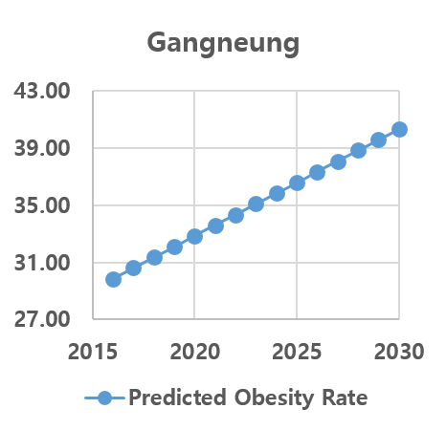
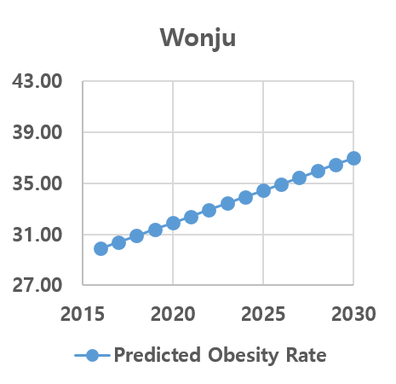
Model Establishment
Assessment Model
- Future Obesity Rates based on Least Square Method
Fig. 3. Future Obesity Rate of Gangneung (Least Square Method)
Fig. 4. Future Obesity Rate of Wonju (Least Square Method)

Slide 7
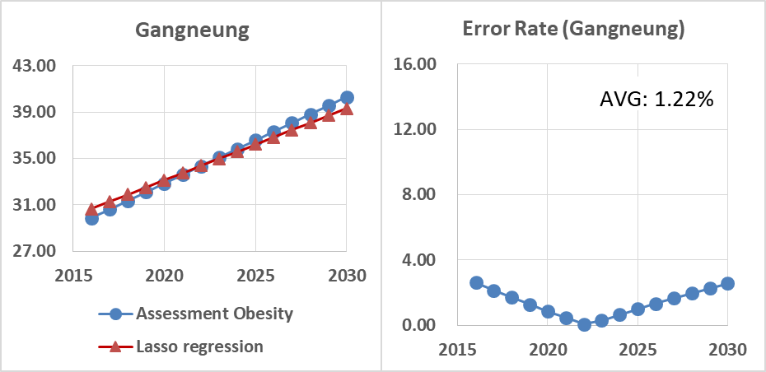
Result & Analysis
Future Economic Indicators and Obesity Rate
- Based on Lasso Regression
Similarity between Past and Future Obesity
Fig. 5. Compared Obesity Rates of Gangneung (Lasso Regression)

Slide 8
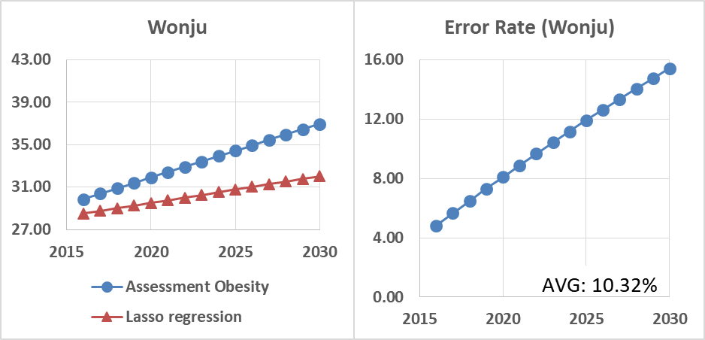
Result & Analysis
Similar but Not the Same
The Difference grows Bigger Very Fast
Fig. 6. Compared Obesity Rates of Wonju (Lasso Regression)

Slide 9
Result & Analysis
Future Obesity Rate doesn’t simply follow the flow of Past Obesity Rate
- Based on the Error Rate in Figure 6
Various Factors should be considered for Accurate Prediction

Slide 10
Conclusion
In this paper,
Obtaining the relationship between Economic Indicators and Obesity Rate
Predicting Future Economic Indicators Data
- based on Least Square Method
- reflects past flow of the data
Predicting Future Obesity
- based on Lasso Regression
- reflects various factors

