Slide 1


CLOUD-NATIVE DATA MANAGEMENT
Notes:
Cool Ice template. We use #62ACC9 for icons

Slide 2


infra-centric data management scales poorly and leaves data exposed
Use existing VM-level data protection solutions
Let me put together a “quick” script
My storage overlay does backups & migration
Data-store snapshots
Tailored to application
No fault isolation
Limited recovery options
More complex than expected
Lowest common denominator
Weak consistency
Often tied to infrastructure
2X management complexity
Complex restore procedure
Difficult to maintain
Performance cost for overlays

Slide 3


where does vm-based backup fall short? a high-level walkthrough
Virtual Machine
Virtual Machine
Virtual Machine
App 1
App 2
App 3

Slide 4
where does vm-based backup fall short? a high-level walkthrough
Virtual Machine
Virtual Machine
Virtual Machine
Kubernetes
Kubernetes
Kubernetes
App 1
App 2
App 3
VM-based solutions loses application visibility with the introduction of Kubernetes

Slide 5
where does vm-based backup fall short? a high-level walkthrough
Virtual Machine
Virtual Machine
Virtual Machine
Kubernetes
Kubernetes
Kubernetes
App 1
App 1
App 2
App 2
App 2
App 3
App 3
VM-based solutions loses application visibility with the introduction of Kubernetes
Transition to microservices increases scale by 100X with Kubernetes

Slide 6
where does vm-based backup fall short? a high-level walkthrough
Virtual Machine
Virtual Machine
Virtual Machine
Kubernetes
Kubernetes
Kubernetes
App 1
App 2
App 3
App 1
App 2
App 2
App 3
VM-based solutions loses application visibility with the introduction of Kubernetes
No single VM has a complete application and breaks VM-based protection platforms
Transition to microservices increases scale by 100X with Kubernetes

Slide 7
where does vm-based backup fall short? a high-level walkthrough
Virtual Machine
Virtual Machine
Virtual Machine
Kubernetes
Kubernetes
Kubernetes
App 1
App 2
App 3
App 1
App 2
App 2
App 3
VM-based solutions loses application visibility with the introduction of Kubernetes
No single VM has a complete application and breaks VM-based protection platforms
Transition to microservices increases scale by 100X with Kubernetes
95% of application components are now Kubernetes resources and not on disk

Slide 8



data management vs. storage platforms our recommendations
Storage Innovation
Overlay Overhead
System Isolation
Innovation at every layer:
Hardware (e.g., NVMe)
Acceleration (e.g., Pensando)
Architecture (e.g., Longhorn)
Standardization
Container Storage Interface (CSI) abstracts away implementation and eliminates switching costs
Recommendation: Pick the best storage system for the environment (on-prem, cloud)
Overhead of layering an SDS on another storage system:
Management Complexity
Security
Budget
Performance
Often limited to lowest-common denominator for features
Recommendation: Do not overlay storage stacks (e.g., block-on-block)
No fault isolation when primary storage system also manages data.
Accidental/Malicious Outage
“Query of Death” faults
Downtime = backup unavailability
Focus: Diversity and depth dictates that storage and data management should evolve independently
Recommendation: Separate your data protection and management from storage

Slide 9

high-level comparison native storage vs. storage overlay
 | Overlay Storage | Details
Performance Overhead | ~33-70% worse | Large improvements possible by skipping spending all IO through a storage overlay layer
Cost / Usable GB | 300%+ | Recommended replication will consume 3X native storage. Storage overlay licensing costs are extra.
Management Overhead | 2X | Need to manage storage, access, security at native and overlay layer
© Kasten, Inc. CONFIDENTIAL, DO NOT DISTRIBUTE.

Slide 10
results overview (100 GB IO performed) native storage vs. storage overlay
© Kasten, Inc. CONFIDENTIAL, DO NOT DISTRIBUTE.

Slide 11

Build vs. Buy
Given significant readiness gap for Velero, is it the right foundation?
Is productizing Velero (multiple man years) a good use of innovation time?
© 2019 Kasten, Inc. CONFIDENTIAL, DO NOT DISTRIBUTE.

Slide 12

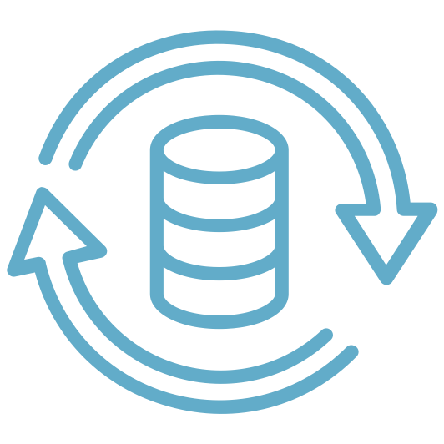




kasten k10 vs. velero enterprise readiness
Enterprise Dashboard + K8s API
Database Support
Extremely easy-to-use UI
Native CLI (kubectl) and APIs
Day 2 support: Monitoring, alerting, logging
Supports database-level tools
App-consistent and local storage support
Replica elimination for space/performance
Correctness and Consistency
Performance and Efficiency
No data loss risk with object stores
Consistent backups
Global catalog to track state
Up to 4X space efficiency on backups
3-5X throughput improvements
Reduced memory and CPU footprint
Security and Safety
Full Stack Support
Backup data is encrypted
No privileged daemonsets required
RBAC + OIDC and Token Auth
On all certified Kubernetes distributions, clouds, and storage providers
Dedicated Slack channel, email, phone
Comparison against Velero v1.4.x

Slide 13
infrastructure integration zero-impact on storage stack or data path
No storage vendor changes needed
Preserves customer’s choice of on-prem storage, does not replace or layer on cloud storage options, or require a new storage provisioner.
No layered abstractions or application changes
No need to change applications or introduce a layered storage defined software solution on top of cloud or on-prem storage. Prevents performance loss and reduces risk.
Wide storage vendor support
K10 supports object and block storage from all major cloud vendors as well as a number of on-prem storage options. CSI support will follow CSI GA.

Slide 14
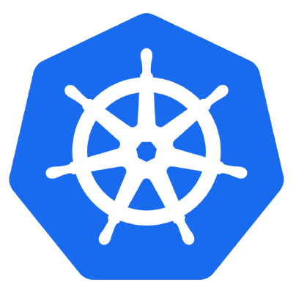


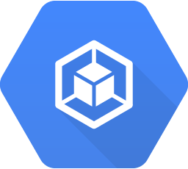

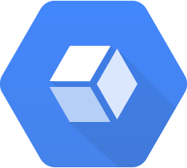




kasten approach: focus on complete application kubernetes resources and persistent state
Applications as the operational unit
Ingress
Service
Automatic and complete application capture
Consistent data and application resources capture
Namespaced objects + non-namespaced dependencies
StatefulSet
Deployment
Registry
Pod
Pod
Abstract underlying infrastructure
Seamless support for storage and data services within
and across clusters, regions, and clouds
Service Account
Persistent VolumeClaim
Secret
Database
ConfigMap
Perform coordinated operations
Proper sequencing of resource and data operations
Meaningful applications cannot be restored as-is
Persistent Volume
Kubernetes Application

Slide 15
talent gap
As Kubernetes production use accelerates, there is a very significant talent gap
Linux/vSphere + Legacy Backup Admins Need On-Ramp

Slide 16
ecosystem
Container data management at scale means not just backup and DR but integration into distribution workflows
Workflow Integrations Into Distributions Of Choice Critical

