Slide 1



Kasten Licensing
Notes:
Cool Ice template. We use #62ACC9 for icons

Slide 2
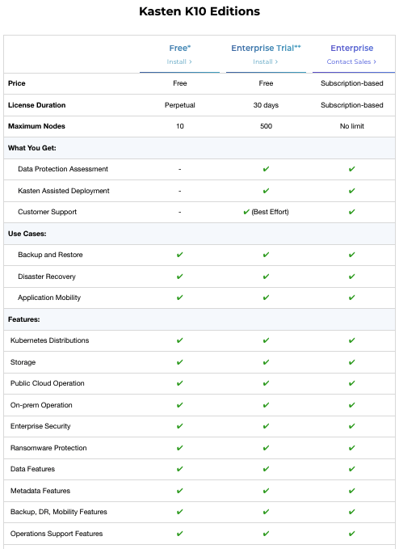
K10 editions choice to fit your needs
Kasten K10 editions:
Free Edition
Enterprise Trial
Enterprise

Slide 3




free k10 starter edition also allows for enterprise trials
No Feature Restrictions
Full native experience
500 Nodes Free for 1 Month
Use K10 Free Now!
Deeper evaluation
10 Nodes Free Forever
Test/dev use and growth

Slide 4
License Strategy
Subscription Sku’s Include Support
(No Perpetual Options Available)
Available Terms (1-5 Years)
Licenses By Number of Worker Nodes
A Kubernetes cluster consists of a set of worker machines, called worker nodes, that run containerized applications. The worker node(s) host the Pods that are the components of the application workload.
Classification can be determined by how nodes are labeled in the cluster.
Other Acquisition Options
VCSP Model – Monthly Recurring
Marketplace – BYOL and PAYG

Slide 5


kasten k10 pricing node-based subscription model
Node-based Subscription
List: $2500/Node/Year
Discounts on list and based on tiers
Predictable Pricing
No per-TB, per-socket or capacity pricing. Pricing based on number of worker nodes.
Flexible Model
Auto-scaling/metering support if needed, volume-based discounts available, add-on licenses

Slide 6
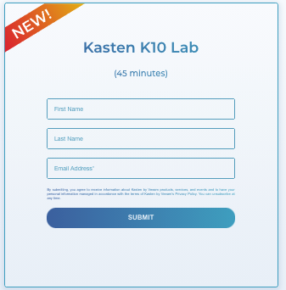
Free K10 Lab
Instructional Free Online Lab

