Slide 1
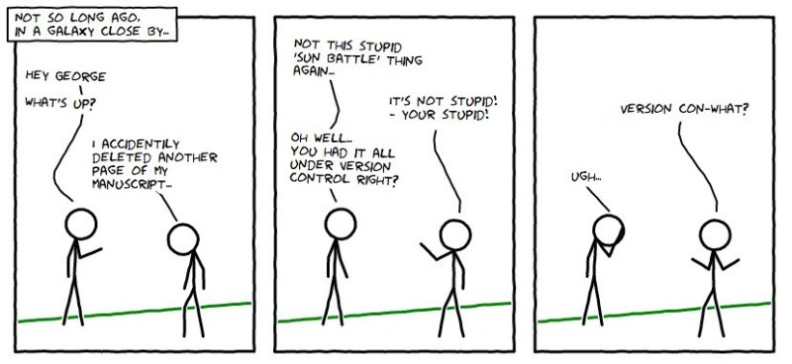

Slide 2


Git-Github
Safa
Prepared for the course COP4331 – Fall 2016

Slide 3
Git
  version control system
  SVN,StarTeam
Github
  repository site

Slide 4
https://git-scm.com/book/en/v2/Getting-Started-Installing-Git
https://git-scm.com/download/win
Let’s define ourselves first
git config --global user.email "you@example.com"
  git config --global user.name "Your Name"

Slide 5
Local first
first lets make a git folder in our computer
  git init
add a file to the folder
  git add newfile.file
  git commit -m “new file added” newfile.file
  If you don’t provide file after the comment, everything you have done will be committed.

Slide 6
Ignore?
Create a file called .gitignore
  Write the file names that should be ignored by git
  Commit the file

Slide 7
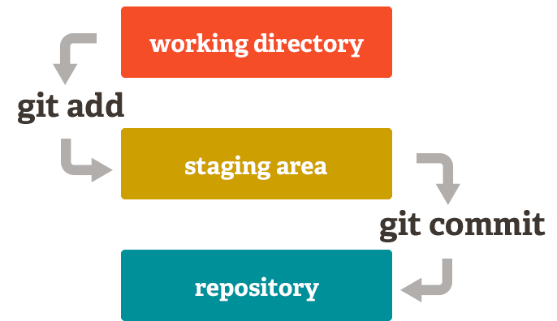

Slide 8
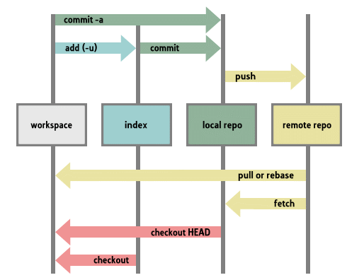

Slide 10
Pulling a repository/editing
lets pull a repository from github
  git pull https://github.com/cosai/test
  git remote add origin https://github.com/cosai/test
      I defined the link as origin. No need to write this link every time.
Edit the file a.txt
git commit –am ‘something added’
git push origin

Slide 11

Remove a file
git rm somefile.txt
git commit –m ‘removed’
git push origin

Slide 12
Conflict
git commit -am 'Conflicts resolved‘

Slide 13

Go back to ies
Git log
  Show me the logs git☺
See the commit id
  git reset --hard c1ac571d9af5fe1126ecdf64c57d6ef4a5990a60 && git clean -f
Destroys the local modifications!
Removes untracked files!

Slide 14

One step back!
An easy way to revert last commit (1)
  git revert HEAD~1..HEAD
  git push origin

Slide 15
Don’t want to enter username?
$ git config credential.helper store
$ git push http://example.com/repo.git
Username: <type your username>
Password: <type your password>
http://stackoverflow.com/questions/11403407/git-asks-for-username-everytime-i-push

Slide 16
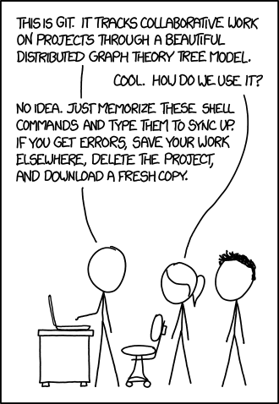
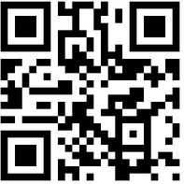
https://www.atlassian.com/git/tutorials/
https://app.box.com/githubUCF

