Slide 1
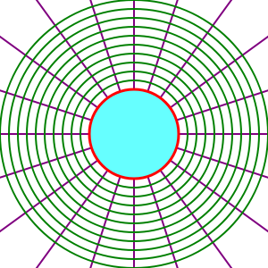
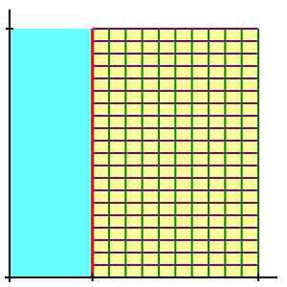

Slide 2
Field points
Immersed boundary surface
Interior points
Field points
Band points
Interior points

Slide 7
DEM+
Code
Particles velocity, their
position with respect to grid.
Calculation of global forces and
global torques
Acting on particles.
CFD
Code

