Slide 1
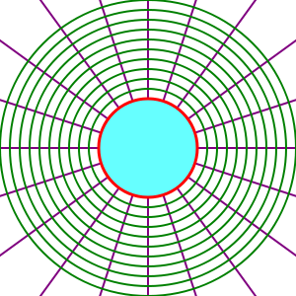
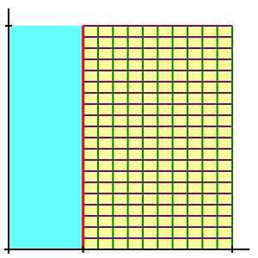

Slide 2
Field points
Immersed boundary surface
Interior points
Field points
Band points
Interior points

