Slide 1
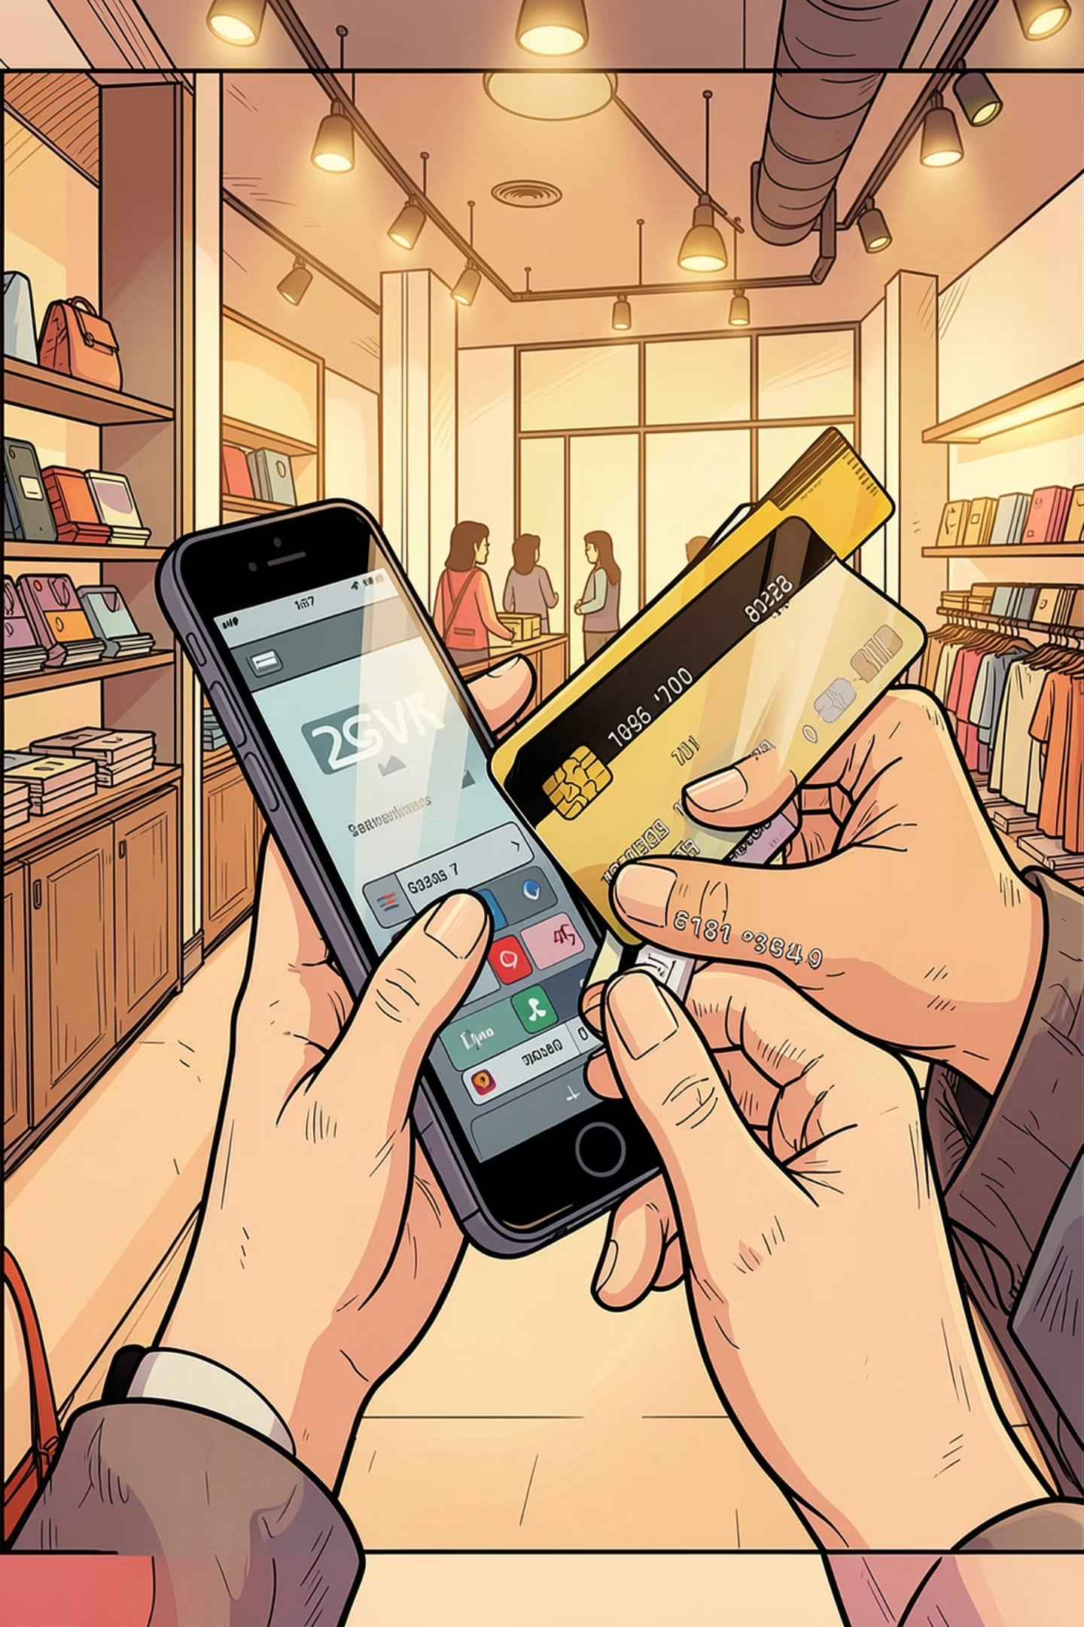
Customer Shopping Behavior — Overview
Analysis of 3,900 purchases to uncover spending patterns, segments, product prefs, subscriptions.

Slide 2
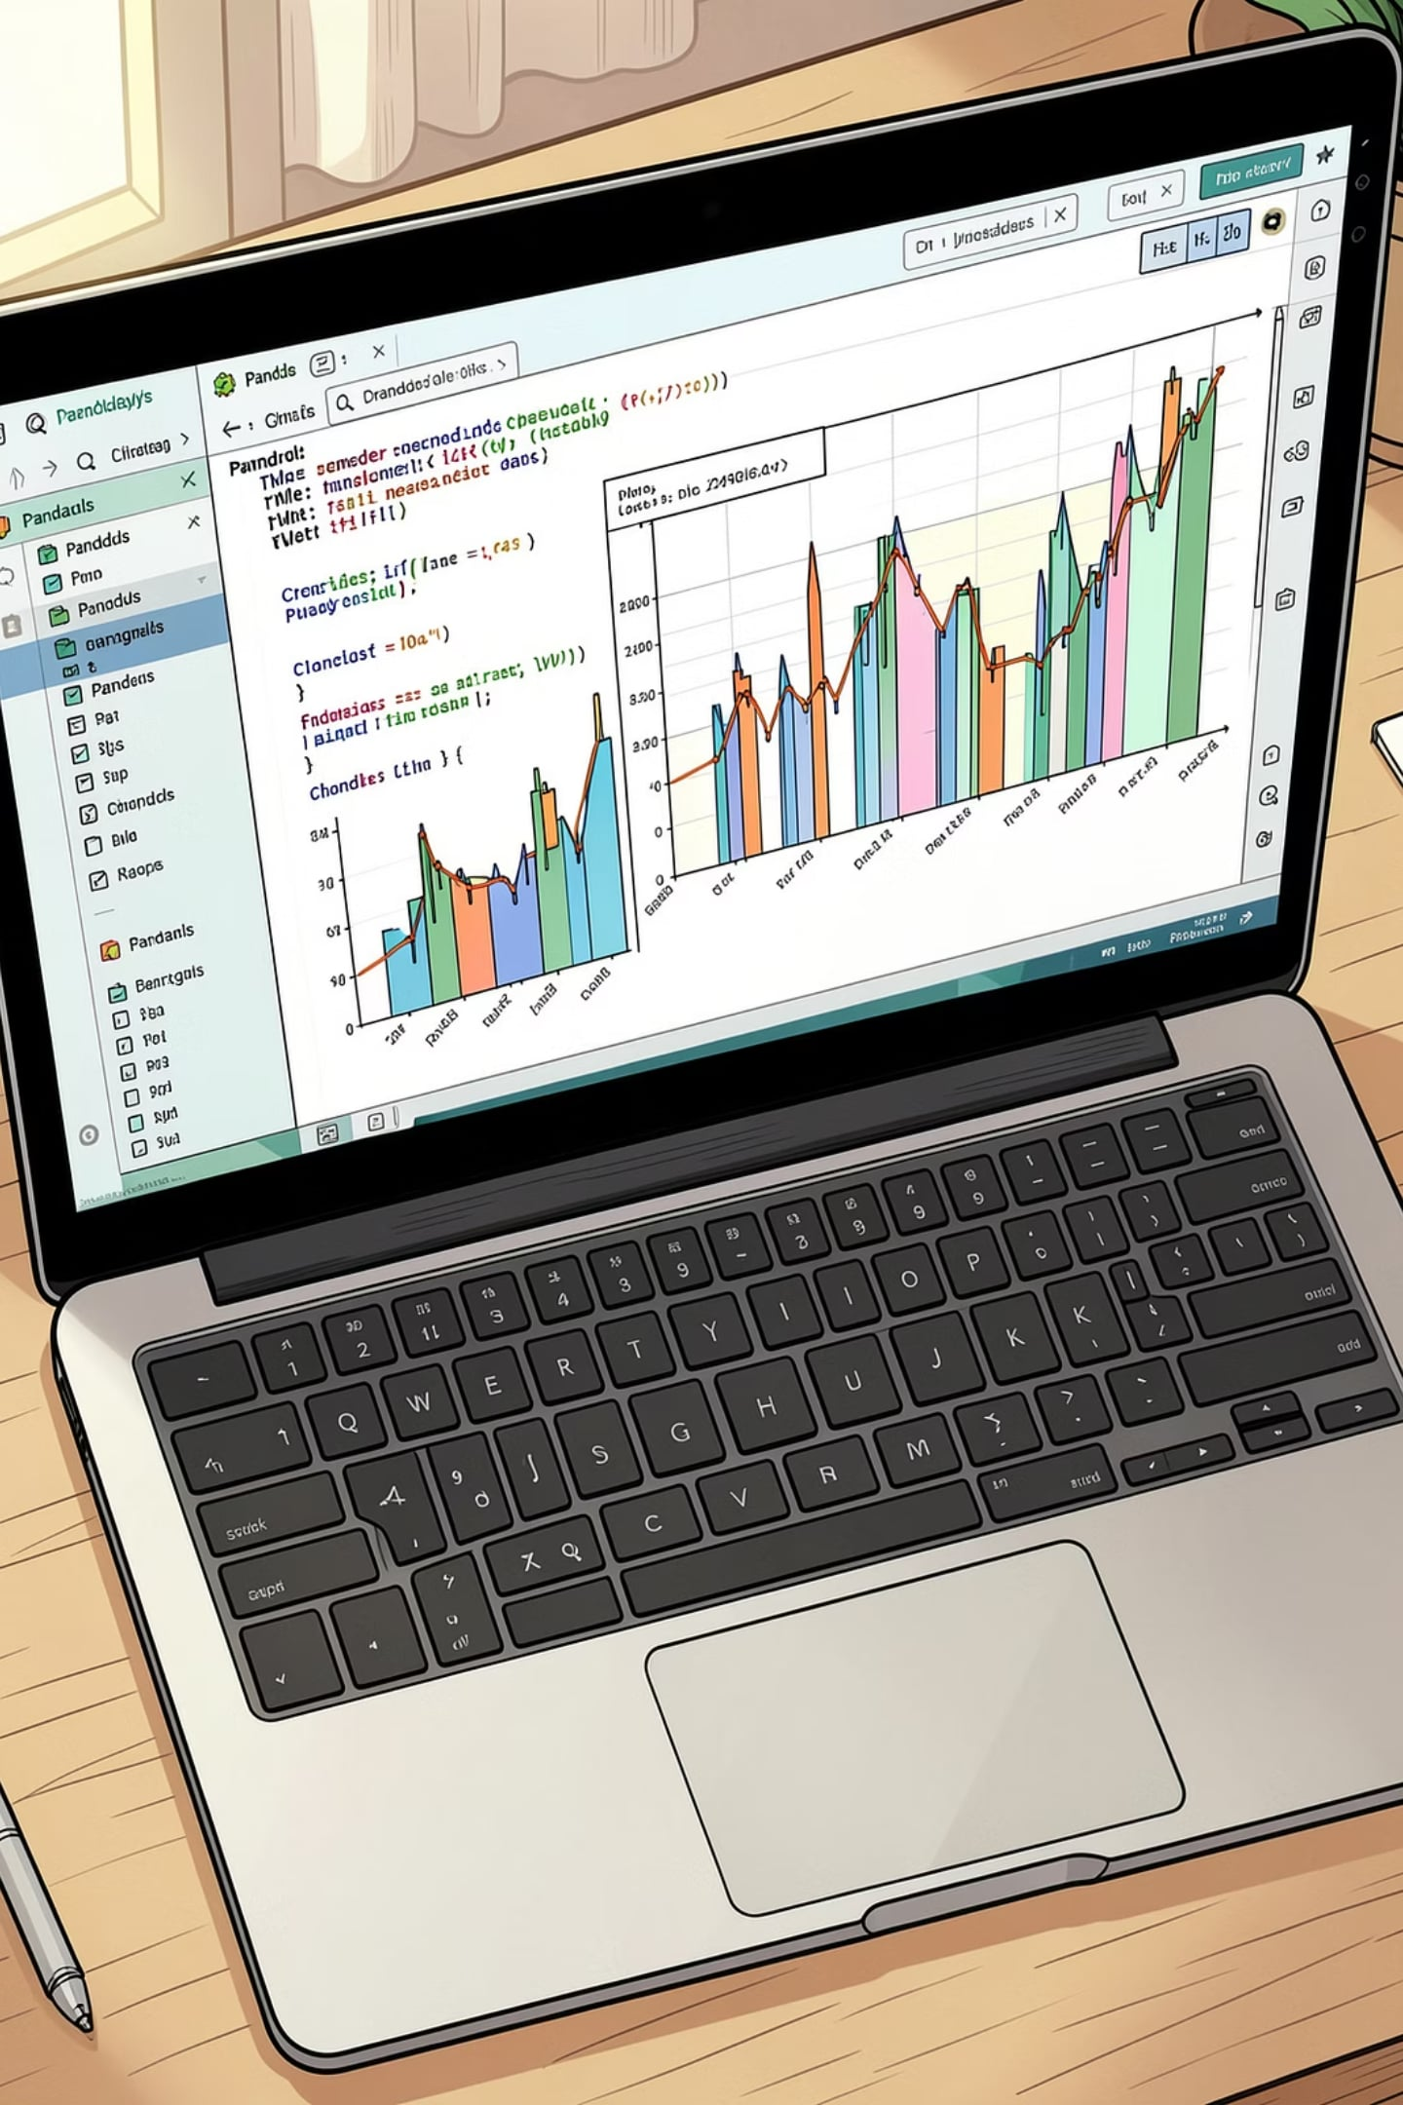
Dataset Summary
Size
Key Features
Rows: 3,900 • Columns: 18
Demographics, purchase details, behavior, shipping, discounts
Missing Data
37 nulls in Review Rating

Slide 3
Exploratory Data Analysis (Python)
01
02
03
Load & Inspect
Missing Values
Cleaning
df.info(), .describe()
Imputed Review Rating by category median
Renamed columns to snake_case
04
05
Feature Eng.
DB Load
age_group, purchase_frequency_days
Loaded cleaned DataFrame into PostgreSQL

Slide 4

SQL Business Analysis — Key Questions
Revenue by gender
High-spending discount users
Top products by rating
Shipping type comparison

Slide 5
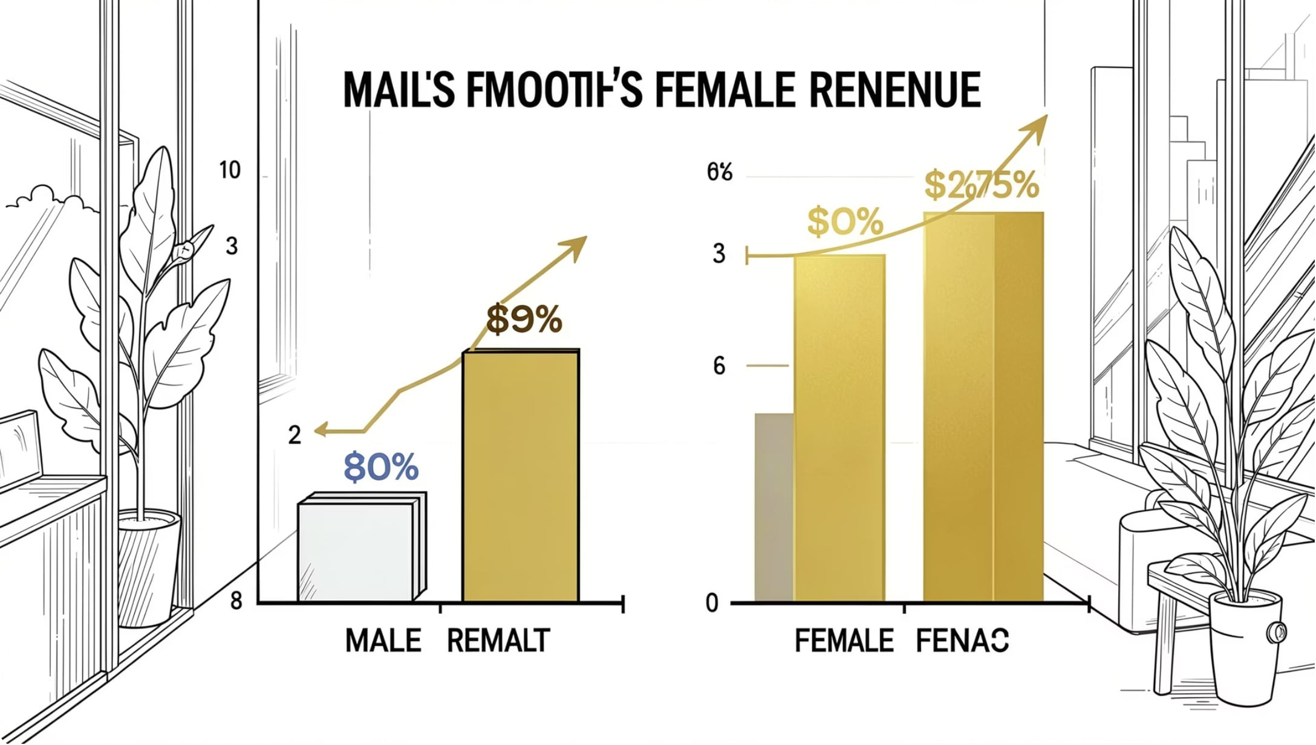
Revenue by Gender
Female
75,191
Male
157,890
Insight: Males generated higher revenue in this dataset.

Slide 6


Top Products & Discount Dependence
Top Rated
Discount-Dependent
Gloves 3.86 • Sandals 3.84 • Boots 3.82
Hat 50% • Sneakers 49.66% • Coat 49.07% • Sweater 48.17% • Pants 47.37%

Slide 7



Customer Segments & Loyalty
Segments
Repeat Buyers
Subscribers
Loyal 3,116 • Returning 701 • New 83
Repeat buyers: 958 subscribe vs 2,518 non-subscribers
Yes: 1,053 customers • Avg spend $59.49 • Revenue 62,645

Slide 8
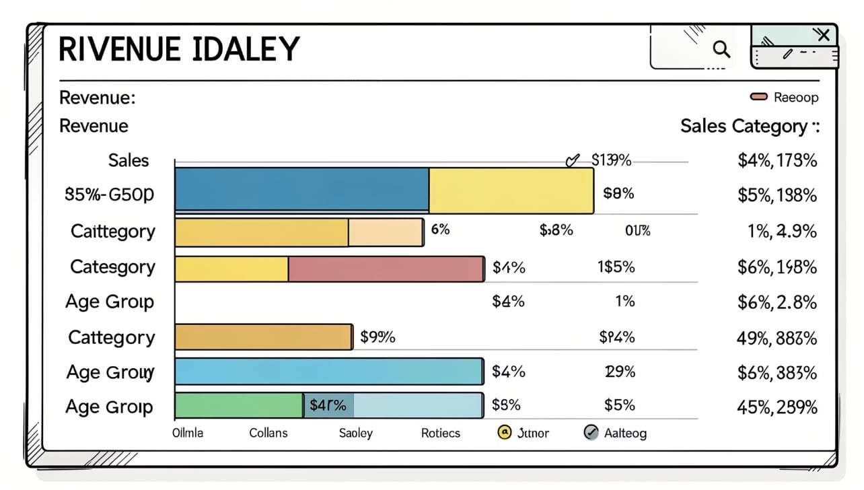
Revenue & Sales by Category / Age
Revenue by Category: Clothing ~100K • Accessories ~60K • Footwear ~30K • Outerwear ~10K
Sales by Category: Clothing ~1,800 • Accessories ~1,200 • Footwear ~600 • Outerwear ~300
Revenue by Age Group: Young Adult 62,143 • Middle-aged 59,197 • Adult 55,978 • Senior 55,763

Slide 9
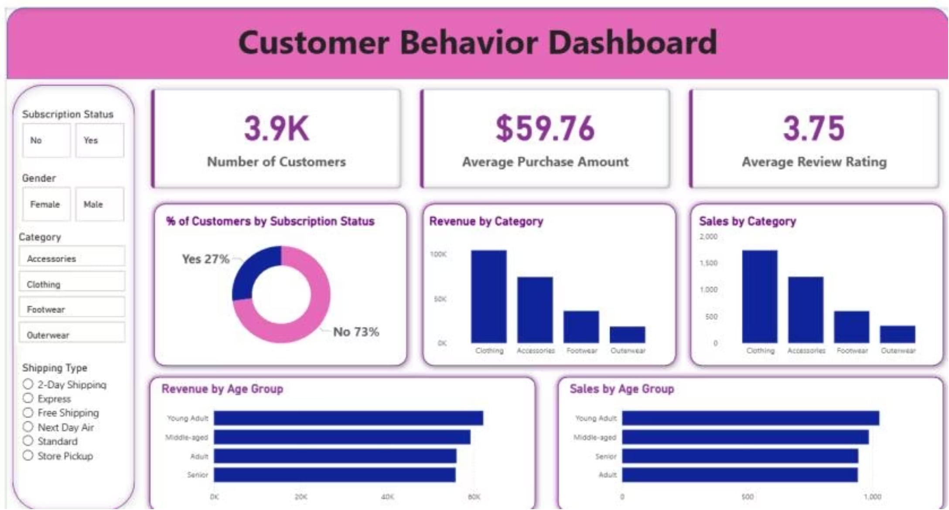
Dashboard Snapshot
Key metrics: 3.9K customers • $59.76 avg purchase • 3.75 avg rating
Subscription split: Yes 27% • No 73%

Slide 10


Business Recommendations
Boost Subscriptions
Loyalty Programs
Review Discount Policy
Promote exclusive subscriber benefits
Reward repeat buyers to increase loyalty
Balance acquisition with margins
Product Positioning
Targeted Marketing
Highlight top-rated & best-selling items
Focus on high-revenue age groups & express-shipping users
Theme accent: #B88E23 used for emphasis throughout.

