Slide 1
Iris Flower Classification Using Exploratory Data Analysis And Logistics Regression. Submitted: Kasthurimounika paidisetti
Semester: 5 th semester, BSC Data science

Slide 2
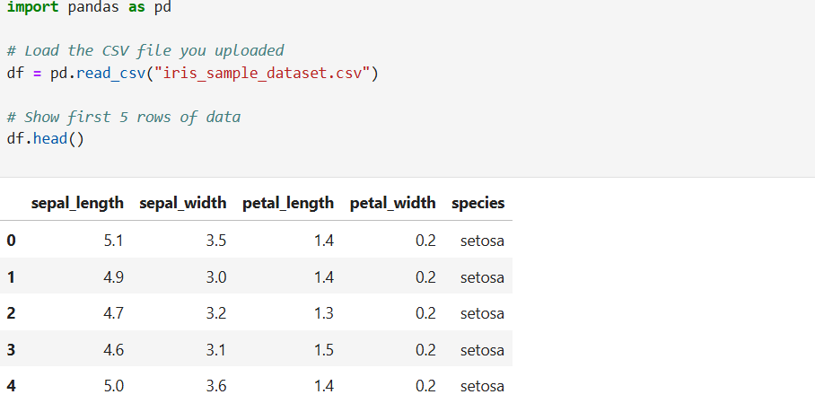

Slide 3
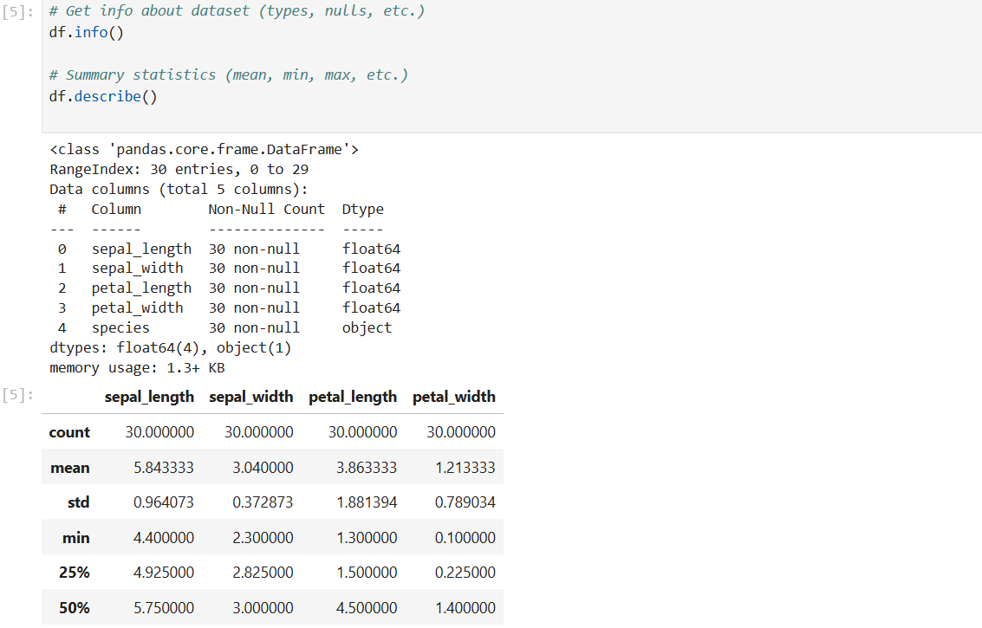

Slide 4
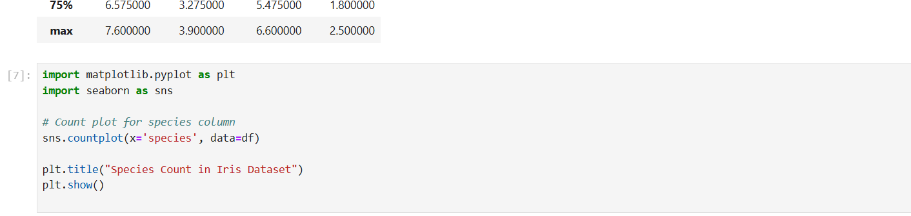

Slide 5
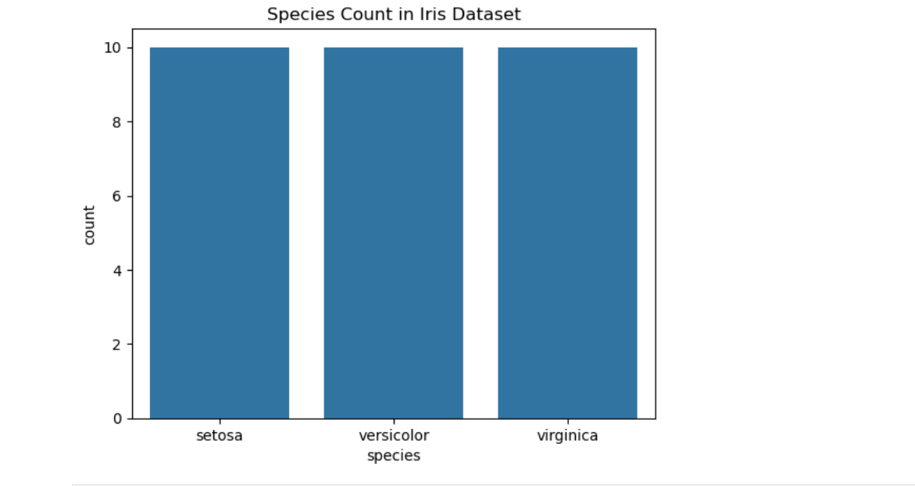
Counted each flower species in the dataset using value count. Plotted a bar graph with seaborn to visualize how many samples are present per species.

Slide 6
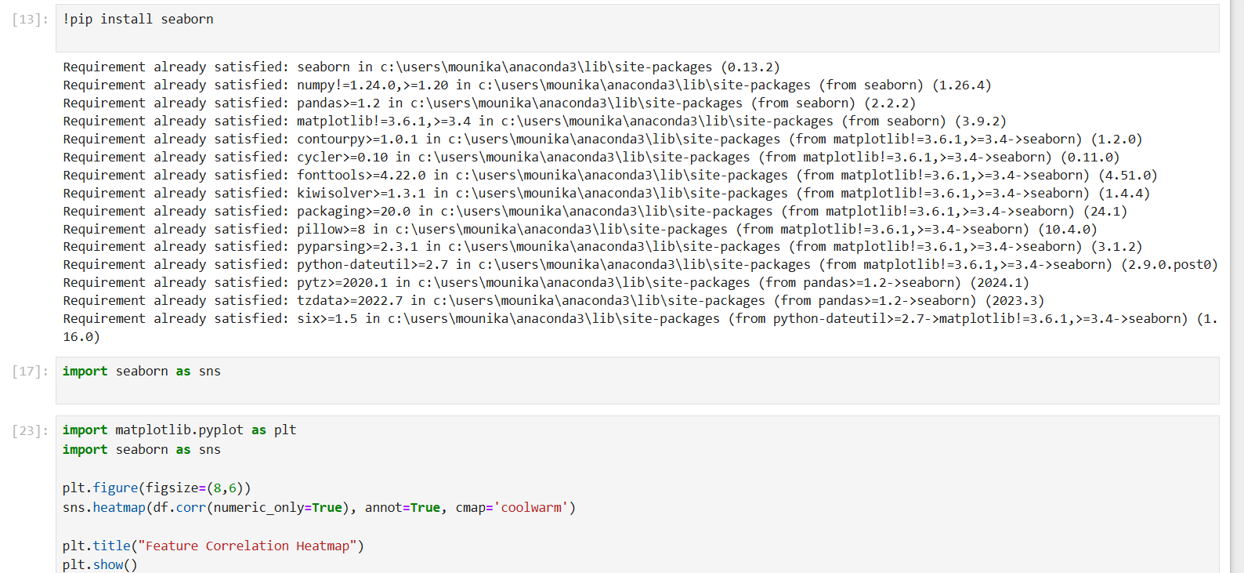

Slide 7
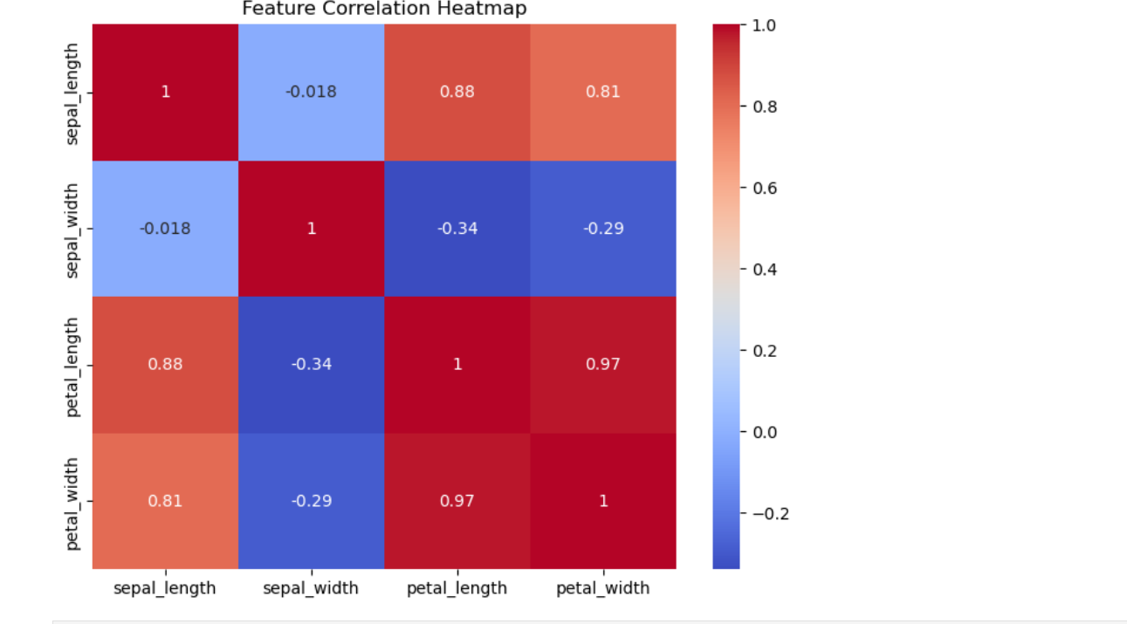
Calculated correlation between numerical features using df correlation Plotted heatmap with seaborn to visualize the relationship between features. Darker colors show stronger correlation, lighter colors show weaker correlation. Helps understand which features are related.

Slide 8
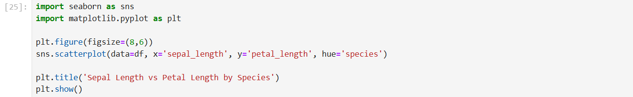

Slide 9
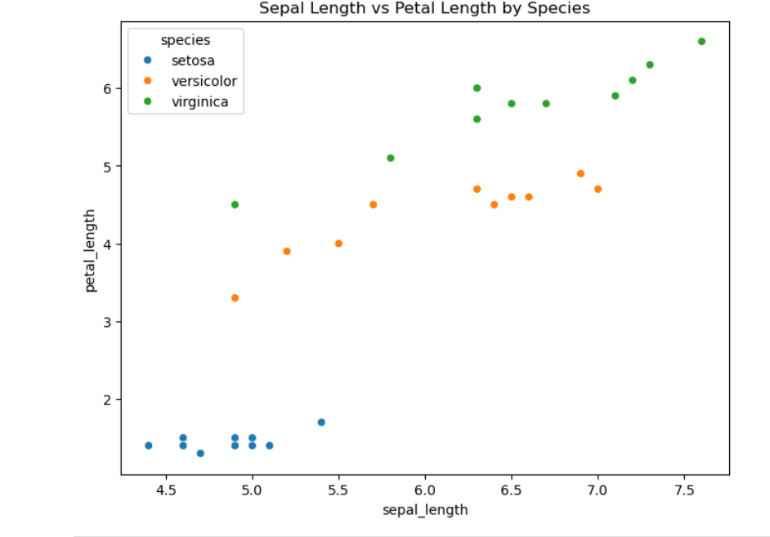
Plotted sepal length vs petal length for each species to observe clustering patterns. Different colors represent different species (Setosa, Versicolor, Virginica). This helps visualize how the species are separable based on these features.

Slide 10
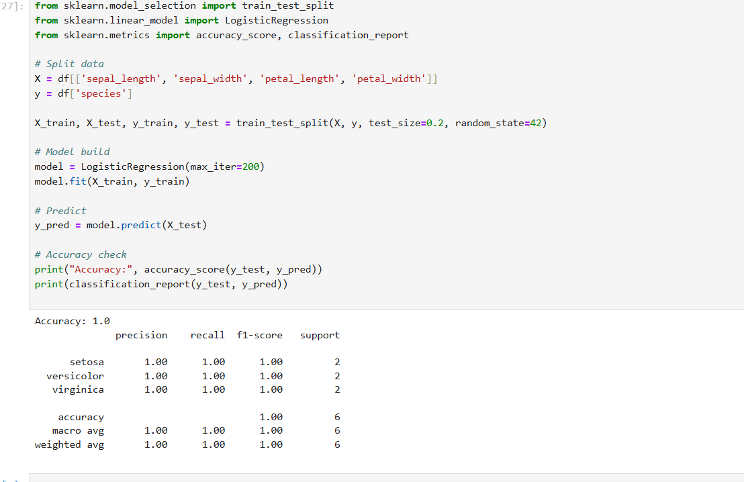
"Analyzed Iris dataset using pandas, visualized with seaborn, trained model with sklearn, achieved 100% accuracy, evaluated using confusion matrix."

Slide 11
Thank you

