Slide 1
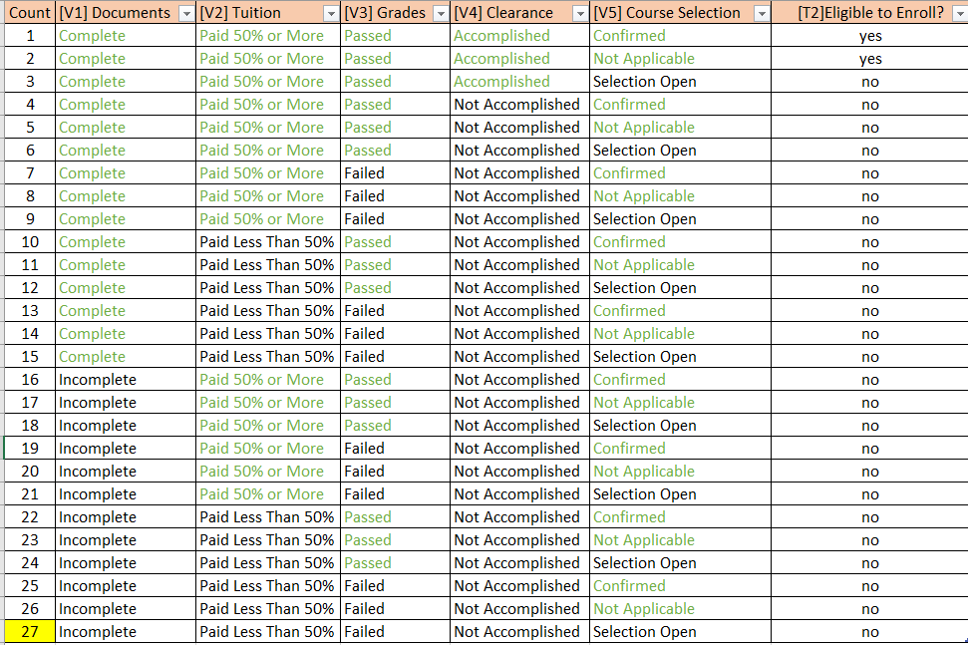
TRAINING DATA SET

Slide 2
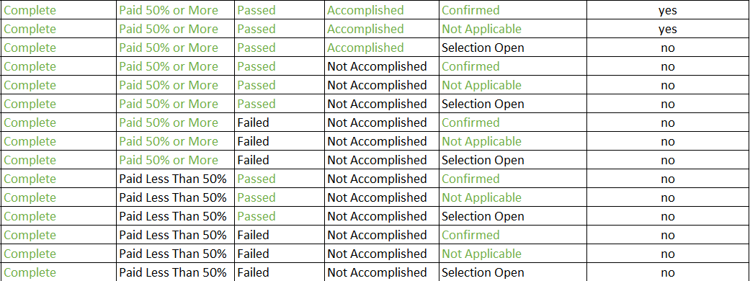
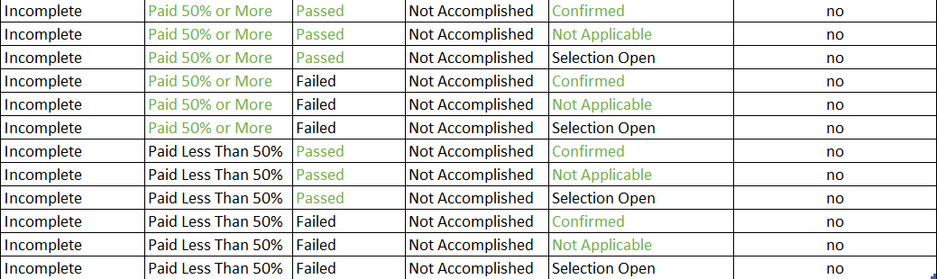
Eligible: y=2, n=25
DOCUMENTS
complete
incomplete
y=2, n=13
split further
n=12
pure subset

Slide 3
Eligible: y=2, n=25
DOCUMENTS
complete
incomplete
TUITION
p>=50%
p<50%
n=6
pure subset
y=2, n=7
split further

Slide 4
Eligible: y=2, n=25
COMPUTE
DOCUMENTS
complete
incomplete
TUITION
p>=50%
p<50%
GRADES
passed
failed
n=3
pure subset
y=2, n=4
split further

Slide 5
Eligible: y=2, n=25
DOCUMENTS
complete
incomplete
TUITION
p>=50%
p<50%
GRADES
passed
failed
CLEARANCE
accomplished
not accomplished
y=2, n=1
split further
n=3
pure subset

Slide 6
Eligible: y=2, n=25
DOCUMENTS
complete
incomplete
TUITION
p>=50%
p<50%
GRADES
passed
failed
CLEARANCE
accomplished
not accomplished
COURSE SELECTION
Confirmed
Not Applicable
Selection Open
n=1
pure subset
y=1
pure subset
y=1
pure subset

Slide 7
TRAINING DATA SET

Slide 8
Eligible: y=2, n=25
DOCUMENTS
complete
incomplete
y=2, n=13
split further
n=12
pure subset

Slide 9
Eligible: y=2, n=25
DOCUMENTS
complete
incomplete
TUITION
p>=50%
p<50%
n=6
pure subset
y=2, n=7
split further

Slide 10
Eligible: y=2, n=25
COMPUTE
DOCUMENTS
complete
incomplete
TUITION
p>=50%
p<50%
CLEARANCE
accomplished
not accomplished
y=2, n=1
split further
n=6
pure subset

Slide 11
Eligible: y=2, n=25
DOCUMENTS
complete
incomplete
TUITION
p>=50%
p<50%
CLEARANCE
accomplished
not accomplished
COURSE SELECTION
Confirmed
Selection Open
Not Applicable
n=1
pure subset
y=1
pure subset
y=1
pure subset

Slide 12
TRAINING DATA SET

Slide 13
Eligible: y=2, n=25
DOCUMENTS
complete
incomplete
y=2, n=13
split further
n=12
pure subset

Slide 14
Eligible: y=2, n=25
DOCUMENTS
complete
incomplete
TUITION
p>=50%
p<50%
n=6
pure subset
y=2, n=7
split further

Slide 15
Eligible: y=2, n=25
COMPUTE
DOCUMENTS
complete
incomplete
TUITION
p>=50%
p<50%
COURSE SELECTION
Confirmed
Selection Open
n=3
pure subset
y=1, n=2
no further split, not pure
Not Applicable
y=1, n=2
no further split, not pure

