Slide 1
Cybersecurity Risk Assessment Framework
For Small Online Retail Businesses
Securing Digital Platforms Using the NIST Framework

Slide 2

The Context: Vulnerability
Low Hanging Fruit
Small online retail businesses are increasingly dependent on digital payments but often lack dedicated IT security teams.
Limited cybersecurity budgets.
Lack of technical expertise.
Easy targets for automated attacks.
The Result: Data breaches, financial loss, and reputational damage.

Slide 3






Why Are They Targets?
Weak Access Control
Many shops use shared admin accounts, weak passwords, and lack Multi-Factor Authentication (MFA).
Untrained Staff
Employees are often unaware of basic cyber hygiene, making them susceptible to phishing.
No Data Redundancy
Lack of automated backups and encryption means ransomware can cause permanent data loss.

Slide 4
Project Objectives
Analyze cybersecurity threats specific to retail.
Create a risk assessment model using NIST.
Score threats using Likelihood vs. Impact.
Recommend actionable security measures.

Slide 5



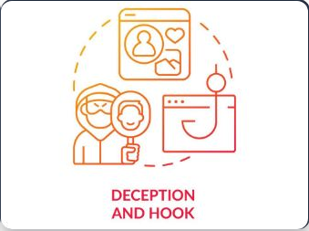
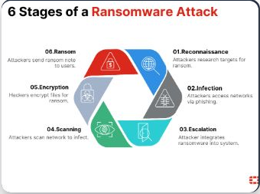

The Threat Landscape
Phishing
Deceptive links to steal credentials.
Ransomware
Encrypts data and demands payment.
Data Breach
Leakage of customer PII.

Slide 6





Methodology: NIST Framework
Identify
Know assets & risks
Protect
Safeguards
Detect
Monitor events
Respond
Take action
Recover
Restore data
A lifecycle approach to security: from prevention to restoration.

Slide 7
Risk Evaluation Matrix
Risk | Likelihood (1-5) | Impact (1-5) | Score | Level
Ransomware | 5 | 5 | 25 | CRITICAL
Phishing | 4 | 5 | 20 | HIGH
Payment Fraud | 4 | 4 | 16 | HIGH
Weak Passwords | 5 | 3 | 15 | HIGH
Data Breach | 3 | 5 | 15 | HIGH
Priority Action: Ransomware & Phishing Mitigation

Slide 8
Mitigation Strategies
Technical Controls
MFA: Mandatory for all admin accounts.
Encryption: SSL/TLS for payment gateways.
Backups: Automated weekly off-site backups.
Firewall: Traffic monitoring and blocking.
Human Controls
Training: Regular phishing simulations.
Access Control: Least Privilege Principle (RBAC).
Policy: Clear "Bring Your Own Device" rules.
Incident Plan: Defined roles during an attack.

Slide 9
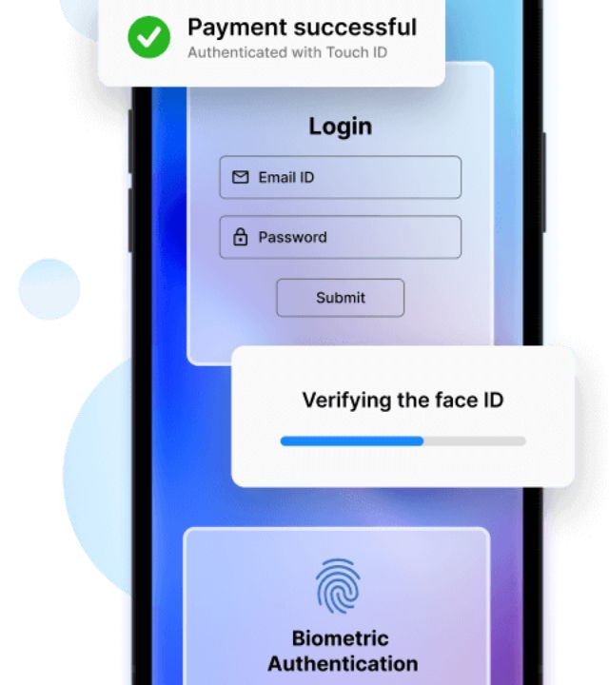
Case Study: XYZ Retail
Challenge: Exposed admin login, no backups, weak
data protection.
Solution Applied:
Enabled MFA & Strong Password
_{P}A_{o}u_{l}t_{ic}o_{y}-.encryption for transactions.
Weekly cloud backups established.
Outcome:
Improved business continuity, zero downtime in Q4, and increased customer trust score.

Slide 10
Conclusion
“
Security is an investment, not an expense. Prioritizing high-impact risks ensures safer transactions and sustainable business growth.

Slide 11





Future Scope
AI Prediction
Using Machine Learning to anticipate and block threats before execution.
Zero Trust
Moving to a "Never Trust, Always Verify" architecture for all users.
Cloud Security
Advanced protection strategies specifically for cloud-hosted inventories.

Slide 12
Questions?
Thank you for your attention.

