Slide 1
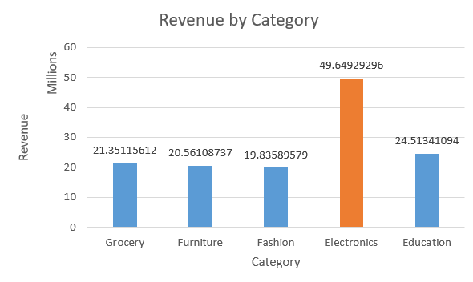
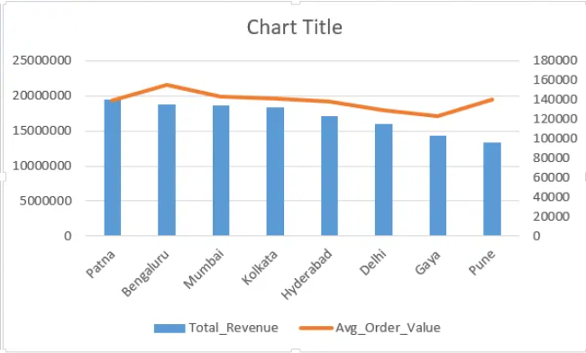
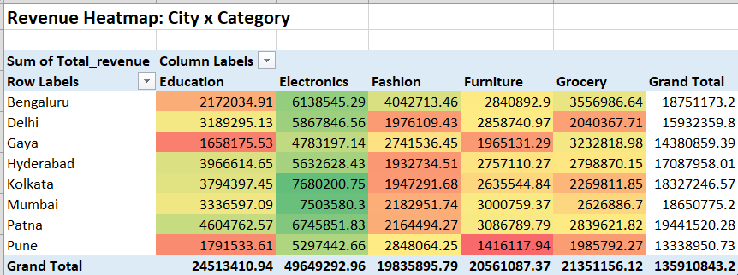
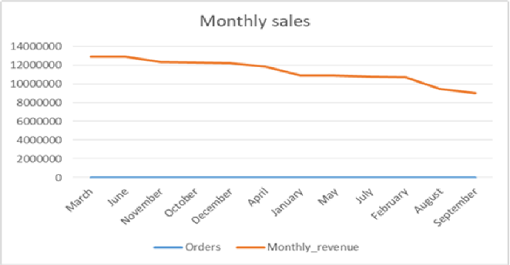
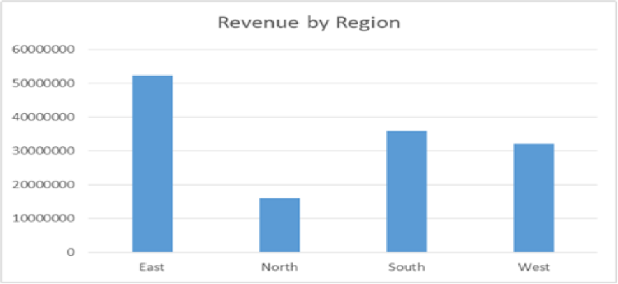
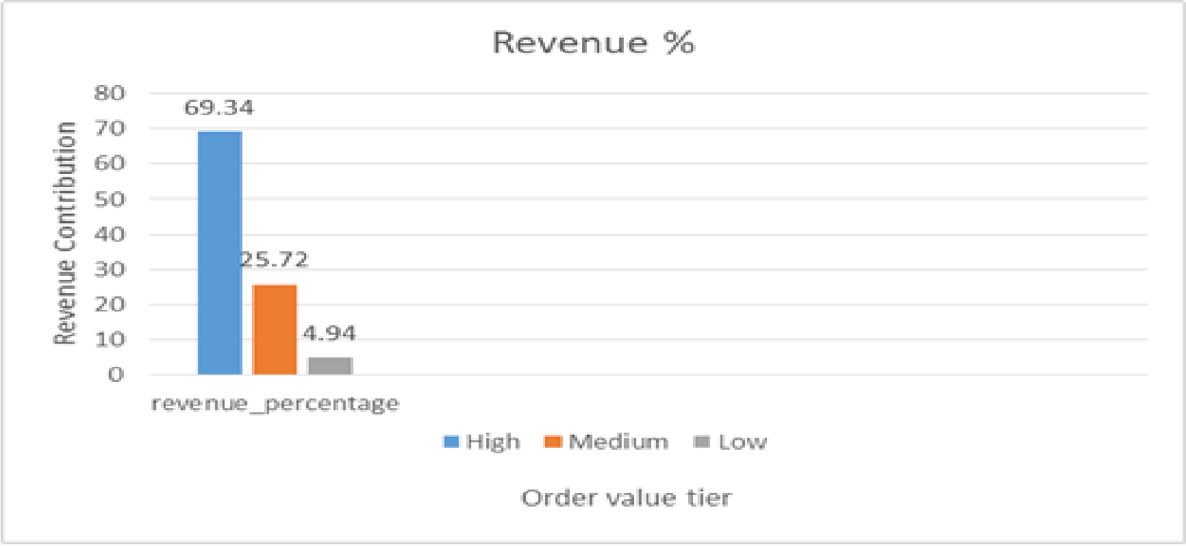
Sales Performance Dashboard
₹1,38,685
Average Order Value
Electronics
Top Category (36.5% of revenue)
69.3%
Revenue from High-tier orders
₹13.59 Cr
Total Revenue

Slide 2
Key Insights
• Electronics generated ₹4.96 Cr (36.5%) of total revenue, making it the top-performing category.
• Mobile (₹2.51 Cr) and Laptop (₹2.46 Cr) were the highest revenue-generating products.
• March recorded the highest monthly revenue (₹1.29 Cr), while September was the lowest (₹0.90 Cr).
• Bengaluru had the highest average order value at ₹1.55 Lakh per order.
• Customers aged 18–24 recorded the highest average order value of ₹1.44 Lakh.
• High-value orders represented 36.5% of transactions but generated 69.3% of total revenue.
• East region generated the highest revenue (₹5.21 Cr), while South had the highest average order value (₹1.46 Lakh).
• Male (₹7.05 Cr) and Female (₹6.55 Cr) customers contributed almost equally to revenue.
Recommendations
• Focus marketing on Electronics, especially Mobile and Laptop, which generated ₹4.97 Cr combined revenue.
• Launch targeted promotions in September to improve sales during the lowest-performing month (₹0.90 Cr).
• Expand premium product offerings in Bengaluru, where average order value is highest (₹1.55 Lakh).
• Target the 18–24 age segment with premium Fashion campaigns, as they show the highest spending behavior.
• Implement loyalty and retention programs for high-value customers, who contribute 69.3% of total revenue.
• Increase premium product penetration in the East region to improve average order value
while maintaining high sales volume.
• Allocate marketing budget based on age groups and product categories rather than gender, as revenue
contribution is nearly equal across genders.

