Slide 1
DATA COMMUNICATION AND NETWORKING
PRESENTATION FOR PROJECT

Slide 2

CONT..
WOLAITA SODO UNIVERSITY
NO | GROUP MEMBER
1 | KASU JIMA | UGR/91890/16
2 | AKLILU ABATE | UGR/92526/16
3 | TIGIST WOLEDE | UGR/93995/16
4 | BITHOW GACH | UGR/94325/16
5 | HERMA WENDEMAGEGN | UGR/93878/16
6 | MEGFIRA ABDALA | UGR/91970/16

Slide 3
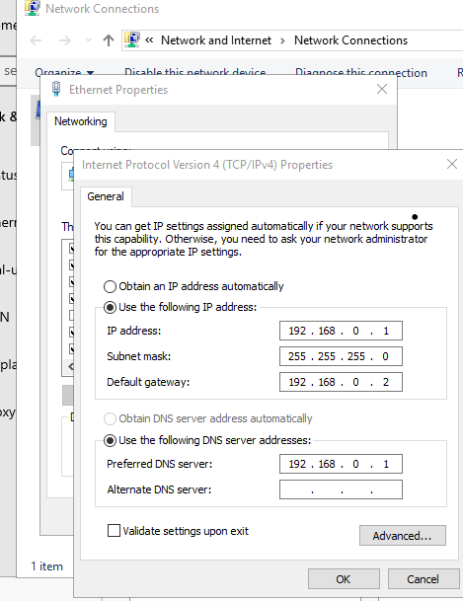
DATA COMMNICATION AND NETWORKING
1.configure static ip address for our server

Slide 4
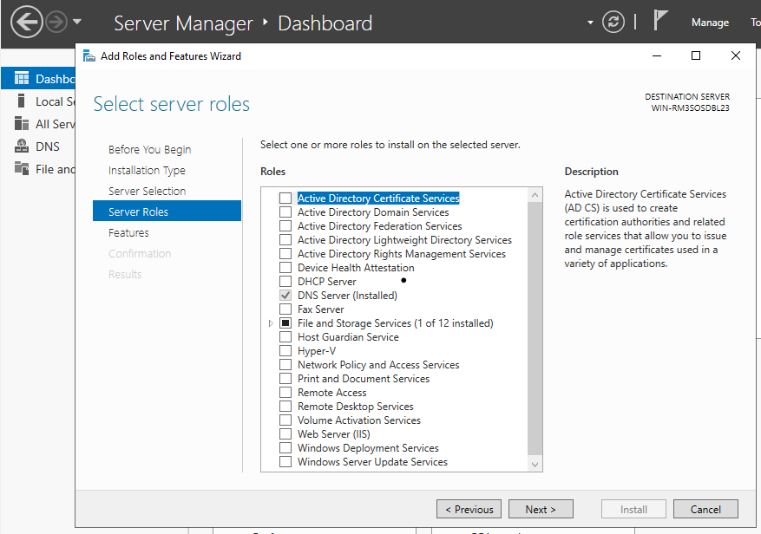
CONT..
2.install the dns server role

Slide 5
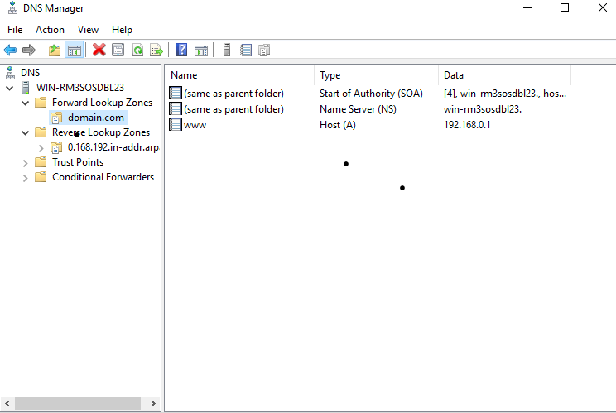
3.configure the forward lookup

Slide 6
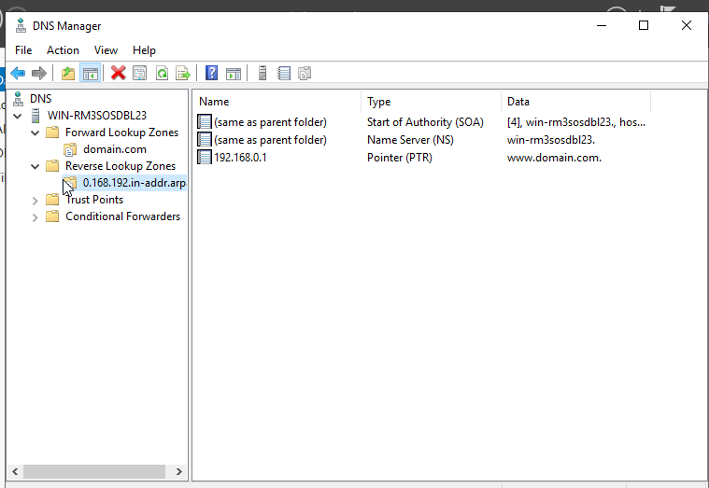
CONT...
4 .configure the backward lookup

Slide 7
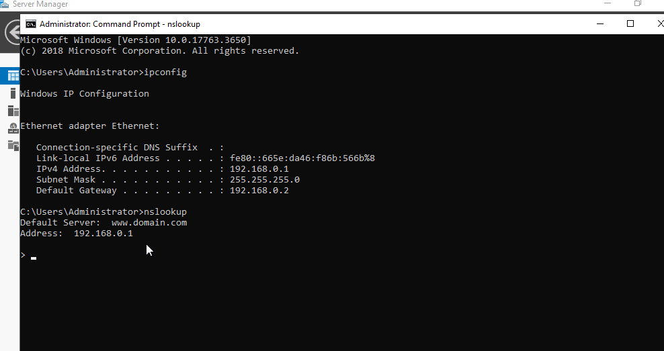
CONT..
5 .testing

