Slide 1

EXPEDIA Recommendation Systems
R Nomads
Avanthi Namburi
Jayasree Akula
Meghana Kasula
Seemantini Chincholkar
Seshi Harianathan
Shaloma Ghosh

Slide 2
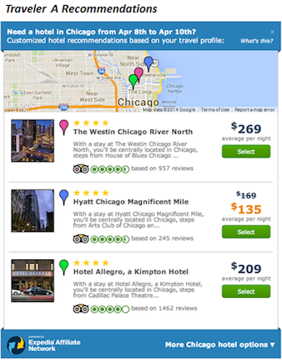
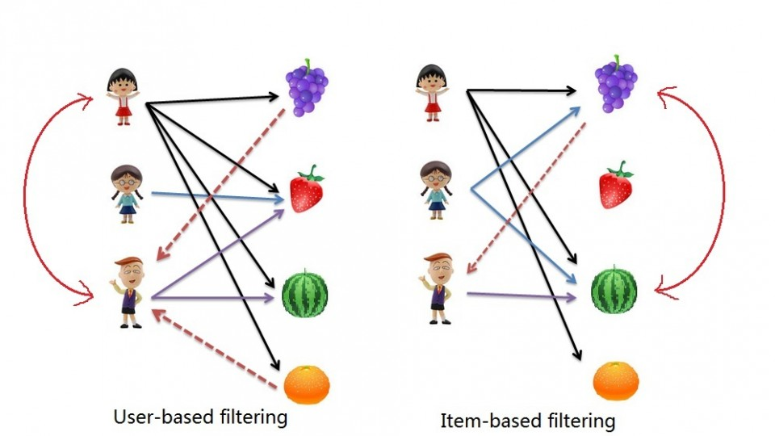
Introduction

Slide 3
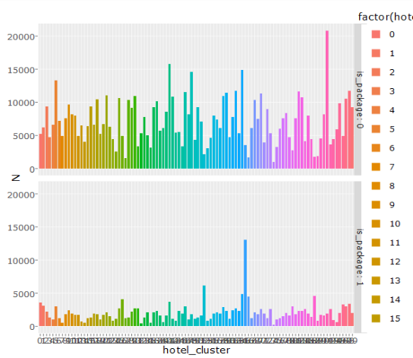
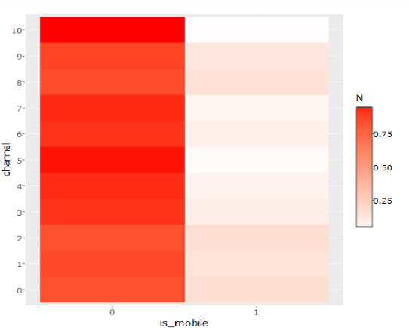
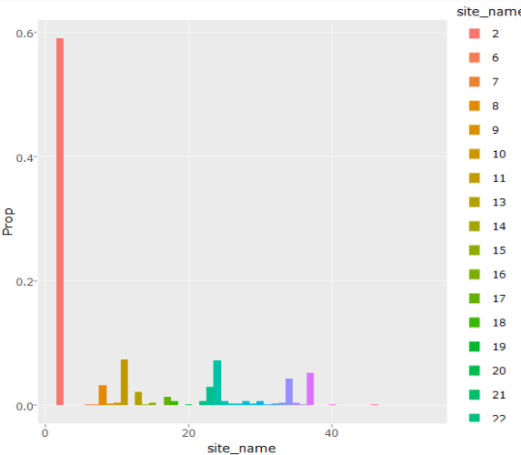
Exploration

Slide 4
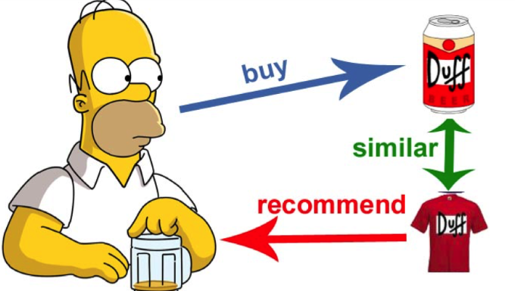
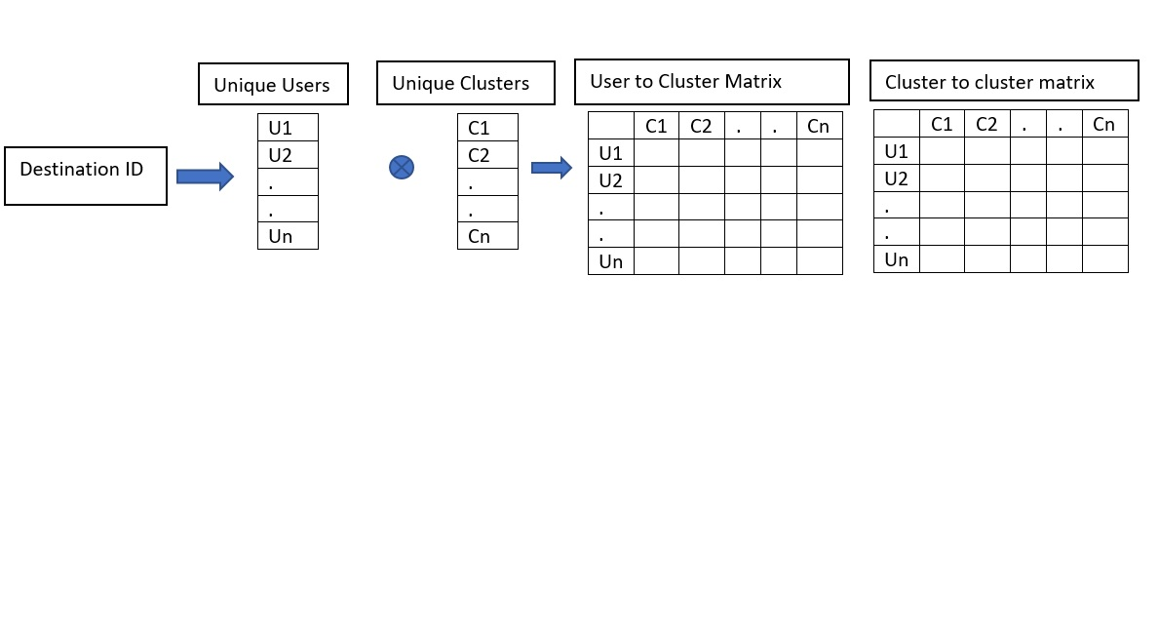
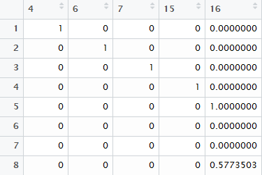
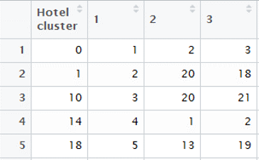
Conventional Recommender system - Content Based

Slide 5
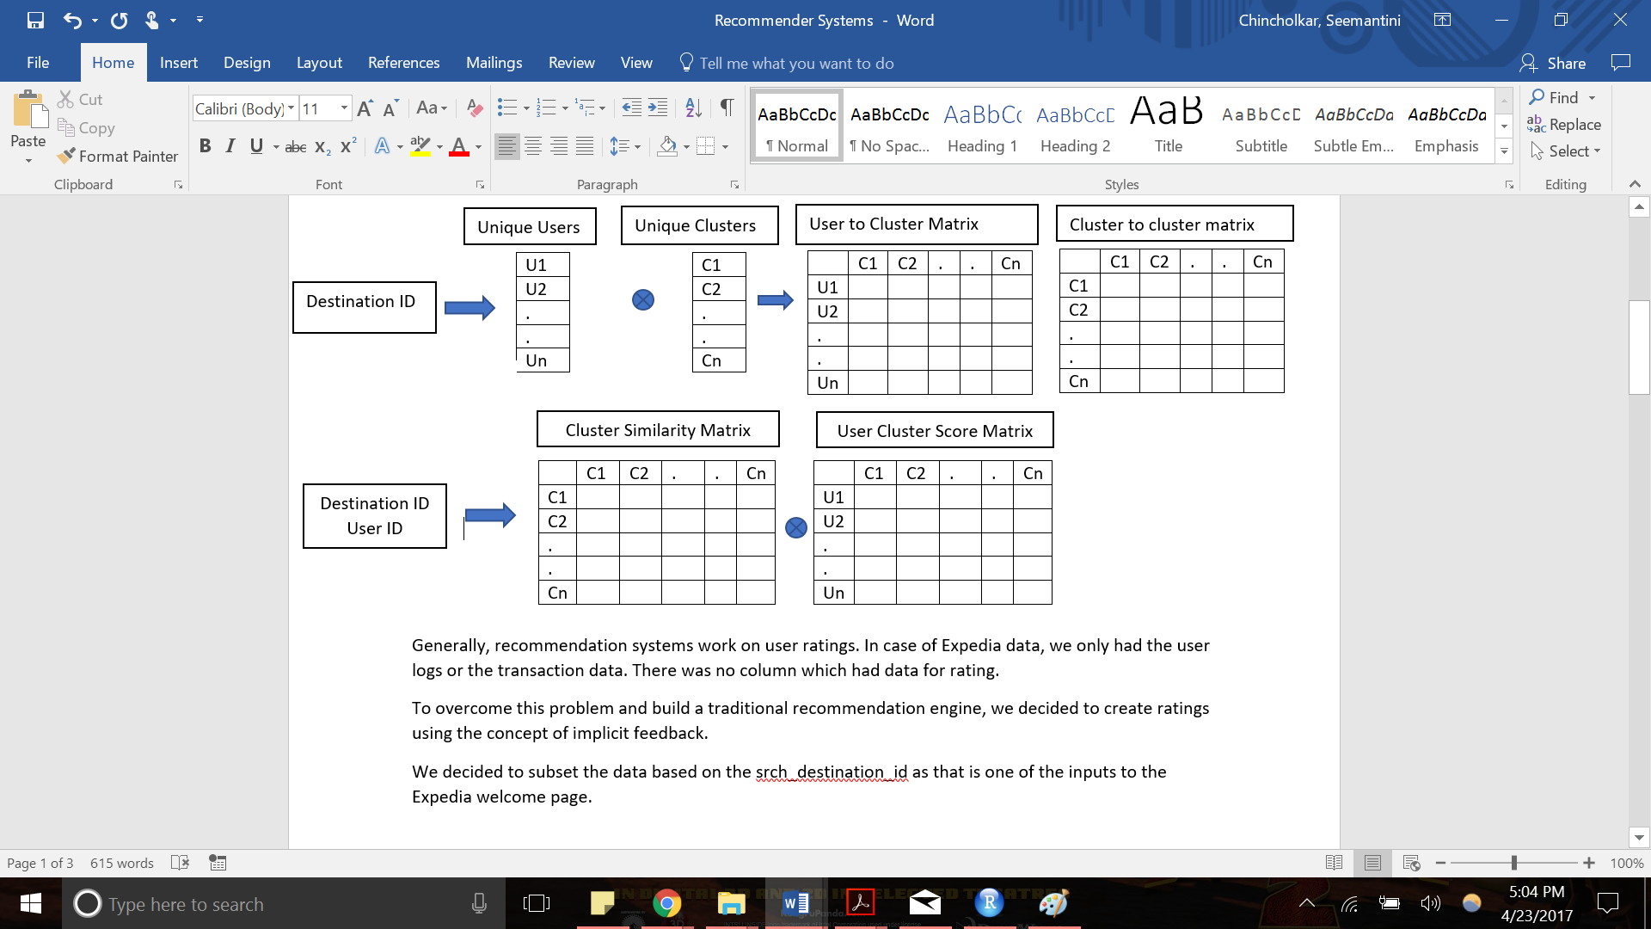
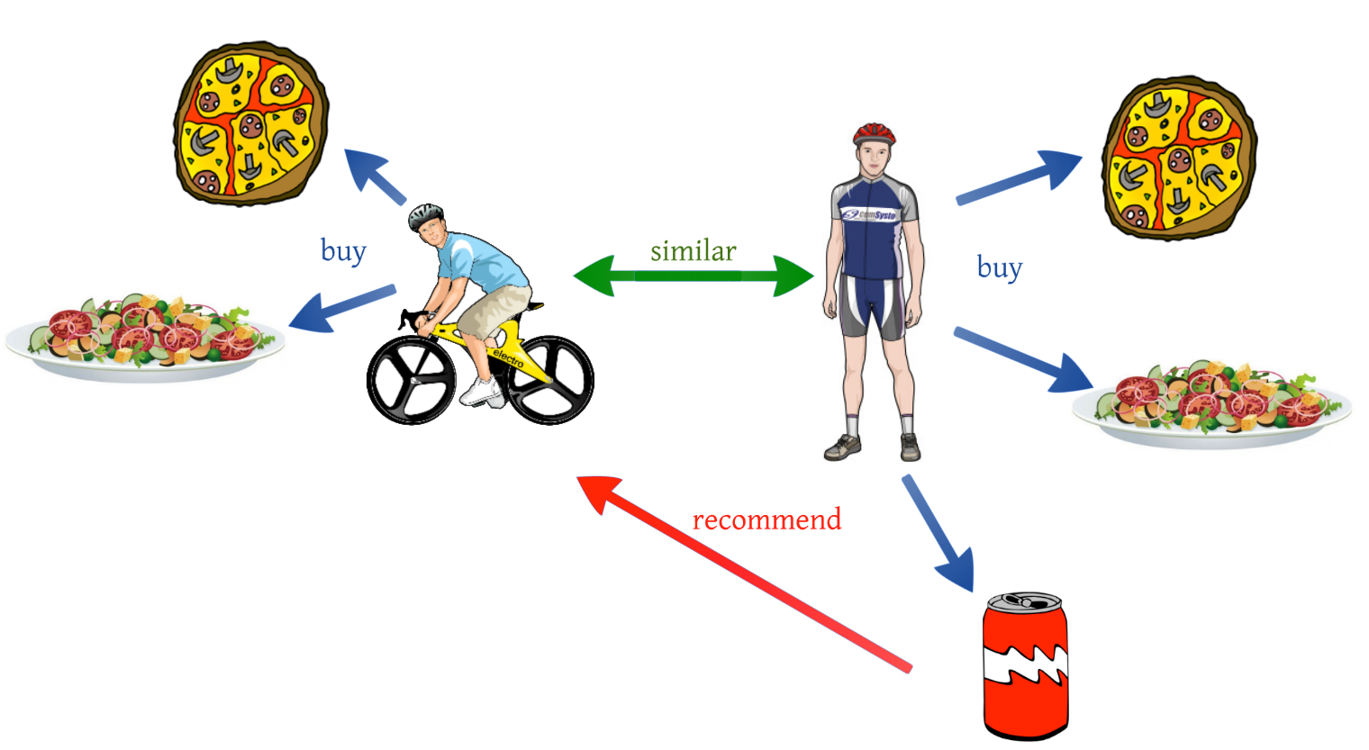
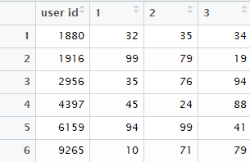
Conventional Recommender system-Collaborative

Slide 6
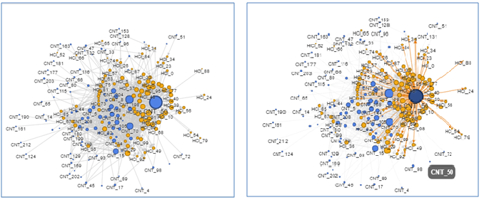
Network Analysis

Slide 7
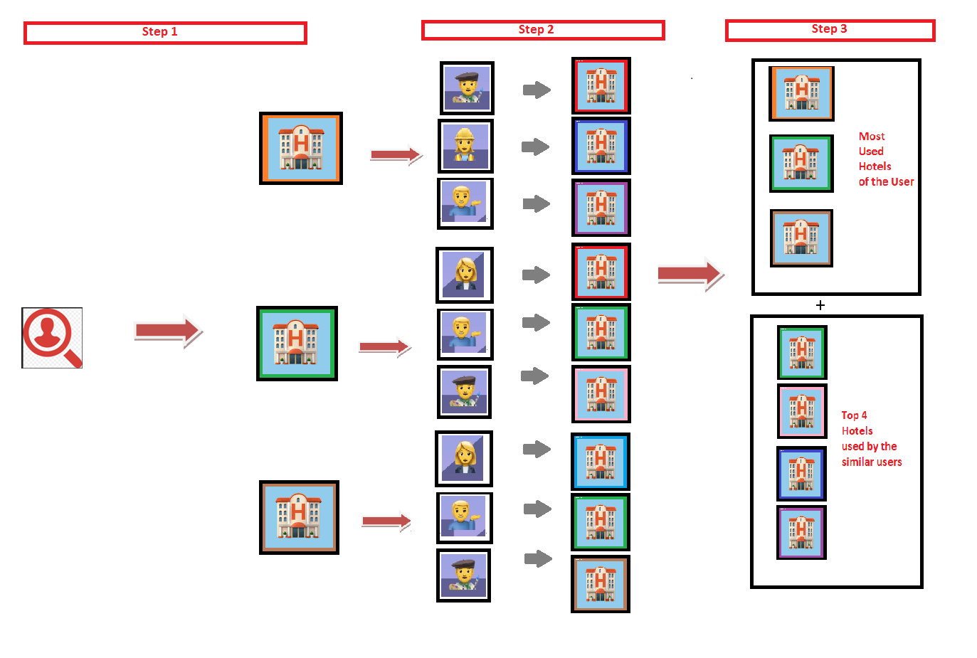
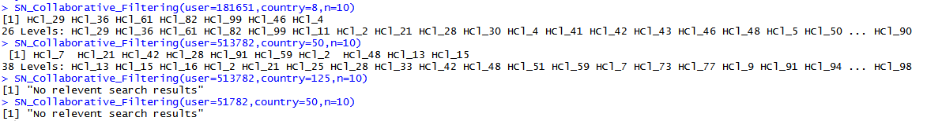

Slide 8
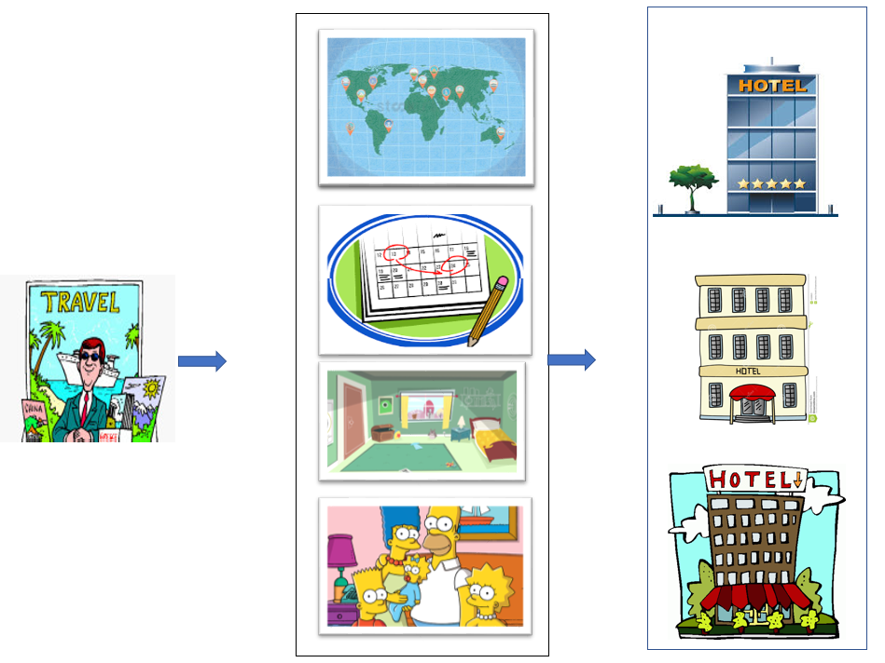
Item Based Filtering

Slide 9
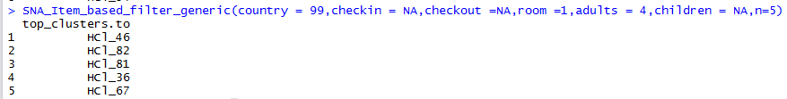
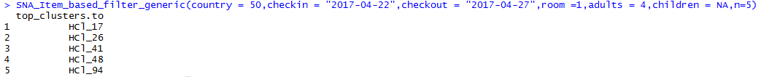
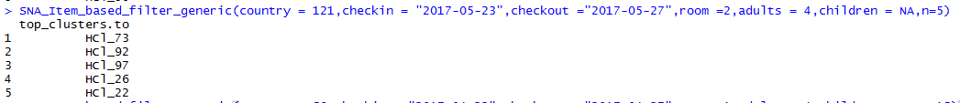
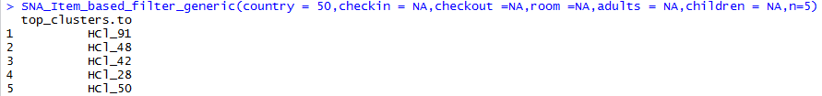
Item Based Filtering

Slide 10
Conclusion – Business Value and Application
Benefits of using Network Analysis for Recommendation systems -
Minimum programming is required, the time required for calculation is very less. Very good for initial insights.
Benefits of using Traditional Recommender systems -
we can use these outputs in support of any machine learning algorithms being built on data.
Conclusion –
when there is no budget or scope for machine learning Recommendations using Network Analysis will be the best.
Applications of Traditional Recommender systems
Not only we can recommend users page, we can make a optimized recommendation systems based on the matrix obtained.
Market Basket Analysis –
Formulated rules, future scope to provide recommendations

Slide 11


