Slide 1






Data Visualization and Dashboards with Tableau
By Kasun Lokugamage

Slide 2





Agenda
Introduction
Data Analysis
Data Visualization
Dashboard
Challenges

Slide 3

Option 02
Dataset : Cause of Death - Our World in Data
Introduction
56 million people died in 2017. What did they die from?
Dataset contains estimated number of deaths by 32 different causes among 70+ countries
In original dataset: columns – 36 & rows – 8255
Years – From 1990 to 2019

Slide 4
Search duplicate rows
Check data types
Remove unwanted & Null values rows
Check Null values
Data Analysis
Add zero values to numeric Null values
Remove unwanted & Null values columns

Slide 5


Data Analysis
Removed – column, Number of executions (Amnesty International)
Create a field Only with Countries.
Create a field with Continents.
Created new fields combining similar causes for death
United Kingdom consists England, Wales, Scotland & Northern Ireland

Slide 6




China
India
USA
Questions
1
2019
What is the leading cause of death across all countries?
2
Top 3 countries with highest number of deaths all times?
3
Cardiovascular Diseases
Continent with highest number of deaths all times?
4
Which year has most number of deaths?
Asia

Slide 7
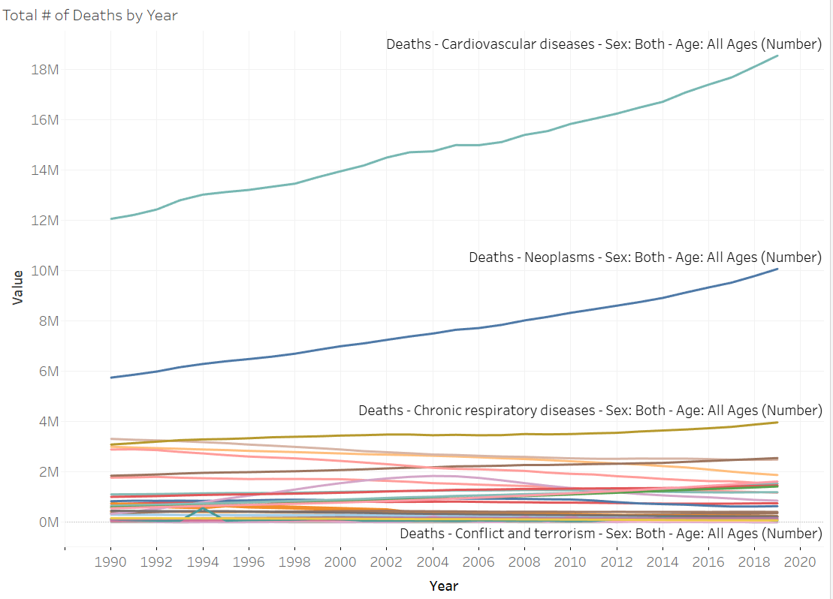
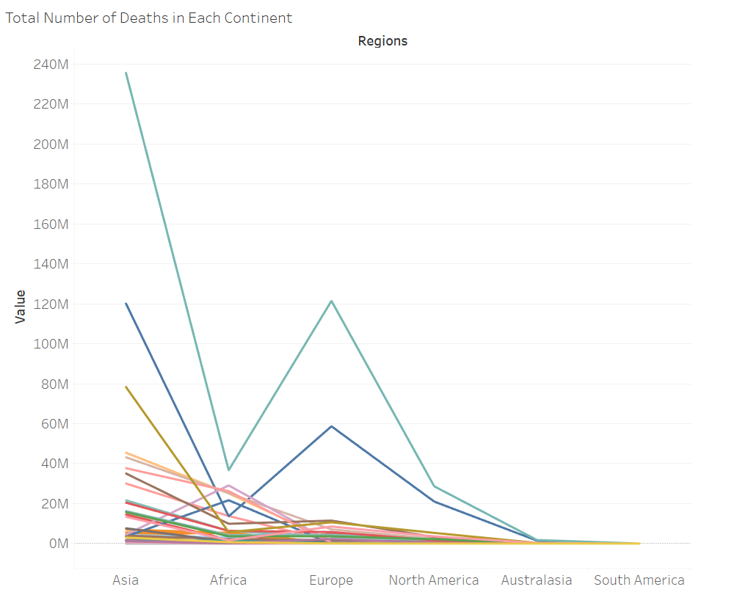
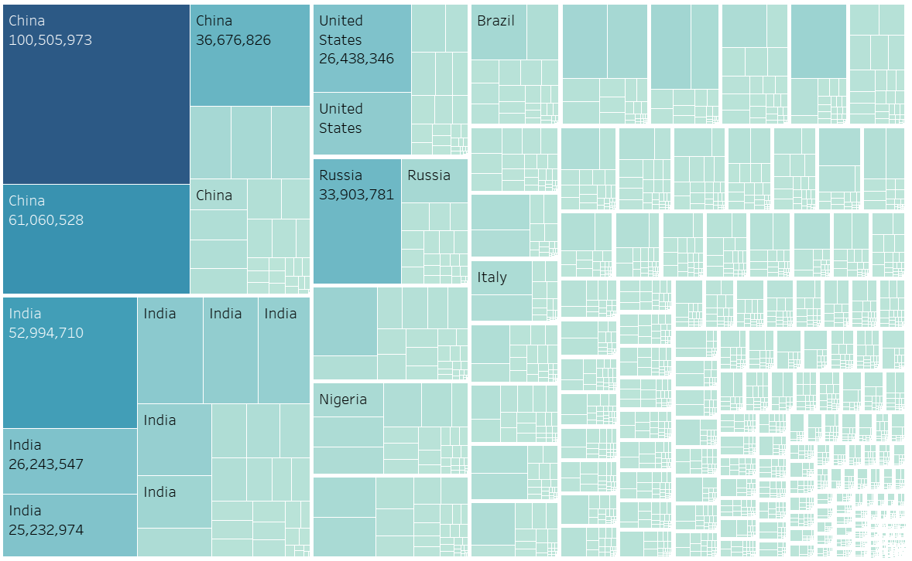
Data Visualization

Slide 8
WRONG IDEAS
Great idea!
Awesome idea!
Creative idea!

Slide 9





CHALLENGERS
Data Cleaning and Preparation
Feature Selection
Technical Issues
Dashboard Design
Visualization Challenges

Slide 10
THANK
YOU!

