Slide 1





REAL ESTATE INSIGHTS
Predictive Analysis and Classification of Real Estate Listings for Client Recommendation
Kasun Lokugamage

Slide 2
PROJECT DESCRIPTION
Dataset – Real Estate (Houses & Apartments)
Columns -
Property ID
Agency ID
Location of the property
Types of property – House or Apartment
Price
Features of the property - # of Bedrooms, # of Bathrooms, Total buildup area
Total Rows - 56090
File Type - CSV

Slide 3




PROJECT GOAL
TECHNICAL TOOLS
DATASET
INPUT
OUTPUT
DATA VISUALIZATION
Dashboard showcasing neighborhood and property options tailored to a client's budget and other specific needs
PYTHON
EXCEL
CSV
TEXT

Slide 4






PROJECT STEPS
Analyze the results and interpretation
2
Loading data
6
5
Cleaning and transforming
Analyzing original dataset
Identifying trends and patterns

Slide 5
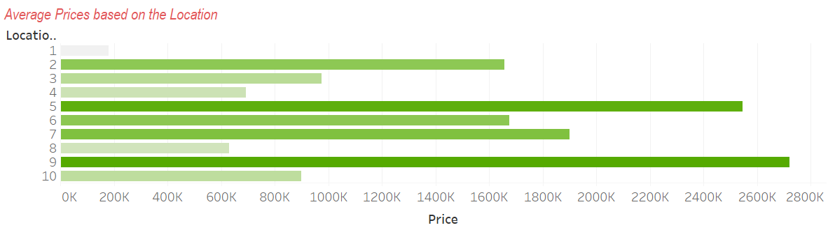
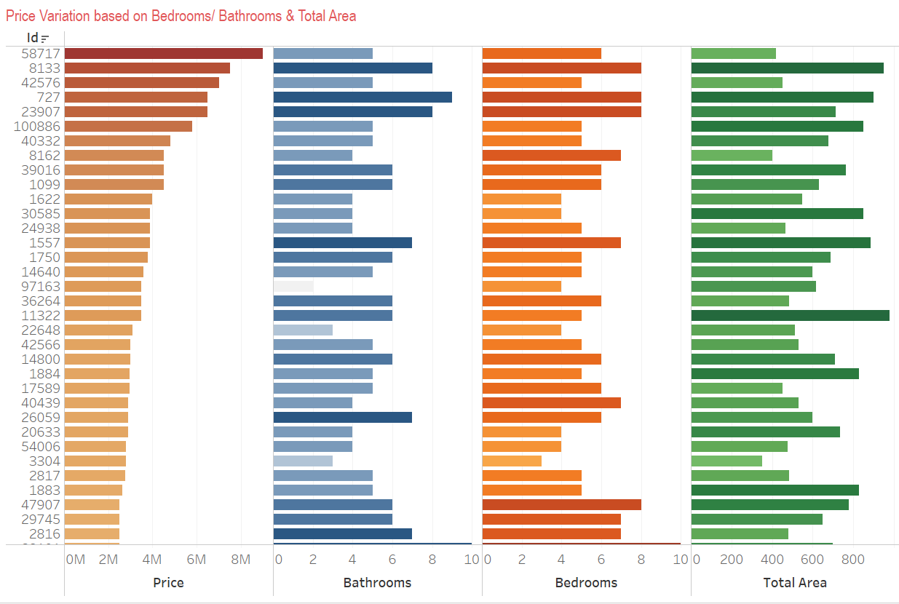
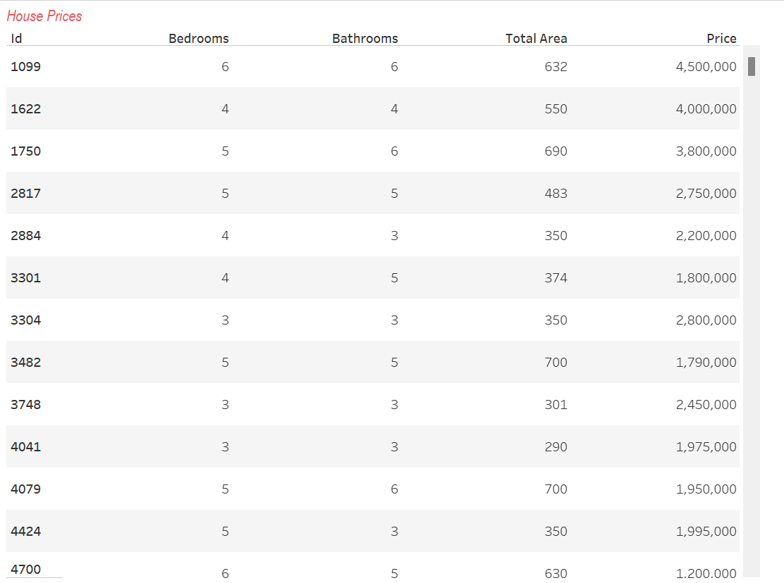
Data Visualization
Number of residences
Average prices based on the locations
Price variation based on the bedrooms, bathrooms and total area
Residence prices
Price based on the # of the bathrooms of the residence with the trend line
Price based on the # of the bedrooms of the residence with the trend line
Price based on the # of the total area of the residence with the trend line
Dashboard - Real Estate Insights
Average Prices Based on the Location
Price variation based on the bedrooms, bathrooms and total area
Residence prices

Slide 6
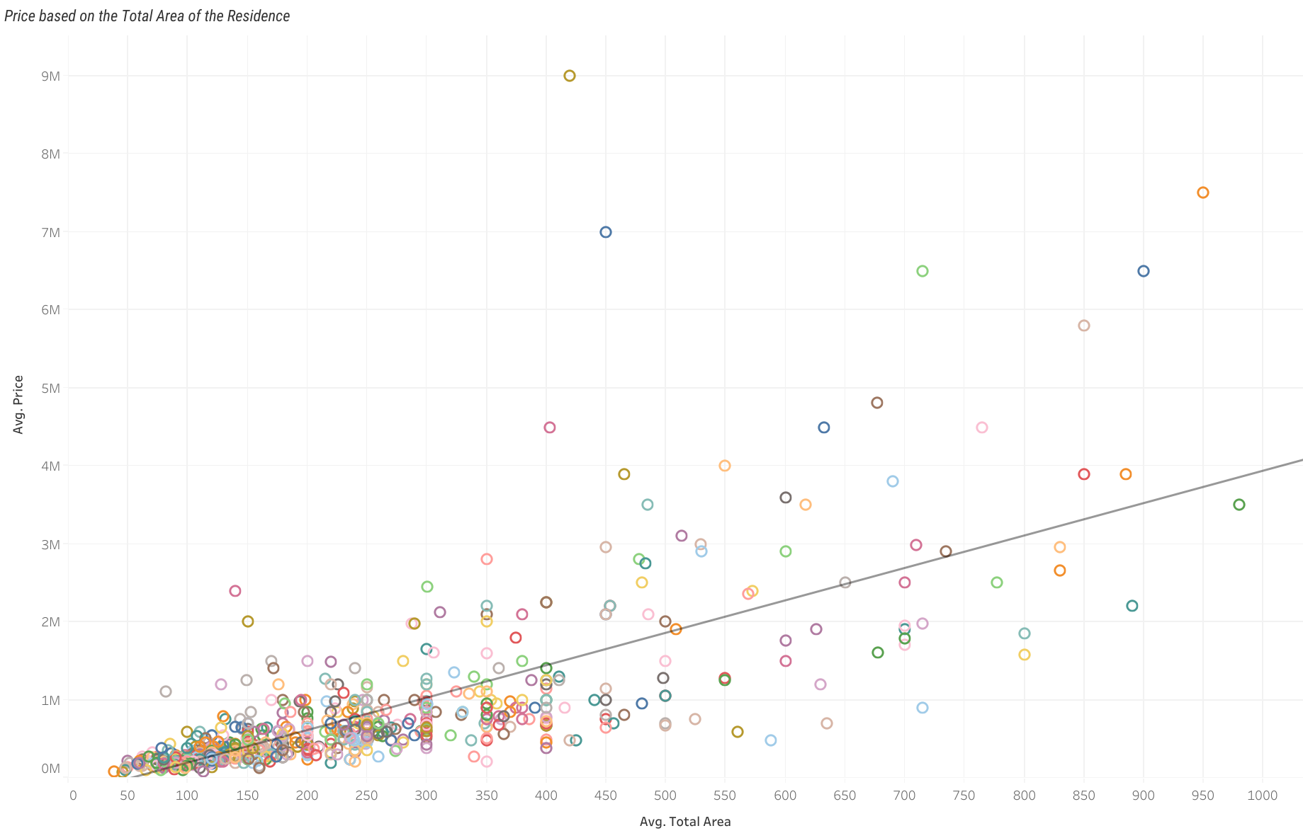
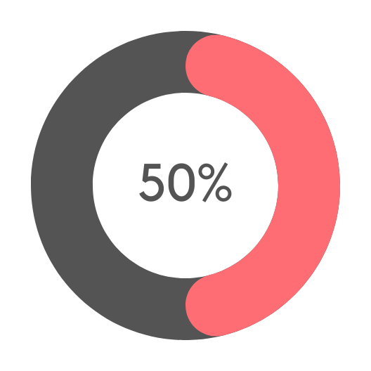

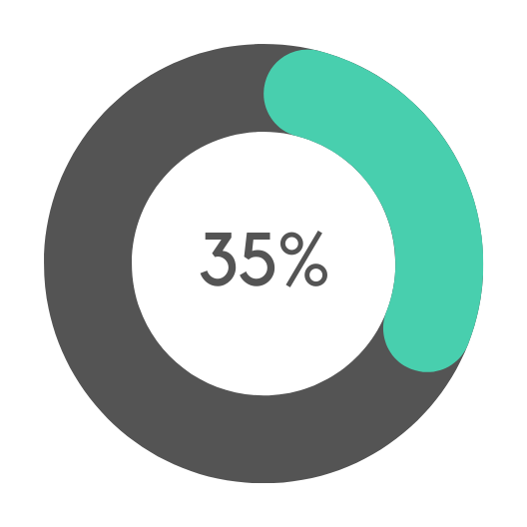
Data Visualization – Trend Line Analysis
Q1. What are the features make most influence in the price of the property?
Price based on the total area
Analysis Output
4159.35
<0.0001
27.6252
Total area Coefficient
P- Value
T-Value
150.563
0.5317
R-Squared
Standard Error

Slide 7
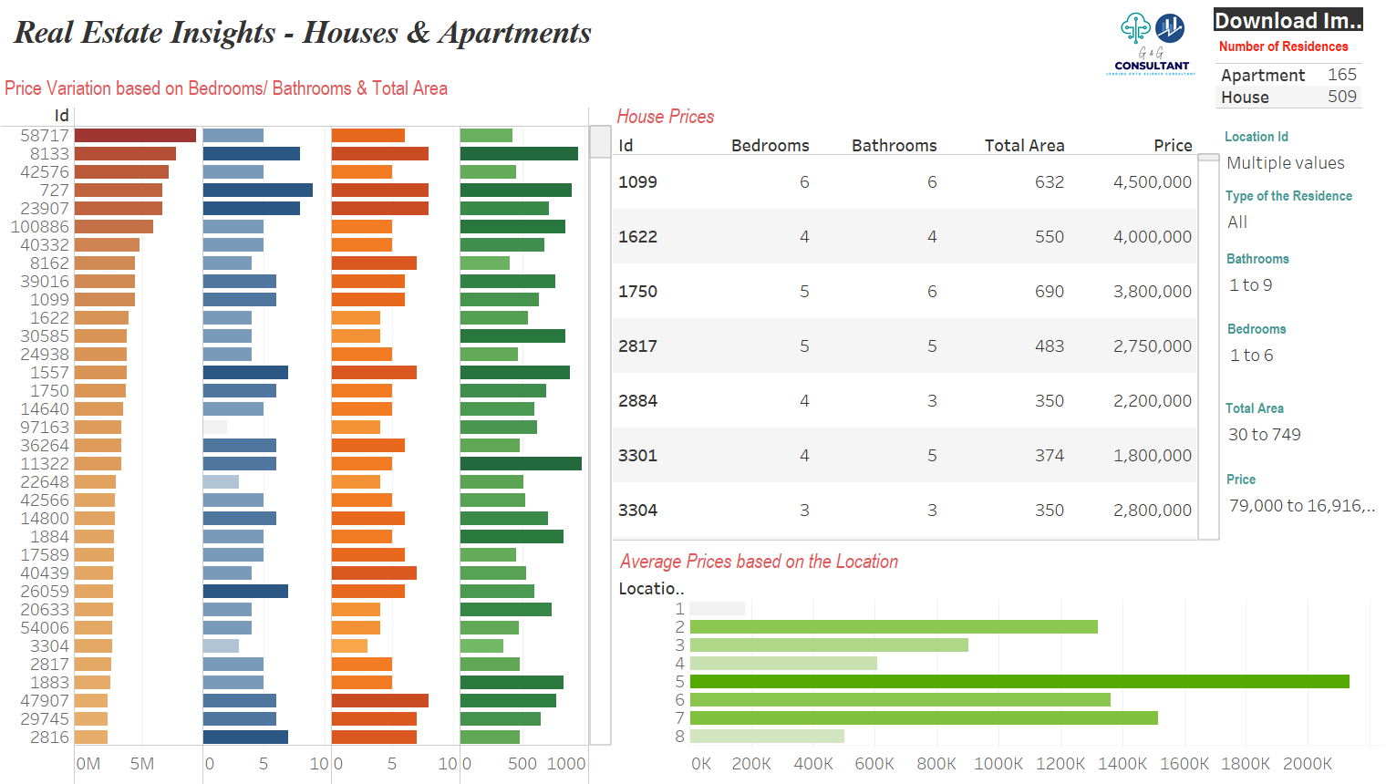
DASHBOARD - DEMO

Slide 8

CHALLENGES
Technical Challenges
Personal Challenges
Understanding dataset. Without having correct domain knowledge of the dataset it’s difficult to come up with solution and make decisions.
Data Cleaning and Preparation
Feature Selection
1
2
Difficult to understand some column values. Providing more details would be helpful.
Dashboard Design
Visualization Challengers
Technical Barriers - Some technical concepts are unfamiliar, and new techniques are frequently introduced.
3
Technical
Issues

Slide 9
PROJECT INSIGHTS
Dashboard supports customers to find the property with their budget range and specific requirements without help of business expertize
1
2
Tableau is one of the best tool that user can visualize their analysis and helps to make decision correctly
In Data analytic world Python and it’s libraries are playing major role. It supports to make data accurate and precise
3

Slide 10
THANK YOU

