Slide 1
INDUSTRIAL TRAINING • HIGHER DIPLOMA IN SOFTWARE ENGINEERING
KNW PRO
Realtor
Design and implementation of a property trading and legal advisory platform

Slide 2
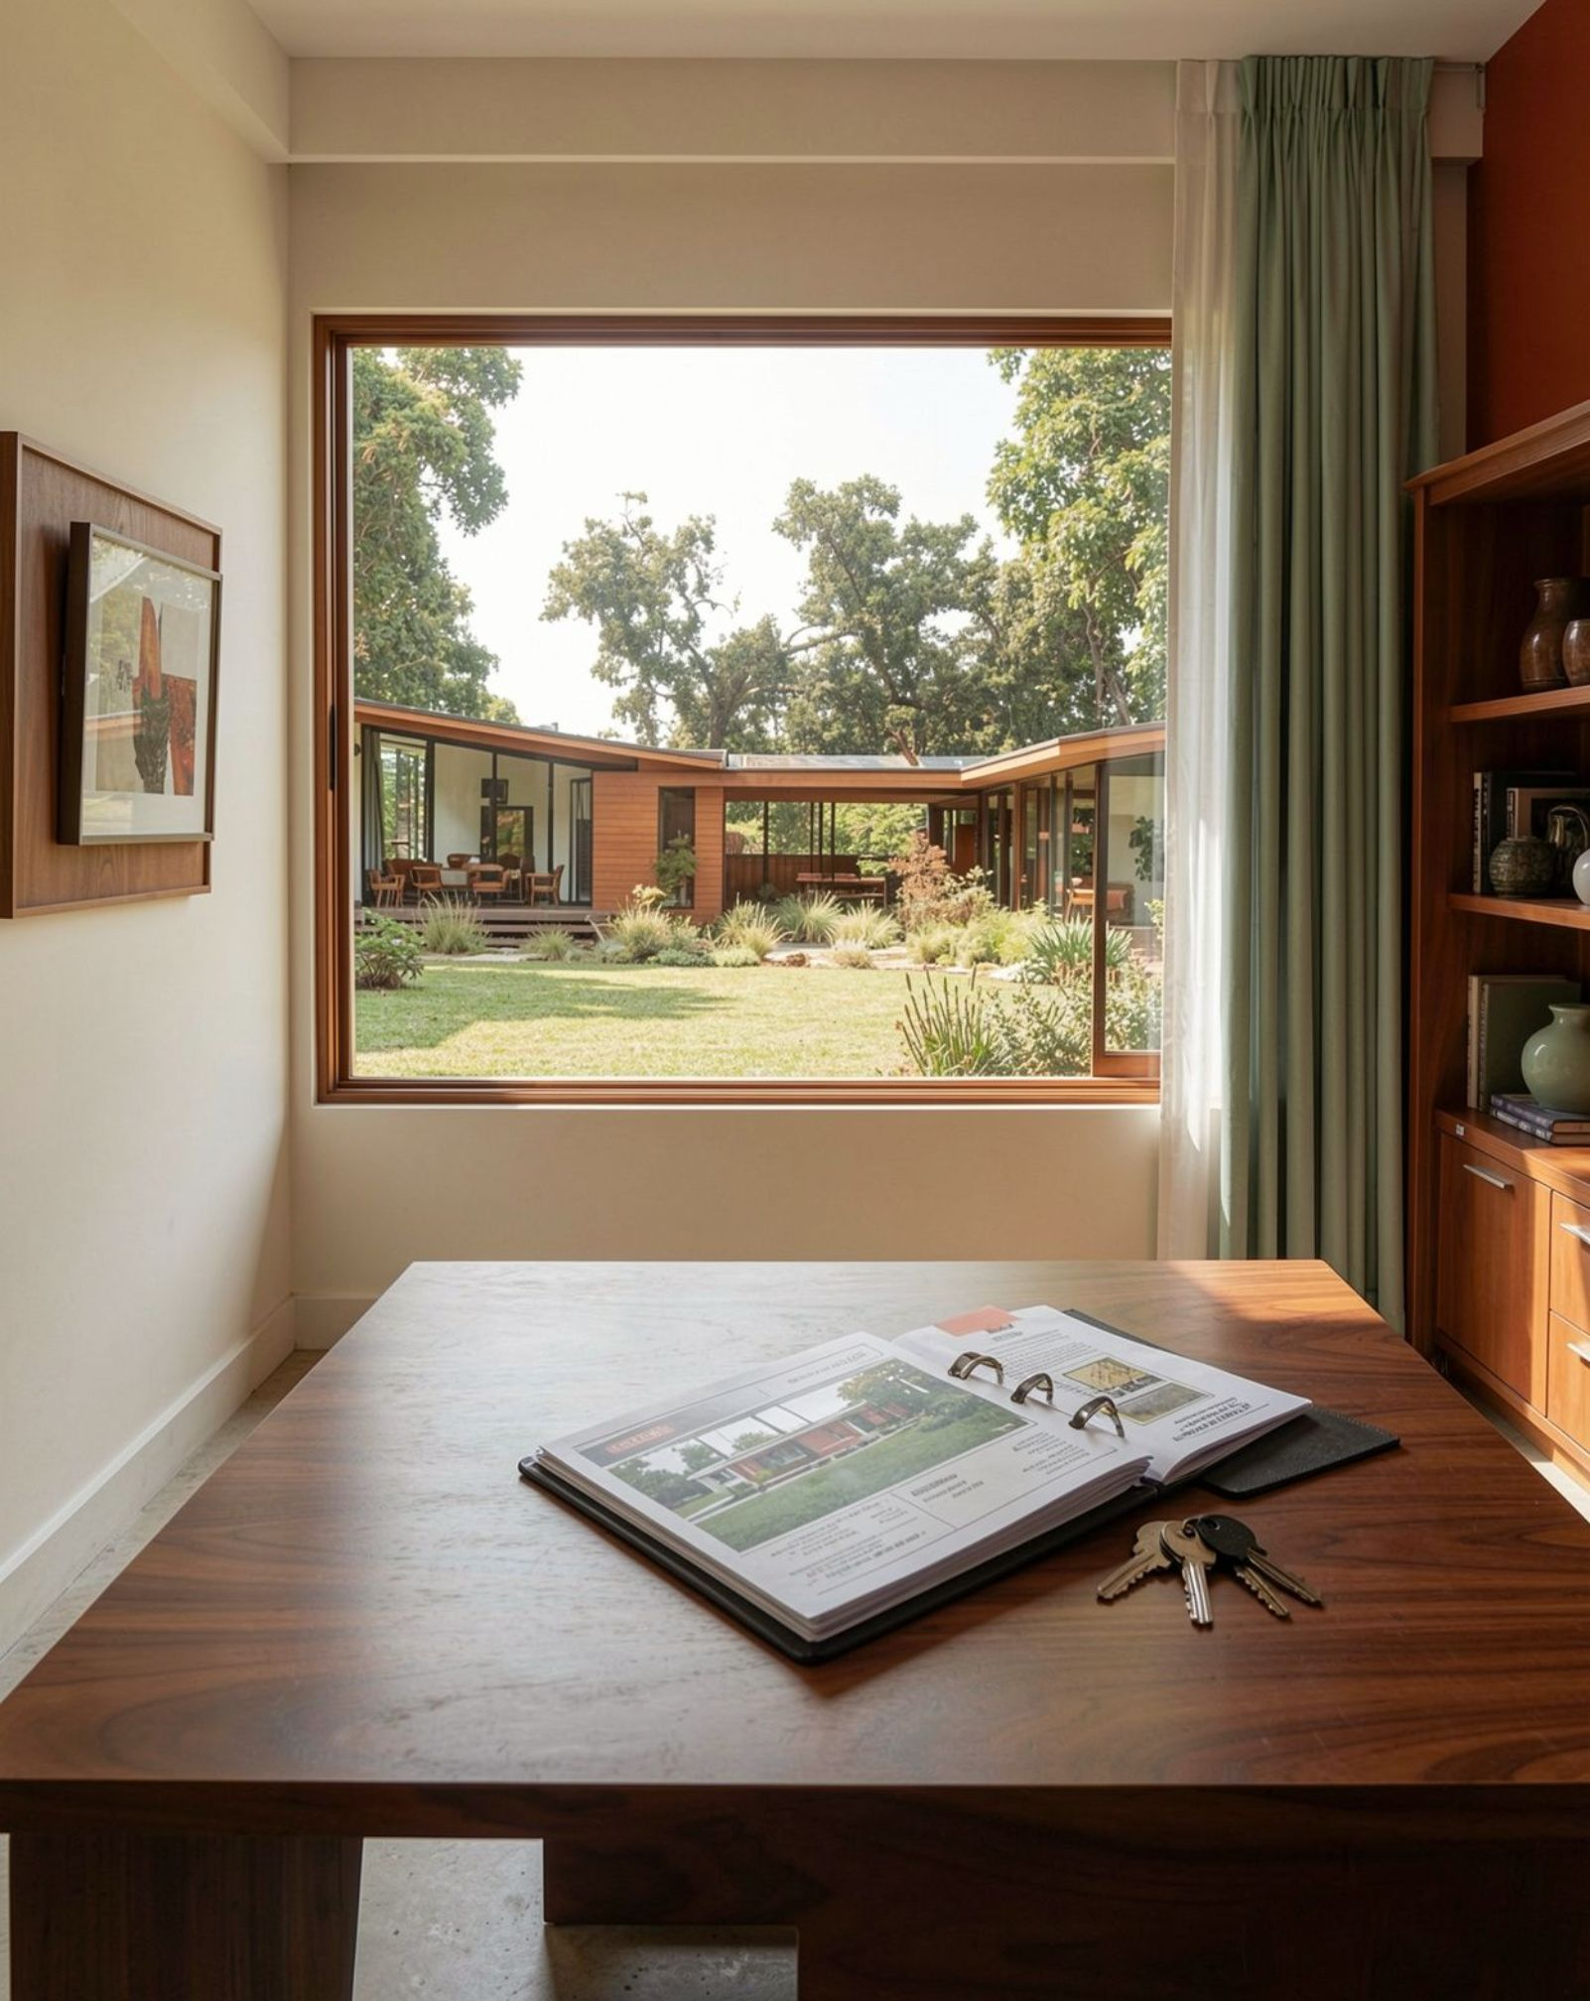
THE CONTEXT
From fragmented property deals to one trusted platform
Connect buyers, sellers, administrators, and registered legal practitioners.
Reduce manual coordination, opaque listings, and unverified property documents.
Training context: KNW PRO Realtor (Pvt) Ltd, Colombo.
KNW PRO Realtor
2

Slide 3

THE AIM
The project aims to make property transactions safer and simpler
Digitize property discovery, seller onboarding, legal review, and buyer engagement.
KNW PRO Realtor
3

Slide 4





PROJECT SCOPE
Scope: a complete property journey
Register
Prepare
Govern
Register and authenticate users.
Apply to sell, submit property details, upload documents, and choose listing plans.
Review, verify, publish, and monitor activity through administration.
Discover
Connect
Search, filter, shortlist, and review property dossiers.
Book site inspections or legal consultations.
KNW PRO Realtor
4

Slide 5
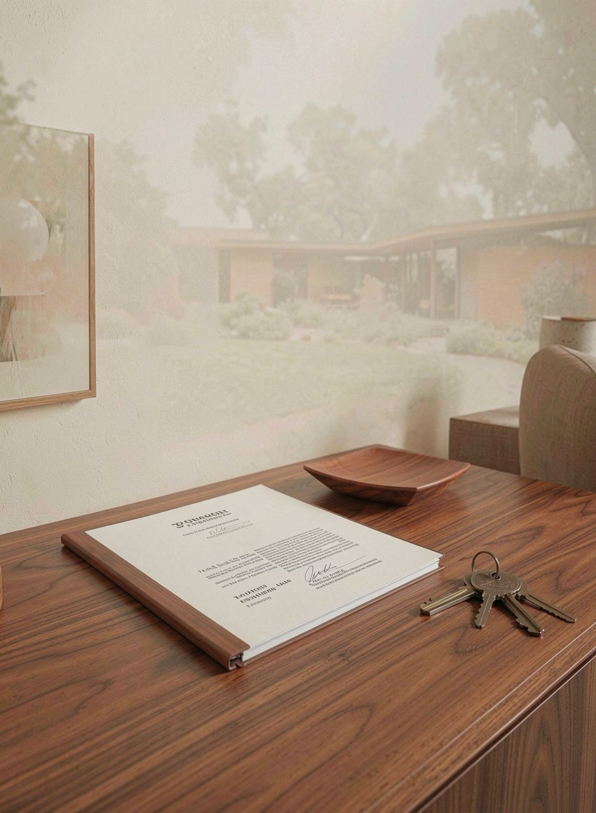
BOUNDARIES
Out of scope for this training project
These remain professional, regulatory, or future-extension concerns.
Professional judgment
Replacing licensed attorneys or issuing final legal opinions.
Automated legal validity decisions without human review.
Regulatory execution
Property ownership transfer, land registry execution, or payment settlement.
Full native mobile apps, OCR identity extraction, and real-time WebSocket messaging.
KNW PRO Realtor
5

Slide 6
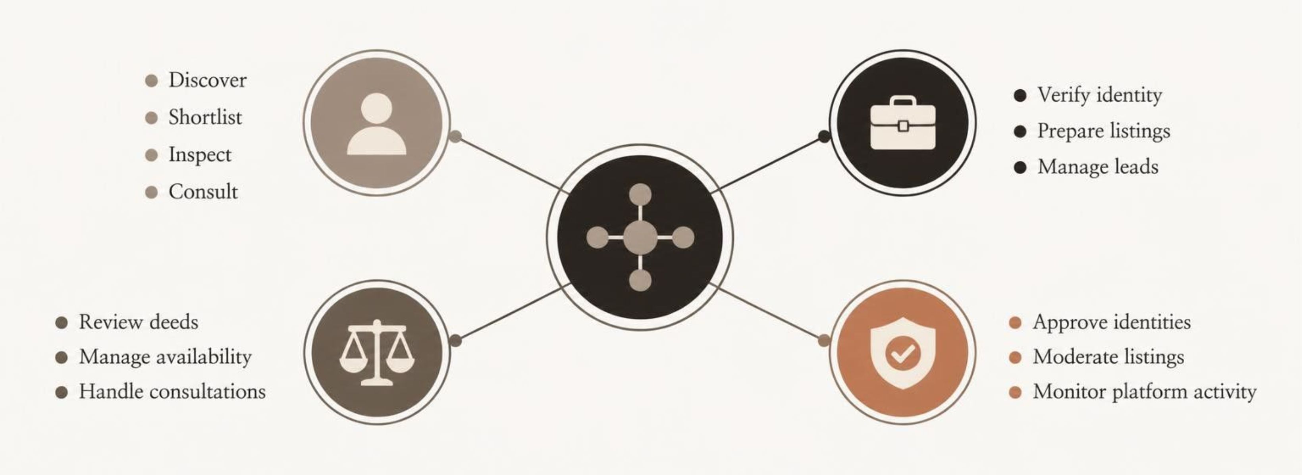
STAKEHOLDERS
One platform, four stakeholder views
KNW PRO Realtor
6

Slide 7

FUNCTIONAL REQUIREMENTS
Functional requirements follow the real user journey
Account Creation
Role & Workspace
Listing Intake
Search & Verify
KNW PRO Realtor
7

Slide 8
QUALITY ATTRIBUTES
Non-functional requirements protect trust
Security
Maintainability
Bcrypt password hashing, private identity-document storage, and permission gates.
Decoupled frontend and backend, MVC organization, REST APIs, and migrations.
Usability
Performance
Responsive layouts, reactive state, multilingual and multi-currency support.
Indexed property searches and independently scalable client/server tiers.
KNW PRO Realtor
8

Slide 9
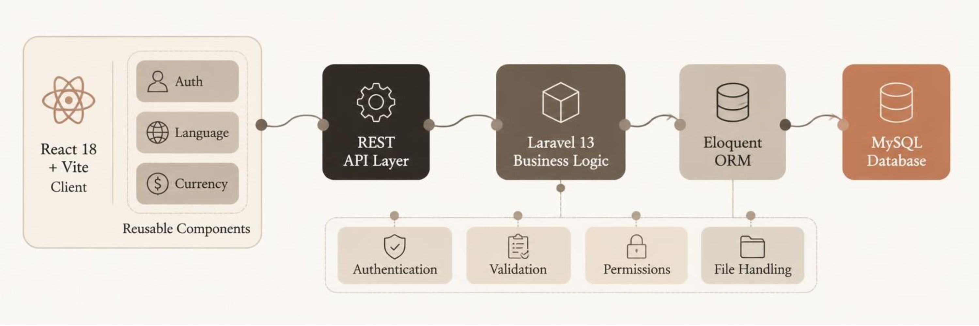
TECHNICAL DESIGN
Decoupled architecture keeps responsibilities clear
KNW PRO Realtor
9

Slide 10
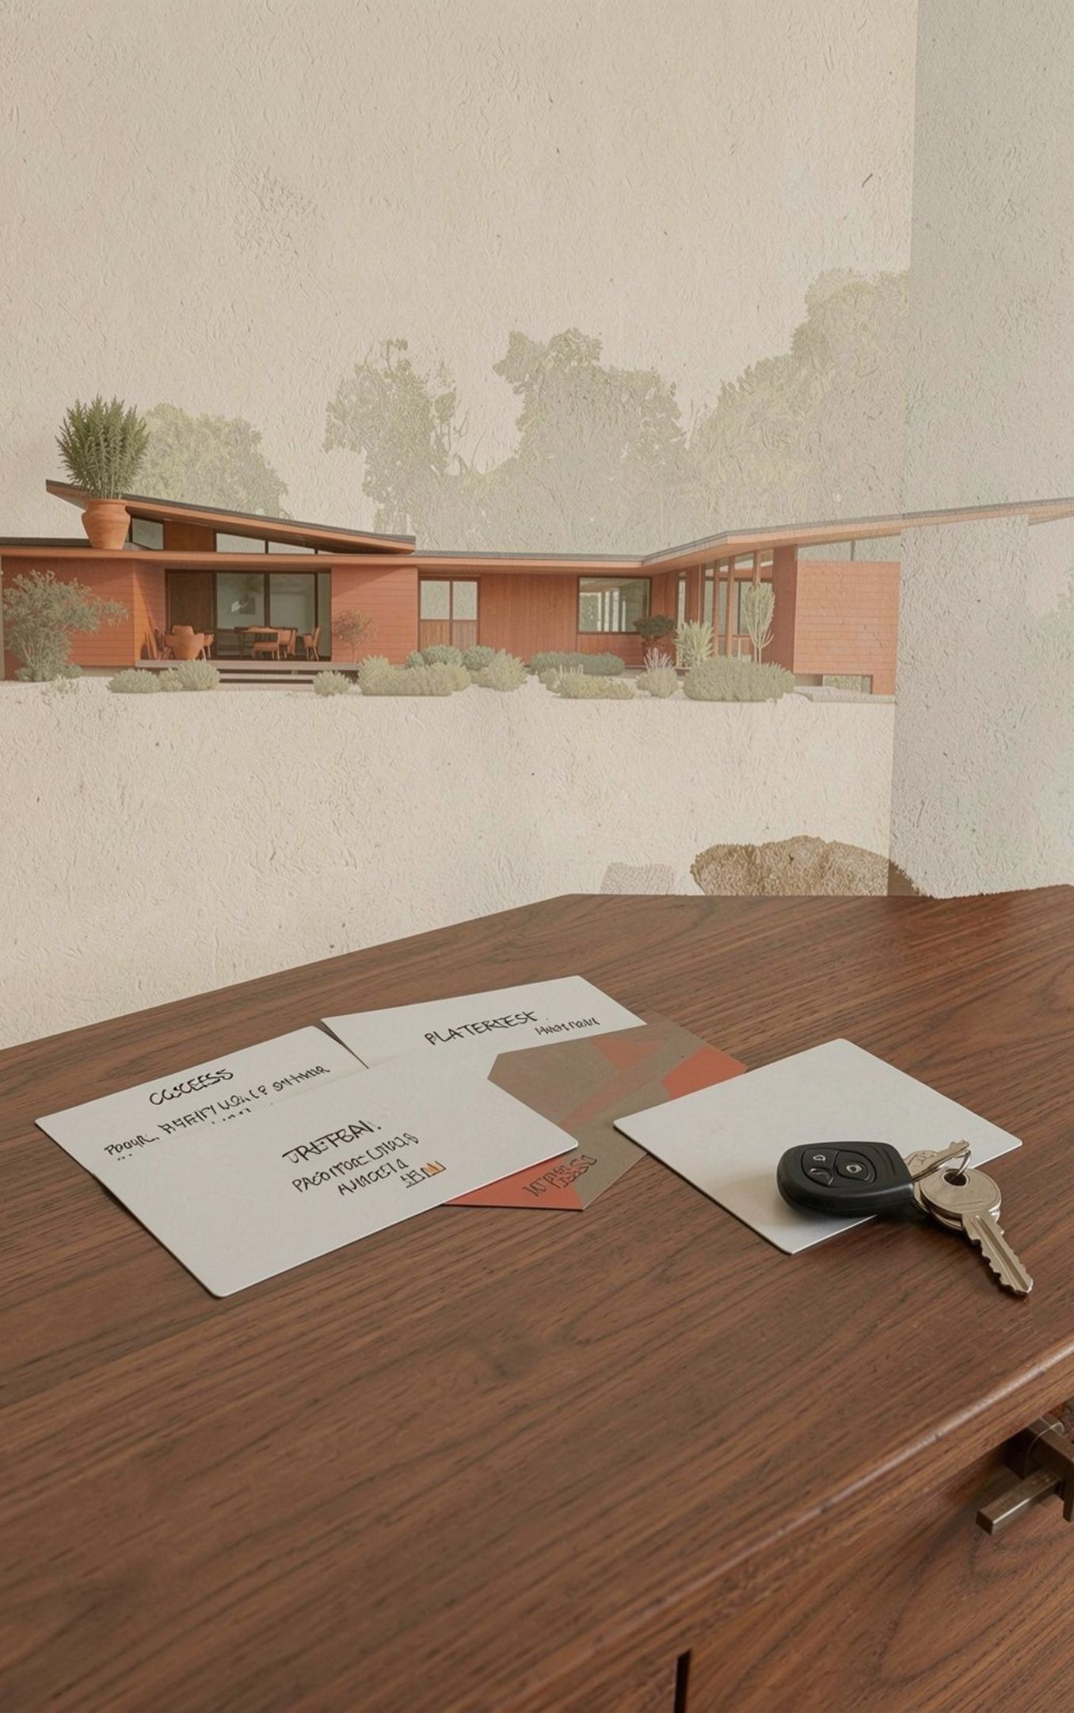
IDENTITY WORKFLOW
Role switching removes a costly account barrier
A user starts with buyer access.
The user submits seller details and NIC documents.
Administration reviews the application.
Approved users switch between Buyer Mode, Seller Mode, and Lawyer Mode from one account.
Separate accounts become one unified identity.

Slide 11
REQUIREMENTS SPECIFICATION
Detailed Functional Requirements by Stakeholder Role
Property Buyer
• FR-B1 Property Discovery
District, property type & price filtering with instant search index.
• FR-B2 Deed Verification
Check 'KNW Certified Deed Verified' badge and legal summary dossier.
• FR-B3 Financial Tools
Mortgage amortization & stamp duty payment calculations.
• FR-B4 Physical Site Visits
Schedule in-person inspection dates and track confirmation.
• FR-B5 Legal Consultation
Browse attorneys, view available calendar slots & book video advice.
Property Seller
• FR-S1 In-Place Verification
Submit Phone, Address & NIC document without re-registering.
• FR-S2 Listing Creation
Multi-step draft intake capturing coordinates, features & price.
• FR-S3 Legal Uploads
Securely upload Title Deeds, Survey Plans & Local Council docs.
• FR-S4 Monetization Tiers
Basic, Verified, and Featured listing plans via PayHere gateway.
• FR-S5 Inquiry Handling
Respond to buyer inquiries and manage site visit bookings.
Real Estate Lawyer
• FR-L1 Profile & Fees
Manage bar credentials, hourly rates, bio, and languages.
• FR-L2 Availability Slots
Define weekly consultation schedule & block holiday dates.
• FR-L3 Deed Review Queue
Access assigned property title deeds and survey cadastrals.
• FR-L4 Legal Clearance
Issue deed review findings and recommend verified badge.
• FR-L5 Video Consultations
Host video advisory meetings with calendar invite sync.
System Administrator
• FR-A1 Identity Governance
Audit pending seller NIC submissions; approve or reject.
• FR-A2 Listing Quality Audit
Screen property drafts and validate payment receipts/slips.
• FR-A3 Deed Badge Control
Toggle official 'KNW Certified Deed Verified' badge.
• FR-A4 Payment Audit
Oversee listing fee & lawyer consultation fee transactions.
• FR-A5 Platform Analytics
Real-time metrics: active users, revenue, and pending tasks.
KNW PRO Realtor • System Architecture & Engineering
11

Slide 12
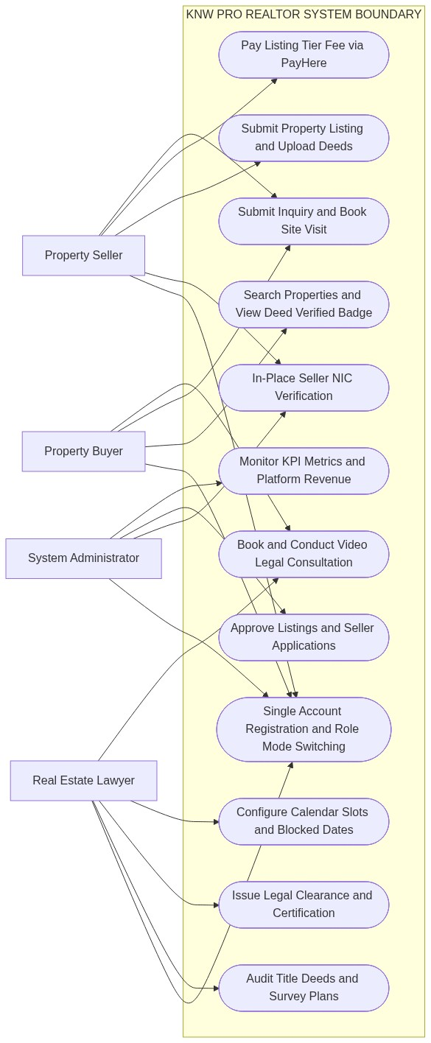
USE CASE MODELING
Unified System Use Case Architecture (All 4 Actors)
1. Unified Identity & Dynamic Role Switching
Eliminated legacy multi-account friction. Every user defaults to Property Buyer. Users activate Seller privileges in-place via NIC upload and toggle views instantly from the navbar.
2. End-to-End Property Monetization Pipeline
Sellers intake listings across districts, upload cadastral surveys and deeds, and select monetization packages (Basic, Verified, Featured) with PayHere integration.
3. LegalTech Deed Verification Workflow
Title deeds uploaded by sellers are automatically routed to licensed real estate attorneys. Once cleared, listings earn the 'KNW Certified Deed Verified' badge to eliminate fraud.
4. Administrative Governance & Trust Gates
Centralized moderation panel ensures no listing is published and no seller is approved without rigorous identity and legal document auditing.
KNW PRO Realtor • System Architecture & Engineering
12

Slide 13
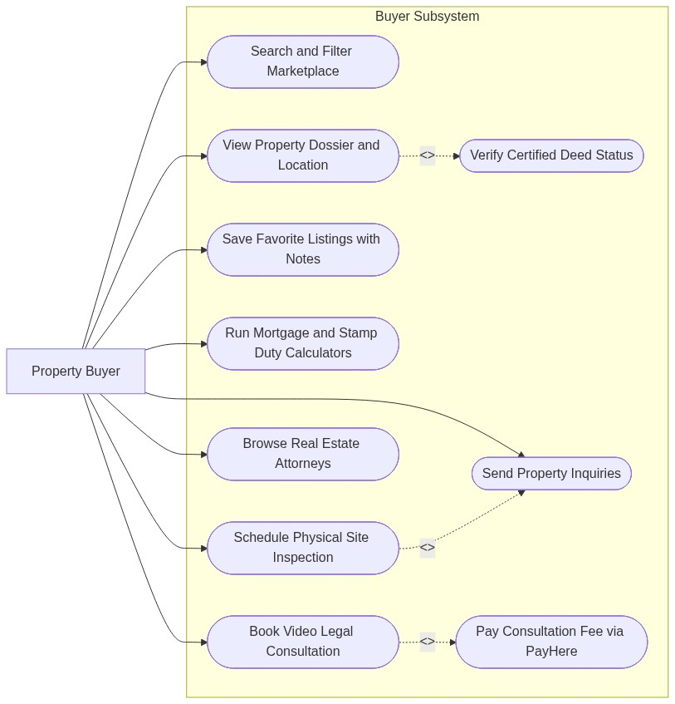
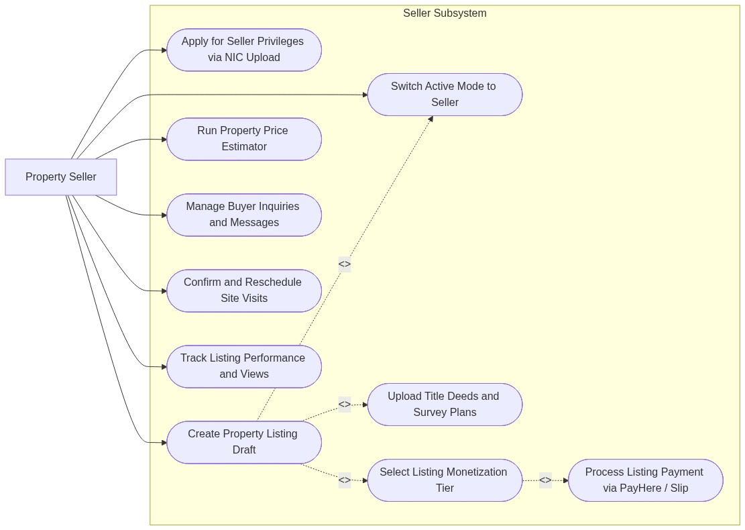
USE CASE SPECIFICATION
Stakeholder Use Cases: Property Buyer & Seller Subsystems
👤 Property Buyer Use Case Model
👤 Property Seller Use Case Model
KNW PRO Realtor • System Architecture & Engineering
13

Slide 14
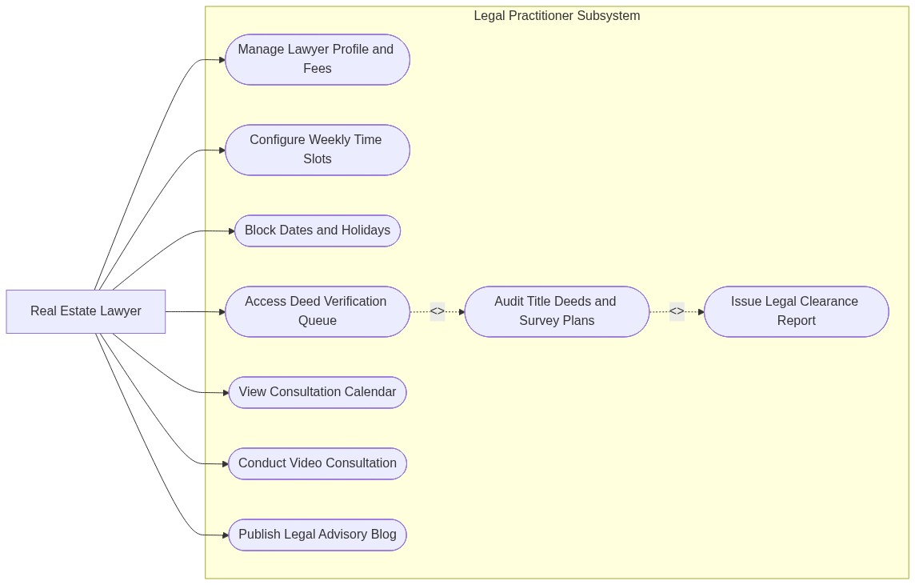
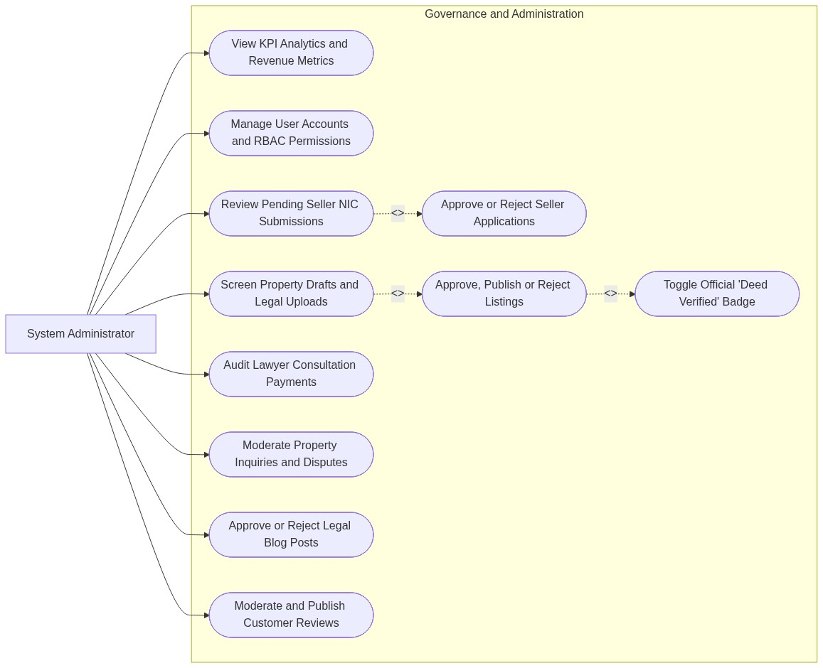
USE CASE SPECIFICATION
Stakeholder Use Cases: Real Estate Lawyer & Administrator
⚖️ Real Estate Lawyer Use Case Model
🛡️ System Administrator Use Case Model
KNW PRO Realtor • System Architecture & Engineering
14

Slide 15
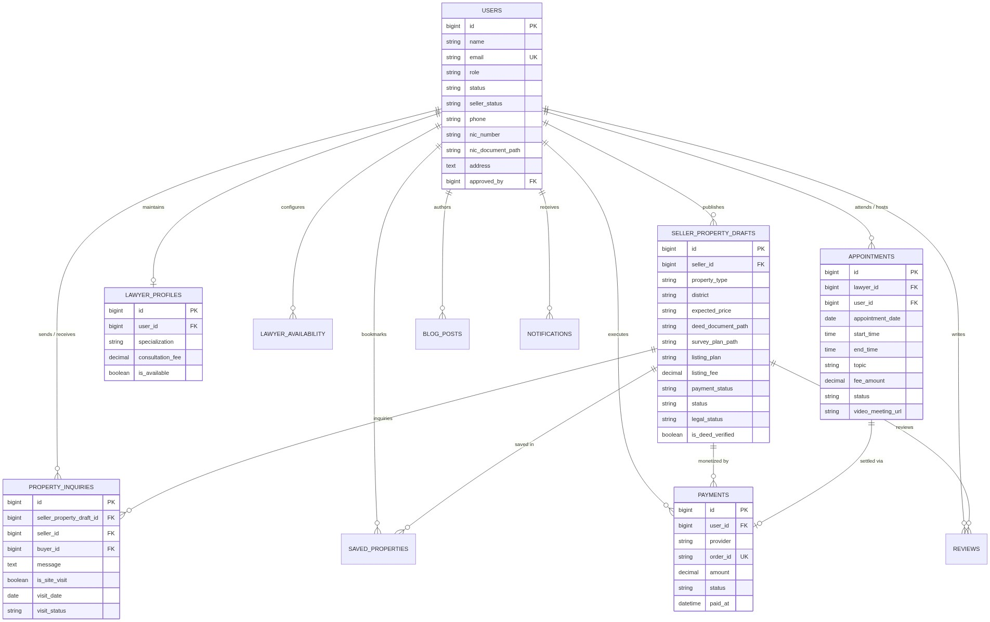
DATABASE ARCHITECTURE
Relational Database Schema (Entity-Relationship Diagram)
KNW PRO Realtor • System Architecture & Engineering
15

Slide 16
Challenges Faced During Development
Multi-RolMulti-Role Access Control
Managing separate permissions for buyers, sellers, lawyers, and administrators.
Property Search and Listings
Implementing accurate search filters and reliable property information management.
Legal Verification
Handling property documents and supporting lawyer-led verification workflows.
Backend and Database Integration
Connecting React.js, Laravel, and MySQL while maintaining data consistency.
Security and Usability
Protecting sensitive information and delivering a responsive interface for all users.
e Access Control
Managing separate permissions for buyers, sellers, lawyers, and administrators.
Property Search and Listings
Implementing accurate search filters and reliable property information management.
Legal Verification
Handling property documents and supporting lawyer-led verification workflows.
Backend and Database Integration
Connecting React.js, Laravel, and MySQL while maintaining data consistency.
Security and Usability
Protecting sensitive information and delivering a responsive interface for all users.
Multi Role Access control
Solved cross-role registration friction. Users operate seamlessly across Buyer, Seller, and Lawyer modes under one email address, with reactive Context API state synchronization.
Dealing With Government Laws AND Regulations
Difficulty of dealing and make some dissitions of government rules and regulations and acts some of them are I study have to study adding features to this whthout having basuc knowledge of that cant do
Enterprise REST API Architecture
Engineered with PHP 8.4 and Laravel 13, incorporating Bcrypt security, Eloquent ORM relations, private storage isolation, and modular controllers.
Security and usability issues
Protecting sensitive details and dealing with personal and legal details with the users
KNW PRO Realtor • System Architecture & Engineering
16

Slide 17
CONCLUSION & EVALUATION
Key Engineering Achievements & Aknowledgement
Academic Mentors: Profound gratitude to Lanka Nippon BizTech Institute, faculty members, and internal supervisors.
• Host Organization: Heartfelt thanks to KNW PRO Realtor (Private) Limited management, external superviors, and engineering colleagues.
• Open for Questions: Thank you for your time, attention, and guidance. I welcome questions from the evaluation panel.
Production-Ready Platform: Successfully built and deployed the full-stack KNW PRO Realtor real estate and legal clearance platform.
• Academic Fulfillment: 100% fulfilled the industrial training curriculum requirements for the Higher Diploma in Software Engineering at LNBTI.
• Commercial Impact: Delivered a fraud-resilient property ecosystem with seamless single-account role switching.
Sincere Acknowledgements
• Academic Mentors: Profound gratitude to Lanka
Nippon BizTech Institute, faculty members, and
internal supervisors.
• Host Organization: Heartfelt thanks to KNW PRO
Realtor (Private) Limited management, external
supervisors
• Open for Questions: Thank you for your time,
attention, and guidance.
I welcome questions from the evaluation panel.
KNW PRO Realtor • System Architecture & Engineering
17

