Slide 1

FollowMe 3W Management System
P.K. Vimarshana (E005170)

Slide 2
Project Overview
FollowMe is a web-based 3W (What, When, Who) task management system.
It improves communication, transparency, and accountability across departments.
Target users: Organizational Staff and Management.
Built using Laravel, MySQL, PHP Mailer.
LDAP integration supports enterprise user access.

Slide 3
Problem Statement
Current systems lack transparency and coordination in task tracking.
No centralized view of responsibilities.
Communication gaps among departments.
Difficulty in managing task timelines and ownership.

Slide 4
Project Aim
To design and develop a scalable, web-based 3W Management System.
enable structured monitoring of tasks, responsibilities, and timelines across departments.

Slide 5
Objective
Study current task management practices.
Identify inefficiencies and gaps.
Design a 3W-centric solution
Enable 3W updates, resource uploads, and notifications
Deliver a user-friendly, maintainable system

Slide 6
What is 3W?
3W = What, When, Who
WHAT: Task Description
WHEN: Due or Completion Date
WHO: Responsible Person
Used to track accountability, timelines, and ownership in teams

Slide 7
Key Features
✔ Department-wise and user-wise task tracking
✔ Real-time updates of 3W entries
✔ Upload related resources
✔ Email and system notifications
✔ Role-based access control
✔ Performance tracking and reporting

Slide 8
Technology Stack
Layer | Technology
Backend | Laravel (PHP)
Frontend | Vue.js, HTML, CSS
Database | MySQL
Authentication | Active Directory
Deployment | Docker

Slide 9
Methodology
- Agile
- Requirements Analysis
- System Design
- Backend/API Development
- Prototype UI (HTML/CSS)
- Testing and Feedback Loops

Slide 10
System Architecture
Presentation Layer: HTML/CSS (Vue.js planned)
Business Logic Layer: Laravel (REST APIs)
Data Access Layer: Repositories, Models
Database Layer: MySQL
Auth Layer: LDAP / Active Directory

Slide 11
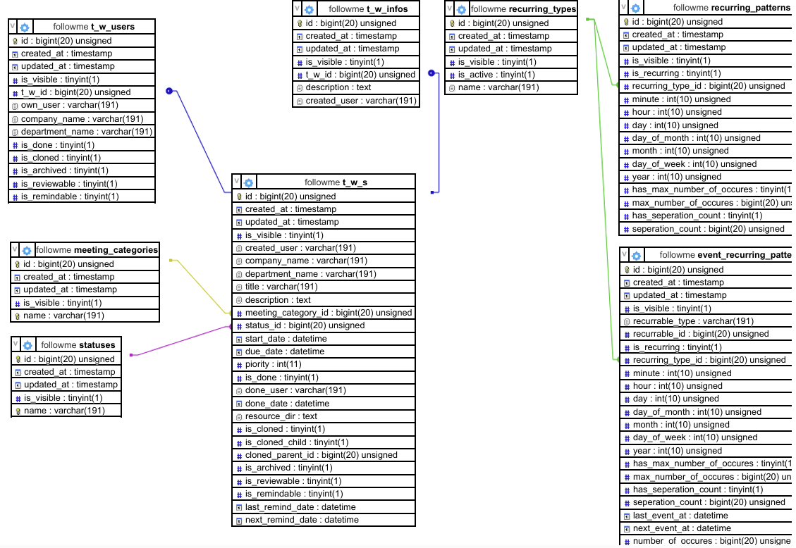
ER DIAGRAM

Slide 12
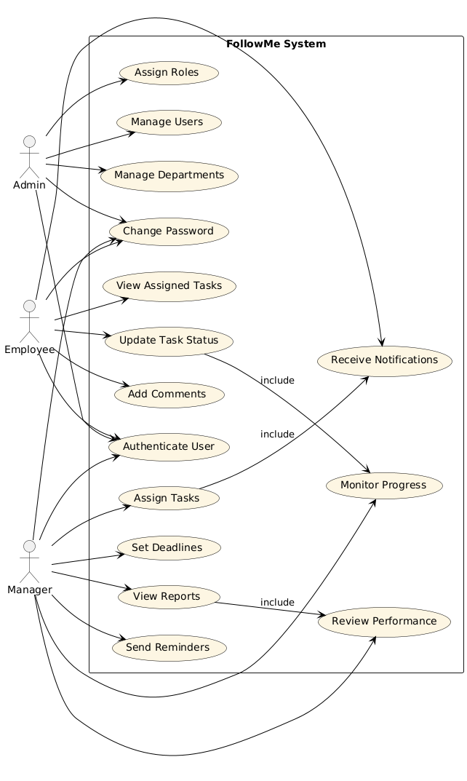
USE CASE

Slide 13
Future Improvements
- Full Vue.js frontend
- Real-time dashboards & analytics (Power BI)
- CI/CD with GitHub Actions
- Docker-based deployment
- Mobile app version

Slide 14
Conclusion
FollowMe offers a centralized, scalable 3W task tracking system.
Enhancing accountability and collaboration across departments.

Slide 15

Thank You

