Slide 1
SOC Design and Verification
By J.J.N.D Harshitha
Kasura Technologies Private Limited

Slide 2
contents
Introduction
SoC componets
SoC Design Process
SoC challenges
How SoC is verified
Conclusion

Slide 3
Introduction
A system on a chip, also known as an SoC, is essentially an integrated circuit or an IC that takes a single platform and integrates an entire electronic or computer system onto it. It is, exactly as its name suggests, an entire system on a single chip. The components that an SoC generally looks to incorporate within itself include a central processing unit, input and output ports, internal memory, as well as analog input and output blocks among other things. Depending on the kind of system that has been reduced to the size of a chip, it can perform a variety of functions including signal processing, wireless communication, artificial intelligence and more.

Slide 4
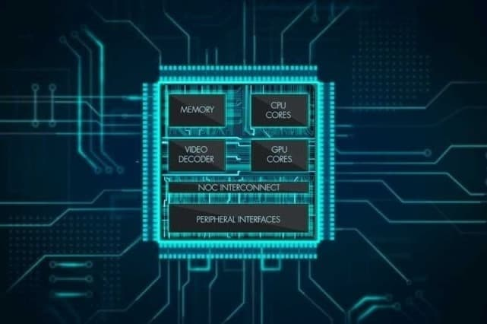

Slide 5
SoC Usually includes
Programmable processor(s)
Memory
Accelerating function units
Input/output interfaces
Software
Re-usable intellectual property blocks (HW + SW)

Slide 6
SoC Design Process
Customer requirements
System specification
Architecture design
Hardware vs. software
Component design
Integration
Verification
Manufacture
Test

Slide 7
SoC Challenges
SoC Designs
More complex, more functions, higher gate counts
Faster, cheaper, smaller
More reliable
How to handle complexity?
System design at multiple abstraction levels
Integration of heterogeneous technologies & tools
Signal integrity & timing
Power management
SoC test methodology

Slide 8
How SoC Verified
Verification of huge chips (> 80 mm2 in 28 nm!) with dozens of cores and hundreds of IP's is a mind-numbing task. So, you may wonder - how do these engineers do it ? Well, the answer is that no-one starts building from scratch. For instance, if some-one wanted to develop a C++ program, the best place to start would be from Qt, which is an application framework. In a similar way, SoC's are usually verified using legacy, flexible testbench structures that have been in use and improved upon over many years and have the ability to re-use a lot of the verification components. Such testbenches also have the flexibility to plug in Verification IP's (Intellectual Property) to aid in faster completion of projects. Such IP's are bought or licensed by these semiconductors firms and used in their testbench structures to verify specific design elements. An example would be Synopsys's AMBA VIPs, to verify AXI/AHB protocols used within the design.

Slide 9
Conclusion
SoC design requires different design approach than traditional ASICs
More modeling & simulation at higher abstraction levels
Heavy use of IP, re-usable modules, platform-based design
SoC design team must work with IP vendor and foundry
Use platform design & standard interfaces between IP
Hardware/software co-design
Many design challenges

Slide 10


