Slide 1
I2C bus
Inter Integrated circuit bus
By Partha Pratim Dey

Slide 2
History
•
When connecting multiple devices to a microcontroller, the address and data lines of each device were conventionally connected individually. This would take up precious pins on the microcontroller, result in a lot of traces on the PCB, and require more components to connect everything together. This made these systems expensive to produce and susceptible to interference and noise.
•
To solve this problem, Philips developed Inter-IC bus, or I2C, in the 1980s. I2C is a low-bandwidth, short distance protocol for on board communications. All devices are connected through two wires: serial data (SDA) and serial clock (SCL).

Slide 3
Overview
◆
Used for moving data simply and quickly from one device to another
Serial Interface Synchronous Bidirectional
◆
◆
◆

Slide 4
Overview
◆
I2C is a Synchronous protocol
➢
➢
The data is clocked along with a clock signal(SCL).
The clock signal controls when data is changed and when it should be read.
Since I2C is synchronous, the clock rate can vary, unlike asynchronous (RS-232 style) communications.
➢

Slide 5
Overview
◆
I2C is a Master-Slave protocol
➢
➢
The Master device controls the clock (SCL).
The slave devices may hold the clock low to prevent data transfer.
No data is transferred unless a clock signal is present. All slaves are controlled by the master clock
➢
➢

Slide 6
Overview
◆
I2C is a Bidirectional protocol
➢
Data is sent either direction on the serial data line (SDA) by the master or slave.

Slide 7
Overview
◆
I2C is a Serial Interface of only two signals:
❑
SDA Serial Data
This line transfers data to or from the master.
❑
SCL Serial Clock
This controls when data is sent and when it is read. The master controls SCK.

Slide 8
Features
I2C has many important features worth mentioning
•
It supports multiple data speeds:
standard (100 kbps)
fast (400 kbps)
high speed (3.4 Mbps) communications.
•
•
•
•
•
•
•
•
•
Built in collision detection
7 bit or 10-bit unique Addressing
Multi-master support (arbitration) Data broadcast (general call). two-wired bus
data transfers: serial, 8-bit oriented, bi-directional
master/slave relationships with multi-master option (arbitration) master can operate as transmitter or receiver
device count limit: max. capacitance 400 pF

Slide 9
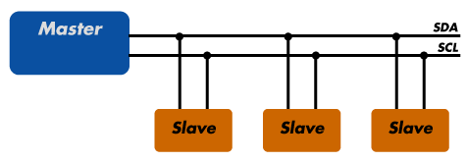
Sample I2C implementation
•
Regardless of how many slave units are attached to the I2C bus, there are only two signals connected to all of them
All devices must have a unique address to identify it on the bus.
Slave devices have a predefined address, but the lower bits of the address can be assigned to allow for multiples of the same devices on the bus.
•
•

Slide 10

Theory of operation
I2C has a master/slave protocol. The master initiates the communication. The sequence of events are
1.
The Master device issues a start condition. This condition informs all the slave devices to listen on the serial data line for instructions.
The Master device sends the address of the target slave device and a read/write flag.
The Slave device with the matching address responds with an acknowledgement signal .
2.
3.
4.
Communication proceeds between the Master and the
Slave on the data bus. Both the master and slave can
receive or transmit data depending on whether the communication is a read or write. The transmitter sends 8- bits of data to the receiver which replies with a 1-bit acknowledgment
When the communication is complete, the master issues a stop condition indicating that everything is done
5.

Slide 11
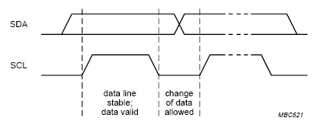
Standard Mode Wires And Signal
◆ Two-wired bus
serial data line (SDA)
serial clock line (SCL)
Voltage levels
HIGH 1
LOW 0
not fixed, depends on associated level of voltage
Bit transfer (level triggered)
SCL = 1 SDA = valid data
one clock pulse per data bit
stable data during high clocks
data change during clocks low

Slide 12
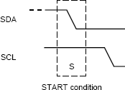
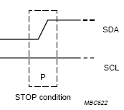
Frame
start condition (S)
– SDA 10 transition when SCL = 1
stop condition (P)
– SDA 01 transition when SCL = 1
repeated start (Sr)
– start is generated instead of stop
bus state
busy … after S and before next P
free … after P and before next S

Slide 13
Masters and Slaves
Master device
controls the SCL
starts and stops data transfer
controls addressing of other devices
Slave device
device addressed by master
Transmitter/Receiver
master or slave
master-transmitter sends data to slave-recevier
master-receiver requires data from slave-transmitter

Slide 14
Data Transfer
data bits are transferred after start condition
transmission is byte oriented
byte = 8 bits + one acknowledge bit
most significant bit (MSB) first
slave address is also datum
first byte transferred
during the first byte transfer: master is transmitter
addressed slave is receiver
next bytes: depends on the last bit in address byte

Slide 15


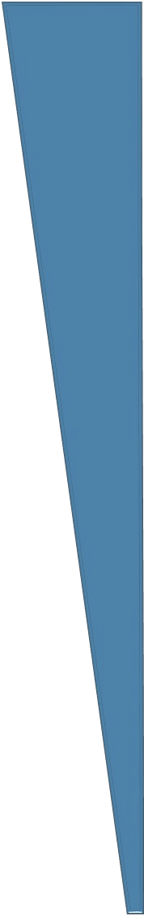
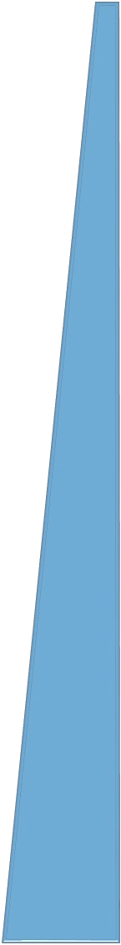

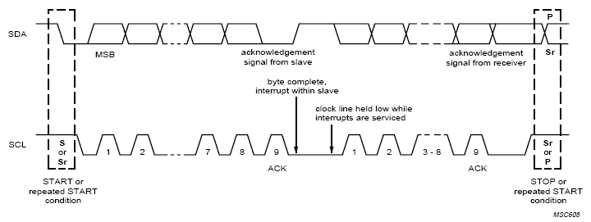



Data Transfer - SCL
master sets SCL = 0 and generates pulse for each data bit
8 pulses for data bits are followed by one pulse for ack. bit
after ack.
master tries to generate next byte’s first pulse
slave can hold SCL low master switches to wait state

Slide 16
Data Transfer - SDA
data bits are generated by transmitter as SCL pulses
9-th pulse:
transmitter releases SDA
receiver must hold SDA low in order to ack. received data
slave must release SDA after ack. bit (allows master to end frame)

Slide 17
Multiple Masters
◆
More bus controllers can be connected
◆
Several masters can start frame at once
◆
Synchronization needed on SCL
◆
Arbitration needed on SDA
◆
Using wired-AND connection to SCL/SDA

Slide 18
Benefits and Drawbacks
Only two wires are required
I2C is well suited for boards with many devices connected on the bus.
Reduce the cost and complexity of the circuit as additional devices are added to the system.
•
•
•
•
Due to the presence of only two wires, there is additional complexity in handling the overhead of addressing and acknowledgments .
•
This can be inefficient in simple configurations and a direct- link interface such as SPI might be preferred.

Slide 19


