Slide 1
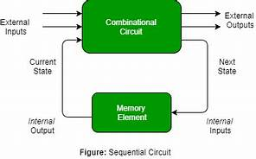
Sequential Circuits and it's Industrial Application
By : Md shakil ansari

Slide 2
CONTENTS
INTRODUCTION
WHAT A SEQUENTIAL CIRCUIT IS
IMPORTANCE OF SEQUENTIAL CIRCUITS IN DESIGNING DIGITAL SYSTEM
VARIOUS TYPES OF SEQUENTIAL CIRCUITS
LATCH
S-R LATCH
D LATCH
FLIP-FLOP
SR
JK
D
T
CONCLUSION

Slide 3
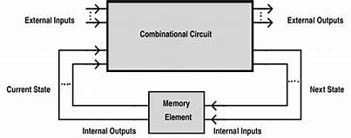
INTRODUCTION
In Digital circuit theory,Sequential circuits are those logic circuit whose output depends on not only on the presents inputs but also on the sequence of past inputs and outputs.In contrast with combinational circuit,sequential circuit has it's own state or memory.It employs memory elements like Flip-Flops in it's circuitary for it's functioning.

Slide 4
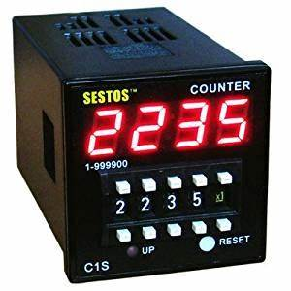
IMPORTANCE OF SEQUENTIAL CIRCUITS IN DESIGNING DIGITAL SYSTEMS
Any digital system is meant for capable of storing and processing informations .Almost all circuits in practical digital systems are a combination of both combinational and sequential circuits.Sequential circuits like flip-flops,registers,counters etc play a major role in terms of holding the state of any digital system.It is an essential part of any digital system.In short we can say that imagination of a digital system is impossible without sequential circuits.

Slide 5
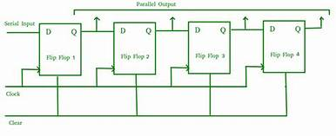
VARIOUS KINDS OF SEQUENTIAL CIRCUITS
Sequential circuits are divided into two types
Asynchronous :state of device can change at any time irrespective of clock signal. E.g- ripple counters etc
Synchronous : state of device can change only at the arrival of respective clock signal. E.g- ring counter, johnson counter etc
More specific types of sequential circuits are discussed in upcoming slides..

Slide 6
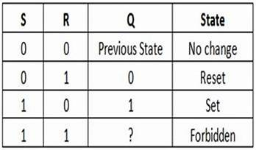
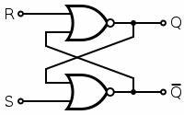
LATCH
Latches are basically fundamental memory elements in any digital system .They are capable of storing one bit of information .They are bi-stable in nature .Latches are actually un-clocked flip-flops.
Latches operate with Enable signal which are Level-sensitive.
Few types of Latches are discussed here...
S-R Latch using NOR Gate: S-R Latch is also called set-reset latch .It works when it's Enable input is HIGH.
Drawback
Circuit Diagramme
Truth Table

Slide 7
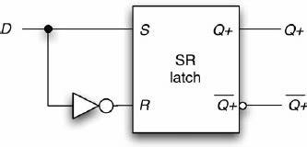
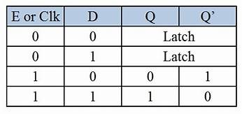
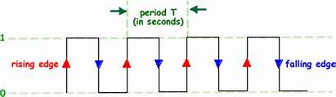
LATCH CONTD..
D Latch : D Latch is obtained from SR Latch by placing an inverter between S and R inputs and connect D input to S .The drawback of SR Latch is Overcomed by using D Latch .It is also known as Data Latch.
INPUT SIGNAL
Circuit Diagramme
Truth Table

Slide 8
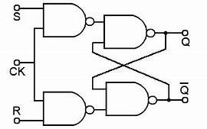
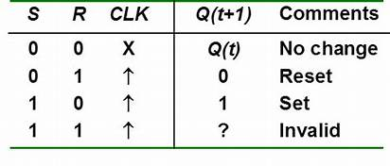
FLIP-FLOPs
FLIP-FLOPs
Flip-Flops are basically clocked Latch .They are bi-stable multivibrater because it has two stable state.
Unlike Latches, flip flops are edge sensitive.
Few types of Flip-flops are discussed here...
S-R FLIP-FLOP: It is also called set reset flipflop .
Truth Table
Truth table
S-R Flip flop

Slide 9
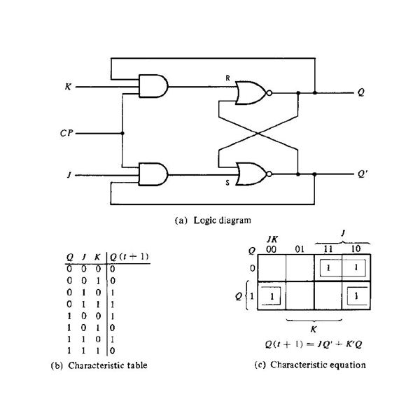
FLIP-FLOPs Contd..
JK Flip-Flop : It is a bit advance version of SR flip-flop .It overcomes the invalid input condition of SR flip flop by Toggling the previous output.
S=JQ'
R=KQ
J=1(SET)
K=1(RESET)
Exciting equation for conversion from SR to JK FLIP FLOP

Slide 10
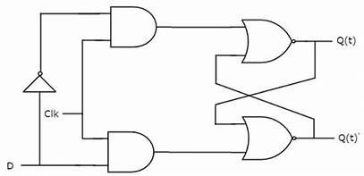
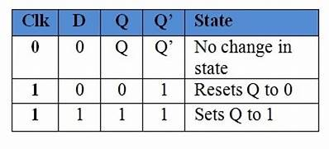
FLIP-FLOPs Contd..​
D Flip-Flop : It is also called as transparent flip-flop. It works as buffer. Whatever input is applied ,appears at output .
Logic Circuit
Truth Table

Slide 11
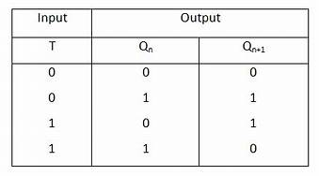
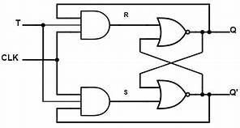
FLIP-FLOPs Contd..
T Flip-Flop : It is also known as Toggle Flip flop.It toggles the present output whenever input is HIGH .
It can be obtained by JK flip flop by simply short circuiting the J and K inputs.
Logic Circuit
Truth Table

Slide 12
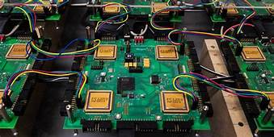
CONCLUSION ​
​
Any modern digital system or device is a combination of both combinational and sequential circuit .
Although sequential circuits play an important role in terms of holding digital information of any digital system .
Sequential circuits like counters ,registers and flip flops are the essential building blocks of a Digital system

